Slide 1
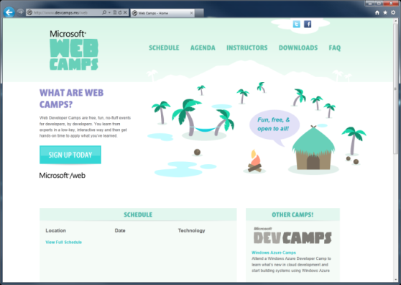

WebCamps Online
Twitter: Follow @webcamps Hashtag #webcamps
SPEAKER NAME/HANDLE HERE
Website: http://www.devcamps.ms/web
What are web camps?
Web Developer Camps are free, fun, no-fluff events for developers, by developers. You learn from experts in a low-key, interactive way and then get hands-on time to apply what you’ve learned.

Slide 2
Entity Framework
Name
Title
Microsoft Corporation

Slide 3
Agenda
What is the Entity Framework?
Database-first, Model-first, Code-First
Demos
Notes:
Estimated Time: 1 minute
In this session we’ll look at how we can take the notion of Models in MVC and use them in data access with the Entity Framework.

Slide 4
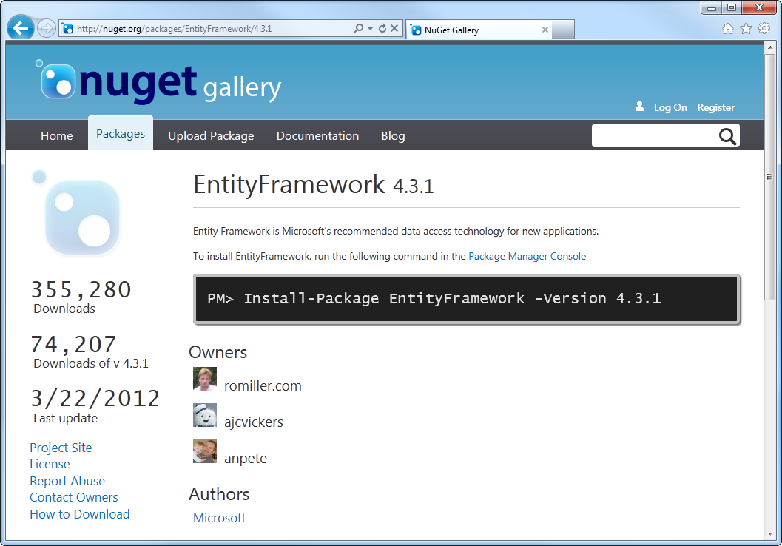
Where is Entity Framework?
EF is available as a NuGet Package
Notes:
Estimated Time: 3 minutes
[Potential Questions to ask the audience:]
Who is using raw SQL script today to access their database? Why?
Who is using stored procedures? Why?
Who is using ORM?
For a long time in the history of programming, the data abstractions that represented the business objects were designed as database objects and were expressed in Entity-Relationship diagrams. This led to databases having great influence on the entity data model that was generated afterwards based on the existing database objects.
Then, software engineering evolved and the design focus was transmuted from the database to the software implementation. This lead to a whole new paradigm, where the entity data model were designed first, based on the user needs, and the database objects has to adapt to it.
The Entity Framework abstracts the database away from the application by providing sets of entities with which to work. Instead of talking to the database, the application developer speaks “entities” and the framework manages all of the database communications on behalf of the developer.

Slide 5
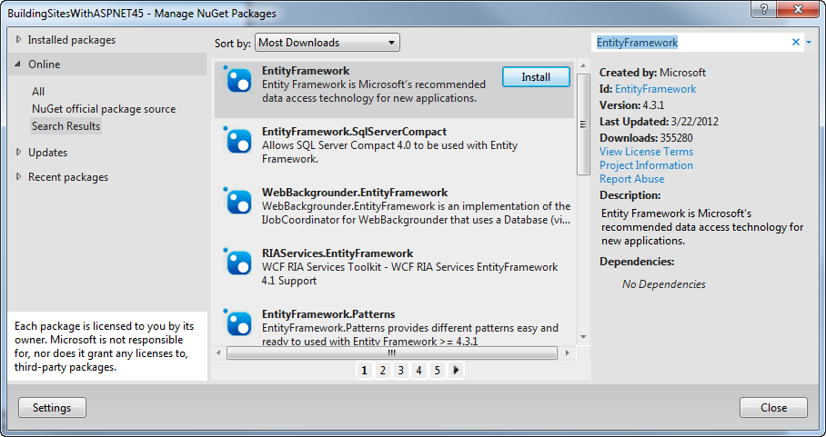
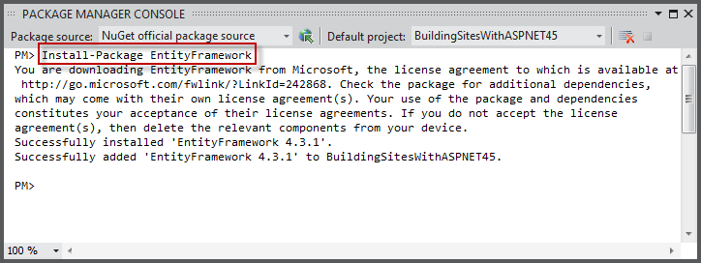
How Can You get Entity Framework?
Using the Manage NuGet Packages Dialog
Or using the Package Manager Console
Notes:
Estimated Time: 3 minutes
[Potential Questions to ask the audience:]
Who is using raw SQL script today to access their database? Why?
Who is using stored procedures? Why?
Who is using ORM?
For a long time in the history of programming, the data abstractions that represented the business objects were designed as database objects and were expressed in Entity-Relationship diagrams. This led to databases having great influence on the entity data model that was generated afterwards based on the existing database objects.
Then, software engineering evolved and the design focus was transmuted from the database to the software implementation. This lead to a whole new paradigm, where the entity data model were designed first, based on the user needs, and the database objects has to adapt to it.
The Entity Framework abstracts the database away from the application by providing sets of entities with which to work. Instead of talking to the database, the application developer speaks “entities” and the framework manages all of the database communications on behalf of the developer.

Slide 6
Different Approaches for Entity Framework
Database First
Existing
Database
Generated
Entity Data
Model
Model First
Entity Data
Model
Generated
Database
Code First
Class File
Generated
Database
Notes:
Estimated Time: 2 minutes
The Entity Framework provides three approaches to getting started. Which approach you choose will depend on your particular scenario.
[Build]
If you already have an existing database from which to work from, Entity Framework provides a way to inspect it and generate an Entity Data Model. An entity data model is a description of the underlying logical model in the database. With this model you’ll then be able to write data access code against the Entity Framework rather than directly against the database.
[Build]
One other approach is to use the visual designer to create your entities and relationships. Once complete you can then use the tooling to generate the database.
[Build]
Finally, code-first allows the developer to write classes that describe models. From these class files the Entity Framework then goes ahead and generates the database.

Slide 7
Model First Database First Code First
demo
Notes:
Estimated Time: 20 minutes

