Slide 1

C# language binding and extensions to Apache Spark

Slide 2
C# API - Motivations
Enable organizations invested deeply in .NET to start building Spark apps and not have to do development in Scala, Java, Python or R
Enable reuse of existing .NET libraries in Spark applications

Slide 3
C# API - Goal
Make C# a first-class citizen for building Apache Spark apps for the following job types
Batch jobs (RDD API)
Streaming jobs (Streaming API)
Structured data processing or SQL jobs (DataFrame API)

Slide 4
Design Considerations
JVM – CLR (.NET VM) interop
Spark runs on JVM
C# operations to process data needs CLR for execution
Avoid re-implementing Spark’s functionality for data input, output, persistence etc.
Re-use design & code from Python & R Spark language bindings

Slide 5
C# API for Spark
Spark Apps in C#
C# API
SparkR
PySpark
Scala/Java API
Apache Spark

Slide 6
Goals
Make C# a first-class citizen for building Apache Spark apps for the following job types
Batch jobs (RDD API)
Streaming jobs (Streaming API)
Structured data processing or SQL jobs (DataFrame API)

Slide 7
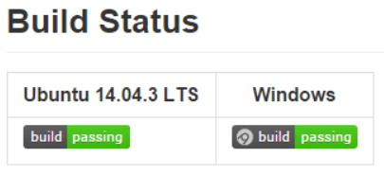
Why C# support in Apache Spark
Enable C# developers use existing .NET libraries and build Spark applications
Lower the barrier for organizations that use C# as the primary application development language to start building Spark applications without having to invest in languages like Scala, Java, Python or R
With Mobius it is possible to develop apps in C# for Spark deployed to private clusters/cloud, Windows-based VMs in Azure or AWS
Mobius is also built in Linux using Mono and samples & unit tests are run as a part of CI builds

Slide 8
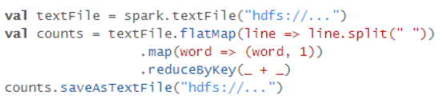
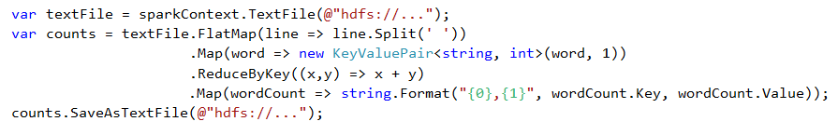
Word Count example
Scala
C#

Slide 9
Interop
Workers
JVM
C# Worker
SparkExecutor
CLR
Driver
IPC Sockets
C# Driver
CLR
SparkContext
JVM
JVM
C# Worker
SparkExecutor
CLR
IPC Sockets
IPC Sockets
JVM
C# Worker
SparkExecutor
CLR
IPC Sockets
Notes:
Sockets provide point-to-point, two-way communication between two processes. Sockets are very versatile and are a basic component of interprocess and intersystem communication. A socket is an endpoint of communication to which a name can be bound. It has a type and one or more associated processes.

Slide 10
Reuse
Driver-side interop uses Netty server as a proxy to JVM – similar to SparkR
Worker-side interop reuses PySpark implementation
CSharpRDD inherits from PythonRDD reusing the implementation to launch external process, pipe in/out serialized data

Slide 11
CSharpRDD
C# operations use CSharpRDD which needs CLR to execute
If no C# transformation or UDF is involved, CLR is not needed – execution is purely JVM-based
RDD<byte[]>
Data is stored as serialized objects and sent to C# worker process
Transformations are pipelined when possible
Avoids unnecessary serialization & deserialization within a stage

Slide 12
Linux Support
Mono (open source implementation of .NET framework) used for C# with Spark in Linux
GitHub project uses Travis for CI in Ubuntu 14.04.3 LTS
Unit tests and samples (functional tests) are run
More info @ linux-instructions.md

Slide 13
Performance Considerations
Map & Filter RDD operations in C# require serialization & deserialization of data – impacts performance
C# operations are pipelined when possible - minimizes unnecessary Ser/De
Persistence is handled by JVM - checkpoint/cache on a RDD impacts pipelining for CLR operations
DataFrame operations without C# UDFs do not require Ser/De
Perf will be same as native Spark application
Execution plan optimization & code generation perf improvements in Spark leveraged

Slide 14
Status
Past Releases
V1.5.200 (supports Spark 1.5.2)
V.1.6.000-PREVIEW1 (supports Spark 1.6.0)
Upcoming Release
V1.6.100 (with support for Spark 1.6.1, in April’16)
In the works
Support for interactive scenarios (Zeppelin/Jupyter integration)
MapWithState API for streaming
Perf benchmarking

Slide 15
Project Info
Repo - https://github.com/Microsoft/SparkCLR. Contributions welcome!
Services integrated with the repo
AppVeyor – Windows builds, unit and functional tests, NuGet & Maven deployment
Travis CI – Linux builds, unit and functional tests
CodeCov – unit test code coverage measurement & analysis
License – code is released under MIT license
Discussions
StackOverflow – tag “SparkCLR”
sparkclr-user or sparkclr-dev@googlegroups.com
Gitter - https://gitter.im/Microsoft/SparkCLR
Slack - https://microsoft.slack.com/messages/sparkclrdiscussion

Slide 16
API Reference
SparkCLR API usage samples are available in the repo at:
Samples - comprehensive set of C# APIs & functional tests
Examples - standalone C# projects demonstrating C# API
Pi
EventHub
SparkXml
JdbcDataFrame
… (could be your contribution!)
Performance tests – side by side comparison of Scala & C# drivers
API documentation

Slide 17
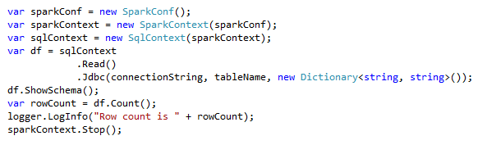
JDBC Example

Slide 18
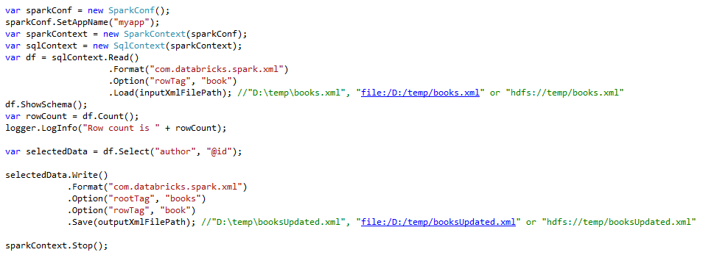
Spark-XML Example

Slide 19
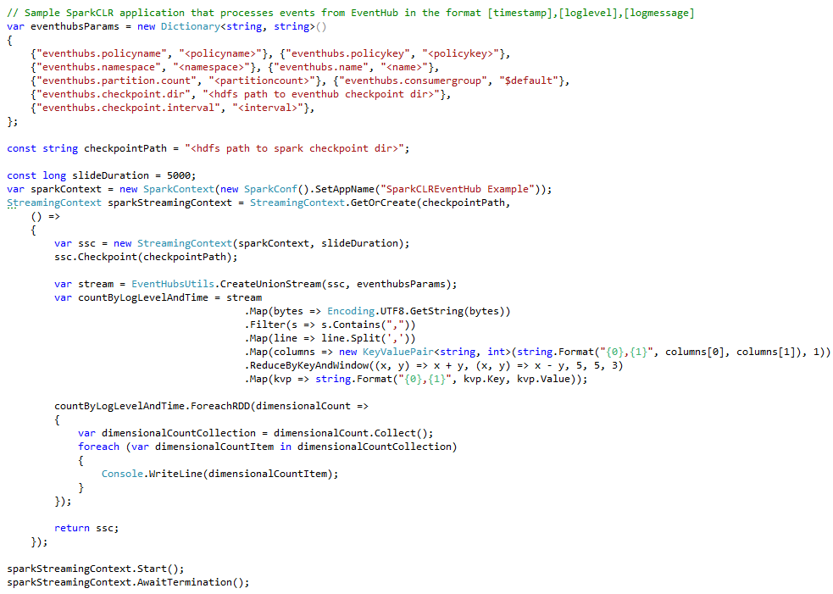
EventHub Example

Slide 20
Log Processing Sample Walkthrough
Requests log
Guid
Datacenter
ABTestId
TrafficType
Metrics log
Unused
Date
Time
Guid
Lang
Country
Latency
Scenario – Join data in two log files using guid and compute max and avg latency metrics grouped by datacenter

Slide 21
Log Processing Steps
Load Request log
Load
Metrics log

Slide 22
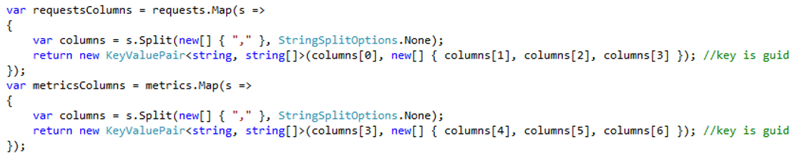
Log Processing
Load Request log
Load
Metrics log
Get columns in each row
Get columns in each row

Slide 23
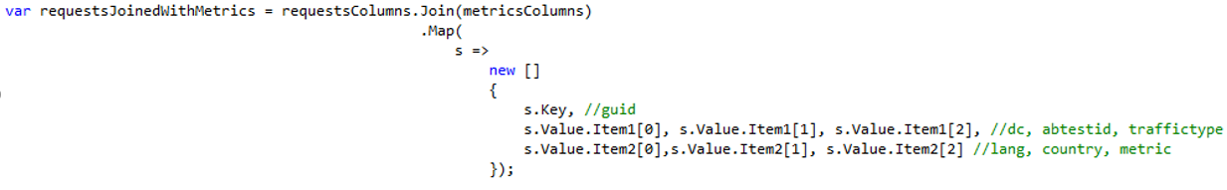
Log Processing
Load Request log
Load
Metrics log
Get columns in each row
Get columns in each row
Join by “Guid” column

Slide 24
Log Processing
Load Request log
Load
Metrics log
Get columns in each row
Get columns in each row
Join by “Guid” column
Compute Max(latency) by Datacenter

Slide 25
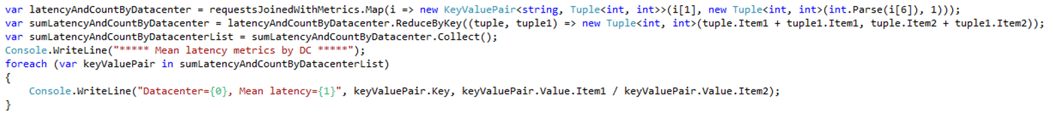
Log Processing
Load Request log
Load
Metrics log
Get columns in each row
Get columns in each row
Join by “Guid” column
Compute Avg(latency) by Datacenter

Slide 26
Implementation Details

Slide 27
Driver-side IPC Interop
Using a Netty server as a proxy to JVM

Slide 28
Driver-side implementation in Mobius
Driver-side interaction between JVM & CLR is the same for RDD and DataFrame APIs -- CLR executes calls on JVM.
For streaming scenarios, CLR executes calls on JVM and JVM calls back to CLR to create C# RDD

Slide 29
DataFrame

Slide 30
JVM
Sql
Context
(Spark)
Data
Frame
(Spark)
create
5
8
Use jsc & create DF in JVM
Called by sparkclr-submit.cmd
CSharpRunner
Launches Netty server creating
proxy for JVM calls
CSharpBackend
1
Invokes method on DF
12
Invokes JVM-method
to create context
4
7
Invokes JVM-method
to create SC
SqlContext has
reference to SC in JVM
2
Driver
(user code)
Init
SqlContext
3
Launches C#
sub-process
create DF
6
9
Java/Scala component
DataFrame
DF has reference
to DF in JVM
Operation
C# component
10
Invokes JVM-method
All components will be Mobius contributions
except for user code and Spark components
11

Slide 31
RDD

Slide 32
JVM
Spark
Context
(Spark)
RDD
(Spark)
CSharpRDD
create
5
8
Use jsc & create JRDD
13
Called by sparkclr-submit.cmd
CSharpRunner
Launches Netty server creating
proxy for JVM calls
CSharpBackend
1
Invokes JVM-method
to create context
4
7
Invokes JVM-method
to create RDD
SparkContext has
reference to SC in JVM
2
Driver
(user code)
Init
SparkContext
3
Launches C#
sub-process
Invokes JVM-method
to create C#RDD
create RDD
12
6
9
Java/Scala component
RDD
RDD has reference
to RDD in JVM
C# operation
create
PipelinedRDD
C# component
10
11
All components will be Mobius contributions
except for user code and Spark components

Slide 33
DStream

Slide 34
JVM
Callback to C#Process
To create C#RDD
Java
Streaming
Context
(Spark)
Java
DStream
(Spark)
CSharp
DStream
14
create
5
8
Use jssc & create JDStream
13
Called by sparkclr-submit.cmd
CSharpRunner
Launches Netty server creating
proxy for JVM calls
CSharpBackend
1
Invokes JVM-method
to create context
4
7
Invokes JVM-method
to create JavaDStream
2
Driver
(user code)
Init
Streaming
Context
3
StreamingContext has reference
to JavaSSC in JVM
Launches C#
sub-process
Invokes JVM-method
to create C#DStream
create RDD
15
6
9
12
DStream has reference
to JavaDStream in JVM
Continue to the
Above RDD graph
Java/Scala component
DStream
C# operation
create
Transformed
DStream
RDD
C# component
10
11
All components will be Mobius contributions
except for user code and Spark components

Slide 35
Executor-side IPC Interop
Using pipes to send data between JVM & CLR

Slide 36
C# Lambda in RDD
Similar to Python implementation

Slide 37
Launch executable
as sub-process
CSharpRDD
Mobius
Worker
Serialize data
& user-implemented C# lambda
and send through socket
Spark calls
Compute()
Serialize processed data and
send through socket
Java/Scala component
CSharpRDD implementation extends PythonRDD
Note that CSharpRDD is not used when there is no
user-implemented custom C# code. In such cases CSharpWorker
is not involved in execution.
C# component

Slide 38
C# UDFs in DataFrame
Similar to Python implementation

Slide 39
Spark
UDF Core
(Python)
C#
Worker
4
Run UDF
3
Pickled data
C#
Driver
2
Run SQL with UDF
1
Register UDF
sqlContext.RegisterFunction<bool, string, int>("PeopleFilter", (name, age) => name == "Bill" && age > 40, "boolean");
sqlContext.Sql("SELECT name, address.city, address.state FROM people where PeopleFilter(name, age)")

Slide 40
Mobius Streaming API
Similar to Python implementation

Slide 41
DStream sample
// write code here to drop text files under <directory>\test
… … …
StreamingContext ssc = StreamingContext.GetOrCreate(checkpointPath,
() =>
{
SparkContext sc = SparkCLRSamples.SparkContext;
StreamingContext context = new StreamingContext(sc, 2000);
context.Checkpoint(checkpointPath);
var lines = context.TextFileStream(Path.Combine(directory, "test"));
var words = lines.FlatMap(l => l.Split(' '));
var pairs = words.Map(w => new KeyValuePair<string, int>(w, 1));
var wordCounts = pairs.ReduceByKey((x, y) => x + y);
var join = wordCounts.Join(wordCounts, 2);
var state = join.UpdateStateByKey<string, Tuple<int, int>, int>((vs, s) => vs.Sum(x => x.Item1 + x.Item2) + s);
state.ForeachRDD((time, rdd) =>
{
object[] taken = rdd.Take(10);
});
return context;
});
ssc.Start();
ssc.AwaitTermination();

Slide 42
Thanks to…
Spark community – for building Spark ☺
Mobius contributors – for their contributions
SparkR and PySpark developers – Mobius reuses design and code from these implementations
Reynold Xin and Josh Rosen from Databricks for the review and feedback on Mobius design doc
Ram Sriharsha and Ram Venkatesh from Hortonworks for their comments on the early project ideas

