Slide 1
Unsupervised Learning and Clustering
Cynthia Rudin | MIT Sloan School of Management

Slide 2
Clustering
Recap of unsupervised learning and intro to clustering
K-Means clustering
Hierarchical Agglomerative Clustering
Distance metrics are important

Slide 3
Recap of unsupervised learning and intro to clustering
Cynthia Rudin | MIT Sloan School of Management

Slide 4
Unsupervised Learning
“Unsupervised” means that the training data has no ground truth labels to learn from.
Supervised:
(chair)
(not a chair)
(not a chair)
chair?
(chair)
(not a chair)
(chair)
(not a chair)

Slide 5
Unsupervised Learning
“Unsupervised” means that the training data has no ground truth labels to learn from.
Unsupervised:

Slide 6
Unsupervised Learning
“Unsupervised” means that the training data has no ground truth labels to learn from.
Unsupervised:

Slide 7
Unsupervised Learning
“Unsupervised” means that the training data has no ground truth labels to learn from.
This means they are much harder to evaluate.
Clustering is an key unsupervised problem.

Slide 8
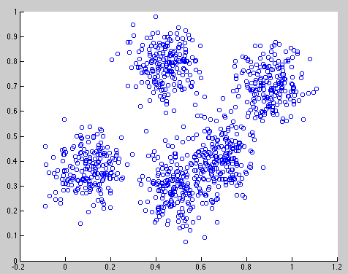
Clustering
Data within a cluster should be similar to other members of the cluster.
Notes:
jellyroll

Slide 9
Clustering
Data within a cluster should be similar to other members of the cluster.
Notes:
jellyroll

Slide 10
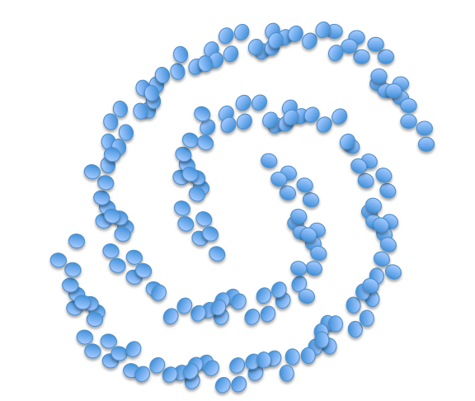
Clustering
Data within a cluster should be similar to other members of the cluster.
Notes:
jellyroll

Slide 11
Clustering
Applications include:
Automatically grouping documents/webpages into topics
For instance, grouping news stories from today into categories
Clustering large number of products
E.g., etsy products
Clustering customers into those with similar purchase behavior
Notes:
jellyroll

Slide 12
Clustering
Tricky to evaluate the quality of a clustering. No ground truth.
One way to test algorithms is to generate the data according to a simulation, so we know ground truth. We can determine whether the clustering algorithm can recover the underlying clusters.

Slide 13
K-means clustering
Cynthia Rudin | MIT Sloan School of Management

Slide 14
Clustering
K means clustering
Input number of clusters, randomly initialize centers
Assign all points to the closest cluster center
Change cluster centers to be in the middle of its points
Repeat until convergence

Slide 15
K-Means in action
Input number of clusters, randomly initialize centers
Assign all points to the closest cluster center
Change cluster centers to be in the middle of its points
Repeat until convergence

Slide 16
K-Means in action
Input number of clusters, randomly initialize centers
Assign all points to the closest cluster center
Change cluster centers to be in the middle of its points
Repeat until convergence

Slide 17
K-Means in action
Input number of clusters, randomly initialize centers
Assign all points to the closest cluster center
Change cluster centers to be in the middle of its points
Repeat until convergence

Slide 18
K-Means in action
Input number of clusters, randomly initialize centers
Assign all points to the closest cluster center
Change cluster centers to be in the middle of its points
Repeat until convergence

Slide 19
K-Means in action
Input number of clusters, randomly initialize centers
Assign all points to the closest cluster center
Change cluster centers to be in the middle of its points
Repeat until convergence

Slide 20
Hierarchical Agglomerative Clustering
Cynthia Rudin | MIT Sloan School of Management

Slide 21
Hierarchical Agglomerative Clustering
Start with each point in its own cluster
Repeatedly merge the clusters of the closest two points

Slide 22
Hierarchical Agglomerative Clustering
Start with each point in its own cluster
Repeatedly merge the clusters of the closest two points
Notes:
jellyroll

Slide 23
Hierarchical Agglomerative Clustering
Start with each point in its own cluster
Repeatedly merge the clusters of the closest two points
Notes:
jellyroll

Slide 24
Hierarchical Agglomerative Clustering
Start with each point in its own cluster
Repeatedly merge the clusters of the closest two points
Notes:
jellyroll

Slide 25
Hierarchical Agglomerative Clustering
Start with each point in its own cluster
Repeatedly merge the clusters of the closest two points
Notes:
jellyroll

Slide 26
Hierarchical Agglomerative Clustering
Start with each point in its own cluster
Repeatedly merge the clusters of the closest two points
Notes:
jellyroll

Slide 27
Hierarchical Agglomerative Clustering
Start with each point in its own cluster
Repeatedly merge the clusters of the closest two points
Notes:
jellyroll

Slide 28
Hierarchical Agglomerative Clustering
Start with each point in its own cluster
Repeatedly merge the clusters of the closest two points
Notes:
jellyroll

Slide 29
Hierarchical Agglomerative Clustering
Start with each point in its own cluster
Repeatedly merge the clusters of the closest two points
Notes:
jellyroll

Slide 30
Hierarchical Agglomerative Clustering
Start with each point in its own cluster
Repeatedly merge the clusters of the closest two points
Notes:
jellyroll

Slide 31
Hierarchical Agglomerative Clustering
Start with each point in its own cluster
Repeatedly merge the clusters of the closest two points
Notes:
jellyroll

Slide 32
Distance metrics are important
Cynthia Rudin | MIT Sloan School of Management

Slide 33
Distance metrics are important
The distance measure used for clustering can have a large impact on the solution.
Some algorithms have “adaptive” distance measures that change with the density of the data.

