Slide 1






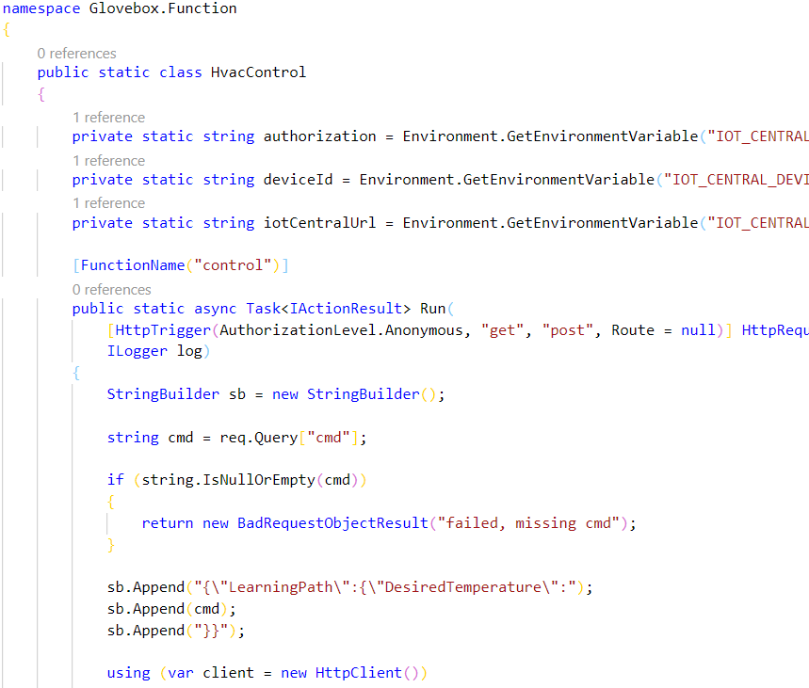
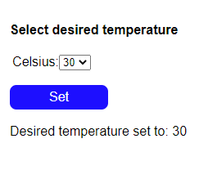
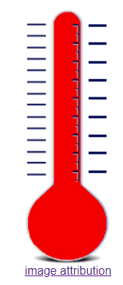
Azure IoT Central
Azure IoT Hub
Azure IoT Hub Device Twin
Azure Sphere
3
4
Update
temperature
Property
Update desired temperature
device twin and send device twin message
Properties.Desired
Device twin
temperature handler
JSON
1
2
5
Change HVAC temperature
6
Query Device Twin
Properties.Reported
Acknowledge device twin
JSON
8
7
Azure Storage Static Website HTML/JavaScript page calls Azure Function HTTP Trigger
Azure Function invokes IoT Central Update Property REST API
Azure IoT Central requests Azure IoT Hub to send “desired temperature” device twin
Azure IoT Hub updates device twin and sends device twin message to Azure Sphere HVAC control device
Azure Sphere implements HVAC actions and reports state
Notes:
Change the rate the sensor os measured

Slide 2

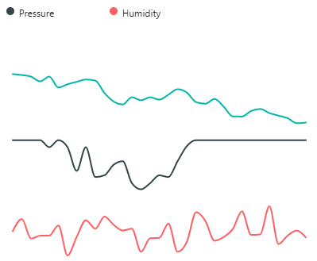
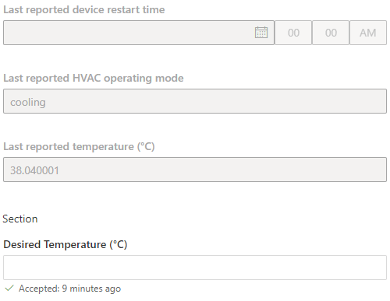
Azure IoT Central
Azure IoT Hub
Azure Sphere
Cortex A7 High-level
Intercore message bridge
Cortex M4 Real-time
5
4
2
3
1
IoT Hub Messaging
Telemetry streaming
Environment service thread
{
“Temperature”:26,
“Humidity”:55,
“Pressure”: 1100
}
7
Environment sensor thread
1
Device twin
Desired Temperature
Device twin virtual HVAC control
6
JSON
Azure Storage Static Website HTML/JavaScript page calls Azure Function HTTP Trigger
Azure Function invokes IoT Central Update Property REST API
Azure IoT Central requests Azure IoT Hub to send “desired temperature” device twin
Azure IoT Hub updates device twin and sends device twin message to Azure Sphere HVAC control device
Azure Sphere implements HVAC actions and reports state
Notes:
Change the rate the sensor os measured

