Slide 1

Getting Started with Workplace Analytics
Analyze business processes
Microsoft Workplace Analytics

Slide 2
Concepts
Define a dataset
Define a business process
Use a query to analyze a business process

Slide 3
Concepts
Define a dataset
Define a business process
Use a query to analyze a business process

Slide 4
One of the strengths of Workplace Analytics is that it combines organizational data (data about hierarchy) with collaboration data (data about how people work together) into a dataset that can be effectively analyzed, to produce useful insights into workplace trends while respecting data-privacy guidelines.
We start with this merged data, which, at first, applies to the entire organization.
One of the strengths of Workplace Analytics is that it combines organizational data (data about hierarchy) with collaboration data (data about how people work together) into a dataset that can be effectively analyzed, to produce useful insights into workplace trends while respecting data-privacy guidelines.
We start with this merged data, which, at first, applies to the entire organization.
Merged collaboration and organizational data

Slide 5
Merged collaboration and organizational data
Create a data set by keeping only applicable organizational data. For example, include data only from geographic locations that you want to analyze.
Defined data set
Defined business process
Create a business process by keeping only applicable collaboration data. For example, only include meetings that have pertinent subject lines.
To analyze this business process, use it as a filter in a query.

Slide 6
In this first procedure, you filter out extraneous organizational data. What’s left is a dataset that contains only pertinent organizational data -- specifically, data that applies to the business process that you want to analyze.
Define a dataset

Slide 7
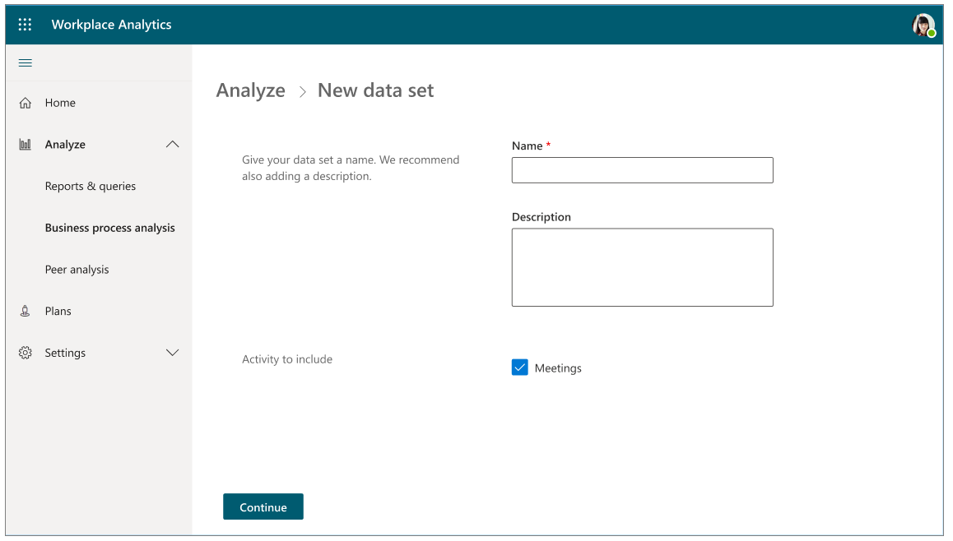
Start by creating the new data set.

Slide 8
Name the data set.
SalesDataSet
Type the name of your data set, and, optionally, a description.

Slide 9
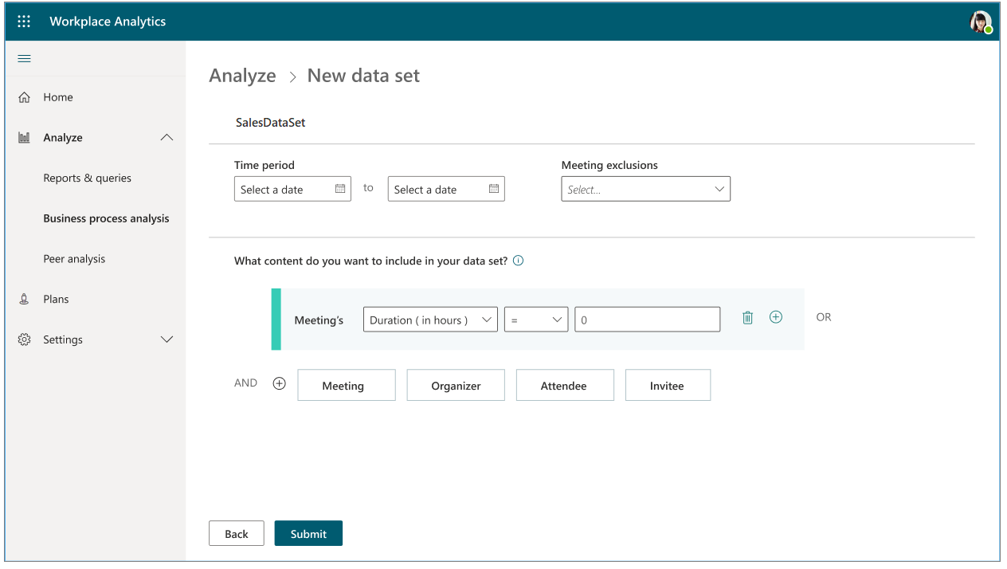
Specify a meeting exclusion or accept the default meeting exclusion.
Select a start date and end date.

Slide 10
Now, start creating a filter.
For content to include, select Meeting.

Slide 11
For more information visit
aka.ms/business-process-analysis
Microsoft Workplace Analytics

