Slide 1
FEATURE OVERVIEW
Synapse Spark
runtime release channels
Choose an update path. Test what comes next.
4 channels
1 GA runtime
Preview feature
Production and test paths
Synapse Runtime 3.5
Default behavior is unchanged
AZURE SYNAPSE ANALYTICS | RELEASE CHANNELS (PREVIEW)
01
Notes:
Opening (about 1 minute). A release channel determines which updates a pool receives within a supported runtime version. The channel feature is in preview; Synapse Runtime 3.5 is already generally available. Pools without an explicit channel use default. This presentation is based on the current documentation, not a new support or availability commitment. Channels do not change runtime lifecycle or support dates.
Source: articles/synapse-analytics/spark/apache-spark-runtime-release-channels.md (September 23, 2026).

Slide 2
CHOOSE YOUR PATH
Four channels, two production choices
CHANNEL
USE IT FOR
YOUR NEXT ACTION
default
Stable production workloads
Test upcoming changes in earlyAccess.
earlyAccess
Upcoming regular updates
Run representative tests before promotion.
compliance
Production + periodic security fixes
Test first; republish after promotion.
complianceEarlyAccess
Upcoming package security fixes
Test packages and library snapshots.
No channel configured? The pool uses default.
AZURE SYNAPSE ANALYTICS | RELEASE CHANNELS (PREVIEW)
02
Notes:
Choice (about 90 seconds). Pair default production pools with earlyAccess test pools. Pair compliance production pools with complianceEarlyAccess test pools. Both stable channels receive the same regular product code. Compliance adds routine package security fixes. Early Access describes timing, not a lower quality standard. Use separate environments and configurations; do not copy an Early Access setting into production as part of application deployment.
Source: articles/synapse-analytics/spark/apache-spark-runtime-release-channels.md (September 23, 2026).

Slide 3
SERVICING MODEL
Three update paths
MONTHLY
Regular code updates
Upcoming code is tested in both Early Access channels, then reaches default and compliance.
SIX-MONTH CYCLE
Routine package security fixes
Added monthly to complianceEarlyAccess; bundled into compliance every six months.
ANY TIME
Urgent, exploitable security issues
High-priority fixes reach all affected channels as soon as possible, outside the normal schedule.
default and earlyAccess do not receive routine non-exploitable security fixes.
AZURE SYNAPSE ANALYTICS | RELEASE CHANNELS (PREVIEW)
03
Notes:
Timing (about 90 seconds). Do not combine regular code updates with security-package servicing. Default and compliance get regular updates monthly. Non-exploitable means the issue is not exploitable in the Synapse service context, not that package upgrades cannot break compatibility. Those fixes enter complianceEarlyAccess monthly and are collected for a six-month promotion to compliance. This is a shared collection cycle, not six months of testing for every individual fix. Default gets security fixes only for exploitable issues. Urgent fixes are not held for either schedule.
Source: articles/synapse-analytics/spark/apache-spark-runtime-release-channels.md (September 23, 2026).

Slide 4
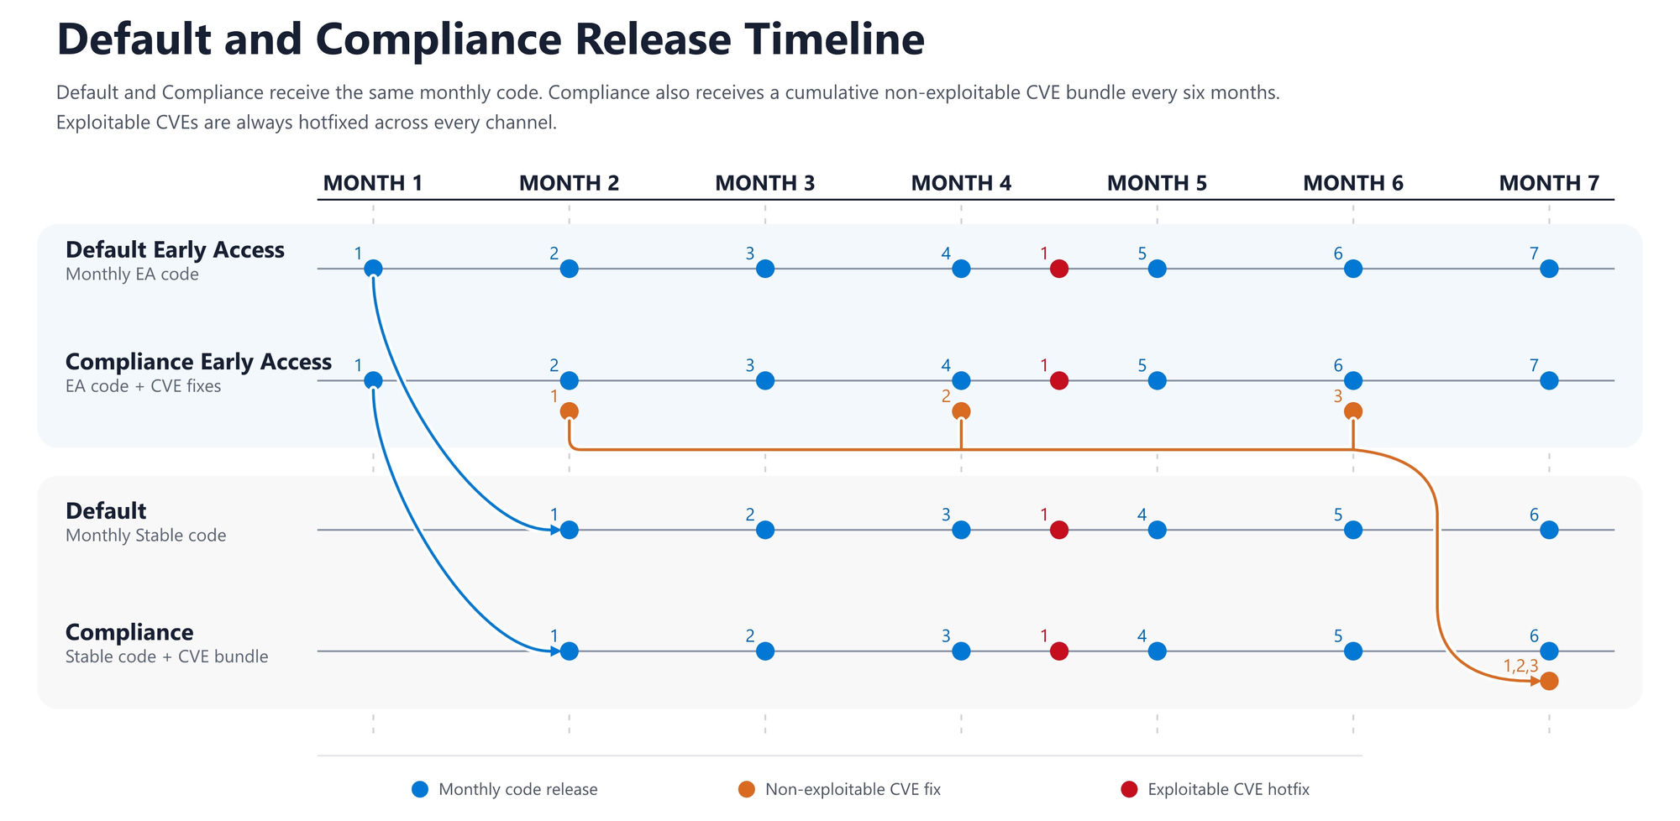
ILLUSTRATIVE TIMELINE
AZURE SYNAPSE ANALYTICS | RELEASE CHANNELS (PREVIEW)
04
Notes:
Walk through the diagram (about 90 seconds). Month 1 can be any calendar month. Blue: release 1 appears in the two Early Access channels in Month 1, then in both stable channels in Month 2. Orange: package security fixes accumulate and move together to compliance in Month 7. Red: the emergency fix between months 4 and 5 is illustrative; urgent fixes can occur at any time. The diagram is an example, not a promised calendar or SLA. Refer to applicable release notes and security notices for real dates and required actions.
Source: articles/synapse-analytics/spark/apache-spark-runtime-release-channels.md (September 23, 2026).

Slide 5
CONFIGURATION
Select a channel; start a new session
spark.computeConf.runtime.releaseChannel=earlyAccess
01
Create or edit an Apache Spark configuration in Synapse Studio.
02
Add the property once, select a value, and publish.
03
Apply the configuration to the intended Spark 3.5 pool.
04
Start a new session and verify the selected channel.
You can change the value later. Running sessions keep their selected channel.
AZURE SYNAPSE ANALYTICS | RELEASE CHANNELS (PREVIEW)
05
Notes:
Configuration demo (about 1 minute). Navigate to Manage > Apache Spark configurations. Add the property under Configuration properties, publish, then select it under the pool Apache Spark configuration settings and Apply. Accepted values: default, earlyAccess, compliance, complianceEarlyAccess. Include the property only once per configuration; it is not a once-ever setting. Changes take effect in a new session. If absent, default is used. Keep production on its stable channel. Detailed steps: https://learn.microsoft.com/azure/synapse-analytics/spark/apache-spark-azure-create-spark-configuration
Source: articles/synapse-analytics/spark/apache-spark-runtime-release-channels.md (September 23, 2026).

Slide 6
OBSERVE AND DIAGNOSE
Know the channel and build you are testing
Release channel
spark.conf.get("spark.computeConf.runtime.releaseChannel", "")
Runtime image (virtual hard disk / VHD)
spark.conf.get("spark.synapse.vhd.name", "")
Run these in a PySpark notebook cell in the active session.
For support: capture runtime version, channel, VHD, libraries, errors, and repro steps.
AZURE SYNAPSE ANALYTICS | RELEASE CHANNELS (PREVIEW)
06
Notes:
Observability (about 1 minute). These commands read session properties. The empty string is a fallback when a property is not returned, not proof of the active channel. If an explicitly configured value is unexpected, check the pool configuration and start a new session. The VHD image name identifies the runtime build and may also be found in Spark UI or cluster logs. Compare the same workload on the matching stable channel to isolate Early Access issues. The snippets are drawn from the documentation; this deck does not demonstrate a live execution.
Source: articles/synapse-analytics/spark/apache-spark-runtime-release-channels.md (September 23, 2026).

Slide 7
VALIDATION WORKFLOW
Test realistic workloads, not just startup
01
Match production
Use representative pools, data access, libraries, and configuration.
02
Exercise the workload
Run notebooks, jobs, pipelines, and library install/import tests.
03
Compare and investigate
Check correctness, performance, startup, and dependency behavior.
04
Prepare production
Deploy validated changes while retaining the stable channel setting.
Microsoft promotes runtime updates; customers validate and prepare their workloads.
AZURE SYNAPSE ANALYTICS | RELEASE CHANNELS (PREVIEW)
07
Notes:
Testing (about 1 minute). Review the release notes before testing. Use earlyAccess for default production workloads and complianceEarlyAccess for compliance production workloads. Report a regression if a workload passes on stable but fails in Early Access. Do not promote the test channel configuration to production. For compliance library updates, the production republish step is after runtime promotion, as described on the next slide.
Source: articles/synapse-analytics/spark/apache-spark-runtime-release-channels.md (September 23, 2026).

Slide 8
LIBRARY MANAGER
Test before promotion. Republish after.
Republishing creates a snapshot using the latest packages in the selected channel.
BEFORE PROMOTION
AFTER SIX-MONTH PROMOTION
complianceEarlyAccess
compliance
Republish test libraries.
Run representative workloads.
Fix incompatibilities and retest.
Republish production libraries.
Verify the new snapshots.
Complete required actions by the deadline.
Republishing on compliance before promotion still uses its older packages.
AZURE SYNAPSE ANALYTICS | RELEASE CHANNELS (PREVIEW)
08
Notes:
Library preparation (about 2 minutes). Package security fixes can upgrade underlying dependencies and break custom libraries. A snapshot captures the library environment built against the channel package versions. Republish on complianceEarlyAccess to validate upcoming packages. After the six-month bundle reaches compliance, republish production libraries on compliance, producing snapshots against the promoted versions. Review the promotion date and enforcement deadline in the applicable notice. Do not promise a fixed grace period or uninterrupted sessions: the article does not define those behaviors. Missing required republishing by enforcement can prevent new sessions from starting. Urgent security updates can require action outside the six-month cycle.
Source: articles/synapse-analytics/spark/apache-spark-runtime-release-channels.md (September 23, 2026).

Slide 9
COMMON QUESTIONS
What stays the same? What can change?
Do I need to opt in?
No. If no channel is configured, the pool uses default.
Is this a preview runtime?
No. Release channels are in preview; Synapse Runtime 3.5 is GA.
Can I return to a stable channel?
Yes, with a new session. This does not pin an older build or undo library changes.
Can urgent fixes arrive between releases?
Yes. Exploitable issues are high priority across all affected channels.
AZURE SYNAPSE ANALYTICS | RELEASE CHANNELS (PREVIEW)
09
Notes:
Questions (about 1 minute). Early Access is optional and passes standard validation gates. Moving from earlyAccess to default, or complianceEarlyAccess to compliance, selects the currently available stable channel on a new session. It is not a mechanism for pinning or restoring an earlier build. Selecting a channel does not alter runtime support dates. The feature name compliance should not be presented as a certification or blanket regulatory guarantee.
Source: articles/synapse-analytics/spark/apache-spark-runtime-release-channels.md (September 23, 2026).

Slide 10
TAKEAWAYS AND RESOURCES
Choose. Validate. Republish.
01 Choose a production path and matching test channel.
02 Test monthly changes and track the runtime build.
03 Republish after each six-month compliance promotion.
Release notes: github.com/microsoft/synapse-spark-runtime
Synapse Spark configuration and library management guides
Discussion: Which workloads should you validate first?
AZURE SYNAPSE ANALYTICS | RELEASE CHANNELS (PREVIEW)
10
Notes:
Close (about 1 minute plus discussion). Choose default for stable production with fewer routine package changes, or compliance for periodic routine security-package fixes. Use the corresponding Early Access channel to validate. Track both channel and VHD in test results. Republish production libraries on compliance after the six-month promotion. Urgent exploitable issues bypass the routine schedule. Resources: https://github.com/microsoft/synapse-spark-runtime ; https://learn.microsoft.com/azure/synapse-analytics/spark/apache-spark-azure-create-spark-configuration ; https://learn.microsoft.com/azure/synapse-analytics/spark/apache-spark-azure-portal-add-libraries ; https://learn.microsoft.com/azure/synapse-analytics/spark/runtime-for-apache-spark-lifecycle-and-supportability . Select Synapse-specific notes because the release repository also covers Fabric. Use applicable notices for deadlines; do not infer a notification channel or enforcement grace period.
Source: articles/synapse-analytics/spark/apache-spark-runtime-release-channels.md (September 23, 2026).

