Slide 1
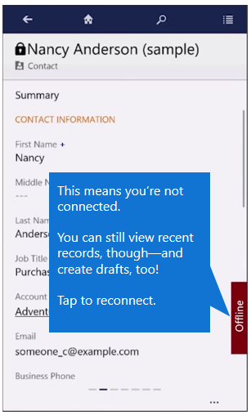
This means you’re not connected.
You can still view recent records though—and create drafts, too!
Tap to reconnect.

