Slide 1
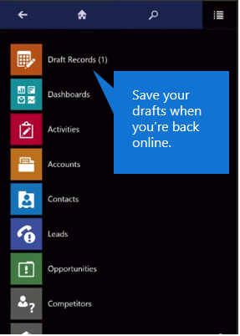
Save your drafts when you’re back online.

