Slide 1

البنية
Dataverseتطبيقات التمويل والعمليات
تطبيقات التمويل والعمليا Dataverse
الجدول
تعيينات
الكيان
تعيينات
CUD
CUD
الوظائف الإضافية
الأحداث
تطبيقات التمويل والعمليات
Dataverse
ODATA
ODATA
الكيان
الجدول
تطبيقات التمويل والعمليات
Dataverse
© Microsoft Corporation Dynamics 365

Slide 2
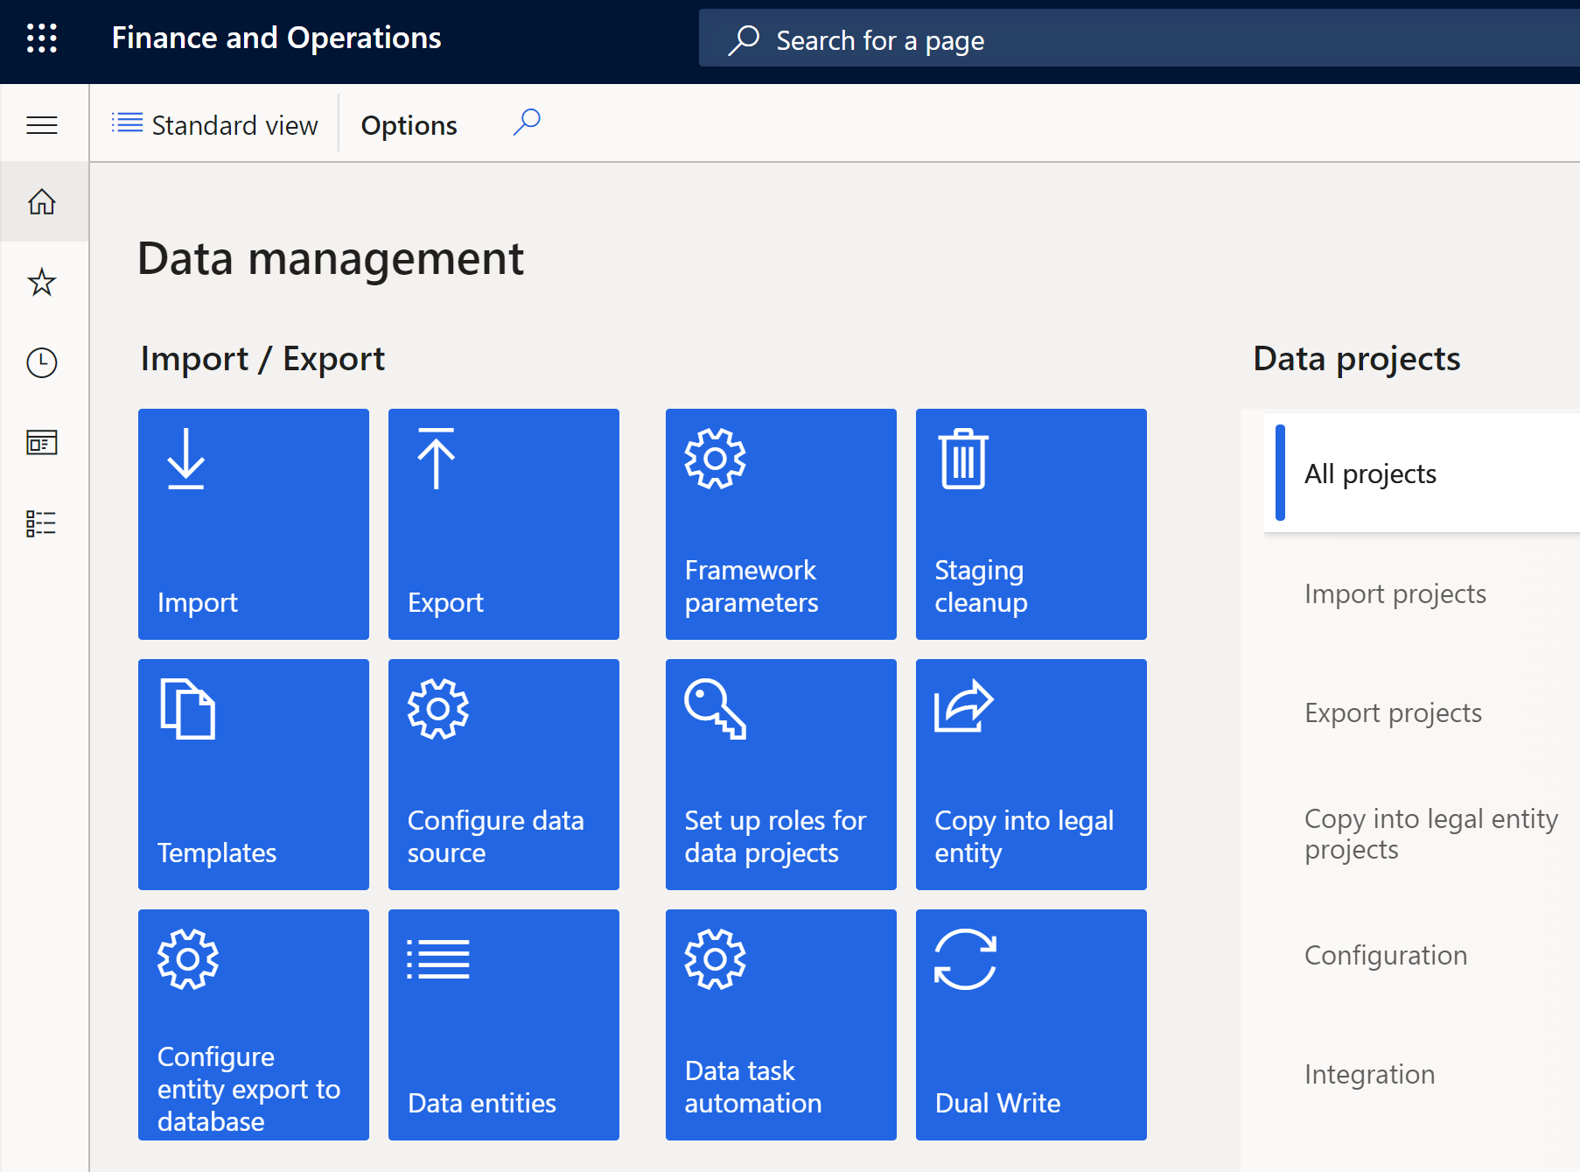
How to get started
Setup required in Finance and Operations
Available in Data management workspace

Slide 3
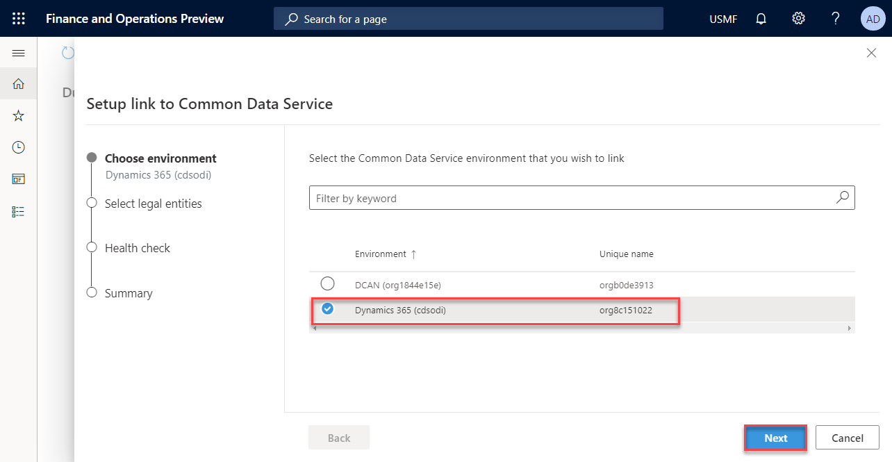
How to get started
Ensure Finance and Operations is linked with Dataverse.
Access connection setup through Dual-write tile or Lifecycle service.
Note: Soon linking experience will be limited to Lifecycle services.

Slide 4
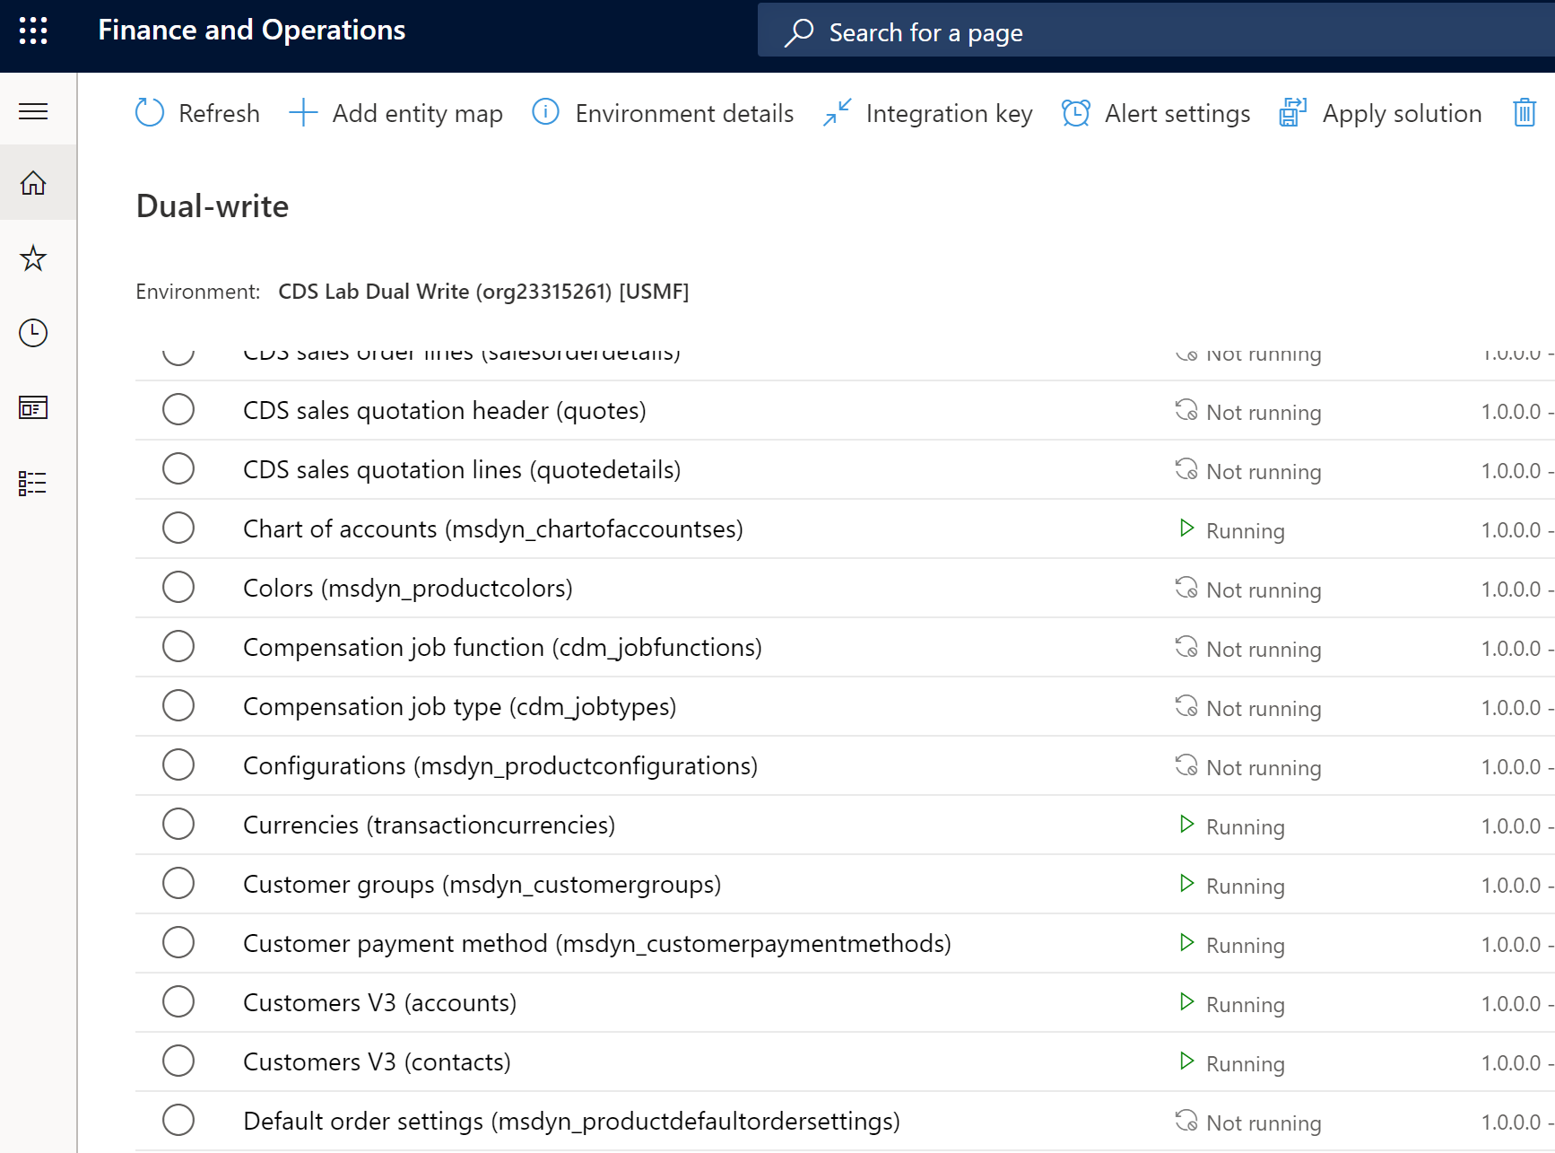
How to get started
Entity mappings are now available to be configured

Slide 5
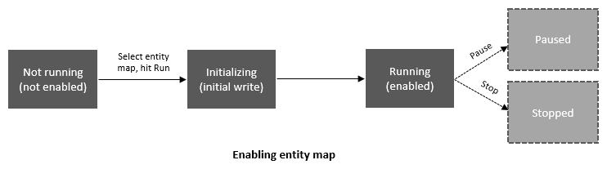
Running an entity map
Status | Description | Available actions
Not running | Every entity begins from the ‘Not Running’ status. Prior to enabling an entity for Dual Write, it is in the ‘Not Running’ status | Run
Initializing | Initial write/Copy pre-existing data | N/A
Running | Entity is enabled for Dual write | Stop, Pause
Paused | Entity is in paused state and all new requests are queued | Run
Resuming | Catch-up on queued records from when entity was paused | N/A
© Microsoft Corporation Dynamics 365

Slide 6
البنية
Dataverse
تطبيقات التمويل والعمليات
OData API
الكيانات الظاهرية
الوظيفة الإضافية للكيانات الظاهرية
الكيانات
CRUD
SSL/TLS 1.2
واجهة API للويب
خدمة ويب JSON
Power Apps / Power Automate / UCI / Odata / والمزيد..
الكيانات الأصلية
الجداول‏‎
CRUD
قاعدة البيانات
قاعدة البيانات
Notes:
Translates entity names to Finance and Operations public entity/field names based on metadata, also translates some well-known concepts like Company into native Common Data Service references
CDSVirtualEntityAdapterService
Custom WebAPI translates Common Data Service QueryExpression into QueryBuildDataSource, common buffer, etc, and back into EntityCollection/EntityReference
Standard IsPublic=Yes entities, persistence goes through standard persistence stack, meaning methods on the backing tables, eventually to SQL

Slide 7
The comparison – choose the right technology
Attribute | Dual write | Finance and Operations Virtual entity
Scenario | Near real-time CRUD | Real-time CRUD
Method | Synchronous (Live sync) | Run-time
Direction | Bi-directional | Not applicable
Data | Data is duplicated | Data remains in source i.e., Finance and Operations
Logic | Auto business logic execution | Auto business logic execution, you can call Odata actions
Offline scenario | Catch-up capability | Not supported
Development | Finance and Operations data entity + Dual write entity map + Dataverse table | Finance and Operations data entity + Dataverse configuration
Bootstrapping | May be needed for existing Dataverse data | Not applicable
ALM | Finance and Operations package + Dataverse solution (including entity map solution) | Finance and Operations package + Dataverse solution
User | Runs as S2S call, user doesn’t need to exist in both apps | Runs against the user context, user does need to exist in both apps

