Slide 1




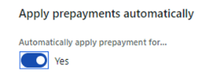
Vendor prepayments
Enable
Check
Search
Apply
Yes
Imported invoices are checked for any applicable prepayments.
Vendor invoice automation searches for open prepayments.
Any matching prepayments are applied to the relevant invoices.

Slide 2
Vendor prepayments
Enable
Check
Search
Apply
Yes
Imported invoices are checked for any applicable prepayments.
Vendor invoice automation searches for open prepayments.
Any matching prepayments are applied to the relevant invoices.

