Slide 1
Role
Duty
Privilege
Permission
Menu items
Tables and fields
Forms
Services
Reports

Slide 2
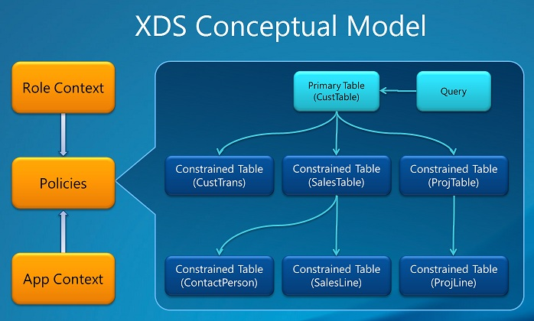
Extensible Data Security Policies

