Slide 1
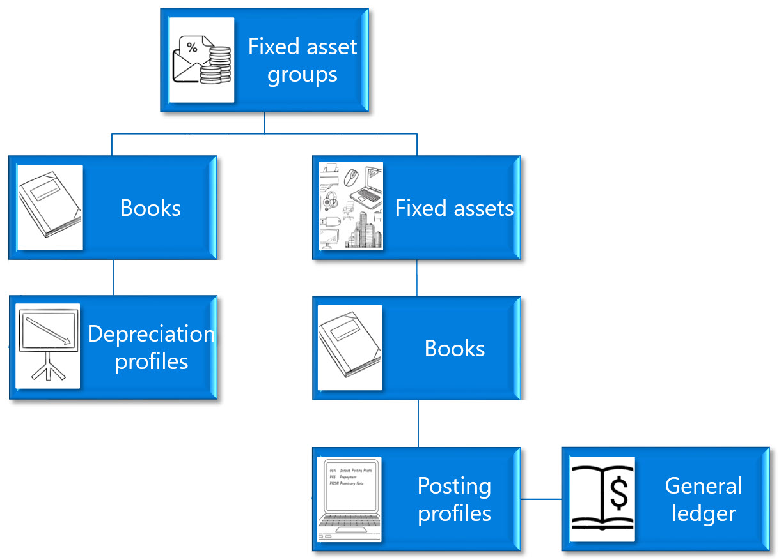
Fixed asset
groups
Books
Fixed assets
Depreciation
profiles
Books
Posting profiles
General ledger

