Slide 1
Module 22 : Configure and use budget planning processes in Dynamics 365 for Finance and Operations

Slide 2
Agenda
Introduction
Configure Budget planning components
Module exercises
Exercise 1: Configure Budget planning, create and use a planning process.
Module summary
Knowledge Check

Slide 3
Lesson 1: Introduction

Slide 4
Budget planning overview
Budget planning processes – Budget planning processes determine how budget plans can be updated, routed, reviewed, and approved in the budgeting organization hierarchy. A budget planning process is linked to a budget cycle and an organization via a legal entity.
Budget plans – Budget plans contain the budget data for a budget planning process . You can have multiple budget plans that are used for various purposes. For example, budget plans can be used to create budget amounts for different organizational units, or they can help you make comparisons and informed decisions.
Budget plan scenarios – Budget plan scenarios define categories of data for the budget plans. You define budget plan scenarios to support monetary and other unit of measure classes, such as quantity. Examples of monetary budget plan scenarios include Department previous year and Department requests. Examples of budget plan scenarios that use quantities include Previous year support calls and Full-time equivalent (FTE) count.
Budget planning stages – Budget planning stages define the steps that a budget plan follows from its inception to final approval. Budget planning stages are arranged in budget planning workflows.
Budget planning workflows – Budget planning workflows consist of and define budget planning stages. Budget planning workflows are associated with Budgeting workflows. Budgeting workflows are the automated and manual processes that move budget plans through the budget planning stages.

Slide 5
Lesson 2: Configure Budget planning components

Slide 6
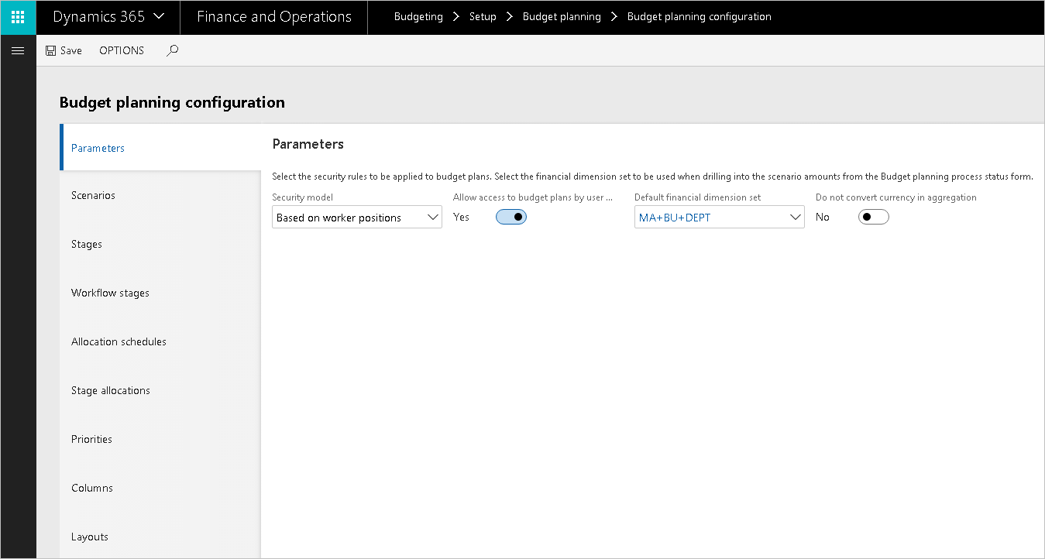
Budget planning configuration

Slide 7
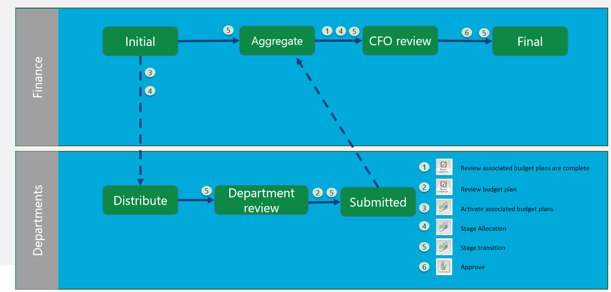
Create a budget planning schema

Slide 8
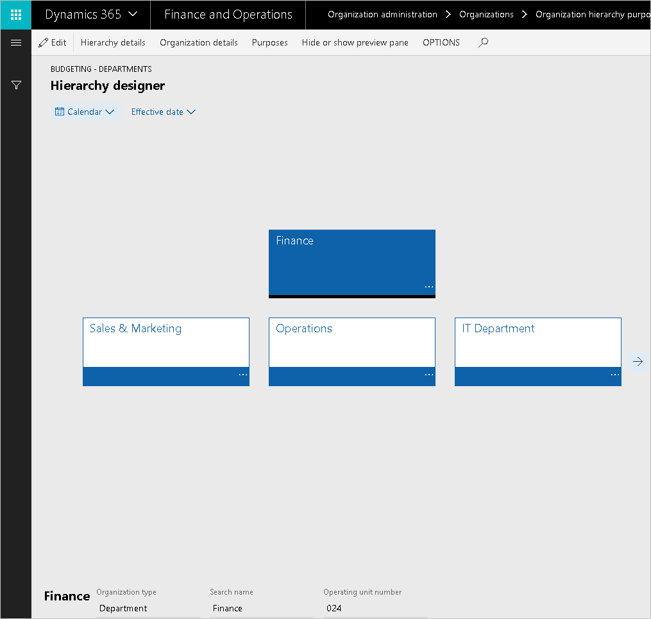
Budget planning hierarchy

Slide 9
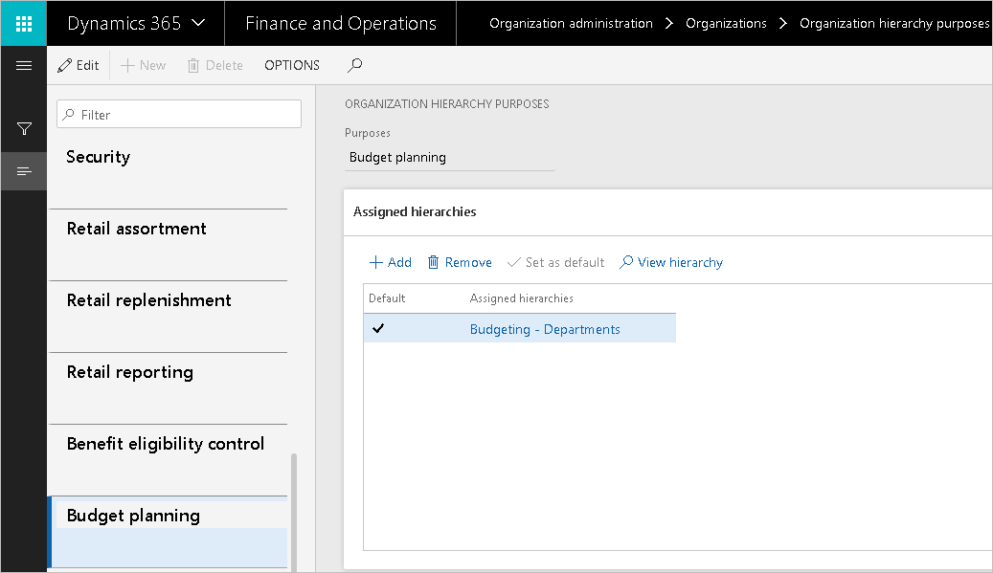
Budget planning purpose

Slide 10
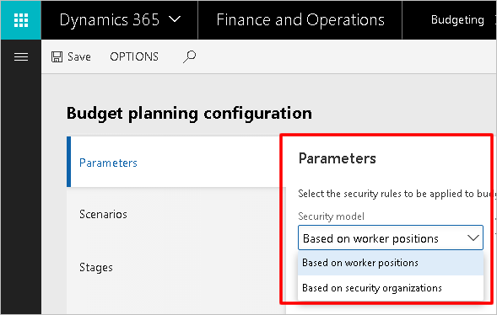
Security

Slide 11
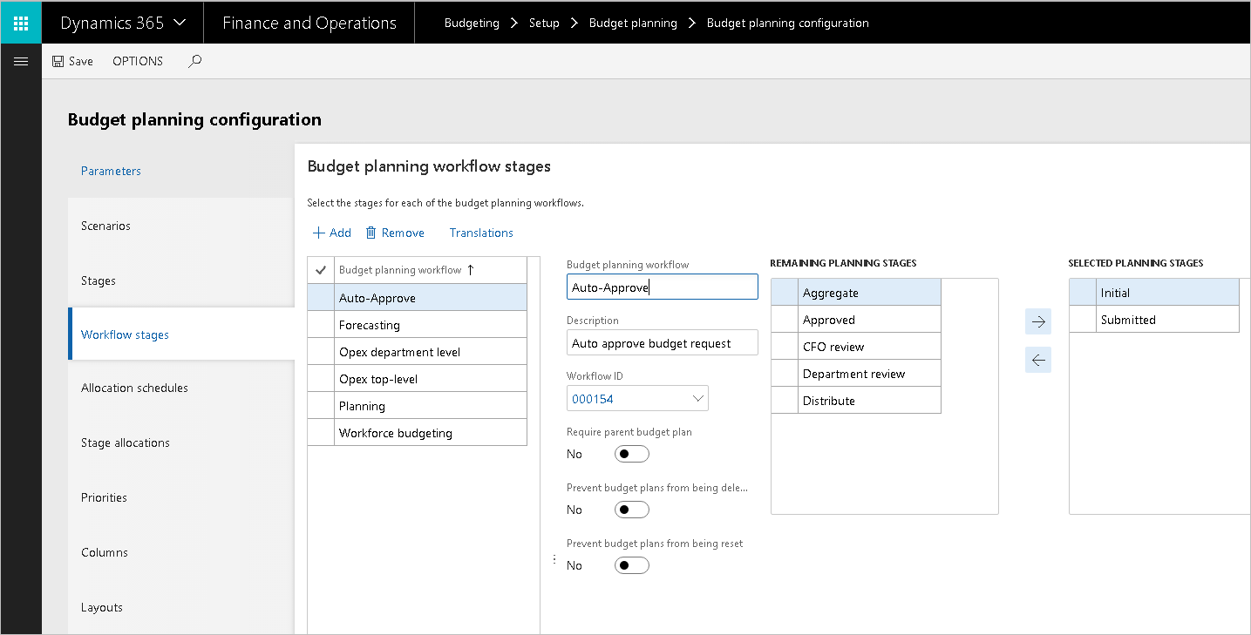
Budget planning workflows stages

Slide 12
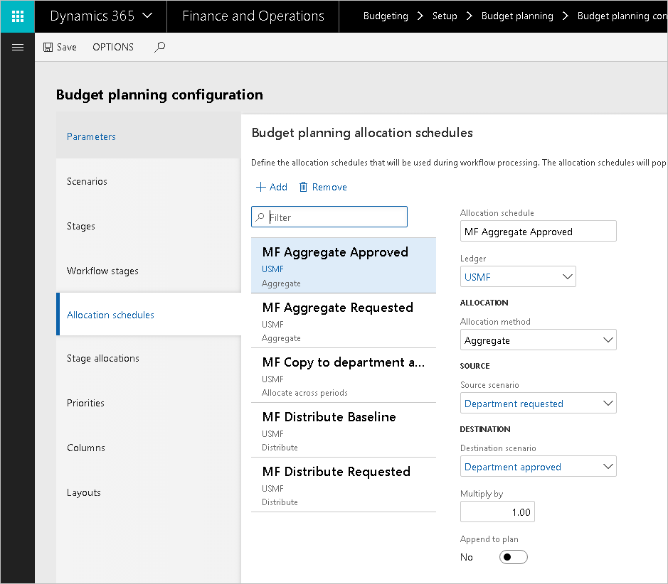
Allocation schedules

Slide 13
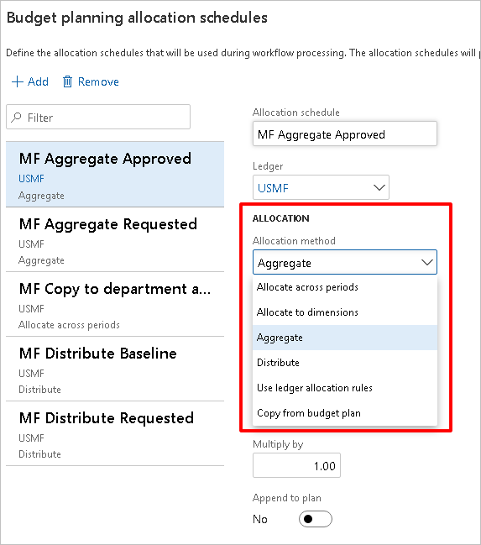
Allocation method

Slide 14
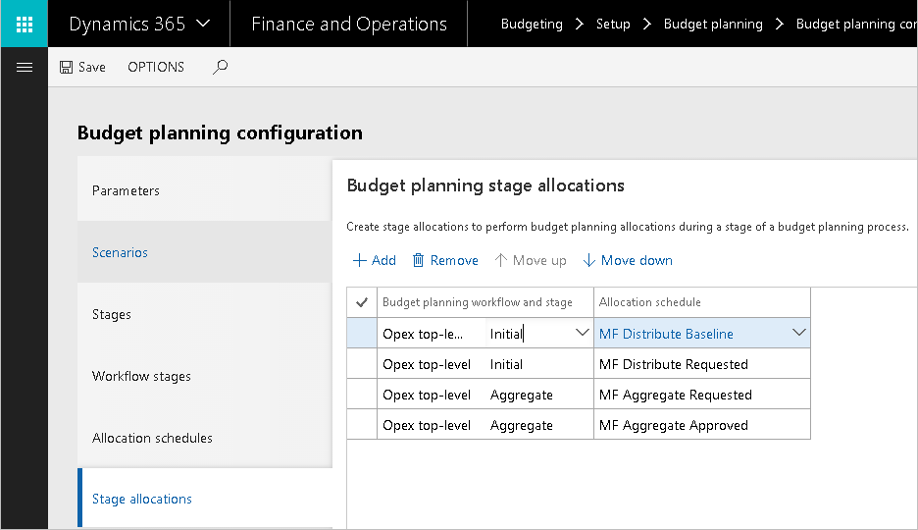
Stage allocation

Slide 15
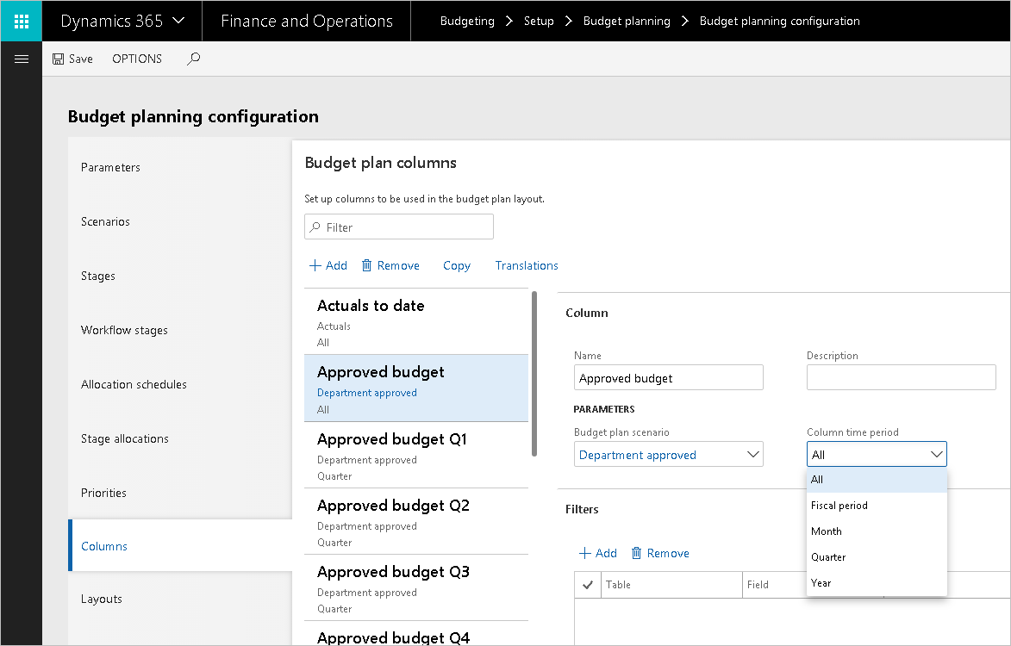
Columns

Slide 16
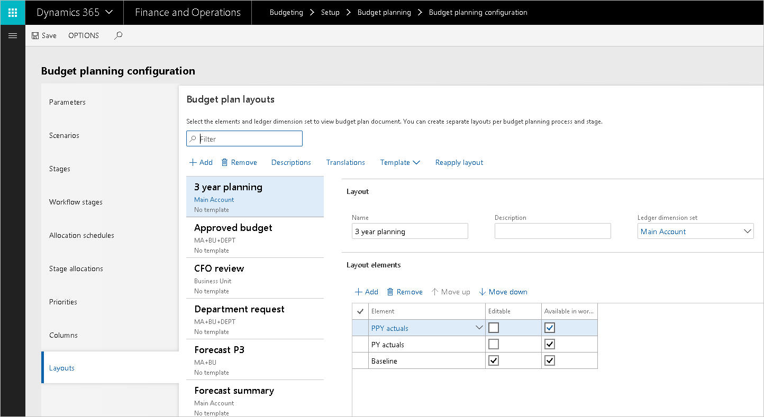
Layouts

Slide 17
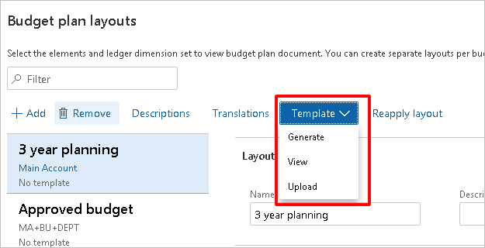
Templates

Slide 18
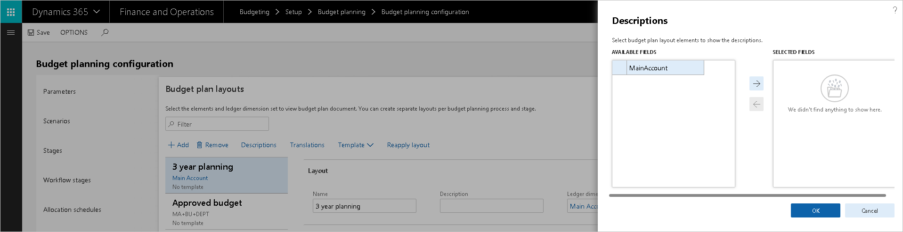
Descriptions

Slide 19
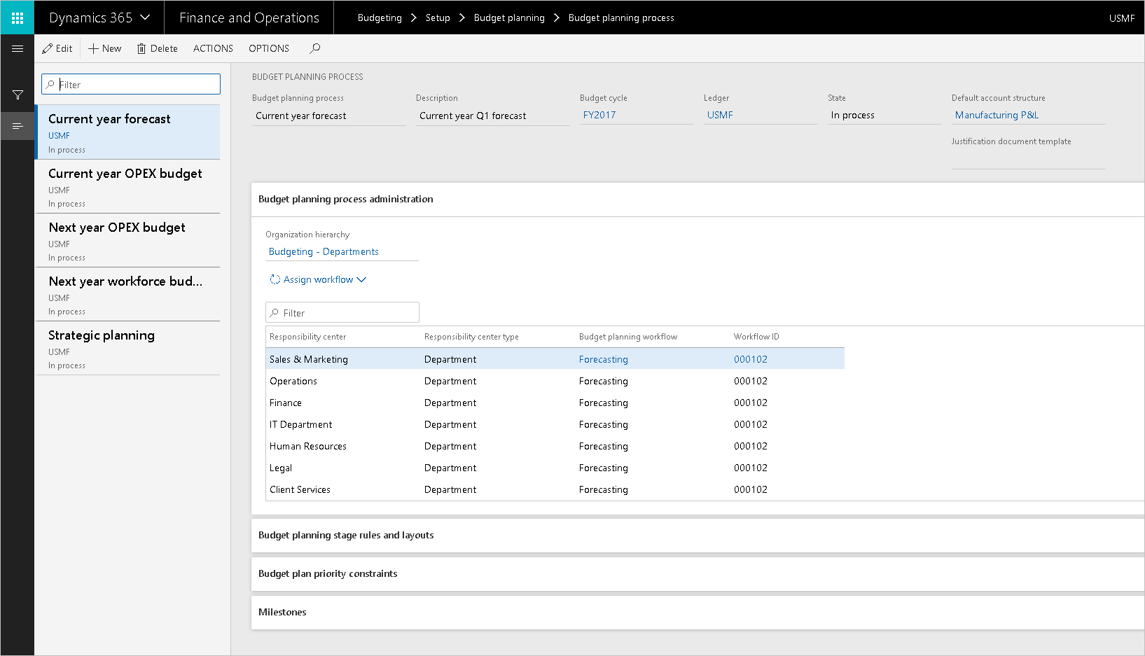
Budget planning process

Slide 20
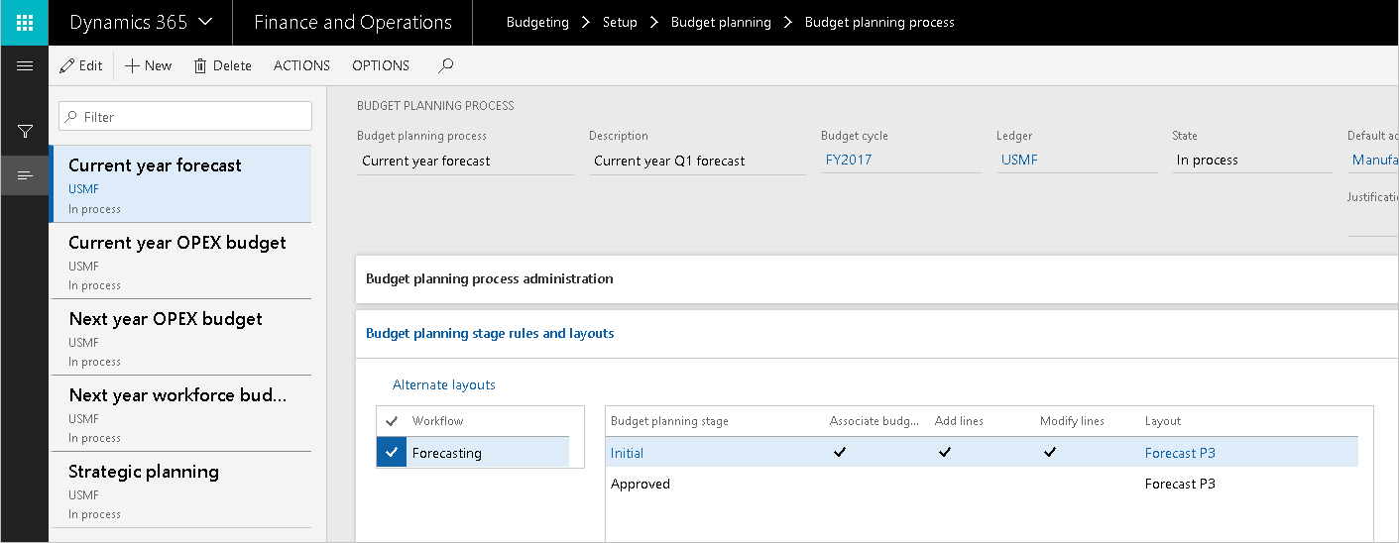
Budget planning stage rules and layouts

Slide 21
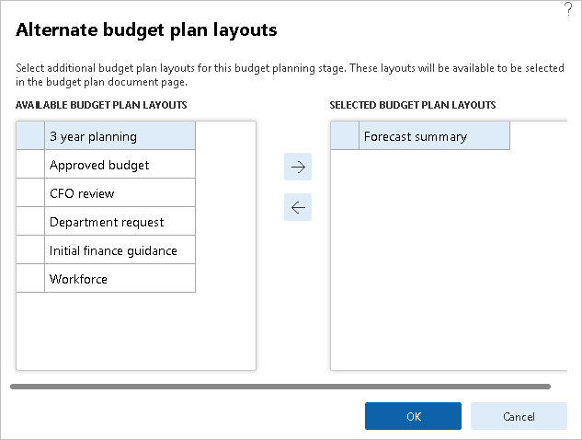
Alternate layout

Slide 22
Lesson 3: Module Exercises

Slide 23
Lesson Introduction
The goal of the lab exercise is to apply the knowledge we’ve learned regarding the security management in Finance and Operations.
Exercises:
Exercise 1: Configure Budget planning, create and use a planning process.
Exercise

