Slide 1
سلسلة التوريد وإدارة اللوجستيات
المستودع
النقل
المخزون
إدارة اللوجستيات
التخطيط والجدولة
الشراء والتوريد
إدارة الإنتاج
Notes:
Transportation management integrates Supply and Demand Management functions encompassing the planning and management of all activities involved in sourcing and procurement, conversion, and all logistics management activities.
Transportation management is part of supply chain management that plans, implements, and controls the efficient, effective forward and reverse flow and storage of goods, services, and related information between the point of origin and the point of consumption in order to meet customer's requirements.

Slide 2
Transportation flows
وارد
الشراء
الإنتاج
صادر
Sales
تحويل للداخل
تحويل للخارج
Logistics Pricing Options
Included in Item Price
Separate Charge Line

Slide 3

Transportation Management
تعقب
فوترة الشحن والتدقيق والمدفوعات
التحليلات
إدارة الأوامر
شركات الشحن والخدمات والمسارات والعقود
تحسين/تخطيط الأحمال
إدارة الأسطول
التخطيط
إدارة الأسعار
Notes:
Transportation management is a subset of the Logistics management function that focuses on the physical flow of goods and services, and their associated information, between the point of source and the point of consumption.
Some features that transportation management solutions, such as Dynamics 365 for Operations, use to help organizations manage their transportation include the following:
Tracking
Freight Billing, Audit, and Payments
Analytics
Order Management
Load Planning/Optimization
Fleet Management
Planning
Carrier, Services, Routes, and Contracts,
Pricing Management

Slide 4
Transportation Functions
التحليلات
تحليلات الإنفاق
تحليلات الأداء
الفوترة
إدارة فاتورة الشحن
النزاعات
تحليلات الإنتاجية
تسوية عمليات الشحن
التعديلات
تسوية الفاتورة
التدقيق
‏‏تنفيذ
الجدولة
إدارة الإرساء/الفناء
عمليات المستودعات
وثائق النقل
تعقب الحالة
Notes:
Taking a closer looks at typical functions within some of the major features, you can see more specific features and functions that Transportation management solutions include.
Analytics – Good reporting and visibility allow management to make decisions about long-term growth, staffing, and so on. This includes:
Spend analytics
Performance analytics
Productivity analytics
Billing – Accounting requires tools to be able closely manage the costs of transportation. These costs can be significant and greatly affect margins as well as customer satisfaction. This includes:
Freight invoice management
Freight reconciliation
Disputes
Adjustments
Invoice settlement
Audit
Execution – Transportation managers and shop floor management need tools that allow them to plan the movement of people and products through the facilities. Without these tools, the flow of products coming into and out of a warehouse can become chaotic. This includes:
Scheduling
Dock/Yard management
Warehouse operations
Transport documentation
Status tracking

Slide 5
إدارة الأوامر
طلبات/أوامر النقل
التعاقد
تخطيط الحِمل
تحسين الحِمل
تخطيط المسار
تحميل التسعير/عروض الأسعار
إدارة أوامر شراء النقل
توظيف شركة النقل
إدارة خدمة شركة النقل
إدارة مسارات شركة النقل
إدارة تسعير شركة النقل
إدارة عقد شركة النقل
التخطيط
تخطيط القدرة الإنتاجية
خطط المصادر
Notes:
Order Management – Whether an organization uses the sales team to help determine pricing for orders or if this is handled separately by the transportation department, having accurate orders and freight information helps organizations manage their customer satisfaction and cost margins more effectively. This includes:
Transport requests/orders
Load planning
Load optimization
Route planning
Load pricing/quotes
Transport PO management
Contracting – Finding the right carrier, service, pricing, and so on can save time in the planning phase of your transportation management process. This includes:
Carrier recruitment
Carrier service management
Carrier routes management
Carrier pricing management
Carrier contract management
Planning – Before you can ship or receive a product to your customers, you will need to carefully plan your warehouse capacity, as well as your worker capacity. To help keep internal costs down, many organizations use a just-in-time sourcing philosophy. Having accurate sales, purchase, and production information is crucial to the overall transportation management functions. This includes:
Capacity planning
Sourcing plans

Slide 6
تخطيط النقل
تعريف
الطلب
الخطة
أصل الحمل
الوجهة
المراكز
المعدات
نوع الحِمل
أمر المبيعات
أمر الشراء
أمر التحويل
من الأمر
من منضدة تخطيط الحمل
Notes:
All transportation scenarios will start with transportation planning. You are able to define the load’s origin, destination, and any hubs between the two. Along with these, you can define what type of equipment you might be using and the type of load.
All transportation planning is based on demand from a purchase order, sales order, or transfer order.
We begin planning transportation from either the order itself or from the load planning workbench. The Load planning workbench is designed to hold all of the order lines for the loads that need to be planned or rated and routed. The form includes special features and functions to help you easily manage all your inbound and outbound loads. We will take a close look at this form later on.

Slide 7
Transportation Execution
السعر‬‬
تحويل
تأكيد
إنشاء
Notes:
The process of executing a transportation plan consists of three basic steps after the creation of the load from our planning phase:
Rating the load, which determines the cost and methods or modes of delivery for that load
Routing the load, which determines the sequence and “path” the load will take to reach its final destination
Confirming the order. You can optionally use appointment scheduling and freight reconciliation features. which involve additional steps in the shipping confirmation step. We will look at these in more detail later on.

Slide 8
Freight Rating
شركة نقل
ملف تعريف التقييم
السعر الرئيسي
محرك وقت الانتقال
تعيين قاعدة الأسعار
بيانات تعريف التقييم
قاعدة الأسعار
Notes:
In Microsoft Dynamics 365 for Operations, *carriers are set up and enabled. This allows them to be used for rating a specific order or a load.
When rating, the system will evaluate the *Rating Profile first in order to determine if the carrier's rate is applicable for the items or load being rated. Each carrier can be linked to one or more rating profiles. A *transit time engine is used to determine how long a carrier will take to deliver an item from one point to another, such as from one zip code to another or from one shipping zone to another.
The *rate master includes one or more *rate base assignments which include attributes that are determined by the rate base type that is linked to the rate master. For example, the attributes might be destination zip code and origin zip code or warehouse. The rate base is then linked to the rate master, which holds the actual rates for a particular combination defined in the rate master through the use of rate base types and assignments.
For example, the rate master could be based on a mileage rate base. The *rate base type includes rate base type attributes, such as the from and to zip codes, which are used by the system to determine how many miles the shipment will travel. The *Rate base includes tiers or breaks for certain mileages, such as 0–100 miles for one rate, and 101–200 miles for another rate.
You can configure the system for any combination of attributes to calculate freight. However, the engines that are provided out of the box do have certain limitations. The engines provided with Microsoft Dynamics 365 are designed to be extended to support any scenario your business might require.

Slide 9
Rating Configuration
التقنية
أقل سعر
سعر المتجر
المصروفات
محدد (جدول)
عام (المجموعة أو الكل)
الخصومات
خاص أو عام
السعر والمسار معاً
النسبة المئوية أو المبلغ الأساسي
إيجابي أو سلبي
التكاليف الإضافية
المصاريف الإضافية للوقود
المهام
رسوم الوسيط
Notes:
Dynamics 365 for Operations has the ability to rate strictly for the lowest rate every time. Alternatively, you can rate shop. Rate shopping allows for the Transportation Manager to see all of the carrier options that are available for use, so that they can choose the optimal carrier for the situation. The system also allows for rating and routing at the same time.
To determine which code will be used when writing the apportioned charges back to the line, all the records in the Charge table will be evaluated, choosing the most specific to the most general.
Discounts, if applicable, will determine the overall rate for the customer or shipper as charged. The criteria can be set up so that you can specify which discounts apply to which transactions. The result of the discount can either be a percentage of the overall original total or just an amount. Discounts can be either a positive or negative amount.
Accessorial charges are any additional charges to be added when rating freight, which will be assigned according to the configurations defined in the module. One example of an accessorial charges is a fuel surcharge, which is typically made up of three parts: fuel indices determined by the Department of Energy, carrier fuel indices, and the accessorial assignment.

Slide 10
Outbound Transportation Flow
Customer
Transportation
Procurement
Supply Planning
Production
Transportation
Inventory/ Warehousing
Transfer
Notes:
For outbound transportation scenarios, let’s use the example of a customer ordering peanut butter from Company X.
We start with the customer delivery, which involves the creation of a sales order for the peanut butter.
Next we move to supply planning, which includes procurement of any raw materials (such as peanuts or jars), production of the peanut butter, and transfer of any goods necessary. This creates the finished product.
The finished peanut butter is then transported to the warehouse for distribution.
Goods can also be transported between warehouses or distribution centers during transfer out and stock replenishment activities.
After transporting the peanut butter to the warehouse, the goods are then distributed to the customers.

Slide 11
Other Transportation Flows
Customer
Transportation
Procurement
Supply Planning
Production
Transportation
Inventory/ Warehousing
Transfer
Notes:
There are three other transportation flows that are important.
First, Sales Return/Repairs operate very similarly to inbound transportation flows. Using our peanut butter example, the Customer X receives finished product of peanut butter and the jars are cracked.
The Customer X sends the peanut butter back to Company Y. During Supply Planning, Company Y receives the faulty peanut butter into the warehouse.
Purchase Return/Repairs operate very similarly to outbound transportation flows. Using the peanut butter example again, Company Y receives roasted peanuts when the purchase order specified raw peanuts.
Company Y sends the peanuts back. During Supply Planning, Company Y removes the peanuts from inventory and sends them back to the warehouse.
End-of-life disposals refers to slightly different situation. Using the peanut butter example, let’s say that Company Y has jars of peanut butter sitting in the warehouse that are nearing the expiration date.
To make room for new jars, the peanut butter in the warehouse is transported out, either for disposal, discount sale, or donation, and new product is transported to the warehouse.

Slide 12
Inbound Load Process
إنشاء حمل عمل
السعر والمسار
تجميع
تأكيد الحمل
تخطيط المواعيد
تسجيل برنامج تسجيل دخول/تسجيل خروج السائق
Notes:
When you order items from a vendor for delivery to your warehouse, you might want to arrange the transport of the items yourself. There are six steps in the business process flow for planning transportation for an inbound load.
Create or modify an inbound load for shipping.
Assign a rate and route to the inbound load.
Optionally, consolidate multiple shipments into one load.
Confirm the load for shipping.
Plan appointments for a load.
Register driver check-in and check-outs for an appointment.

Slide 13
Outbound Load Process
إنشاء حمل عمل
السعر والمسار
تجميع
تخطيط المواعيد
تسجيل برنامج تسجيل دخول/تسجيل خروج السائق
معالجة الموجة
انتقاء الموجة وإبعادها وتعبئتها
تأكيد الحمل
Notes:
You can plan and process an outbound load to ship specific items from a company’s warehouse to a customer. There are eight steps in the business process flow for planning transportation for an outbound load.
Use a sales order or transfer order to manually create an outbound load for shipping. You can also modify an existing outbound load.
Assign a rate, route, and shipping carrier.
Create and process a wave manually or automatically, depending on your configuration, which will specify the pick and put location.
Pick a load from the storage location and put it in a staging area for packing or put it onto the outbound dock for shipping.
Optional: Consolidate multiple shipments that are shipped to one or more destinations in the same route.
Plan when to ship the packed load from the outbound dock to a destination.
Register a driver check-in and check-out to complete the appointment.
Confirm the load.

Slide 14
عملية التقييم
بيانات تعريف التقييم
السعر الرئيسي
التوقف الرئيسي
قاعدة الأسعار
محرك الأسعار
شركة نقل
ملف تعريف التقييم
ملف تعريف التقييم
Notes:
Before you set up a rate master, you must set up at least one set of rating metadata. The rating metadata can be applied to any rate master. It defines lookup criteria that are used to determine rates of a shipping carrier. Setting up rating metadata requires the following tasks:
Set up rating metadata with lookup criteria, such as postal code and carrier service.
Associate a rate master with the rating metadata and, on the rate master, provide values for criteria, such as postal code and carrier service. One or more rate masters are associated with a shipping carrier in the rating profile fast tab. You can use rate masters to determine the available rates for the shipping carrier and to determine whether the rates justify considering the shipping carrier for an assignment.
The break master defines the break values that you must associate with the rate base. For example, distances are structured into breakpoints of 50, 100, and 150 miles. A distance of up to 50 miles is charged with 10 USD per assignment, between 50 and 100 miles is charged with 18 USD, and from 100 to 150 miles is charged with 20 USD.
If you want to set up a tariff structure for the rate master, you can create a rate base. The rate base structures rates in breakpoints.
To calculate rates, you must manually create one or more engines, or automatically initialize the base engine data. You can search for available shipment rates based on information such as travel distance or zones in a region. The search criteria are interpreted by transportation management engines that calculate the available rates.
Finally, you will link all the rating information to a carrier by creating a rating profile and then selecting one or more rating profiles on the Rating profiles FastTab of the Shipping carriers form.

Slide 15
Rating Profile
ملف تعريف التقييم
شركة الشحن
الموقع والمستودع
محرك الأسعار
السعر الرئيسي
محرك وقت الانتقال
مؤشر وقود الناقل
تواريخ السريان
Notes:
The rating profile links the shipping carrier with a rate master. The rate master defines the rate base assignment and the rate base. The rate base determines the rate of the carrier. You can also link the rating profile to a specific site and/or warehouse and select the carrier fuel index to be used with the rating profile. All of the information is date effective so you can configure changes to be within a given time frame.

Slide 16
Transportation Template Setup
شركة نقل
قالب
إعداد التقييم العام
تجاوز التكلفة
العميل
شركة نقل
المصروفات
Notes:
Templates enable you to identify specific charges that apply to the shipping carrier. If a transportation template is selected for a shipping carrier, the template charges will override the charges from the general rating setup that applies to the shipping carrier. The template also overrides any charges that are set up for the shipping carrier in the Override charges form.
When you use a transportation template, you can specify that charges from a shipping carrier should correspond to charges for a customer or to a specific charge that will be applied in the rating of the shipment carrier.

Slide 17
Carrier Fuel Index Setup Process
مناطق مؤشرات الوقود
مؤشرات الوقود
مؤشرات وقود شركة النقل
ربط شركة نقل بمنطقة
Notes:
You must set up a fuel index region before you can create a fuel index.
The fuel index region determines where freight will be delivered. The region is associated with the shipping carrier through the carrier’s accessorial assignment.
Fuel indexes are associated with a fuel index region. To reflect the change in fuel prices over time, you can associate a region with multiple fuel indexes. Typically, the price information for a fuel index can be downloaded from the Internet.
The carrier fuel index is part of the carrier’s rating profile. You must set up fuel indexes for carriers that will deliver freight in a specific region. In the carrier fuel index, you specify the per-gallon fuel charge limits for the carrier.
To calculate fuel surcharges for a shipping carrier, you must specify a fuel index region with the carrier’s accessorial assignment.

Slide 18
عملية إعداد المسار
أنواع الموزِّعين
المراكز
المسافة بالميل
أوقات الانتقال
التحقق من صحة الإعداد
دليل التوجيه
خطط المسارات
Notes:
There are seven basic steps in the route setup process:
First, you create hub types, which are used to group hubs by type such as sea port, airport, and rail yard just as a few examples.
Second, you create hubs, which are physical locations.
Next, you create mileage and transit times, relying on information from mileage engines.
Then, you create route plans, which link hubs together.
After that, you create a routing guide, which links routing plans together.
Then you validate the routing setup to make sure it is configured properly.

Slide 19
Inbound Transportation Flow
إنشاء أمر شراء
إنشاء حمل عمل
سعر المتجر
جدولة المواعيد
استلام أمر الشراء
تأكيد الحمل الوارد
مراجعة تكاليف الشحن
الفاتورة والدفع للمورد
Notes:
There are eight major steps in the inbound transportation process flow.

Slide 20
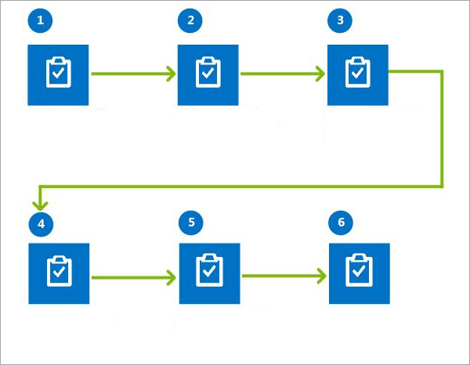
النقل الوارد
إنشاء
حمولة واردة
أو تعديلها للشحن
تعيين سعر
والتوجيه إلى
الحمولة الواردة
دمج عدة
شحنات إلى حمولة
تأكيد حمولة
للشحن
تخطيط المواعيد
لحمولة
تسجيل برنامج تشغيل
تسجيل دخول / خروج لـ
لأحد المواعيد

Slide 21
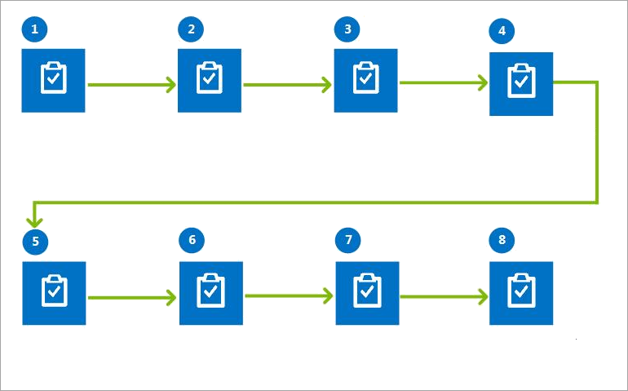
النقل الصادر
إنشاء
حمولة صادرة
للشحن
تعيين سعر
والتوجيه إلى
حمولة صادرة
إنشاء موجة إصدار
أو معالجتها يدويًا
انتقاء الحمولة الصادرة
ووضعها وتعبئتها
دمج عدة
شحنات إلى حمولة
تخطيط المواعيد
لحمولة
تسجيل برنامج تشغيل
تسجيل دخول / خروج لـ
لأحد المواعيد
تأكيد حمولة
للشحن

Slide 22
Outbound Transportation Flow
استلام أمر العميل
إنشاء حمل عمل
سعر المتجر
جدولة المواعيد
تأكيد شحنة صادرة
تنفيذ أمر مبيعات
تسوية فاتورة الشحن
حجز المخزون
تعيين شركة النقل/الخدمة
إصدار الحمل
معالجة/إصدار الموجة
إكمال عمل المستودع
Notes:
There are twelve major steps in the outbound transportation process flow.

Slide 23
Overview of Multi-Segment Transportation
دفتر عناوين العملاء الجديد
مناطق مؤشرات الوقود، ومؤشرات وقود شركة النقل، ومؤشرات الوقود
التكاليف الإضافية والرئيسية
مهام إضافية
مراكز إضافية
الأميال وأوقات الانتقال للمقاطع
تعيينات أسس الأسعار
الدليل وخطة التوجيه متعددة المقاطع
ملف تعريف تقييم شركة النقل
رمز التكاليف المتنوعة في الواقع المعزز (AR) والنقل
الخصومات
Notes:
There are several areas of setup that are either added or modified in multi-segment transportation. Let’s look at what they are, and then we’ll take a look at some screenshots.
New Customer Address
Additional Hubs
Mileage and Transit Times for Segments
Rate Base Assignments
Multi-Segment Route Plan and Guide
Fuel Index Regions, Carrier Fuel Indexes, and Fuel Indexes
Accessorial Master and Charges
Accessorial Assignments
Carrier Rating Profile
Miscellaneous Charge Code in AR and Transportation
Discounts

Slide 24
Multi-Segment Outbound Transportation Flow
إنشاء أمر المبيعات وتأكيده
حجز المخزون وإنشاء حمل نقل جديد
سعر المتجر
تعيين شركة النقل/الخدمة
إصدار الحمل
إكمال عمل المستودع
تأكيد الشحنة الصادرة
تسوية فاتورة الشحن
Notes:
Let’s take another look at the outbound transportation process flow, this time based around multi-segment transportation.
Create and Confirm the Sales Order
Reserve Stock Create a New Transportation Load
Rate Shop
Assign a Carrier/Service
Release the Load
Complete the Warehouse Work
Confirm the Outbound Shipment
Reconcile the Freight Invoice
Next, we’ll look at demonstrations for the two areas of this transportation flow that differ from the outbound transportation flow we discussed earlier: Rate shopping and assigning a carrier or service.

Slide 25
Multi-Warehouse Delivery Outbound Transportation Flow
استلام أمر مبيعات وتأكيده
حجز المخزون لبنود الأمر
إنشاء حمل وتعيين شركة نقل (الحمل 1)
إنشاء حمل وتعيين شركة نقل (الحمل 2)
إنشاء حمل دمج المراكز وتعيين شركة نقل
إصدار الأحمال إلى المستودع
إكمال عمل المستودع
تأكيد الشحن للحمل المدمج
مراجعة تكاليف الشحن
تنفيذ أمر مبيعات
تسوية تكاليف الشحن
Notes:
Let’s take look at the variation of the outbound transportation process flow for multi-warehouse delivery.
In this scenario, several steps are different from the standard outbound transportation flow. Next, we’ll look at demonstrations of those steps, including reserving stock for order lines, creating a load and assigning a carrier for the separate loads, as well as the hub consolidation load, confirming shipment for the consolidated load, and reviewing the separate freight charges.

Slide 26
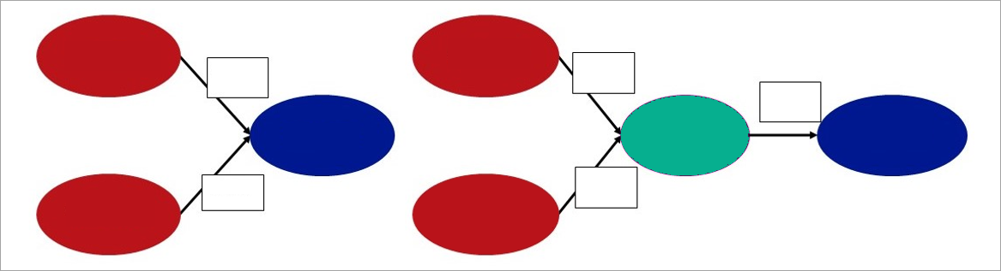
توحيد الموزِّعين
المستودع 1
المستودع 1
الحمل 1
الحمل 1
الحمل 3
العميل A
المركز
العميل A
الحمل 2
الحمل 2
المستودع 2
المستودع 2

Slide 27
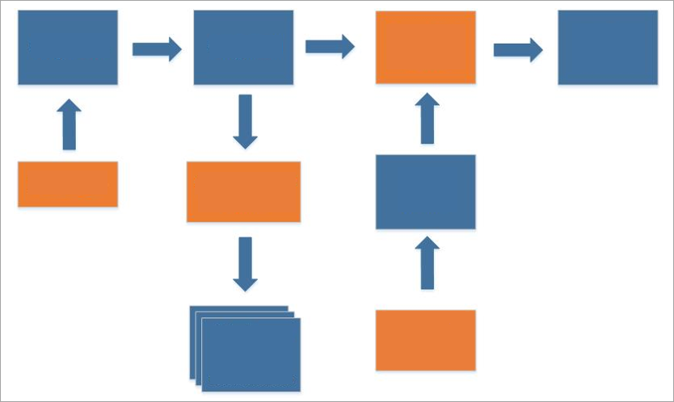
تسوية عمليات الشحن
تسوية /
مطابقة
دفتر يومية
الأستاذ
معدل الشحن
كمبيالة الشحن
محرك الأسعار
محرك
الموعد
فاتورة
الشحن
مستند
خارجي
تكاليف متنوعة

