Slide 1
Module 17 : Identify and configure batch attributes for process manufacturing in Dynamics 365 for Finance and Operations

Slide 2
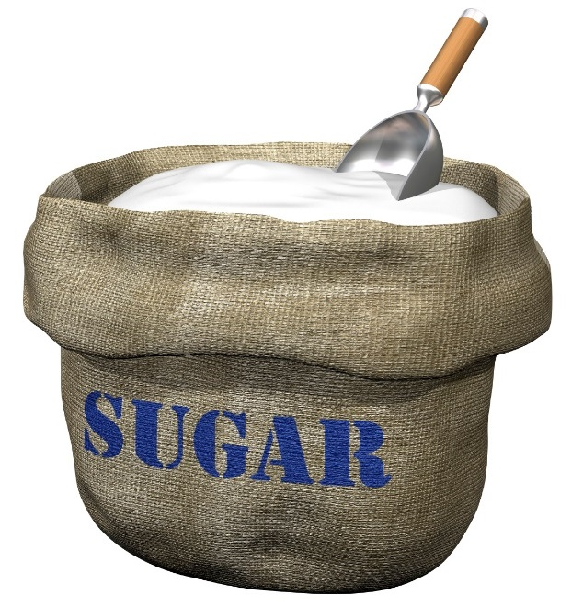
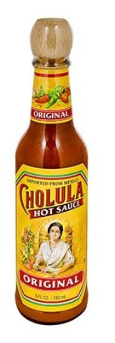

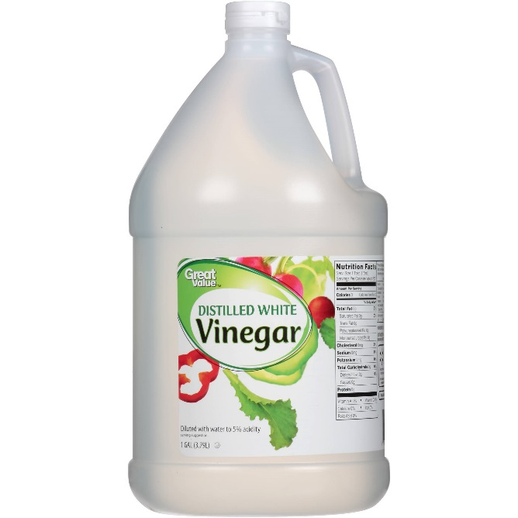
Potency Example
Compensating Ingredients
H2O
Filler Ingredient
Active Ingredient
Batch Attribute
Scoville Units
Pricing
Scoville Unit
Finished Good
Batch Attribute
Scoville Units
Consistent Value
Notes:
Uses of Potency management exist in many industries including food, chemical and the pharmaceutical industries. As an example of the concept of potency management we will look at an example in the food industry. This example will be used throughout the course as I will create the potency items, formula and process the batch orders for this example.
In the production of hot sauce the heat index (Scoville Heat Units) of the raw chili batch that is used to produce the hot sauce has an impact on how much of the other ingredients are used in the mixture. Each batch of chili's is tested upon receipt for a Scoville Heat Unit value. The price of the batch of chilis is based upon the SHU value as the higher the value, the less chilis have to be used in the production of the hot sauce. Based upon the Scoville Unit test for a batch of chilis the amount of sugar and vinegar that is used in the hot sauce is adjusted to maintain an even heat value for the finished product. Once this value is calculated, water is added as a filler ingredient to complete the total needed quantity of the batch order. This allows for the finished product to have a consistent heat value for the customer, and not have varying levels of heat bottle to bottle.

Slide 3
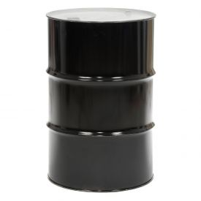
Configure Attribute-Based Pricing
Actual 2
$$Batch Price =Target Price ×\frac{Actual Potency}{Target Potency}$$
Target
50 gallons
75% Active =
$937.50
Actual 1
50 gallons
70% Active =
$875.00
50 gallons
60% Active =
$750.00
Notes:
One of the more common equations is to take the target price and multiply it by the ratio of the actual potency to the target potency which will then give the price for the batch received.
For example, if we have a target pricing of 50 gallons of material at 70% active potency with a cost of $875.00, this would be the ideal situation.
But since we can’t get each batch to be at exactly 70% active potency, we have established attribute-based pricing on the item. So if a batch at 60% active potency is received, the calculated price of the 50 gallons would be $750. It’s a cheaper rate since the active percentage is lower than the target value from the supplier
If a batch at 75% active potency is received, the 50 gallons would have a calculated price of $937.50, which is more expensive than the target, but since we have to use less in production, the cost evens out.

Slide 4
موازنة الدُفعات – المكون النشط
كمية المكونات النشطة
كمية متوازنة من المكونات النشطة = ((الكمية المقدّرة للمكوِّن النشط * قيمة الفاعلية المستهدفة) / قيمة القوة الفعلية محجوزة)
القيمة الفعلية
الهدف
32.5٪
35 ٪
50 رطل
53.85 رطل
سمة القوة
Notes:
When a batch order for a manufactured item that consumes a potency item is created, Dynamics completes a process of batch balancing to determine the actual quantities to consume of the active, compensating and filler ingredients. For the active ingredient a target value is set on the released product for the potency attribute, when the real batch is selected Dynamics will use the actual potency attribute to calculate the quantity of the batch to consume using the following equation:
Active ingredient Balanced Quantity =
((Estimated Quantity of Active ingredient * Target potency value) /
Actual potency value reserved)
For example, is the target potency of an active ingredient was 35%, and the estimated quantity was 50 lbs, but the actual batch that was picked for production was 32.5% potency, the formula for that specific batch order would be adjusted to have the quantity of 53.85 lbs picked of that specific batch.

Slide 5
Batch Balancing – Compensation Ingredient
Compensation Ingredient Quantity
Compensation Ingredient Balanced Quantity = ((Estimated Quantity of Active ingredient – Balanced (Actual) Quantity of Active ingredient) * Compensation Factor) + Compensation ingredient Estimated Quantity
Actual
Target
32.5%
53.85 lbs
35%
50 lbs
Potency Attribute
Notes:
Once the actual active ingredient batch has been identified and the adjusted active quantity calculated, Dynamics will next calculate the compensation ingredient quantity. The equation used to calculate the compensation quantity is:
Compensation Ingredient Balanced Quantity =
((Estimated Quantity of Active ingredient –
Balanced (Actual) Quantity of Active ingredient) * Compensation Factor) + Compensation ingredient Estimated Quantity
For the example from the previous slide, the calculated balanced quantity of 53.85 would be subtracted from the estimated value of 50, giving a value of -3.85. This value would then be multiplied by the user-specified compensation factor and added to the estimated quantity of the compensation ingredient.
Since the Compensation Factor is user-defined there is no requirement that the Active and Compensating ingredients be in the same unit of measure. If the Active and Compensating ingredients have units of measure of Lbs. and Kg then a Factor of 2.2 would be used to execute a “pound-for-pound” adjustment.

Slide 6
Batch Balancing – Filler Ingredient
Filler Ingredient Quantity
Filler ingredient Adjustment Quantity = ((Total Estimated Quantities of Active ingredients + Total Estimated Quantities of Compensating ingredients) – (Total Balanced Quantities of Active ingredients + Total Balanced Quantities of Compensating ingredients))
Notes:
After the Active and Compensating ingredient balanced quantities have been determined any filler ingredient quantities are calculated. The calculation that is used to determine the inventory quantity of the Filler ingredient is:
Filler Ingredient Quantity
Filler ingredient Adjustment Quantity =
((Total Estimated Quantities of Active ingredients +
Total Estimated Quantities of Compensating ingredients) –
(Total Balanced Quantities of Active ingredients +
Total Balanced Quantities of Compensating ingredients))
The Filler adjustment quantity will be added to the Filler ingredient estimated quantity. If there are multiple Filler ingredients then the adjustment will be applied in a prorated manner.

