Slide 2








إنشاء حزمة قابلة للنشر
تخصيص خرائط الكيان
مكتبة الأصول
تصديرها إلى
البيئة الحالية
صفحة البيئة:
الصيانة > تطبيق التحديثات
استخدمه كنسخة احتياطية
في المستقبل
Customer engagement
تطبيقات التمويل والعمليات
حزمة قابلة للنشر
مثيل تطبيقات التمويل والعمليات
نشر على AppSource

Slide 3
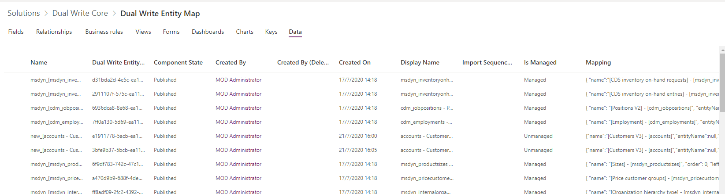
Dual Write Entity maps
Dual Write entity maps repository

Slide 4
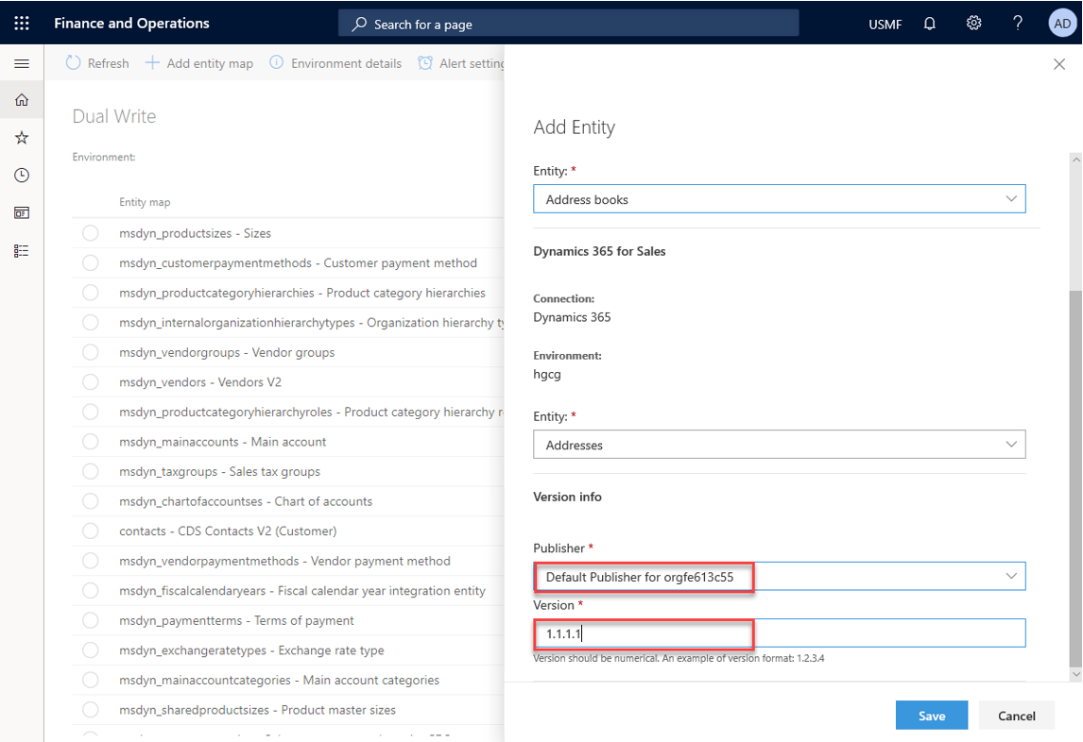
Dual-write table map Customizing standard maps
Dual-write lets you add table mappings.
You can also add standard or custom table maps.
A dual-write solution can contain one or more dual-write table maps.
Dual-write supports mappings only between cross-company tables or company-specific tables from both sides.

Slide 5
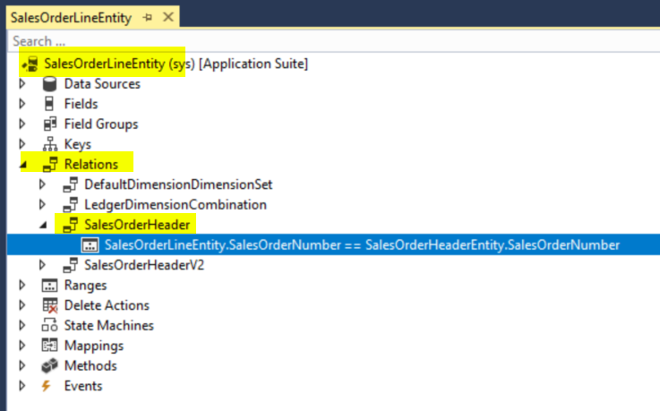
FO transactions Header and lines in the same transaction in FO
For any transaction, F&O creates data in a batch and sends it as a batch to Dataverse. If there are two records that are getting created as part of the same transaction and they reference each other, in that case the F&O users will see an error like this:
Unable to write data to entity x . Unable to lookup entity with values {xxxx}.Unable to lookup entity x with values {xxxx }.
Mitigation: Create Entity relationships within F&O to indicate the Dual-write platform that the two entities are linked and there are relationships that exist between the two records within the same transaction.

