Slide 1

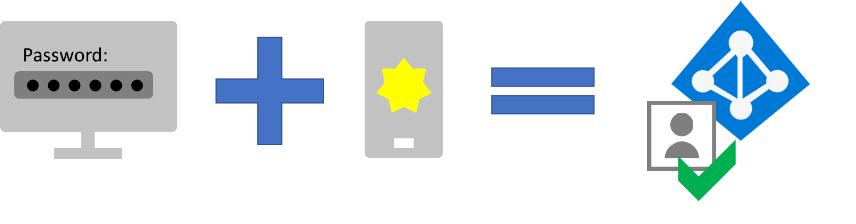



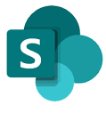
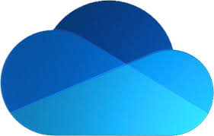




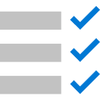
Empower remote workers with Microsoft 365
Features in Microsoft 365 and other Microsoft cloud services enable you to work from anywhere and at any time in a highly collaborative, productive, and secure way. Follow the steps below to empower remote workers.
Step 1. Increase sign-in security with multi-factor authentication and Conditional Access
Use Conditional Access to require remote workers to sign in using a password and an additional verification method such as Microsoft Authenticator, a phone call, or a text message.
Step 2. Provide remote access to on-premises apps and services
For many organizations, remote workers need access to both on-premises and cloud apps and resources.
Your organization
Microsoft 365
Microsoft 365
Microsoft 365 traffic
Teams
Exchange
SharePoint
OneDrive
On-premises AD DS forest
On-premises traffic
Application datacenters
Enrolled devices
Intune
Azure
On-premises resources include apps and services running on internal servers.
Remote worker
Microsoft 365 resources include productivity apps, the data stored in them, device management, and security services.
Use this flowchart to determine how to provide remote access:
Existing remote access VPN?
No
Want your
workers to use their personal computers?
No
Are all your on-premises apps web-based?
No
Use Azure Point-to-Site (P2S) VPN
Yes
Yes
Yes
Remote Desktop Services (RDS)
Configure split tunneling
Use Windows Virtual Desktop
Use Azure AD Application Proxy
Use an RDS Gateway to protect access to on-premises Windows devices and servers.
Step 3. Deploy security and compliance
Security
Office 365 Advanced Threat Protection (ATP) to protect your Microsoft 365 apps and data from attack
Malware protection for Windows 10, SharePoint files, and Exchange email
Microsoft Defender ATP to detect and respond to advanced cyberthreats
Cloud App Security to protect both Microsoft 365 and other SaaS apps
Azure Active Directory (Azure AD) Identity Protection to detect and remediate identity-based risks
docs.microsoft.com/microsoft-365/compliance/compliance-quick-tasks
Compliance
Sensitivity labels to classify your data for levels of protection
Data Loss Protection (DLP) to prevent inappropriate sharing of data
Conditional Access App Control to keep sensitive data off personal devices
Data retention labels and policies to implement data governance
Office message encryption (OME) for secure email to internal and external mailboxes
Communication Compliance to prevent inappropriate messages and Insider Risk Management to address malicious and inadvertent risks
Compliance Manager and Compliance Score (preview) to manage and improve your subscription’s compliance configuration
docs.microsoft.com/microsoft-365/security/top-security-tasks-for-remote-work
For deployment guidance, visit aka.ms/m365eremoteworkers
July 2020 © 2020 Microsoft Corporation. All rights reserved.
Notes:
To extend the graphics in this poster to include additional Office symbols sorted by category, see the 2019_PowerPoint_ArtTemplate.pptx file in the “2019_OfficeContent_ArtandPosterTemplates” download at https://go.microsoft.com/fwlink/?linkid=2056186.

Slide 2

Empower remote workers with Microsoft 365
Step 4. Deploy endpoint management
Microsoft Intune
Configuration Manager
Co-management
Desktop Analytics
Windows Autopilot
Use app protection policies for granular control over data and allow access only for the right people under the right conditions.
Deploy apps, software updates, and operating systems to manage desktops, servers, and laptops from on-premises or the cloud.
Attach your existing Configuration Manager deployment to the Microsoft 365 cloud to concurrently manage Windows 10 devices.
Use Desktop Analytics to inventory apps running in your organization and deploy Windows 10 to pilot and production-managed devices.
Simplify the lifecycle of Windows devices by pre-configuring new devices for production use and for resetting and recovering existing devices.
Microsoft Endpoint Manager includes Microsoft Intune and Configuration Manager.
Step 5. Deploy remote worker productivity apps and services
Microsoft Teams
Exchange Online and Outlook
SharePoint and OneDrive
Microsoft 365 Apps
Chat and conversations
Meetings, events, and conferences
Calling
Apps and workflows
Send and receive email
Manage calendars, contacts, and tasks
Migrate files to SharePoint and OneDrive
Collaborate on, store, and manage documents
Work from Teams, Office desktop apps, or a web browser
Create and co-author in real time on documents
Get the latest security and feature updates
Includes PCs and mobile devices such as smartphones and tablets.
Step 6. Train remote workers
Sign-in
How to use MFA with an additional verification method
How sign-ins can be blocked for users that use legacy authentication
How risky sign-ins can be blocked or force the employee to change their password
Remote access
How to use your organization’s remote access VPN client, an Azure virtual desktop, or RDS
Endpoint management
How endpoint management policies can be used to block access for non-compliant devices
The use of allowed apps and how app polices can be used to block the use of apps
How to use and interact with Windows 10 Enterprise security features
Productivity apps and services
How to install and use Microsoft 365 Apps
How to use Teams for chat, video-based conferencing, document sharing, and threaded conversations
How to use Outlook for email and scheduling
How to use SharePoint team or communication sites and OneDrive folders to browse and collaborate on files in a user's library and those belonging to a group
support.microsoft.com/training
For deployment guidance, visit aka.ms/m365eremoteworkers
July 2020 © 2020 Microsoft Corporation. All rights reserved.
Notes:
To extend the graphics in this poster to include additional Office symbols sorted by category, see the 2019_PowerPoint_ArtTemplate.pptx file in the “2019_OfficeContent_ArtandPosterTemplates” download at https://go.microsoft.com/fwlink/?linkid=2056186.

