Slide 1

Zava Retail Group Co. Marketing Principles
Core strategies driving successful retail marketing efforts
Notes:
---

Slide 2
Introduction
Notes:
Overview of Zava Retail Group and Marketing Focus

Slide 3
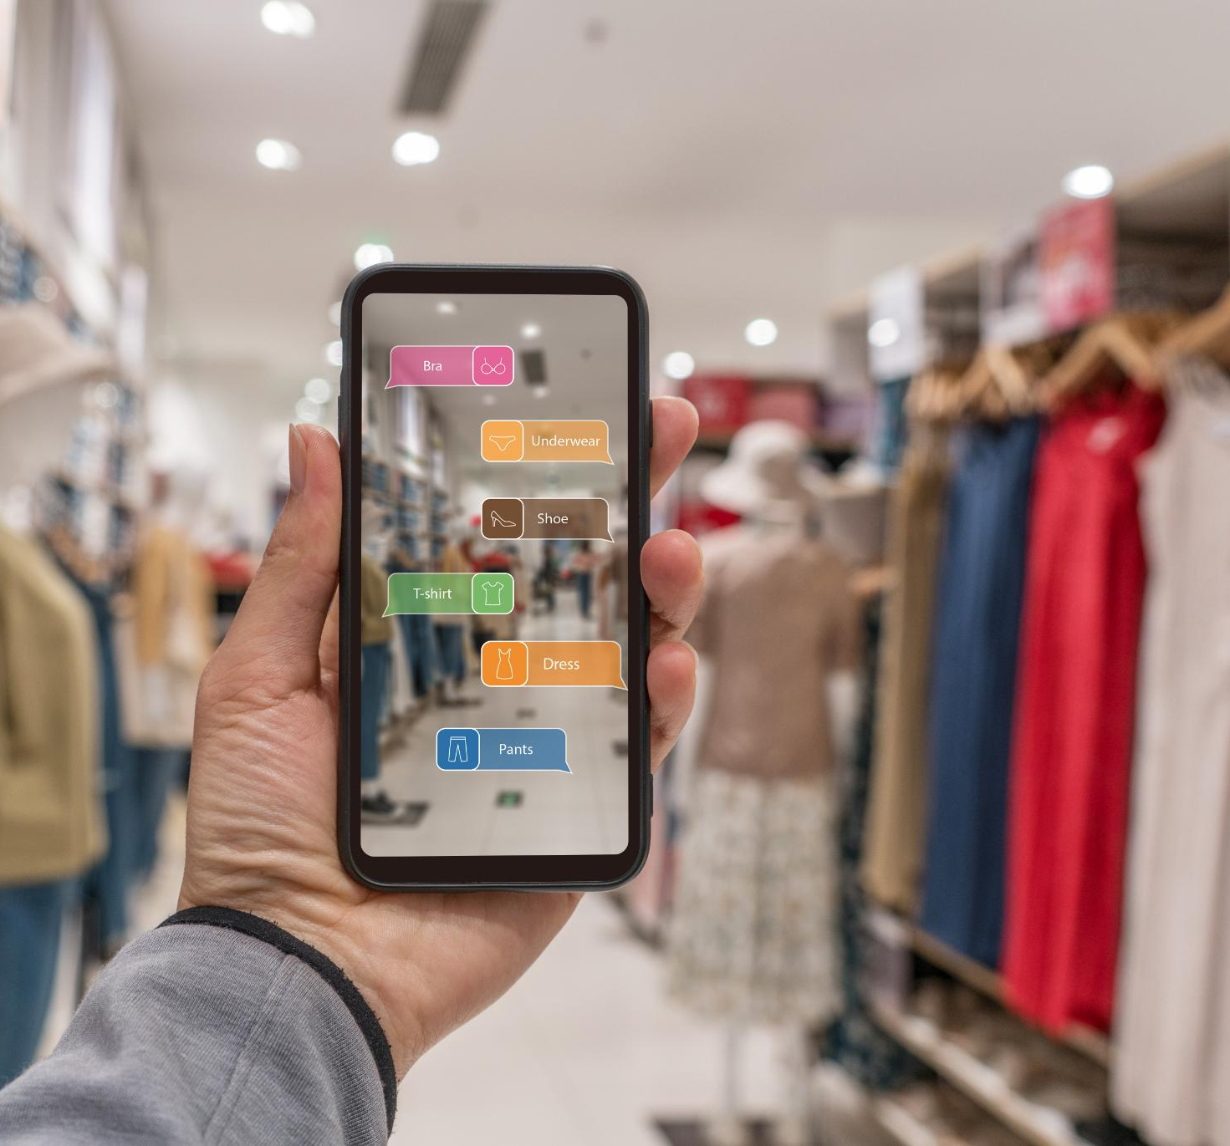
Overview of Zava Retail Group and Marketing Focus
Global Retail Operations
  Zava operates both physical stores and a growing e-commerce platform to reach global consumers effectively.
Unified Brand Presence
  The company focuses on creating a consistent brand experience across all physical and digital channels.
Data-Driven Marketing
  Leveraging data insights allows Zava to tailor marketing strategies to customer needs and preferences.
Customer-Centric Approach
  Maintaining customer focus ensures exceptional experiences and supports sustainable business growth.
Notes:
Zava Retail Group is a global retail company operating across brick-and-mortar stores and a rapidly growing e-commerce platform. The company’s marketing principles are designed to align with its vision of delivering exceptional customer experiences while driving sustainable growth. This introduction sets the stage for understanding how Zava integrates traditional retail strategies with modern digital marketing approaches. The focus is on creating a unified brand presence, leveraging data-driven insights, and maintaining customer-centricity in all marketing efforts. By combining physical and digital channels, Zava aims to meet evolving consumer expectations and strengthen its competitive position in the global retail market.

Slide 4
Customer-Centered Marketing
Notes:
Principles of Customer-Centricity

Slide 5

Principles of Customer-Centricity
Understanding Customer Needs
  Anticipating and understanding customer needs at every touchpoint builds trust and adds value consistently.
Personalized Experiences
  Tailoring recommendations, promotions, and communications enhances loyalty and long-term customer engagement.
Feedback and Data Analysis
  Actively listening to customer feedback and analyzing behavior helps refine offerings to exceed expectations.
Seamless Shopping Journey
  Creating a smooth and enjoyable shopping experience across online and in-store channels fosters customer satisfaction.
Notes:
Customer-centered marketing is the cornerstone of Zava’s strategy. It involves understanding and anticipating customer needs across all touchpoints, ensuring that every interaction adds value and builds trust. Zava prioritizes personalized experiences, tailoring product recommendations, promotions, and communications to individual preferences. This approach fosters loyalty and long-term engagement, which are critical for sustaining growth in a competitive retail environment. By actively listening to customer feedback and analyzing behavioral data, Zava continuously refines its offerings to exceed expectations. The ultimate goal is to create a seamless, enjoyable shopping journey that resonates with customers both online and in-store.

Slide 6
Omnichannel Strategy
Notes:
Integration of Physical and Digital Channels

Slide 7

Integration of Physical and Digital Channels
Unified Shopping Experience
  Zava integrates physical stores with e-commerce, creating a seamless shopping journey across channels.
Convenient Services
  Features like buy-online-pickup-in-store and easy returns provide convenience and flexibility for customers.
Consistent Brand Presence
  Consistent pricing, branding, and customer support reinforce trust across all shopping platforms.
Enhanced Customer Engagement
  Digital tools like apps, loyalty programs, and personalized emails increase customer interaction and retention.
Notes:
Zava’s omnichannel strategy ensures that customers experience a unified brand presence regardless of where they shop. This involves integrating brick-and-mortar stores with e-commerce platforms, enabling features such as buy-online-pickup-in-store (BOPIS) and seamless returns across channels. Consistent pricing, branding, and customer support are maintained to reinforce trust and convenience. Omnichannel marketing also leverages digital tools like mobile apps, loyalty programs, and personalized email campaigns to enhance engagement. By bridging the gap between physical and digital experiences, Zava creates a cohesive ecosystem that empowers customers to shop on their terms, improving satisfaction and retention.

Slide 8
Data-Driven Marketing
Notes:
Leveraging Analytics for Strategic Decisions

Slide 9

Leveraging Analytics for Strategic Decisions
Informed Marketing Decisions
  Data-driven marketing optimizes campaigns and boosts customer engagement through detailed analysis.
Predictive Analytics for Growth
  Predictive analytics forecast demand, personalize offers, and improve resource allocation.
Continuous Performance Evaluation
  Ongoing evaluation ensures marketing investments yield measurable returns and strategic agility.
Data-Driven Product Strategy
  Insights from data guide product development, pricing, and promotional planning for growth.
Notes:
Data-driven marketing enables Zava to make informed decisions that optimize campaigns and improve customer engagement. By analyzing sales data, loyalty program metrics, and sentiment feedback, Zava identifies trends and opportunities for growth. Predictive analytics help forecast demand, personalize offers, and allocate resources efficiently. This approach also supports continuous performance evaluation, ensuring that marketing investments deliver measurable returns. Data insights guide product development, pricing strategies, and promotional planning, creating a feedback loop that enhances agility and responsiveness in a dynamic retail landscape.

Slide 10
Brand Positioning
Notes:
Building a Strong Brand Identity

Slide 11
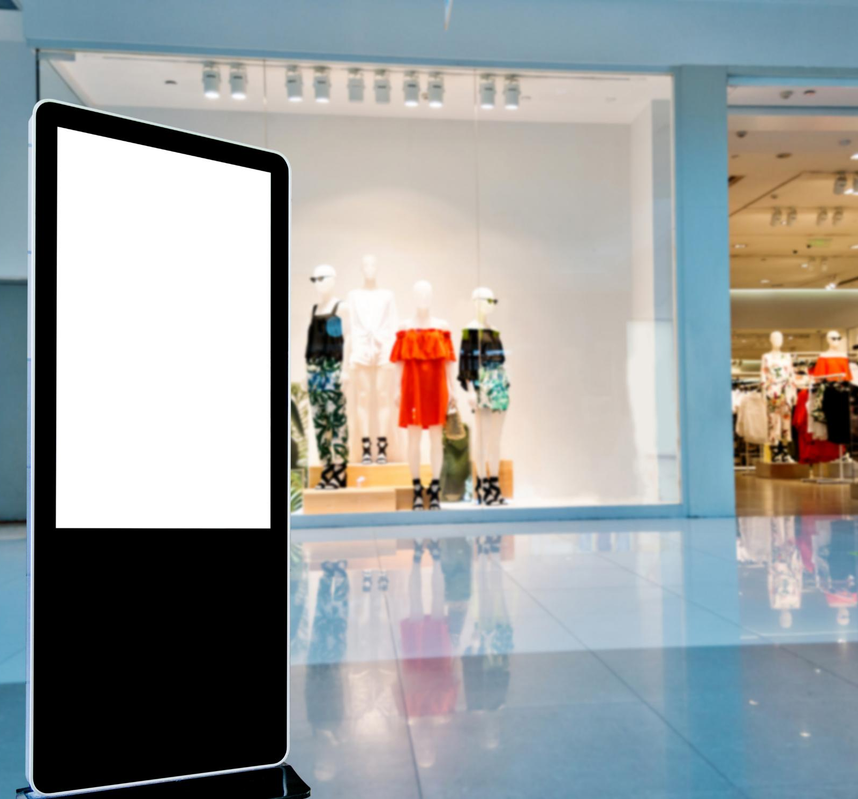
Building a Strong Brand Identity
Core Brand Values
  Zava emphasizes quality, convenience, and trust to create a strong brand foundation.
Consistent Brand Messaging
  Marketing communicates core values consistently across all channels including advertising and social media.
Customer Connection and Loyalty
  Zava builds emotional connections through superior service and immersive shopping experiences.
Market Differentiation
  Differentiation is achieved with curated products and high service standards in a competitive market.
Notes:
Zava’s brand positioning emphasizes quality, convenience, and trust. Marketing efforts focus on communicating these values consistently across all channels. The brand narrative highlights Zava’s commitment to customer satisfaction, innovation, and reliability. Differentiation is achieved through superior service standards, curated product assortments, and immersive shopping experiences. By reinforcing these attributes in advertising, social media, and in-store messaging, Zava strengthens its emotional connection with customers and builds long-term loyalty. Effective brand positioning ensures that Zava remains top-of-mind in a crowded marketplace.

Slide 12
Digital Engagement
Notes:
Maximizing Online Interaction

Slide 13

Maximizing Online Interaction
Multichannel Digital Marketing
  Using social media, email campaigns, and digital ads helps maintain brand visibility and customer relevance.
Engagement Through Interaction
  Interactive content and influencer partnerships create deeper audience connections and community engagement.
AI-Driven Customer Support
  Real-time AI assistants offer convenient support, enhancing responsiveness and customer satisfaction.
Feedback and Brand Trust
  Feedback mechanisms encourage participation, building trust and strengthening brand advocacy online.
Notes:
Digital engagement is critical for reaching today’s connected consumers. Zava leverages social media platforms, targeted email campaigns, and digital advertising to maintain visibility and relevance. Interactive content, influencer partnerships, and community-building initiatives foster deeper connections with audiences. Real-time support through AI-driven assistants enhances convenience and responsiveness, while feedback mechanisms encourage customer participation. By creating engaging digital experiences, Zava not only drives traffic and conversions but also strengthens brand advocacy and trust in an increasingly competitive online environment.

Slide 14
Conclusion
Notes:
Summary of Marketing Principles

Slide 15

Summary of Marketing Principles
Customer-Centric Approach
  Zava Retail prioritizes customer needs to create personalized and exceptional shopping experiences.
Omnichannel Integration
  The company seamlessly integrates multiple sales channels to provide a consistent brand experience.
Data-Driven Decision-Making
  Marketing strategies are guided by data analytics to optimize performance and customer engagement.
Brand Positioning and Digital Engagement
  Strong brand identity and active digital presence foster loyalty and sustainable growth.
Notes:
Zava Retail Group’s marketing principles revolve around customer-centricity, omnichannel integration, data-driven decision-making, strong brand positioning, and digital engagement. These pillars collectively support the company’s mission to deliver exceptional experiences, foster loyalty, and drive sustainable growth. By aligning marketing strategies with evolving consumer behaviors and technological advancements, Zava ensures its continued relevance and leadership in the global retail industry.

