Slide 1
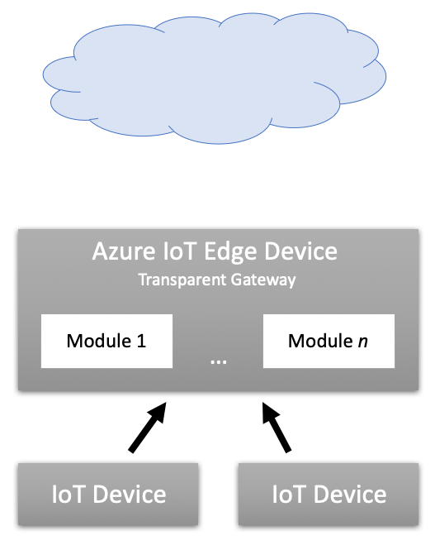

Azure IoT Hub
Internet

