Slide 1
BLACKOCEAN TECHNOLOGIES
Adherent Electrical Design Review
System interfaces and mechanical integration
Prepared for Adherent360
Automated Pharmaceutical Dispensing Unit
Current system architecture, 25 September 2026
Notes:
Project sources: SYS/ADHERENT_System_Wiring_Diagram.drawio; SYS/ADHERENT_Electrical_Tables.xlsx; brain.md. Current architecture: PSU1 24 V, SYSCTRL integrated 12 V SMPS and power connectors, CAN row control and RS485 IOCTRL. Unresolved interfaces retain TBC.

Slide 2
System interfaces
One 24 V PSU, SYSCTRL power conversion, CAN row control, RS485 door I/O and wired site Ethernet.
1
Gantry drives and sensors
2
SYSCTRL power conversion
3
CAN row controllers
4
Ethernet panel connection
5
RS485 door controller
6
Status indicator
7
iPad site-network access
8
Direct wiring and harnesses
9
NFC antenna and reader
10
Connector selection
Blackocean Technologies · Adherent360 APDU · Design review · 25 Sep 2026
2
Notes:
Project sources: SYS/ADHERENT_System_Wiring_Diagram.drawio; SYS/ADHERENT_Electrical_Tables.xlsx; brain.md. Current architecture: PSU1 24 V, SYSCTRL integrated 12 V SMPS and power connectors, CAN row control and RS485 IOCTRL. Unresolved interfaces retain TBC.

Slide 3

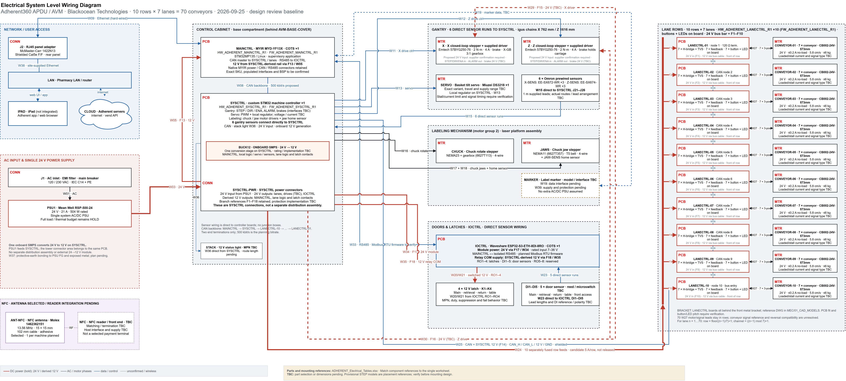



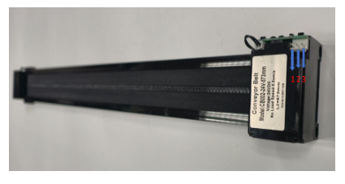
System architecture
70
2
2
1
conveyor lanes
10 rows × 7
custom boards
SYSCTRL · LANECTRL ×10
COTS controllers
MAINCTRL · IOCTRL
24 V system PSU
12 V generated on SYSCTRL
Boards
MAINCTRL ×1 and IOCTRL ×1 are COTS. SYSCTRL ×1 and LANECTRL ×10 are custom assemblies. Each lane row has seven motors, buttons and LEDs.
Power
PSU1 feeds SYSCTRL at 24 V. One onboard SMPS creates 12 V. Power distribution and connectors are part of SYSCTRL.
Comms
CAN links MAINCTRL, SYSCTRL and the ten LANECTRL boards. RS485 links MAINCTRL and IOCTRL. Ethernet connects the site network.
Connectors
Micro-Fit candidates on custom boards; native COTS connectors retained. Sensors run directly to controller boards.
ADHERENT_System_Wiring_Diagram.drawio and ADHERENT_Electrical_Tables.xlsx
Lane conveyor CB002-24V-573mm: 24 V, ≤ 0.2 A idle, 5.8 cm/s, ≤ 6 kg — 70 of them, one LANECTRL per row of 7.
Blackocean Technologies · Adherent360 APDU · Design review · 25 Sep 2026
3
Notes:
Project sources: SYS/ADHERENT_System_Wiring_Diagram.drawio; SYS/ADHERENT_Electrical_Tables.xlsx; brain.md. Current architecture: PSU1 24 V, SYSCTRL integrated 12 V SMPS and power connectors, CAN row control and RS485 IOCTRL. Unresolved interfaces retain TBC.

Slide 4

TOPIC 1 OF 6
Gantry drives from the mechanical BOM
PSU1 · 24 V system rail (drive use TBC)
ENGINEERING CHECKS
SYSCTRL
Control + alarms
Brake interface TBC
X / Z motors + supplied drivers
Brakes; X has 3:1 gearbox
Provide the exact motor, driver and brake datasheets.
Can the supplied driver meet the motion load at 24 V?
What are the STEP/DIR, ALARM and brake interfaces?
Can the sensor leads reach SYSCTRL directly?
6 sensors → SYSCTRL directly (W15)
Single 24 V architecture; exact drive compatibility and brake interface remain open.
Two Emtech 57BYG250-76 motors include supplied drivers and brakes. X uses a 3:1 gearbox.
Verify 24 V operation, driver input current, control levels and brake requirements.
Six gantry sensors connect directly to SYSCTRL. Confirm lead lengths and chain routing.
HOLD O01/O15: W11, W12, W15, W29, W30 and the full PSU budget.
Blackocean Technologies · Adherent360 APDU · Design review · 25 Sep 2026
4
Notes:
Project sources: SYS/ADHERENT_System_Wiring_Diagram.drawio; SYS/ADHERENT_Electrical_Tables.xlsx; brain.md. Current architecture: PSU1 24 V, SYSCTRL integrated 12 V SMPS and power connectors, CAN row control and RS485 IOCTRL. Unresolved interfaces retain TBC.

Slide 5

TOPIC 2 OF 6
Ethernet panel connection
INTEGRATION CHECKS
MAINCTRL
Native Ethernet port
J2 · McMaster
1422N13
Shielded Cat5e F/F
Site LAN
IT policy TBC
Confirm rear-panel placement and service access.
Agree DHCP or static addressing with site IT.
Confirm VLAN, firewall and server access requirements.
W09 internal patch · W38 external site cable · no internal switch
J2 selected: McMaster-Carr 1422N13, quantity 1 per machine.
J2 is the McMaster 1422N13 shielded Cat5e RJ45 female/female panel adapter.
Check its 24.13 mm panel cutout, fasteners and cable bend clearance.
W09 connects MAINCTRL to J2. W38 connects J2 to the site network.
J2 is selected in both BOMs. W09 is internal; W38 is the site-supplied cable.
Blackocean Technologies · Adherent360 APDU · Design review · 25 Sep 2026
5
Notes:
Project sources: SYS/ADHERENT_System_Wiring_Diagram.drawio; SYS/ADHERENT_Electrical_Tables.xlsx; brain.md. Current architecture: PSU1 24 V, SYSCTRL integrated 12 V SMPS and power connectors, CAN row control and RS485 IOCTRL. Unresolved interfaces retain TBC. Ethernet adapter: https://www.mcmaster.com/product/1422N13

Slide 6

TOPIC 3 OF 6
iPad access through the site network
INTEGRATION CHECKS
External iPad
Adherent app / browser
Site network
J2 / MAINCTRL
Wired Ethernet
Confirm application and server endpoints.
Define machine selection and account permissions.
Agree authentication ownership and session handling.
Adherent application / server endpoints TBC
The external iPad uses the Adherent app or browser on the site network.
MAINCTRL connects to the site network through J2.
The external iPad accesses the Adherent application through that network.
Authentication and device-to-machine association remain to be defined.
Application behavior remains to be implemented and tested.
Blackocean Technologies · Adherent360 APDU · Design review · 25 Sep 2026
6
Notes:
Project sources: SYS/ADHERENT_System_Wiring_Diagram.drawio; SYS/ADHERENT_Electrical_Tables.xlsx; brain.md. Current architecture: PSU1 24 V, SYSCTRL integrated 12 V SMPS and power connectors, CAN row control and RS485 IOCTRL. Unresolved interfaces retain TBC.

Slide 7

TOPIC 4 OF 6
Wire harness drawings
SYSCTRL
J21–J26
6 gantry sensors
W15 direct; route lengths TBC
ENGINEERING CHECKS
IOCTRL
DI1–DI5
5 door sensors
W23 direct; route lengths TBC
Measure direct sensor routes and check the supplied 1 m leads.
Confirm chain fill, bend radius and service loops.
Verify LANECTRL placement against the bracket DWG.
Release one pin-to-pin drawing per required harness.
LANECTRL ×10
70 conveyor leads W27
Bracket / feedback interface TBC
Sensors connect directly to SYSCTRL and IOCTRL; no junction boxes.
W15 carries six direct gantry sensor runs to SYSCTRL. W23 carries five direct door sensor runs to IOCTRL.
W04, W06 and W07 are internal SYSCTRL connections.
Finalize external harness routes, conductor sizes, mating connectors and service loops.
HOLD O06/O12/O15: no blanket 22 AWG or parallel-pin current rating.
Blackocean Technologies · Adherent360 APDU · Design review · 25 Sep 2026
7
Notes:
Project sources: SYS/ADHERENT_System_Wiring_Diagram.drawio; SYS/ADHERENT_Electrical_Tables.xlsx; brain.md. Current architecture: PSU1 24 V, SYSCTRL integrated 12 V SMPS and power connectors, CAN row control and RS485 IOCTRL. Unresolved interfaces retain TBC.

Slide 8

TOPIC 5 OF 6
NFC antenna and reader
INTEGRATION CHECKS
ANT-NFC
Molex 1462362151
15 × 15 mm, 102 mm cable
NFC reader / front end
Selection pending
RF matching / supply TBC
Confirm the reading position and surrounding metal.
Select a compatible reader/front-end.
Define RF termination, host interface and power.
Validate reading range in the final enclosure.
Host interface and board allocation TBC
Selected antenna: Molex 1462362151, one per machine.
ANT-NFC is Molex 1462362151: 13.56 MHz, 15 × 15 × 0.27 mm, adhesive mounting and 102 mm cable.
The NFC reader/front-end remains to be selected.
Host interface, supply voltage and RF matching remain unassigned.
Antenna selected. Reader integration and mounting remain open.
Blackocean Technologies · Adherent360 APDU · Design review · 25 Sep 2026
8
Notes:
Project sources: SYS/ADHERENT_System_Wiring_Diagram.drawio; SYS/ADHERENT_Electrical_Tables.xlsx; brain.md. Current architecture: PSU1 24 V, SYSCTRL integrated 12 V SMPS and power connectors, CAN row control and RS485 IOCTRL. Unresolved interfaces retain TBC. NFC source: https://www.molex.com/en-us/products/part-detail/1462362151 and https://www.digikey.com/en/products/detail/molex/1462362151/15204370

Slide 9
TOPIC 6 OF 6
Connector standard
CUSTOM BOARDS
Match PCB connector MPNs
Verify mates and current limits
COTS BOARDS
Native MYIR / Waveshare connectors
Verify pinouts
PANEL / POWER
J2: 1422N13
Mains / protection selection pending
ENGINEERING CHECKS
Approve exact mating housings, contacts and keying.
Validate gauge, temperature rise and voltage drop.
Confirm service access and panel cutouts.
Do not treat a generic per-pin rating as harness approval.
Connector families are candidates until mating and current checks are complete.
Custom PCB connector selections must match their actual schematics and mating harnesses.
MYIR and Waveshare boards retain their native connectors. J2 is McMaster 1422N13.
SYSCTRL contains its power routing and connectors. Verify ratings, pinouts and mounting access.
HOLD O03/O05/O06: conveyor feedback, H-bridge/TVS coordination and protection.
Blackocean Technologies · Adherent360 APDU · Design review · 25 Sep 2026
9
Notes:
Project sources: SYS/ADHERENT_System_Wiring_Diagram.drawio; SYS/ADHERENT_Electrical_Tables.xlsx; brain.md. Current architecture: PSU1 24 V, SYSCTRL integrated 12 V SMPS and power connectors, CAN row control and RS485 IOCTRL. Unresolved interfaces retain TBC.

Slide 10
Remaining integration work
OPEN
Gantry drives
OPEN
SYSCTRL power
24 V compatibility and brake/control levels
Onboard SMPS sizing and branch protection
OPEN
CAN network
OPEN
Ethernet
Termination and backbone wiring validation
J2: 1422N13. Site IT policy pending
OPEN
RS485 door I/O
OPEN
Status indicator
IOCTRL protocol and native pinouts
Select STACK model and confirm W36 route
OPEN
iPad access
OPEN
Harnesses
Site network and application authentication
Direct sensor runs, route lengths and fit
OPEN
NFC
OPEN
Connectors
1462362151 selected. Reader interface TBC
Exact mates, conductor sizes and ratings
Open items: drive data, converter sizing, protection, harness validation and NFC reader selection.
Notes:
Project sources: SYS/ADHERENT_System_Wiring_Diagram.drawio; SYS/ADHERENT_Electrical_Tables.xlsx; brain.md. Current architecture: PSU1 24 V, SYSCTRL integrated 12 V SMPS and power connectors, CAN row control and RS485 IOCTRL. Unresolved interfaces retain TBC.

