Slide 1
BLACKOCEAN TECHNOLOGIES
APDU Electrical Design Review
Aligned architecture, BOM and engineering release gates
Prepared for Adherent360
Automated Pharmaceutical Dispensing Unit (AVM)
Baseline: Electrical System Level Wiring Diagram R27 · 24 September 2026
Notes:
R27 design review, 2026-09-24. Source: APDU_Electrical_Tables_R27.xlsx (BOM, Power, OpenItems and Sources). Confirmed project scope: single 24 V system PSU, SYSCTRL-derived 12 V, direct sensor wiring without junction boxes. Engineering release remains on hold. Supplier references: https://www.meanwell.com/Upload/PDF/RSP-500/RSP-500-SPEC.PDF ; https://www.myirtech.com/list.asp?id=727 ; https://www.waveshare.com/wiki/ESP32-S3-ETH-8DI-8RO ; https://www.mcmaster.com/product/1422N13

Slide 2










Review topics and meeting decisions
Confirmed: one 24 V PSU · on-board 12 V conversion · direct sensor wiring · no junction boxes · COTS MAINCTRL and IOCTRL.
1
Gantry drives from the mechanical BOM
2
Camera and OCR: needed?
3
UPS / battery: not approved
4
Ethernet port location
5
Cellular: not approved
6
Product illumination
7
iPad connection: QR, Wi-Fi or BLE
8
Wire harness drawings
9
NFC and card reader
10
Connector standard
Blackocean Technologies · Adherent360 APDU · Design review · 24 Sep 2026
2
Notes:
R27 design review, 2026-09-24. Source: APDU_Electrical_Tables_R27.xlsx (BOM, Power, OpenItems and Sources). Confirmed project scope: single 24 V system PSU, SYSCTRL-derived 12 V, direct sensor wiring without junction boxes. Engineering release remains on hold. Supplier references: https://www.meanwell.com/Upload/PDF/RSP-500/RSP-500-SPEC.PDF ; https://www.myirtech.com/list.asp?id=727 ; https://www.waveshare.com/wiki/ESP32-S3-ETH-8DI-8RO ; https://www.mcmaster.com/product/1422N13

Slide 3

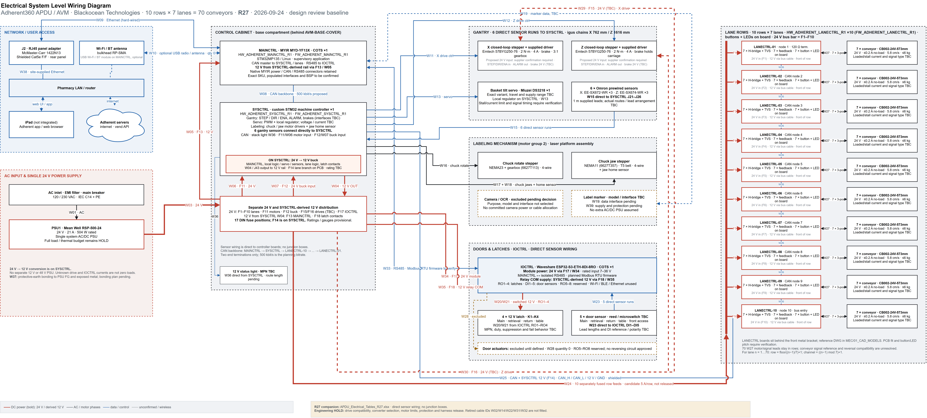

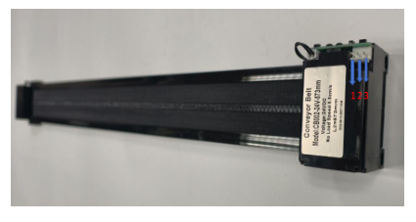
Architecture baseline (R27)
70
2
2
31
conveyor lanes
10 rows × 7
custom boards
SYSCTRL · LANECTRL ×10
COTS controllers
MAINCTRL · IOCTRL
required cable types
5 routes need lengths
Boards
MAINCTRL ×1 and IOCTRL ×1 are COTS. SYSCTRL ×1 and LANECTRL ×10 are custom assemblies. Each lane row has seven motors, buttons and LEDs.
Power
One 24 V / 21 A PSU. SYSCTRL generates 12 V. IOCTRL uses 24 V module power plus separate 12 V relay contacts.
Comms
CAN: MAINCTRL → SYSCTRL → lane rows. Separate RS485 to IOCTRL. Wired site Ethernet; Wi-Fi/BLE remains optional.
Connectors
Micro-Fit candidates on custom boards; native COTS connectors retained. Sensors run directly to controller boards.
Electrical System Level Wiring Diagram R27 · APDU_Electrical_Tables_R27.xlsx · engineering release remains HOLD
Lane conveyor CB002-24V-573mm: 24 V, ≤ 0.2 A idle, 5.8 cm/s, ≤ 6 kg — 70 of them, one LANECTRL per row of 7.
Blackocean Technologies · Adherent360 APDU · Design review · 24 Sep 2026
3
Notes:
R27 design review, 2026-09-24. Source: APDU_Electrical_Tables_R27.xlsx (BOM, Power, OpenItems and Sources). Confirmed project scope: single 24 V system PSU, SYSCTRL-derived 12 V, direct sensor wiring without junction boxes. Engineering release remains on hold. Supplier references: https://www.meanwell.com/Upload/PDF/RSP-500/RSP-500-SPEC.PDF ; https://www.myirtech.com/list.asp?id=727 ; https://www.waveshare.com/wiki/ESP32-S3-ETH-8DI-8RO ; https://www.mcmaster.com/product/1422N13

Slide 4

TOPIC 1 OF 10
Gantry drives from the mechanical BOM
PSU1 · 24 V system rail (drive use TBC)
QUESTIONS FOR ADHERENT360
SYSCTRL
Control + alarms
Brake interface TBC
X / Z motors + supplied drivers
Brakes; X has 3:1 gearbox
Provide the exact motor, driver and brake datasheets.
Can the supplied driver meet the motion load at 24 V?
What are the STEP/DIR, ALARM and brake interfaces?
Can the sensor leads reach SYSCTRL directly?
6 sensors → SYSCTRL directly (W15)
Single 24 V architecture; exact drive compatibility and brake interface remain open.
Emtech 57BYG250-76: two motors with supplied drivers and brakes; X has a 3:1 gearbox. Driver packaging is unconfirmed.
No separate 48 V PSU. Verify 24 V operation, supply input current, signals and brake requirements.
Six gantry sensors wire directly to SYSCTRL. Lead lengths and chain routing need confirmation.
HOLD O01/O15: W11, W12, W15, W29, W30 and the full PSU budget.
Blackocean Technologies · Adherent360 APDU · Design review · 24 Sep 2026
4
Notes:
R27 design review, 2026-09-24. Source: APDU_Electrical_Tables_R27.xlsx (BOM, Power, OpenItems and Sources). Confirmed project scope: single 24 V system PSU, SYSCTRL-derived 12 V, direct sensor wiring without junction boxes. Engineering release remains on hold. Supplier references: https://www.meanwell.com/Upload/PDF/RSP-500/RSP-500-SPEC.PDF ; https://www.myirtech.com/list.asp?id=727 ; https://www.waveshare.com/wiki/ESP32-S3-ETH-8DI-8RO ; https://www.mcmaster.com/product/1422N13

Slide 5
TOPIC 2 OF 10
Camera and OCR: is it needed?
LABELING STATION
Bottle orientation method pending
Mechanical reference / sensor / vision
CAMERA / OCR
Excluded; quantity 0
QUESTIONS FOR ADHERENT360
Is a camera needed at all: bottle orientation for marking, dispense verification, or an audit photo?
If yes: read text (OCR), or only find a mark or the label edge?
USB or Ethernet camera, and where does it mount: labeling station or retrieval bay?
Are images stored? Labels carry patient data, so retention and encryption rules apply.
MAINCTRL interface and ports
TBC after product selection
Camera/OCR is excluded; no reserved port or mounting space has been verified.
Camera/OCR remains outside the approved baseline. No camera, ring light or cable is procured.
Available MYIR ports and processing capacity must be checked against the selected board and marker.
Bottle orientation still needs a defined mechanical reference, sensor or vision solution.
Affects: MAINCTRL software scope, ring light and 24 V budget, one cable, labeling-station bracket.
Blackocean Technologies · Adherent360 APDU · Design review · 24 Sep 2026
5
Notes:
R27 design review, 2026-09-24. Source: APDU_Electrical_Tables_R27.xlsx (BOM, Power, OpenItems and Sources). Confirmed project scope: single 24 V system PSU, SYSCTRL-derived 12 V, direct sensor wiring without junction boxes. Engineering release remains on hold. Supplier references: https://www.meanwell.com/Upload/PDF/RSP-500/RSP-500-SPEC.PDF ; https://www.myirtech.com/list.asp?id=727 ; https://www.waveshare.com/wiki/ESP32-S3-ETH-8DI-8RO ; https://www.mcmaster.com/product/1422N13

Slide 6
TOPIC 3 OF 10
UPS and battery backup
MEETING DECISION
AC mains
PSU1
24 V / 21 A
System loads
Not approved during the meeting.
UPS and battery backup are not required.
Excluded from the electrical design.
UPS and battery backup excluded by customer decision
Current power architecture; UPS and battery exclusion remains the meeting decision.
The customer rejected UPS and battery backup.
The baseline uses one AC-fed 24 V system power supply.
Power-loss recovery and safe motion/door states still need implementation and testing.
Closed: no UPS or backup battery in the R27 drawing.
Blackocean Technologies · Adherent360 APDU · Design review · 24 Sep 2026
6
Notes:
R27 design review, 2026-09-24. Source: APDU_Electrical_Tables_R27.xlsx (BOM, Power, OpenItems and Sources). Confirmed project scope: single 24 V system PSU, SYSCTRL-derived 12 V, direct sensor wiring without junction boxes. Engineering release remains on hold. Supplier references: https://www.meanwell.com/Upload/PDF/RSP-500/RSP-500-SPEC.PDF ; https://www.myirtech.com/list.asp?id=727 ; https://www.waveshare.com/wiki/ESP32-S3-ETH-8DI-8RO ; https://www.mcmaster.com/product/1422N13

Slide 7
TOPIC 4 OF 10
Ethernet panel connection
QUESTIONS FOR ADHERENT360
MAINCTRL
Native Ethernet port
J2 · McMaster
1422N13
Shielded Cat5e F/F
Site LAN
IT policy TBC
Confirm panel placement and cable bend clearance.
DHCP or static IP; VLAN and firewall rules?
Select the label marker and its interface.
Is optional Wi-Fi/BLE actually required?
W09 internal patch · W38 external site cable · no internal switch
J2 selected: McMaster-Carr 1422N13, quantity 1 per machine.
Shielded Cat5e RJ45 female/female adapter; black plastic housing; mounting fasteners included.
Rear panel: 0.95 in (24.13 mm) cutout; check mounting drawing and service clearance.
MAINCTRL connects by an internal patch cable. No cabinet Ethernet switch. Optional radio hardware is not procured.
J2 is selected in both BOMs. W09 is internal; W38 is the site-supplied cable.
Blackocean Technologies · Adherent360 APDU · Design review · 24 Sep 2026
7
Notes:
R27 design review, 2026-09-24. Source: APDU_Electrical_Tables_R27.xlsx (BOM, Power, OpenItems and Sources). Confirmed project scope: single 24 V system PSU, SYSCTRL-derived 12 V, direct sensor wiring without junction boxes. Engineering release remains on hold. Supplier references: https://www.meanwell.com/Upload/PDF/RSP-500/RSP-500-SPEC.PDF ; https://www.myirtech.com/list.asp?id=727 ; https://www.waveshare.com/wiki/ESP32-S3-ETH-8DI-8RO ; https://www.mcmaster.com/product/1422N13

Slide 8
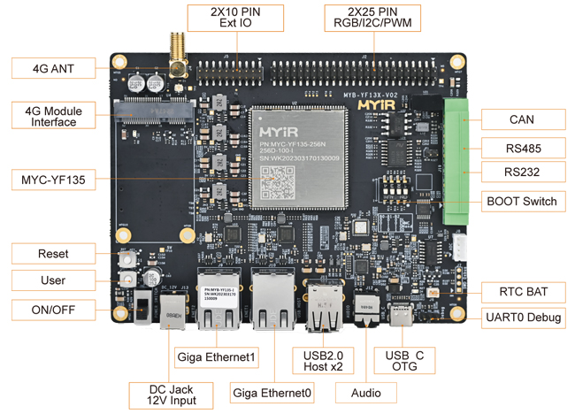
TOPIC 5 OF 10
Cellular (LTE) modem
MEETING DECISION
Not approved during the meeting.
Cellular connectivity is not required.
Excluded from the electrical design.
MYIR MYD-YF13X MAINCTRL board. Cellular hardware will not be fitted.
The customer rejected cellular connectivity during the meeting.
The site network carries the vend API and remote service.
No cellular modem, SIM, data plan or LTE antennas are included.
Closed: no cellular connection in the R27 drawing.
Blackocean Technologies · Adherent360 APDU · Design review · 24 Sep 2026
8
Notes:
R27 design review, 2026-09-24. Source: APDU_Electrical_Tables_R27.xlsx (BOM, Power, OpenItems and Sources). Confirmed project scope: single 24 V system PSU, SYSCTRL-derived 12 V, direct sensor wiring without junction boxes. Engineering release remains on hold. Supplier references: https://www.meanwell.com/Upload/PDF/RSP-500/RSP-500-SPEC.PDF ; https://www.myirtech.com/list.asp?id=727 ; https://www.waveshare.com/wiki/ESP32-S3-ETH-8DI-8RO ; https://www.mcmaster.com/product/1422N13

Slide 9
TOPIC 6 OF 10
Product illumination
INTERIOR LIGHTING
Quantity 0
Zones, voltage and power pending customer approval
STATUS LIGHT
Required: quantity 1
SYSCTRL W36
Model and route length TBC
QUESTIONS FOR ADHERENT360
Which zones need light?
For the customer through a window, or for staff during restocking?
Always on, or only on events?
Neutral white, or a status colour at the retrieval bay?
Interior lighting remains a proposal; zero committed quantity and budget.
No interior lighting zones are included in the baseline.
If approved, select voltage, strip power and output drivers before adding load to the SYSCTRL converter.
The separate status light remains a required item; its model and W36 route are open.
Affects: SYSCTRL outputs, 12 V budget, row harness routing.
Blackocean Technologies · Adherent360 APDU · Design review · 24 Sep 2026
9
Notes:
R27 design review, 2026-09-24. Source: APDU_Electrical_Tables_R27.xlsx (BOM, Power, OpenItems and Sources). Confirmed project scope: single 24 V system PSU, SYSCTRL-derived 12 V, direct sensor wiring without junction boxes. Engineering release remains on hold. Supplier references: https://www.meanwell.com/Upload/PDF/RSP-500/RSP-500-SPEC.PDF ; https://www.myirtech.com/list.asp?id=727 ; https://www.waveshare.com/wiki/ESP32-S3-ETH-8DI-8RO ; https://www.mcmaster.com/product/1422N13

Slide 10
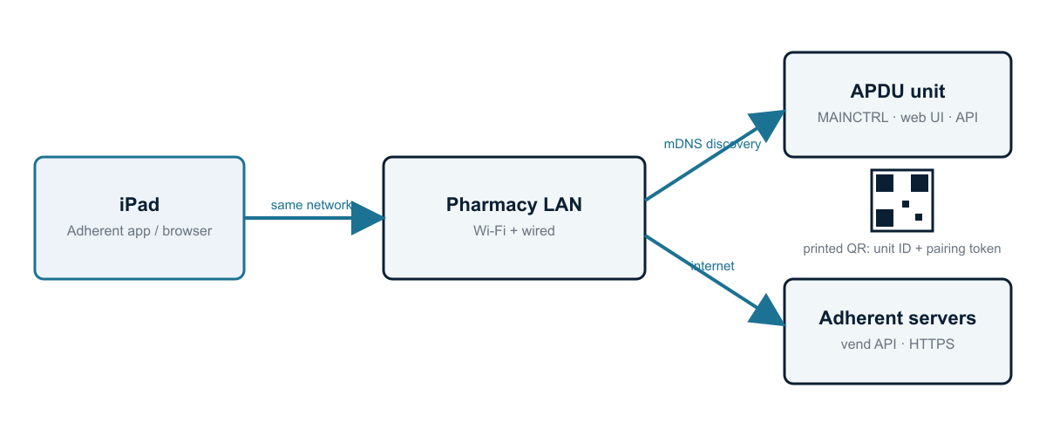
TOPIC 7 OF 10
iPad connection: QR code, Wi-Fi or BLE
QUESTIONS FOR ADHERENT360
Will the iPad be on the pharmacy Wi-Fi, or must it work without the site network?
Printed QR code acceptable, or a dynamic code on the unit?
How many units per pharmacy?
Who owns authentication: the Adherent cloud or a local login?
Proposed flow: site LAN and QR onboarding; authentication design remains open.
The external iPad uses the site network and the Adherent app or browser.
QR onboarding and local discovery are proposals, not implemented security controls.
BLE requires approved radio hardware and firmware. The wired baseline does not include it.
Affects: MAINCTRL software scope, cabinet label, antenna placement.
Blackocean Technologies · Adherent360 APDU · Design review · 24 Sep 2026
10
Notes:
R27 design review, 2026-09-24. Source: APDU_Electrical_Tables_R27.xlsx (BOM, Power, OpenItems and Sources). Confirmed project scope: single 24 V system PSU, SYSCTRL-derived 12 V, direct sensor wiring without junction boxes. Engineering release remains on hold. Supplier references: https://www.meanwell.com/Upload/PDF/RSP-500/RSP-500-SPEC.PDF ; https://www.myirtech.com/list.asp?id=727 ; https://www.waveshare.com/wiki/ESP32-S3-ETH-8DI-8RO ; https://www.mcmaster.com/product/1422N13

Slide 11
TOPIC 8 OF 10
Wire harness drawings
SYSCTRL
J21–J26
6 gantry sensors
W15 direct; route lengths TBC
QUESTIONS FOR ADHERENT360
IOCTRL
DI1–DI5
5 door sensors
W23 direct; route lengths TBC
Measure direct sensor routes and check the supplied 1 m leads.
Confirm chain fill, bend radius and service loops.
Verify LANECTRL placement against the bracket DWG.
Release one pin-to-pin drawing per required harness.
LANECTRL ×10
70 conveyor leads W27
Bracket / feedback interface TBC
Sensors connect directly to SYSCTRL and IOCTRL; no junction boxes.
W15: six direct gantry sensor runs. W23: five direct door sensor runs. W14 and W22 are retired.
W01–W39 retain stable identifiers: 31 required cable types. Five required route lengths are still unknown.
111 m is only the known routing subtotal, not a cutting or purchase length. Finalize gauge, pinout, mates and service loops.
HOLD O06/O12/O15: no blanket 22 AWG or parallel-pin current rating.
Blackocean Technologies · Adherent360 APDU · Design review · 24 Sep 2026
11
Notes:
R27 design review, 2026-09-24. Source: APDU_Electrical_Tables_R27.xlsx (BOM, Power, OpenItems and Sources). Confirmed project scope: single 24 V system PSU, SYSCTRL-derived 12 V, direct sensor wiring without junction boxes. Engineering release remains on hold. Supplier references: https://www.meanwell.com/Upload/PDF/RSP-500/RSP-500-SPEC.PDF ; https://www.myirtech.com/list.asp?id=727 ; https://www.waveshare.com/wiki/ESP32-S3-ETH-8DI-8RO ; https://www.mcmaster.com/product/1422N13

Slide 12
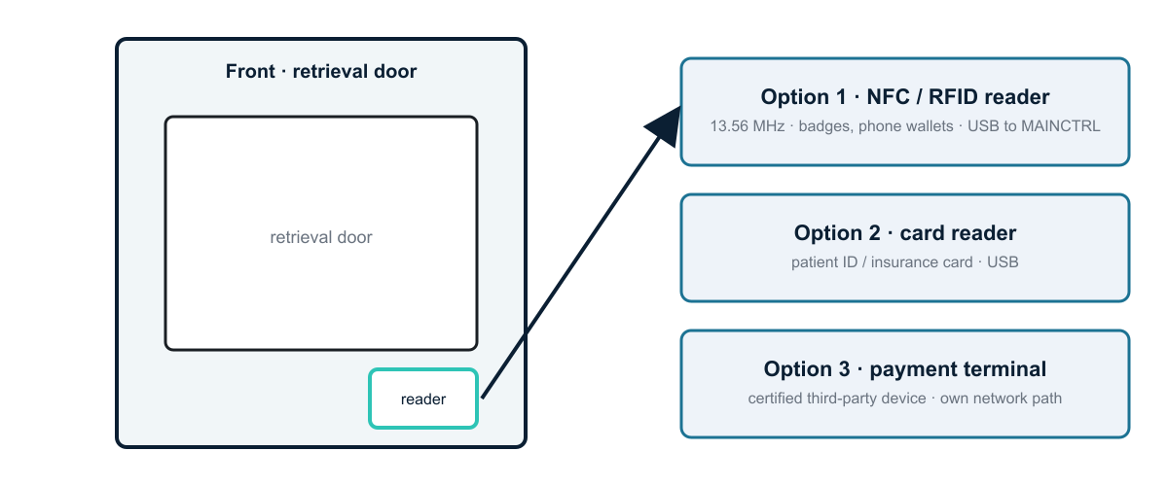
TOPIC 9 OF 10
NFC and card reader
QUESTIONS FOR ADHERENT360
Use case: staff login, patient pickup, or payment?
Which card: badge, patient ID, insurance, credit, phone wallet?
Where should the reader sit?
Validated in the Adherent cloud, or locally?
NFC and payment hardware remain excluded; select the product before panel design.
No NFC, RFID or payment terminal is included in the baseline BOM.
Choose the use case and certified product/interface before reserving a panel opening or MAINCTRL port.
Budget power, network integration and data handling only after the requirement is approved.
Affects: MAINCTRL USB ports, front-panel cut-out, security scope.
Blackocean Technologies · Adherent360 APDU · Design review · 24 Sep 2026
12
Notes:
R27 design review, 2026-09-24. Source: APDU_Electrical_Tables_R27.xlsx (BOM, Power, OpenItems and Sources). Confirmed project scope: single 24 V system PSU, SYSCTRL-derived 12 V, direct sensor wiring without junction boxes. Engineering release remains on hold. Supplier references: https://www.meanwell.com/Upload/PDF/RSP-500/RSP-500-SPEC.PDF ; https://www.myirtech.com/list.asp?id=727 ; https://www.waveshare.com/wiki/ESP32-S3-ETH-8DI-8RO ; https://www.mcmaster.com/product/1422N13

Slide 13
TOPIC 10 OF 10
Connector standard
CUSTOM BOARDS
Micro-Fit candidates
Mating set and current rating pending
COTS BOARDS
Native MYIR / Waveshare connectors
Verify pinouts
PANEL / POWER
J2: 1422N13
Mains / protection selection pending
QUESTIONS FOR ADHERENT360
Approve exact mating housings, contacts and keying.
Validate gauge, temperature rise and voltage drop.
Confirm service access and panel cutouts.
Do not treat a generic per-pin rating as harness approval.
Connector families are candidates until mating and current checks are complete.
Custom PCBs prefer Micro-Fit 3.0. COTS MYIR and Waveshare boards retain their native connectors.
J2 is McMaster 1422N13. Mains entry, power connectors, fuse holders and crimps still need final coordination.
No junction boxes. Lane buttons and LEDs are PCB-mounted; bracket geometry must match the DWG.
HOLD O03/O05/O06: conveyor feedback, H-bridge/TVS coordination and protection.
Blackocean Technologies · Adherent360 APDU · Design review · 24 Sep 2026
13
Notes:
R27 design review, 2026-09-24. Source: APDU_Electrical_Tables_R27.xlsx (BOM, Power, OpenItems and Sources). Confirmed project scope: single 24 V system PSU, SYSCTRL-derived 12 V, direct sensor wiring without junction boxes. Engineering release remains on hold. Supplier references: https://www.meanwell.com/Upload/PDF/RSP-500/RSP-500-SPEC.PDF ; https://www.myirtech.com/list.asp?id=727 ; https://www.waveshare.com/wiki/ESP32-S3-ETH-8DI-8RO ; https://www.mcmaster.com/product/1422N13

Slide 14
Decisions and engineering release gates
OPEN
Gantry drives
OPEN
Camera / OCR
24 V compatibility · exact drive / brake data
needed at all · purpose · USB vs Ethernet
OUT
Backup power
OPEN
Network
Not approved in the meeting. Not required.
J2: McMaster 1422N13 · site IT policy open
OUT
Cellular
OPEN
Lighting
Not approved in the meeting. Not required.
zones · event-driven vs always on · colour
OPEN
iPad pairing
OPEN
Harnesses
LAN + QR (recommended) vs AP mode vs BLE
direct sensor runs · lengths · bracket fit
OPEN
NFC / card
OPEN
Connectors
use case · card type · location
mates / gauge · protection · current limits
R27 documents are aligned. Release waits for drive data, converter sizing, measured loads, protection and direct-harness validation.
Notes:
R27 design review, 2026-09-24. Source: APDU_Electrical_Tables_R27.xlsx (BOM, Power, OpenItems and Sources). Confirmed project scope: single 24 V system PSU, SYSCTRL-derived 12 V, direct sensor wiring without junction boxes. Engineering release remains on hold. Supplier references: https://www.meanwell.com/Upload/PDF/RSP-500/RSP-500-SPEC.PDF ; https://www.myirtech.com/list.asp?id=727 ; https://www.waveshare.com/wiki/ESP32-S3-ETH-8DI-8RO ; https://www.mcmaster.com/product/1422N13

