Slide 1
BLACKOCEAN TECHNOLOGIES
APDU Electrical Design Review
Open questions to close before schematics start
Prepared for Adherent360
Automated Pharmaceutical Dispensing Unit (AVM)
Baseline: Electrical System Level Wiring Diagram R23 · 11 September 2026

Slide 2










Ten topics, one decision each
Already closed: no E-stop (vending machine) · table-door actuator out of scope · MAINCTRL and DOORIO are off-the-shelf boards.
1
Gantry drives from the mechanical BOM
2
Camera and OCR: needed?
3
UPS and battery backup
4
Ethernet port location
5
Cellular (LTE) modem: needed?
6
Product illumination
7
iPad connection: QR, Wi-Fi or BLE
8
Wire harness drawings
9
NFC and card reader
10
Connector standard
Blackocean Technologies · Adherent360 APDU · Design review · 11 Sep 2026
2

Slide 3
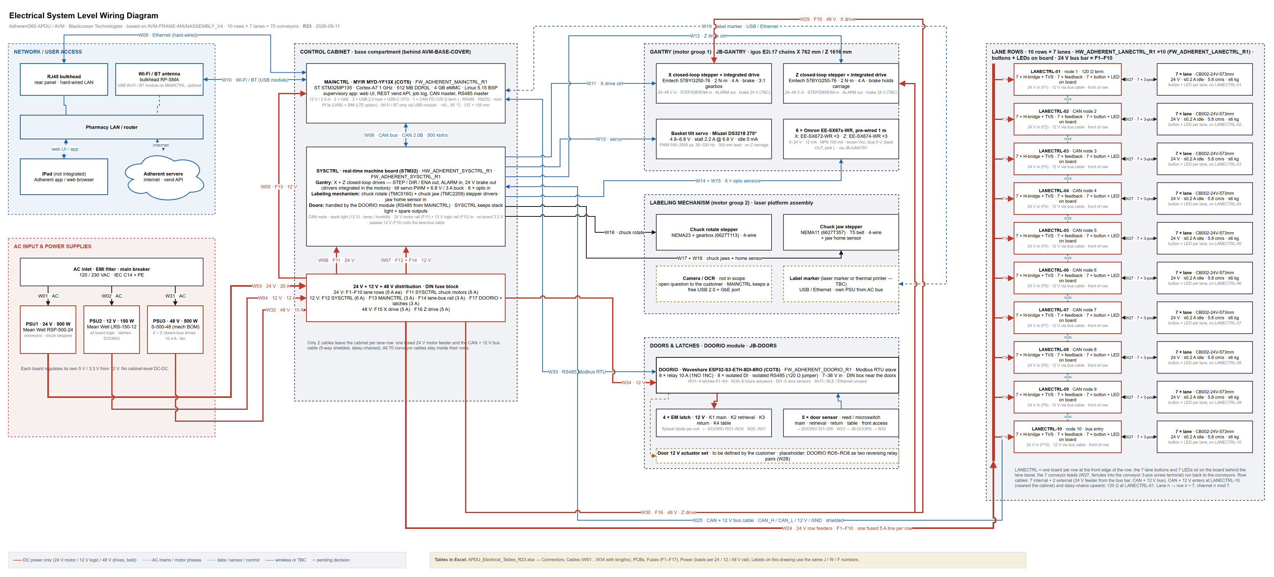


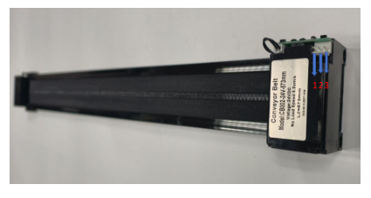
Architecture baseline (R23)
70
2
2
34
conveyor lanes
10 rows × 7
custom boards
SYSCTRL · LANECTRL ×10
COTS controllers
MAINCTRL · DOORIO
cables W01–W34
≈ 125 m
Boards
MAINCTRL = COTS MYIR MYD-YF13X (STM32MP135, Linux) · SYSCTRL custom STM32 (gantry + labeling) · DOORIO = COTS relay / IO module on RS485 · LANECTRL ×10 custom, our design, with the lane buttons and LEDs on the board.
Power
24 V motor rail · 12 V logic rail for every board · 48 V for the gantry drives · DIN fuses F1–F17.
Comms
CAN backbone to SYSCTRL and the 10 lane rows · RS485 to DOORIO · Ethernet / Wi-Fi to the site.
Connectors
Micro-Fit 3.0 on every PCB · one standard 4c 22 AWG cable · every cable named and listed.
Electrical System Level Wiring Diagram R23 (full drawing in draw.io; tables in APDU_Electrical_Tables_R23.xlsx)
Lane conveyor CB002-24V-573mm: 24 V, ≤ 0.2 A idle, 5.8 cm/s, ≤ 6 kg — 70 of them, one LANECTRL per row of 7.
Blackocean Technologies · Adherent360 APDU · Design review · 11 Sep 2026
3

Slide 4
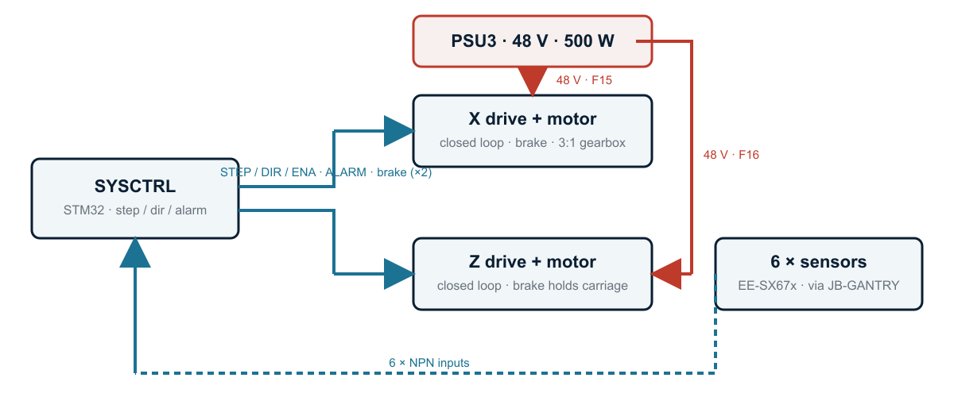

TOPIC 1 OF 10
Gantry drives from the mechanical BOM
QUESTIONS FOR ADHERENT360
Drive datasheet: STEP / DIR signal level, ALARM output, who controls the brake?
Is 48 V really needed, or would the 24 V rail do?
Generic drive acceptable, or a documented equivalent (Leadshine class)?
Labeling-mechanism BOM: when, and integrated drives there too?
48 V drive units with brake and driver built in; SYSCTRL sends step / direction and reads alarms.
Emtech 57BYG250-76 closed-loop steppers, 2 N·m / 4 A, brake and driver integrated; X with a 3:1 gearbox.
New 48 V / 500 W supply (PSU3) for the two drive units; SYSCTRL keeps only STEP / DIR / ENA, ALARM and the brake outputs.
6 Omron EE-SX67x sensors with 1 m leads meet in JB-GANTRY; chains X 762 mm, Z 1616 mm.
Affects: PSU count, SYSCTRL I/O, connectors J16 / J17, cables W11, W12, W29, W30.
Blackocean Technologies · Adherent360 APDU · Design review · 11 Sep 2026
4

Slide 5
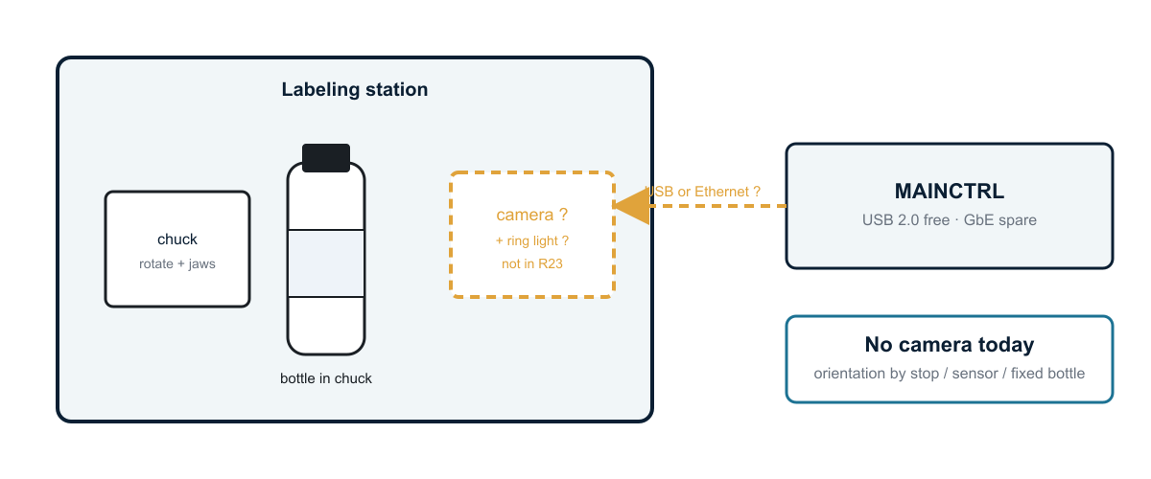
TOPIC 2 OF 10
Camera and OCR: is it needed?
QUESTIONS FOR ADHERENT360
Is a camera needed at all: bottle orientation for marking, dispense verification, or an audit photo?
If yes: read text (OCR), or only find a mark or the label edge?
USB or Ethernet camera, and where does it mount: labeling station or retrieval bay?
Are images stored? Labels carry patient data, so retention and encryption rules apply.
Taken out of the R23 baseline; the labeling station keeps the space and the ports for it.
R23 has no camera, no ring light and no camera cable; nothing from the customer defines one yet.
MAINCTRL keeps a free USB 2.0 port and a spare Gigabit port, so a camera can be added later without a board change.
Without a camera the chuck needs another reference to orient the bottle for marking: a mechanical stop, a sensor, or one fixed bottle type.
Affects: MAINCTRL software scope, ring light and 24 V budget, one cable, labeling-station bracket.
Blackocean Technologies · Adherent360 APDU · Design review · 11 Sep 2026
5

Slide 6
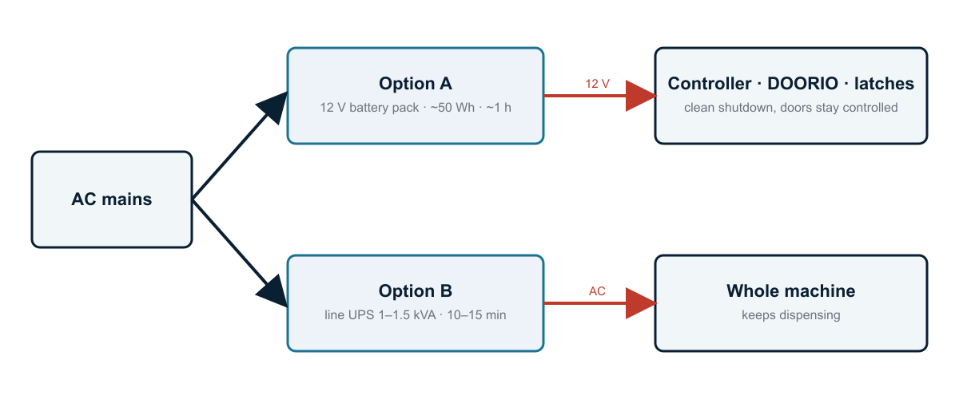
TOPIC 3 OF 10
UPS and battery backup
QUESTIONS FOR ADHERENT360
What must keep working in an outage: records and doors, or full dispensing?
How long must the unit ride through?
Must a dispense in progress finish?
Latches fail-secure or fail-safe when power is lost?
Two ways to ride through a power cut; today the design has neither.
Idle about 50 W, about 300 W while dispensing, up to 1.1 kW only if every rail peaks at once.
Option A: a 12 V battery pack (~50 Wh) keeps the controller, DOORIO, latches and network alive for about an hour and shuts down cleanly.
Option B: a 1–1.5 kVA line UPS keeps the whole machine dispensing for 10–15 min; needs a shelf and adds ~10 kg.
Affects: PSU2 sizing, cabinet layout, latch type, shutdown firmware.
Blackocean Technologies · Adherent360 APDU · Design review · 11 Sep 2026
6

Slide 7
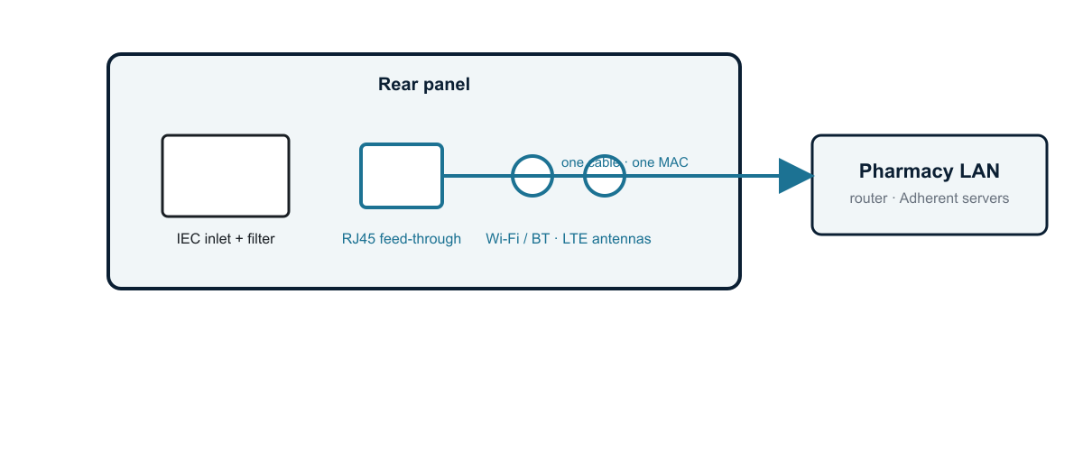
TOPIC 4 OF 10
Ethernet port location
QUESTIONS FOR ADHERENT360
Rear, side or bottom for the port, and how close to the wall does the unit stand?
Static IP or DHCP; any VLAN or firewall rules?
Is the label marker Ethernet or USB?
Is Wi-Fi acceptable as the only link at some sites?
Rear panel as drawn in R23: one RJ45 feed-through, no switch inside the cabinet.
One RJ45 feed-through on the rear panel beside the AC inlet; Wi-Fi (USB module on MAINCTRL) is the backup path.
MAINCTRL has two Gigabit ports on board: one to the site, one spare for an Ethernet label marker. No switch in the cabinet.
One external port means one cable and one MAC address on the pharmacy network.
Affects: rear-panel cut-outs, cabinet BOM, IT onboarding sheet.
Blackocean Technologies · Adherent360 APDU · Design review · 11 Sep 2026
7

Slide 8
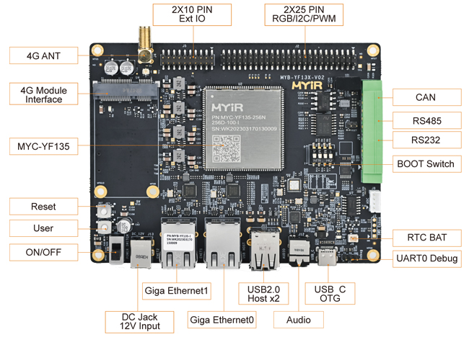
TOPIC 5 OF 10
Cellular (LTE) modem: is it needed?
QUESTIONS FOR ADHERENT360
Required at all: primary link, failover, or remote diagnostics only?
Who owns the SIM, the data plan and carrier certification?
Data volume: vend events only, or logs and diagnostics?
VPN or fixed IP needed, or outbound HTTPS enough?
MAINCTRL board, MYIR MYD-YF13X (STM32MP135, 137 × 105 mm): the 4G module interface (mini-PCIe, USB) and its antenna are top left.
No cellular path today; the site network carries the vend API and remote service.
An LTE Cat-4 mini-PCIe module (Quectel EG25-G class, ~USD 60–90) plus two antennas is all the hardware needed.
Alternative: a DIN-rail LTE router with failover (~USD 200–250), or no cellular at all.
Affects: rear-panel cut-outs, BOM, certification scope, monthly cost.
Blackocean Technologies · Adherent360 APDU · Design review · 11 Sep 2026
8

Slide 9
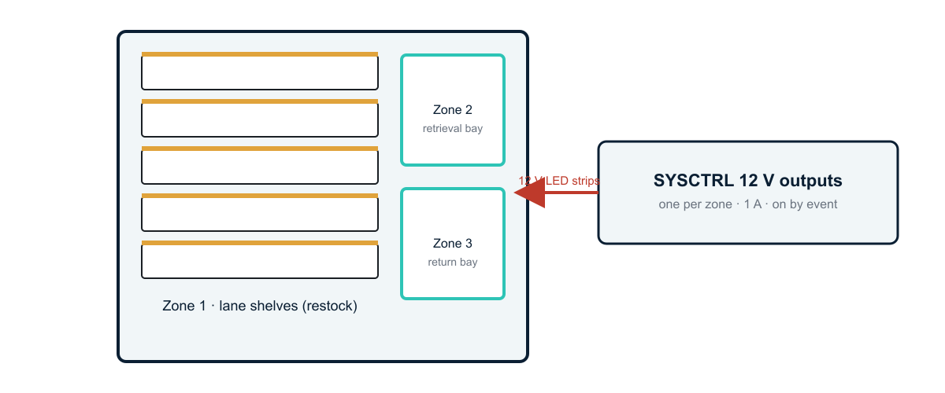
TOPIC 6 OF 10
Product illumination
QUESTIONS FOR ADHERENT360
Which zones need light?
For the customer through a window, or for staff during restocking?
Always on, or only on events?
Neutral white, or a status colour at the retrieval bay?
Three candidate zones, each on its own 12 V output.
No lighting in the R23 baseline.
Proposal: 12 V LED strips per zone driven by SYSCTRL outputs — lane shelves, retrieval bay, return bay — switched on by events.
Same Micro-Fit connectors; about 1 A of 12 V per zone.
Affects: SYSCTRL outputs, 12 V budget, row harness routing.
Blackocean Technologies · Adherent360 APDU · Design review · 11 Sep 2026
9

Slide 10
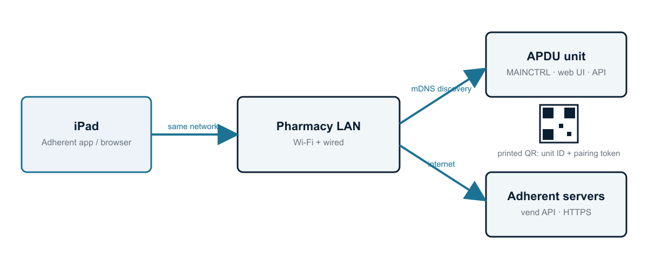
TOPIC 7 OF 10
iPad connection: QR code, Wi-Fi or BLE
QUESTIONS FOR ADHERENT360
Will the iPad be on the pharmacy Wi-Fi, or must it work without the site network?
Printed QR code acceptable, or a dynamic code on the unit?
How many units per pharmacy?
Who owns authentication: the Adherent cloud or a local login?
Recommended flow: same LAN, mDNS discovery, printed QR code for first pairing.
The iPad talks to the unit over the pharmacy LAN; the unit talks to the Adherent servers.
Recommended: mDNS discovery plus a printed QR code (unit ID and pairing token). No extra hardware.
BLE only if proximity pairing is wanted; it needs the optional USB Wi-Fi / BT module, the board has no radio on board.
Affects: MAINCTRL software scope, cabinet label, antenna placement.
Blackocean Technologies · Adherent360 APDU · Design review · 11 Sep 2026
10

Slide 11
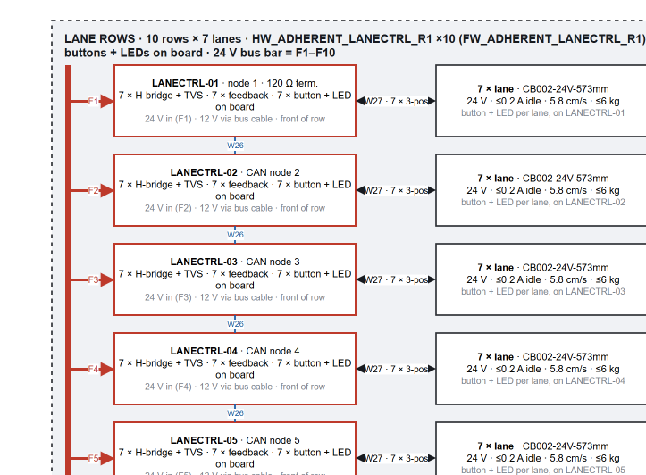
TOPIC 8 OF 10
Wire harness drawings
QUESTIONS FOR ADHERENT360
Can we get the cable routing paths and the chain inner sizes?
Service loops or blind-mate connectors on the drawer rows?
Who builds the harnesses: us, a harness shop, or the integrator?
Any existing colour or labelling convention?
Lane rows in R23: every cable already carries its W number and appears in the cable list.
Next deliverable: one drawing per cable, W01–W34, derived from the R23 diagram and the cable list.
Lengths estimated from the CAD envelope (855 × 890 × 1905 mm): about 125 m in total, 146 m of the standard 4c 22 AWG cable.
Routing paths and chain fill are needed from the mechanical team before lengths are final.
Affects: harness drawing effort, connector counts, BOM v1 timing.
Blackocean Technologies · Adherent360 APDU · Design review · 11 Sep 2026
11

Slide 12
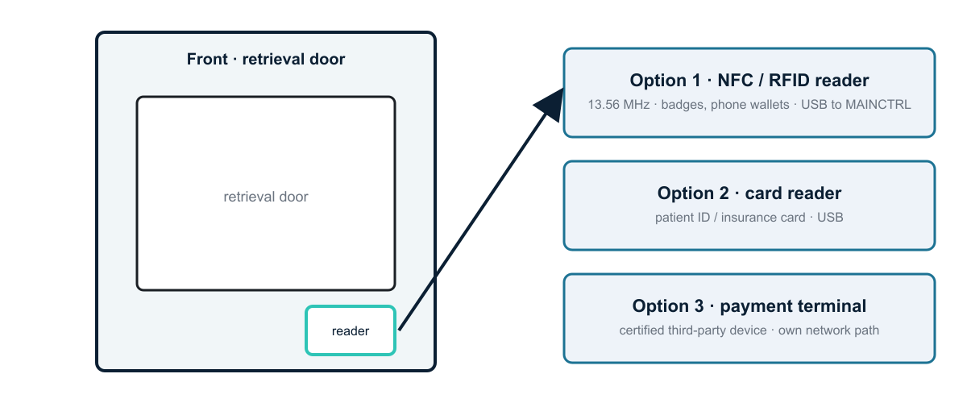
TOPIC 9 OF 10
NFC and card reader
QUESTIONS FOR ADHERENT360
Use case: staff login, patient pickup, or payment?
Which card: badge, patient ID, insurance, credit, phone wallet?
Where should the reader sit?
Validated in the Adherent cloud, or locally?
Not in R23 yet; the cut-out and cable can be planned now.
Natural place: front panel next to the retrieval door, USB to MAINCTRL.
NFC / RFID reader: small cost and one USB port. Payment terminal: a certified third-party device.
Plan the panel cut-out and cable now even if the reader comes later.
Affects: MAINCTRL USB ports, front-panel cut-out, security scope.
Blackocean Technologies · Adherent360 APDU · Design review · 11 Sep 2026
12

Slide 13
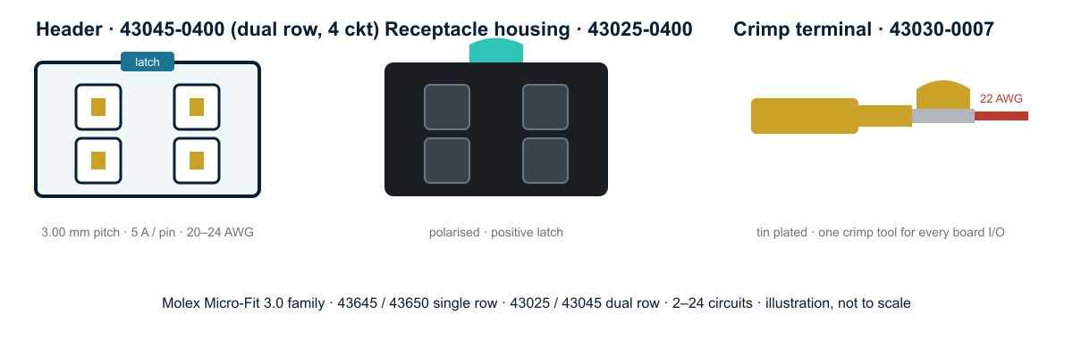
TOPIC 10 OF 10
Connector standard
QUESTIONS FOR ADHERENT360
Approved connector vendor list to follow?
Tool-less field replacement of a LANECTRL or a conveyor expected?
IP rating for the front bays?
Keyed or colour-coded housings so rows cannot be cross-plugged?
Micro-Fit 3.0 parts used on every board (illustration).
Every PCB input and output: Molex Micro-Fit 3.0, 3 mm pitch, 5 A per pin, one crimp tool.
Panel: Schaffner IEC inlet, Neutrik RJ45, RP-SMA; DIN fuse terminals. Conveyor side: its own 3-position screw terminal.
Lane buttons and LEDs sit on the LANECTRL board itself, no extra harness; junction boxes use ferrules and WAGO 221.
Affects: BOM v1 connector lines, LANECTRL layout, service documentation.
Blackocean Technologies · Adherent360 APDU · Design review · 11 Sep 2026
13

Slide 14

Decisions we need to leave with
Gantry drives
Camera / OCR
48 V confirmed · drive interface · datasheet
needed at all · purpose · USB vs Ethernet
Backup power
Network
records-only battery vs full UPS · ride-through time
port location · IP policy
Cellular
Lighting
required or not · failover vs primary · SIM owner
zones · event-driven vs always on · colour
iPad pairing
Harnesses
LAN + QR (recommended) vs AP mode vs BLE
routing paths from mechanical · who builds
NFC / card
Connectors
use case · card type · location
vendor list · tool-less service · IP rating
Next step: answers go into the next revision of the wiring diagram and into BOM v1, then schematic capture starts.

