Slide 1

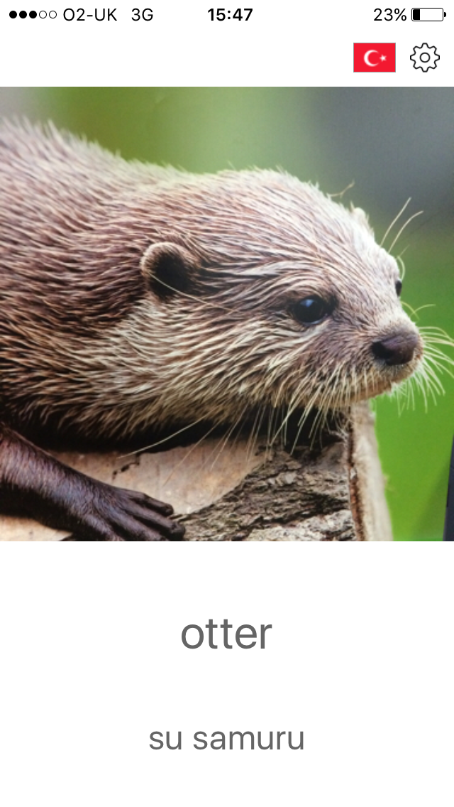
Deploying and hosting DNN through WebApps

Slide 2



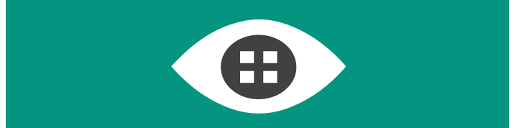
Architecture
Object Detection
Clients
POST
API
Image Classification
Response
Cognitive Services (API)

Slide 3
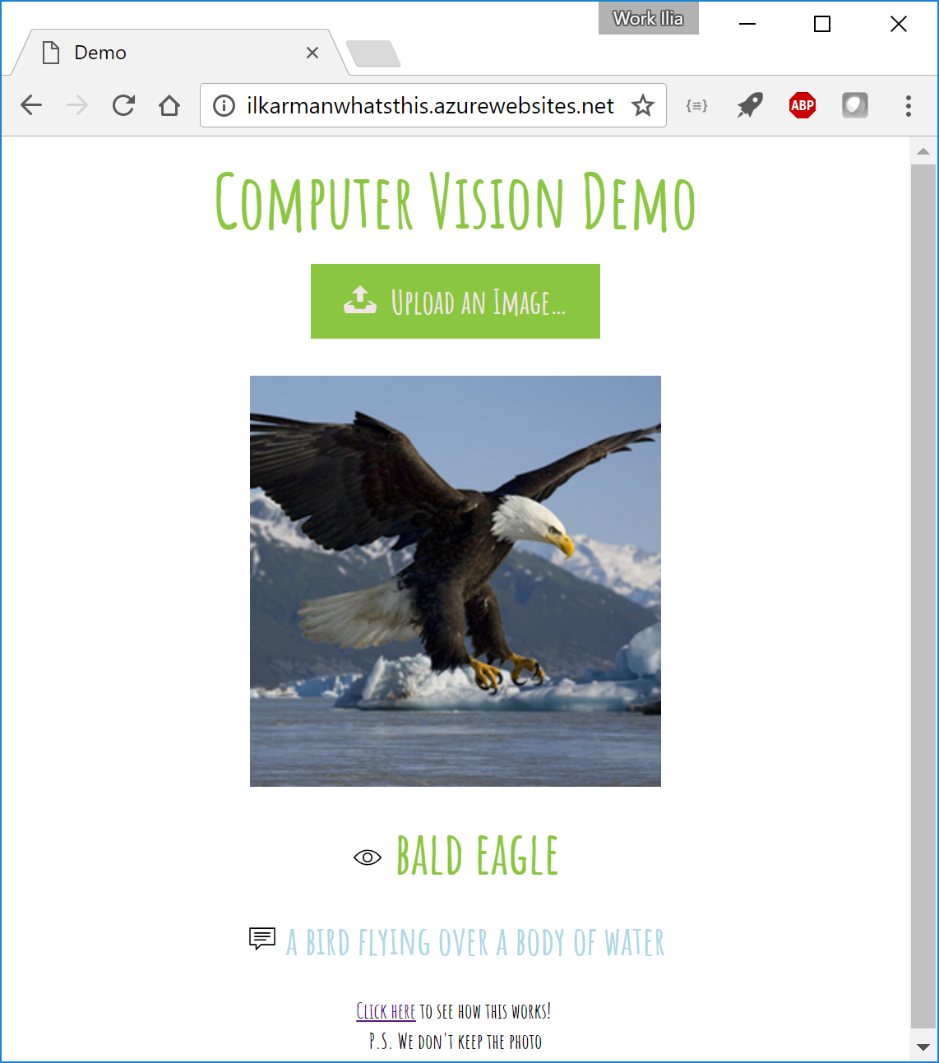

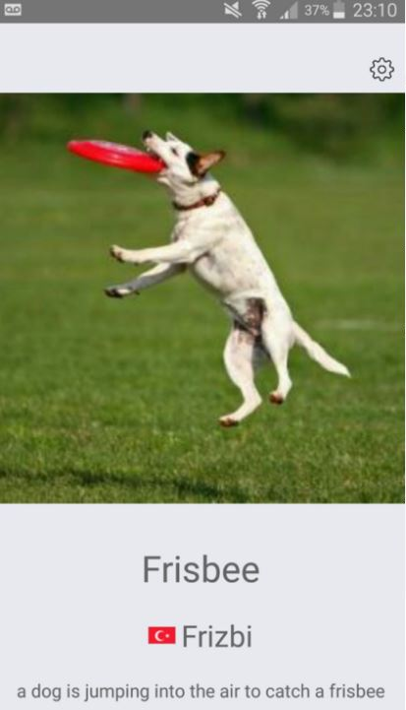
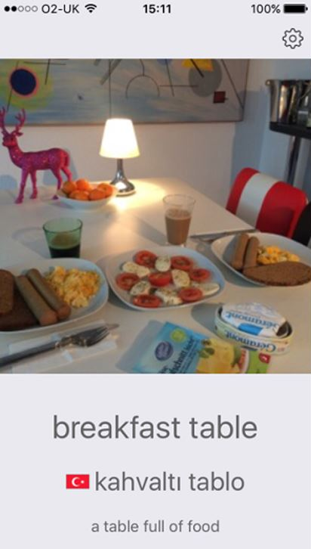
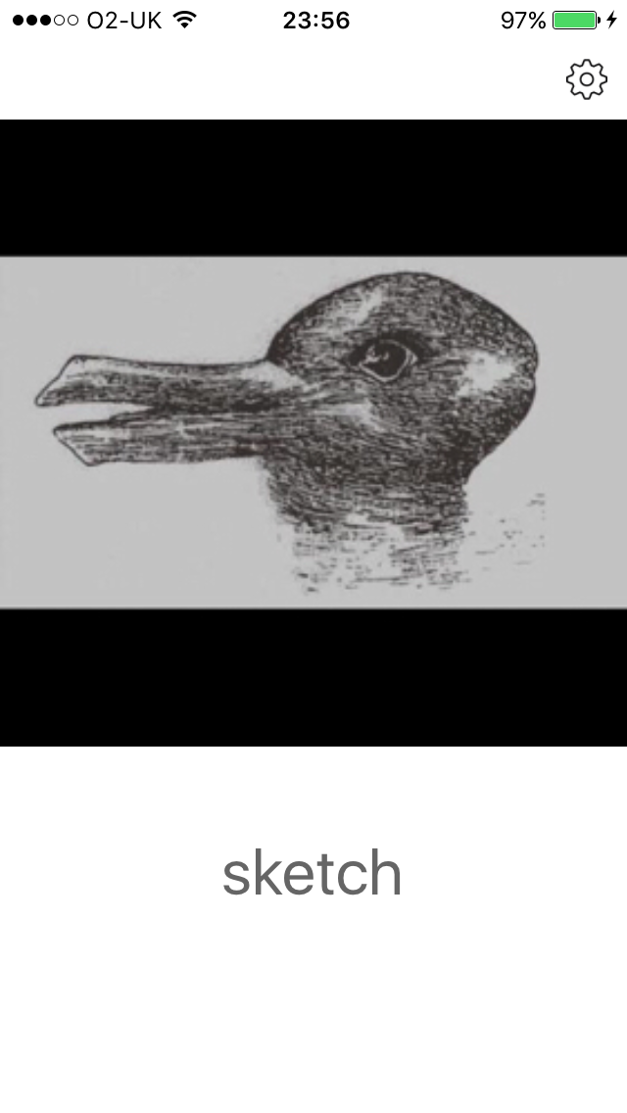
Client-side

Slide 4
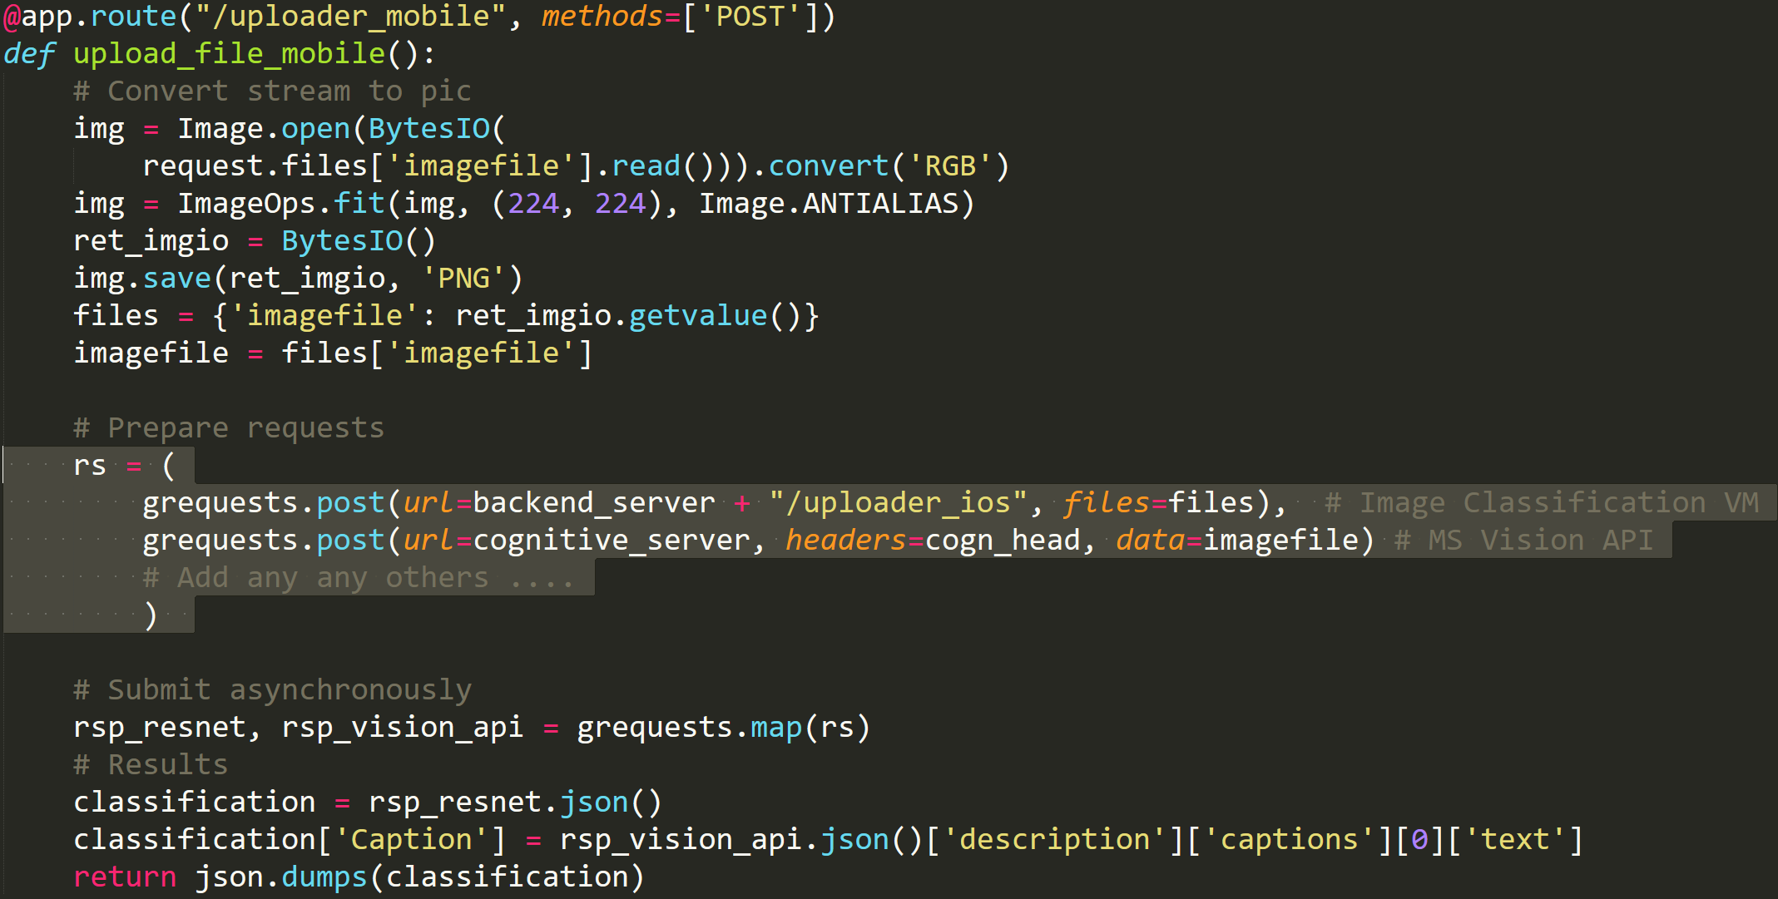
WebApp API
Retrieve image
Asynchronously submit to many different services
Combine responses and return to client

Slide 5
Summary
Most deep-learning models end with cross-validation & we seem to use the cloud only for training …
Releasing tutorials, video-how-to, deployment template to facilitate deployment of models -> AI for everyone
Azure WebApp acts as a ‘glue’, accepting (cross-origin) requests from many different clients and asynchronously passing to back-end (VM/another WebApp) -> scales out & decouples processing from interface
VM backend + CNTK scalable solution to ‘score’ images -> can be replaced or altered without touching WebApp

Slide 6
http://ilkarmanwhatsthis.azurewebsites.net

