Slide 1
Project Group A13
Ankur Garg & Sanket Shahane

Slide 2
Plan of action
124
Categorical = 24
Continuous = 100
PCA
< 10 Features
Subset Selection on ~ 30 features

Slide 3
Estimated Time
5-6 hours for computation
Enjoy the weekend.
However …

Slide 4
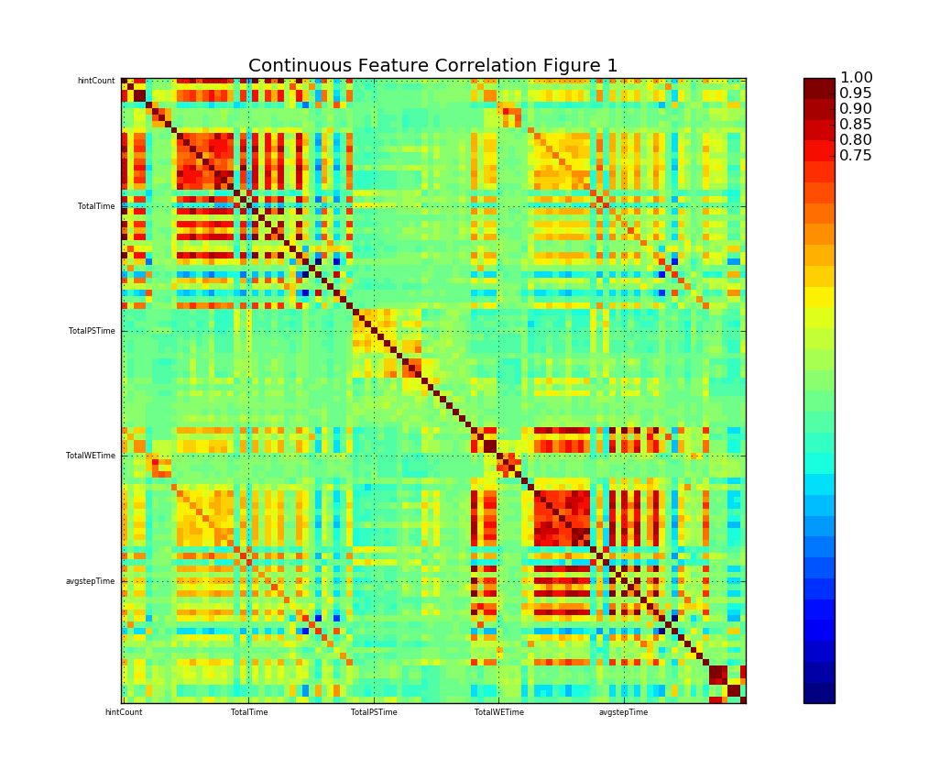
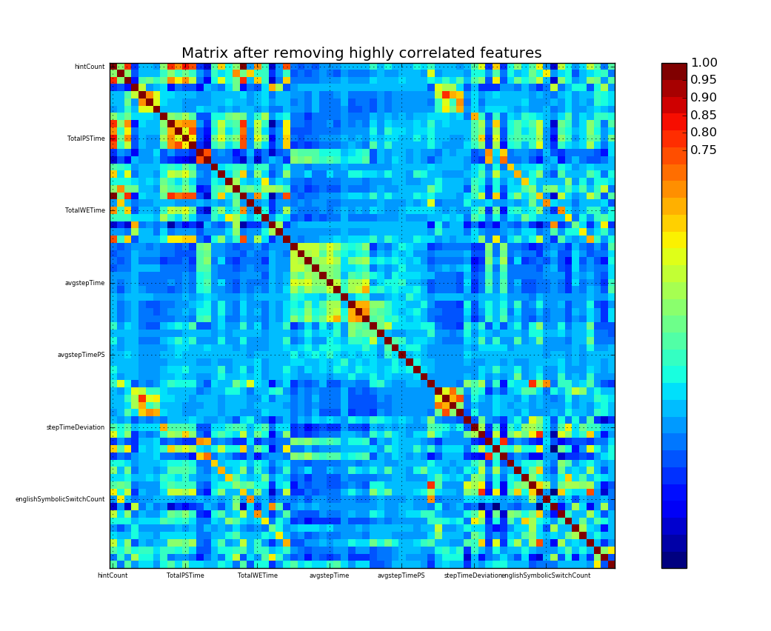
Handling Continuous Features
Remove Correlated Variables before PCA (30 features removed)

Slide 5
Principal Component Analysis
Before removing correlated features, 3 components explained 97% variance
After removal of correlated features, ended up choosing 6 principal components.

Slide 6
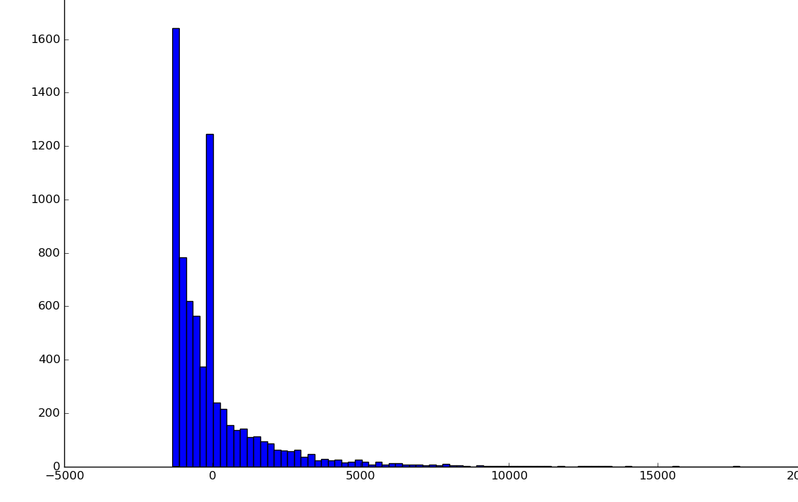
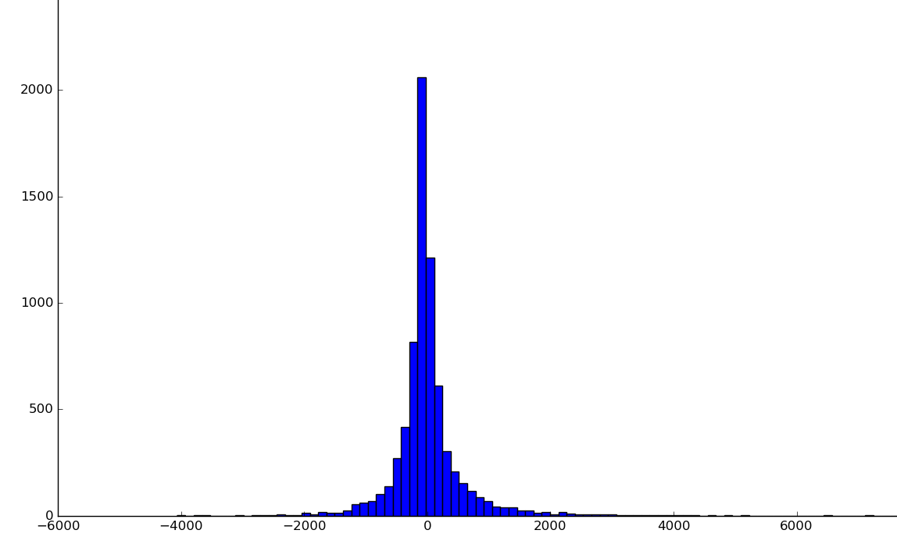
Discretization of Principal Components
1. Based on data distribution

Slide 7
Discretization of Principal Components
2. Based on equal frequency
3. Equal width bins

Slide 8
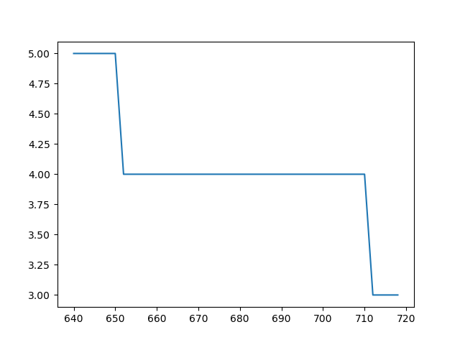
Discretization of Principal Components
4. Clustering - using Mean Shift algorithm

Slide 9
PCA Results
Not so useful
ECR values in the range of 0-15 using just discretized PCA components

Slide 10
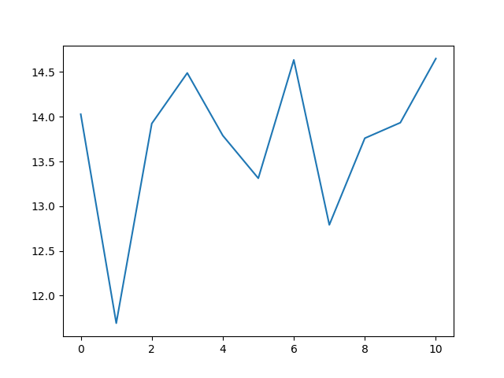
PCA Results
ECR for PCA components

Slide 11
Back to square one
Forward stepwise subset selection
Two good features – {Level, cumul_Interaction} - ECR value: 75.80

Slide 12
Improving ECR
Greedy approach
Discretization of PCA and MFA components based on ECR value

Slide 13
PCA + Greedy discretization + Forward Subset
PCA components along with features of forward subset selection
Discretization of PCA components based on ECR value

Slide 14
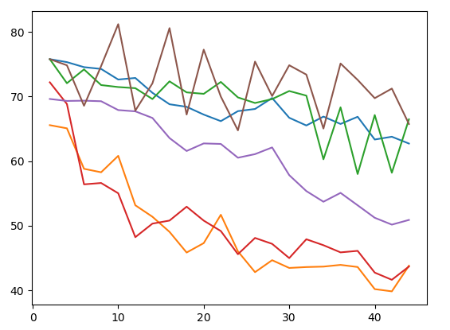
PCA + Greedy discretization + Forward Subset
Improvement in ECR – 81.26

Slide 15
Handling Categorical Features
Mixed Factor Analysis
Extracted best 8 components
Output of Mixed Factor Analysis is continuous
Discretized using previous methods

Slide 16
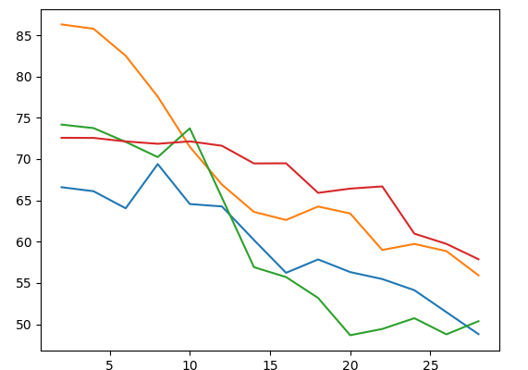
MFA + Greedy discretization + Forward Subset
Improvement in ECR – 86.29

Slide 17
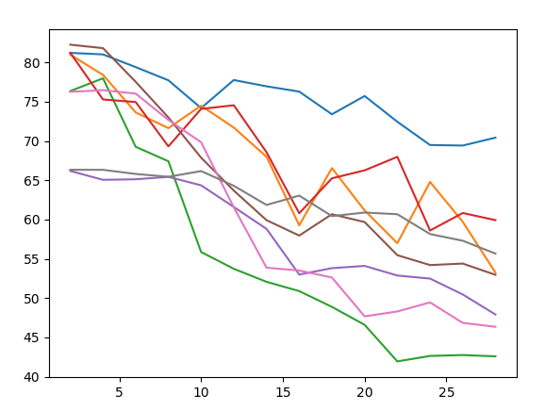
Combining results from PCA and MFA
Using greedy approach to combine components with best results from both approaches
ECR Value - 82.5

Slide 18
Analyses
Traditional feature extraction techniques don’t necessarily work in MDP
Important to remove correlation
Combining results from two good features doesn’t necessarily result in a good combination

Slide 19
Another Approach
Using Neural Network
Method 1: Feature compression using neural network
Method 2: Include MDP process while training the neural network

Slide 20
Neural Network - Structure

Slide 21
Neural Network - Results
Extracted 8 features
Discretized using previous methods
ECR Value: 31.2

Slide 22
Method 2 – Using MDP for training NN

Slide 23
Final Results
Max ECR till now – 86.29
Total Rules: 3155
WE Rules = 1073, PS Rules = 3155

Slide 24
Challenges and Outcomes
Definition of good feature is rather difficult for MDP
Explored different methods for feature selection and feature discretization
Challenges in training and designing a neural network
MDP_Function2.py is the bottleneck. Doesn’t execute in parallel.

Slide 25
Thank You
Group A13

