Slide 1
Project Group A13
Ankur Garg & Sanket Shahane

Slide 2
Plan of action
124
Categorical = 24
Continuous = 100
PCA
< 10 Features
Subset Selection on ~ 30 features

Slide 3
Estimated Time
5-6 hours for computation
Enjoy the weekend.
However …

Slide 4
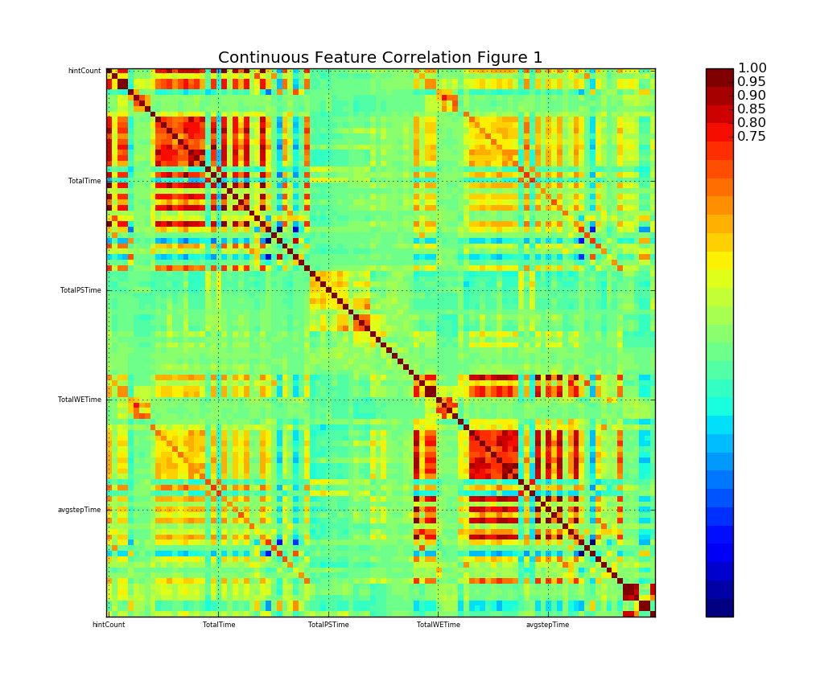
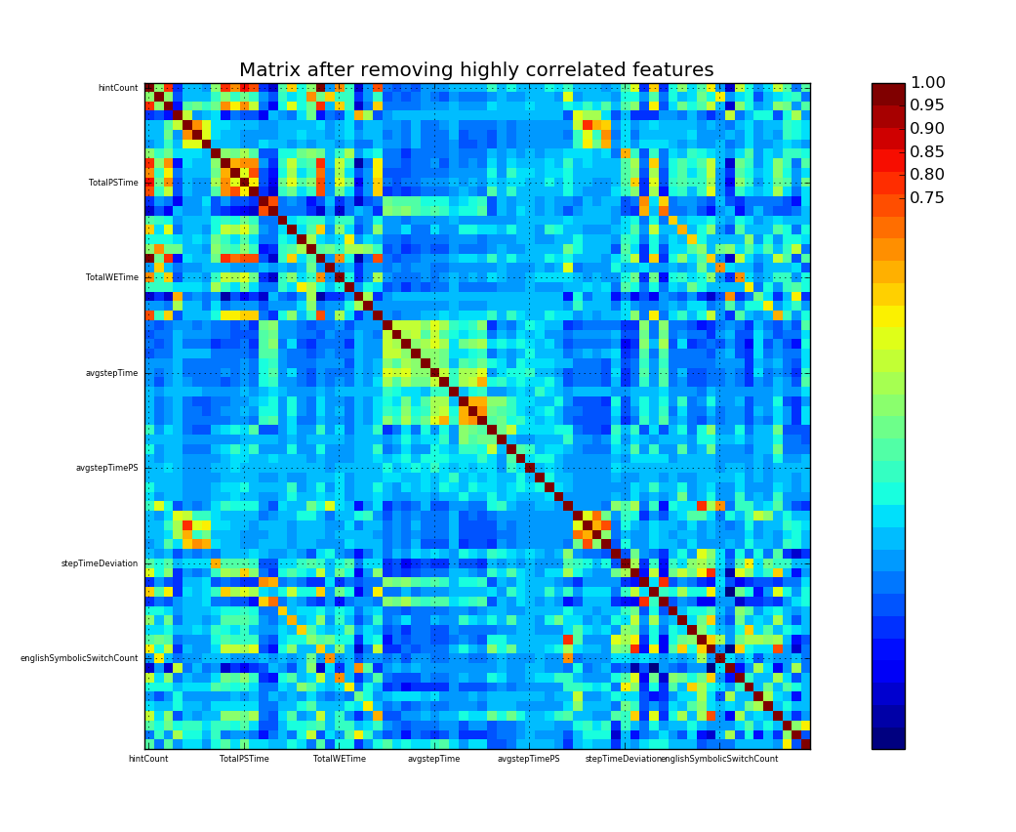
Handling Continuous Features
Remove Correlated Variables before PCA (30 features removed)

Slide 5
Principal Component Analysis
Before removing correlated features, 3 components explained 97% variance
After removal of correlated features, ended up choosing 6 principal components.

Slide 6
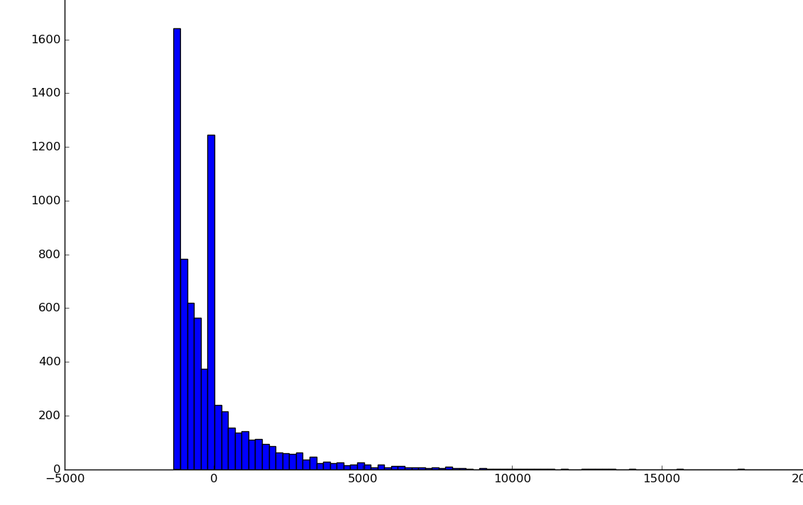
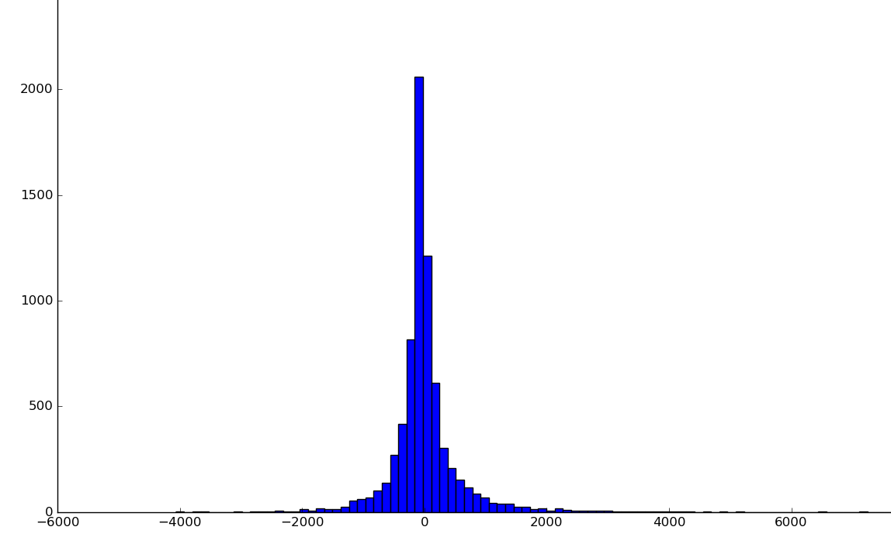
Discretization of Principal Components
1. Based on data distribution

Slide 7
Discretization of Principal Components
2. Based on equal frequency
3. Equal width bins

Slide 8
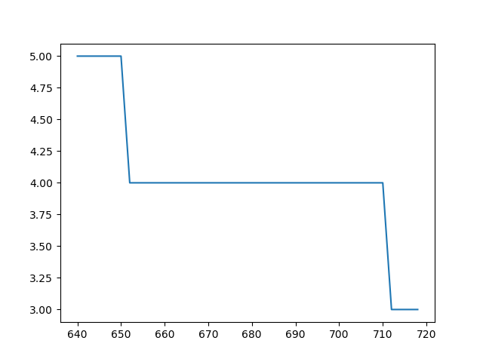
Discretization of Principal Components
4. Clustering - used Mean Shift algorithm

Slide 9
PCA Results
Not so useful
ECR values in the range of 0-15 using just discretized PCA components

Slide 10
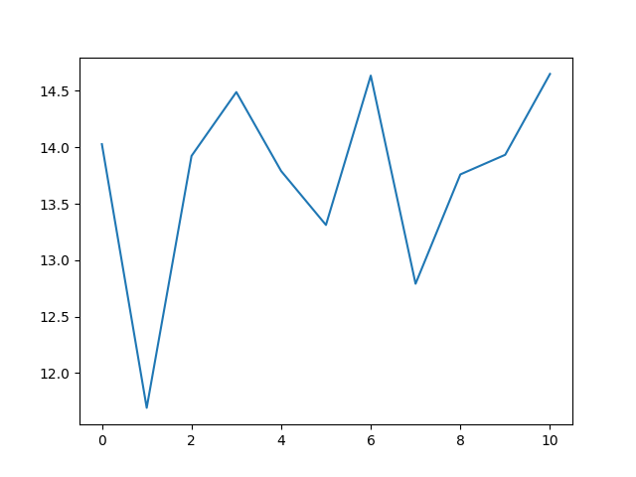
PCA Results
ECR for PCA components

Slide 11
Handling Categorical Features
Mixed Factor Analysis
Extracted best 8 components
Output of Mixed Factor Analysis is continuous
Discretized using previous methods

Slide 12
Back to square one
Forward stepwise subset selection
Two good features – {Level, cumul_Interaction} - ECR value: 75.80

Slide 13
Improving ECR
Greedy approach
Discretization of PCA and MFA components based on ECR value

Slide 14
PCA + Greedy discretization + Forward Subset
PCA components along with features of forward subset selection
Discretization of PCA components based on ECR value

Slide 15
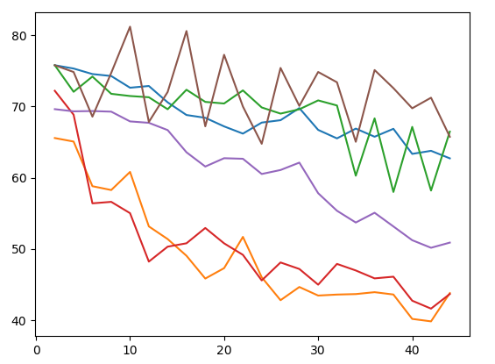
PCA + Greedy discretization + Forward Subset
Improvement in ECR – 81.26

Slide 16
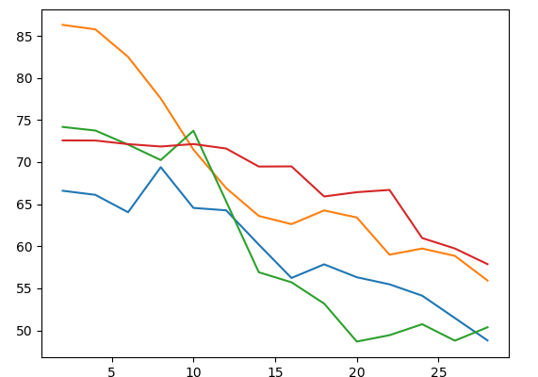
MFA + Greedy discretization + Forward Subset
Improvement in ECR – 86.29

Slide 17
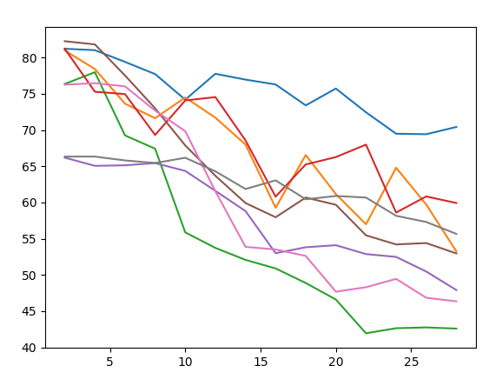
Combining results from PCA and MFA
Using greedy approach to combine components with best results from both approaches
ECR Value - 82.5

Slide 18
Analyses
Traditional feature extraction techniques don’t necessarily work in MDP
Important to remove correlation
Combining results from two good features doesn’t necessarily result in a good combination

Slide 19
Unconventional Approach
Add a new black box to fight the black box
Method 1: Feature compression using neural network
Method 2: Include MDP process while training the neural network

Slide 20
Neural Network - Structure

Slide 21
Neural Network - Results
Extracted 8 features
Discretized using previous methods
ECR Value: 31.2

Slide 22
Method 2 – Using MDP for training NN

Slide 23
Challenges and Outcomes
Definition of good feature is rather difficult for MDP
Explored different methods for feature selection and feature discretization
Challenges in training and designing a neural network
MDP_Function2.py is the bottleneck. Doesn’t execute in parallel.

Slide 24
Thank You
Group A13

