Slide 1
Welcome to Drupal
Everything You Need to Know to Be Dangerous

Slide 2
Agenda
Drupal from 50,000 Feet
Worldview
Terminology
Drupal Core
Drupal Add-ons
Common Workflows
Drupal Community
Getting Help
Your Questions!

Slide 3

Drew Gorton
Drupal: No! … Maybe? … Absolutely!
@dgorton / drew@gortonstudios.com

Slide 4
Drupal from 50,000 Feet
Open Source Web Content Management System
Silly Internet Name
Dorp.org ➛ Drop.org ➛ Druppel ➛ Drupal
Widely Adopted
NBC, Weather.com, White House, United Nations, Stanford, Oxford, Harvard, Louvre, Grammies, Billboard, Economist, Pfizer, Martha Stewart, Mental Floss + many, many more…
Huge Market
Jobs & Hiring

Slide 5
Worldview
Content not Pages
Page + RSS + List + Calendar view + …
National Public Radio “Create Once, Publish Everywhere” (COPE)
Structure before Presentation
Get it working. Then make it look nice.
Building Blocks not Features
Don’t install a feature (Photo Gallery, Calendar, Map, Blog…). Assemble the pieces. Think Recipes.
Flexibility
Yay! (It will do it)
Boo! (I just want that feature)

Slide 6
Terminology
Content Types: The kinds of things on your website. Proper Nouns.
Blog Posts, Events, Pages, Articles, Products…
Fields: Individual nuggets of information in a content type
Text, Image, Date, Select List, Link, Embed, Reference…
Taxonomy: Categorization of content
News, Politics, Colors…
Node: A basic unit of content
A Story, A Blog Post…
View: Collections of things (like Nodes)
Recent Stories, Last Month’s Blog Posts…
http://2015.midcamp.org/session-proposal/around-views-20-minutes - Friday 1:45 pm - 2:45 pm
Theme: What your audience interacts with: colors, layout, UX
Logo, Fonts, Colors…
Module: Add Functionality
Image resizing, SEO-friendly URLs, WYSIWYG, Workflow, …
http://2015.midcamp.org/session-proposal/read-four-steps-selecting-right-modules - Friday 12:30 pm - 1:30 pm
Block: Ancillary bits
Ads, More Like This, Newsletter signup, Shopping cart contents, Social Sharing…

Slide 7
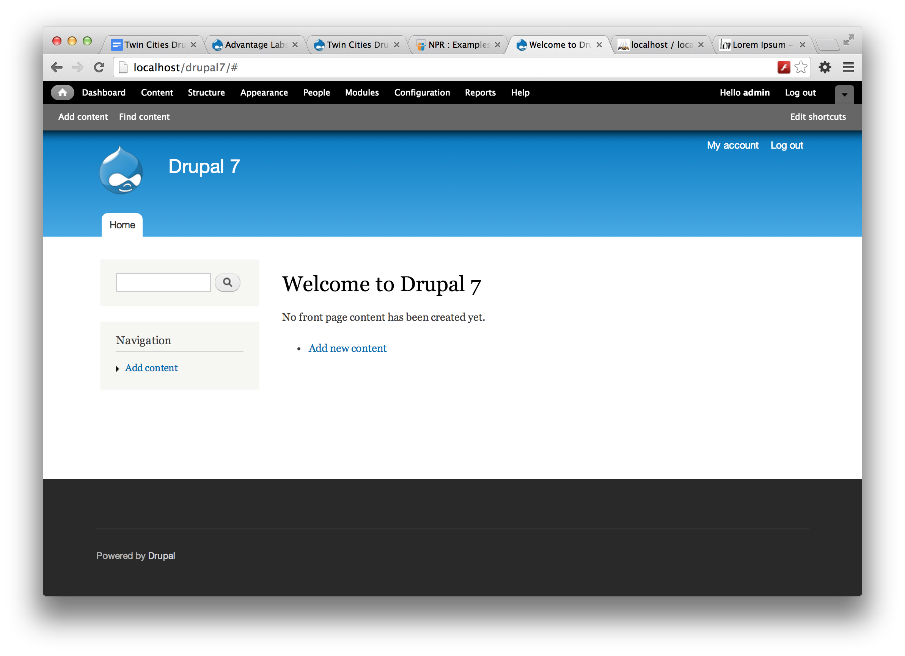
Drupal Core

Slide 8
Drupal Add-Ons
Modules, Themes, Distributions
Found on Drupal.org
Community Contributed
“Site Building”

Slide 9
Common Workflows
Building: Plan!
Designing: Plan!
Editing: Just Edit!
(Bonus: learn how it’s been put together. It will help.)

Slide 10
Drupal Community
Come for the software, stay for the community
1,163,073 people in 229 countries speaking 180 languages power Drupal.
In Internet Space!
Twitter: #drupal, https://twitter.com/webchick/lists/drupal-universe
IRC: https://www.drupal.org/irc
Newsletters: Weekly Drop, Lullabot …
Podcasts: Drupal Easy, Modules Unraveled, Drupalize.Me, Acquia …
Blogs: https://www.drupal.org/planet
Contribute: try something!
In Physical Space!
Meetups: https://groups.drupal.org
Camps
DrupalCon - NA, Europe, Others
Sprints

Slide 11
Getting Help
Ask someone you trust (someone here!)
Google
Drupal.org

Slide 12
Questions!

