Slide 1
Twig | March 20
Using Twig and Views to Create Friendly HTML E-newsletter Code
Presented by: Joshua Yospyn, Web Designer + Photographer

Slide 2

Joshua Yospyn
Not in Chicago. Lives in Kensington, Maryland.
Drupal 8 front-end designer who uses SASS, twig and designs comps in Adobe XD for a public health organization. Former photojournalist and freelancer for The Washington Post and documentary filmmaker.
Has a former stray cat named Bucatini Marbles.

Slide 3
MISSION IMPOSSIBLE: make it easy for a staff member who doesn’t know HTML… …to create HTML e-newsletters

Slide 4

Turn the content of this webpage…
https://www.advancingnutrition.org/resources/resource-review/

Slide 5
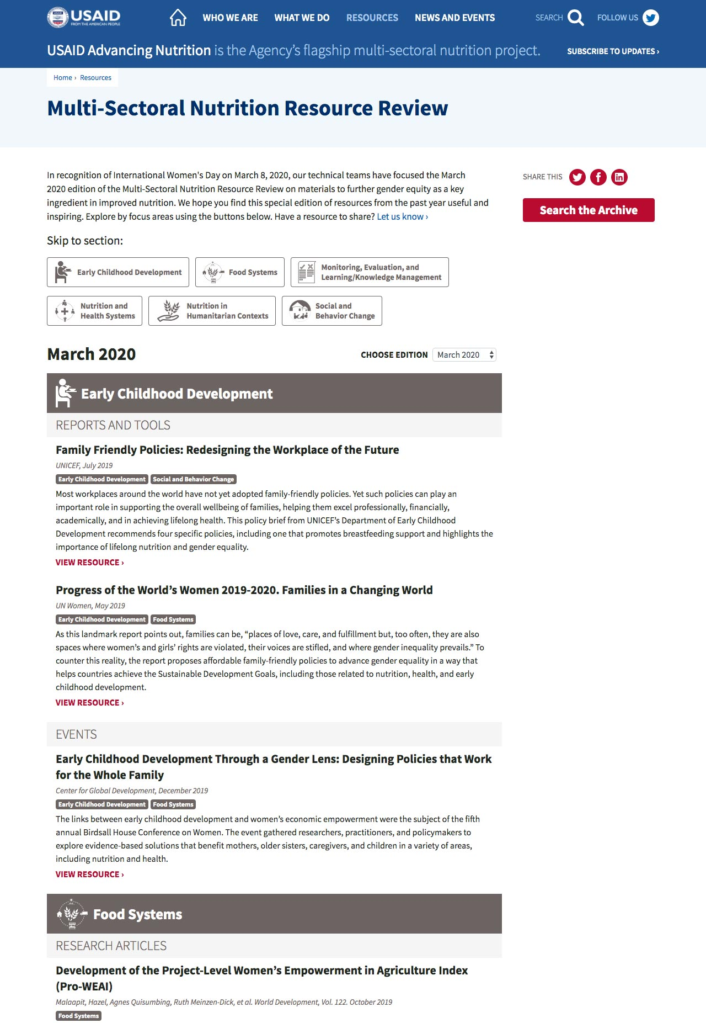

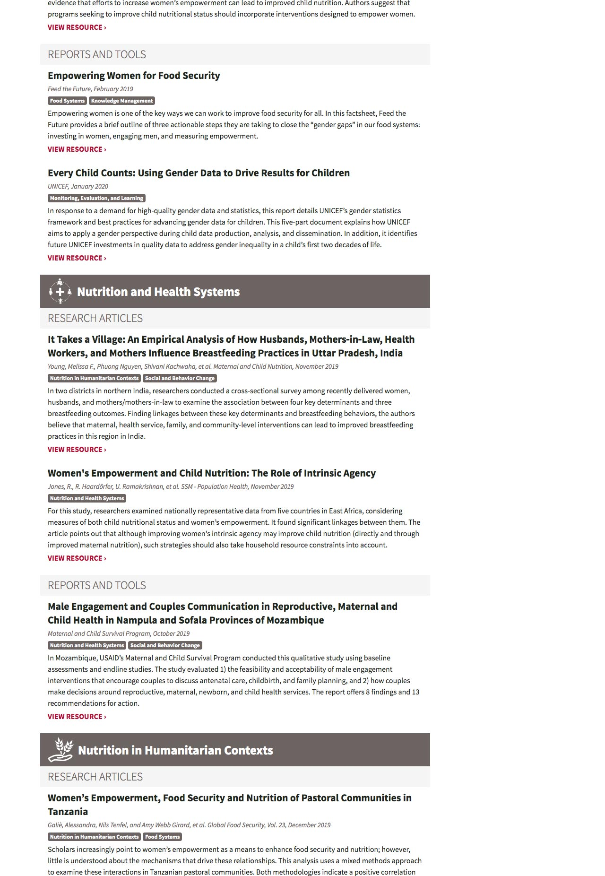
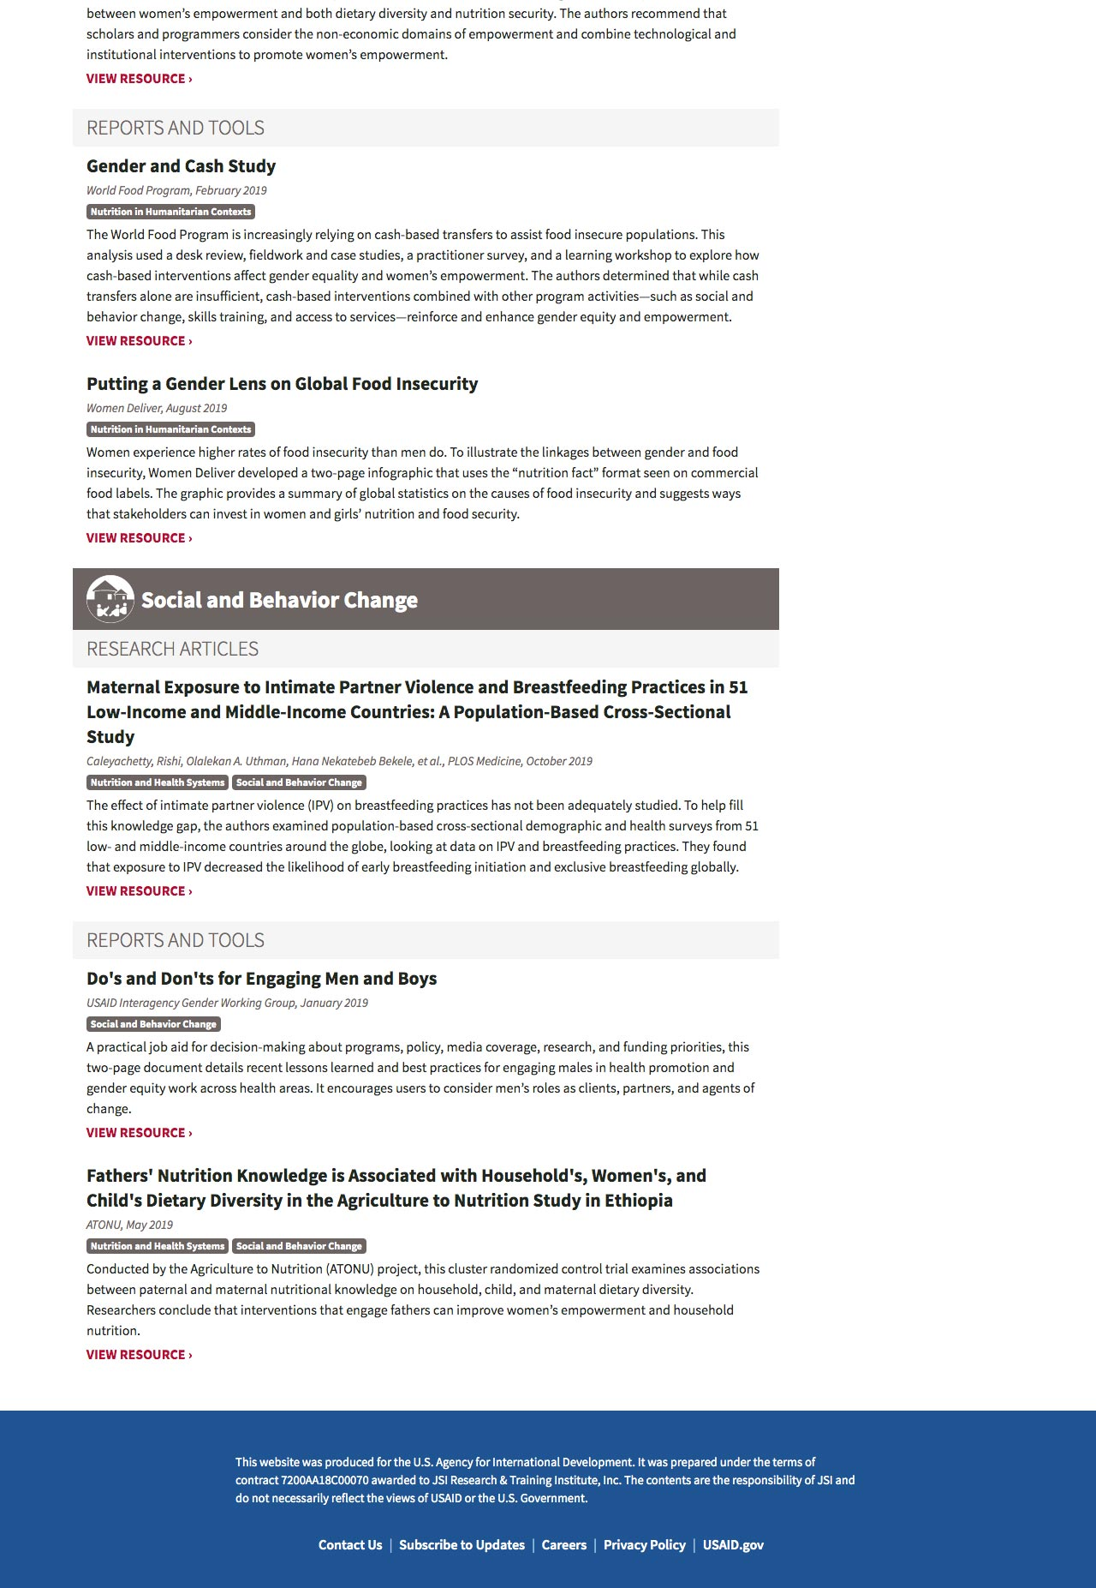
…which is very long and complex view display…
https://www.advancingnutrition.org/resources/resource-review/

Slide 6

…into a Constant Contact e-newsletter.
HTML e-newsletters often require a ton of inline styles.

Slide 7
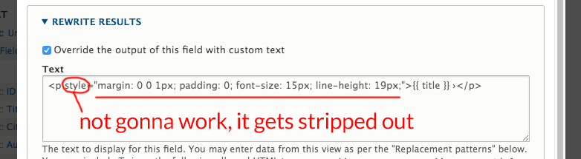
Can I use style=“ ” when
rewriting a field in my view?
No. If you try using the style attribute when rewriting a field, it will get stripped out.

Slide 8

But they only need to change these regions of our Constant Contact template
Pretty much everything else stays the same, every issue, so only this content needs to be pasted in.

Slide 9
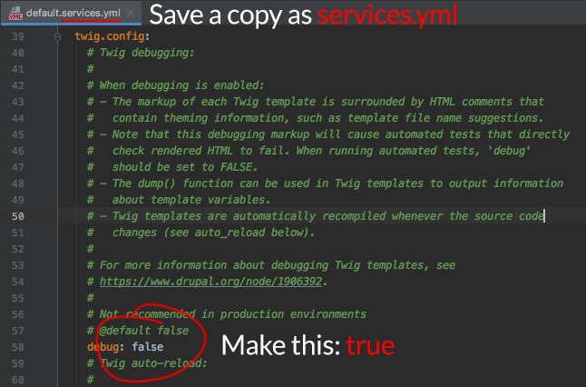
Thus, Twig.
To debug your code using Twig, reference this link:
https://www.drupal.org/docs/8/theming/twig/debugging-twig-templates

Slide 10
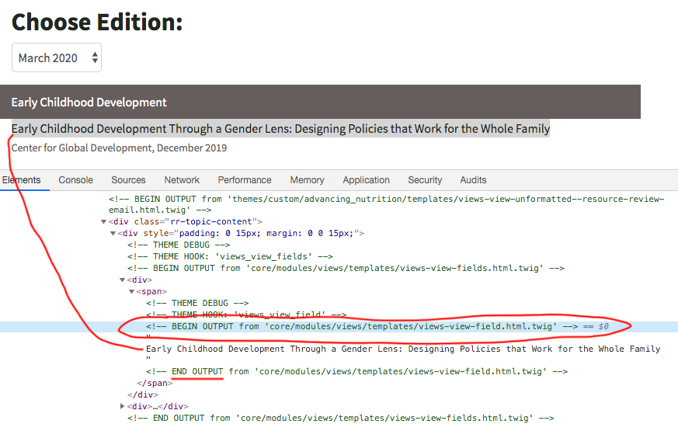
Twig debugging shows us green stuff
Now, when we inspect the code, we’ll see what templates are being used:
<!-- BEGIN OUTPUT from 'core/modules/views/templates/views-view-field.html.twig' -->

Slide 11
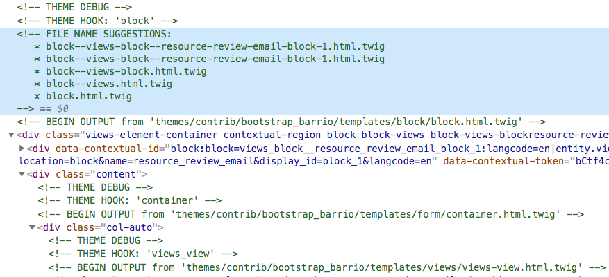
Debugging often shows renaming suggestions, but not always!
We would use one of those file name suggestions, copy the original twig, and save it in our own custom theme folder.

Slide 12
Sometimes we have to improvise on renaming
For example, say there aren’t any filename suggestions for this:
<!-- BEGIN OUTPUT from 'core/modules/views/templates/views-view-field.html.twig' -->
But we can create a new one anyway:
<!-- BEGIN OUTPUT from 'themes/custom/advancing_nutrition/templates/ views-view-field--resource-review-email--block-1--title.html.twig' -->
resource-review-email = machine name of view (with hyphens instead of underscores)
block-1 = machine name of view display (in this case a block)
title = machine name of specific field
also note the single - vs -- pattern
* Clear cache to see your new twig take effect.

Slide 13
Original Twig vs. Custom Twig
The code in the core twig file had very little in it:
{{ output -}}
* Our new, custom twig file has been rewritten to look like this:
<p style="margin: 0 0 1px; padding: 0; font-size: 15px; line-height: 19px;"> <a href="https://www.advancingnutrition.org/resources/resource-review#resource{{ row.nid }}" style="color: #212721; text-decoration: none;"><strong>{{ row._entity.label }} &rsaquo;</strong></a> </p>
We use the numerical Node ID value to provide anchor links for to each piece of the e-newsletter and its corresponding item online.

Slide 14

Another example (the citation field)
Again, we went from simply this in the original twig:
{{ output -}}
To our new twig, surrounding the above with a span and inline styles:
<span style="margin: 0 0 3px; padding: 0; color: #6c6463; font-size: 14px; line-height: 18px;">{{ output -}}</span>
Looks like this in the page:

Slide 15
Yet another example (the grouping container)
In a different kind of twig, we went from this:
{{ title }}
{{ content }}
To surrounding those two items with table code + inline styles:
<div class="view-grouping" style="width: 100%;">
<table width="100%" cellpadding="0" cellspacing="0" style="margin: 0; padding: 0; color: #ffffff; background: #6c6463;">
<tr style="border: 0;">
<td style="padding: 10px 15px; margin: 0; border: 0;">
{{ title }}
</td>
</tr>
</table>
<div class="view-grouping-content">{{ content }}</div>
</div>

Slide 16
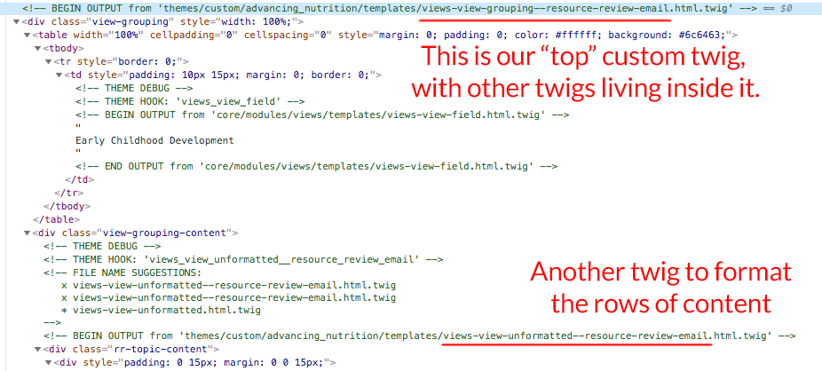
Here’s that grouping twig in the page code

Slide 17
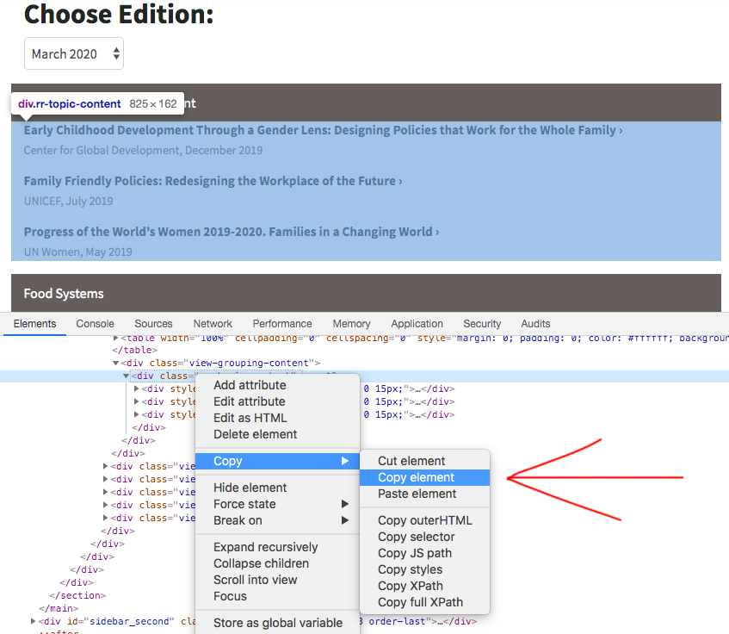
The code our e-news person copies

Slide 18
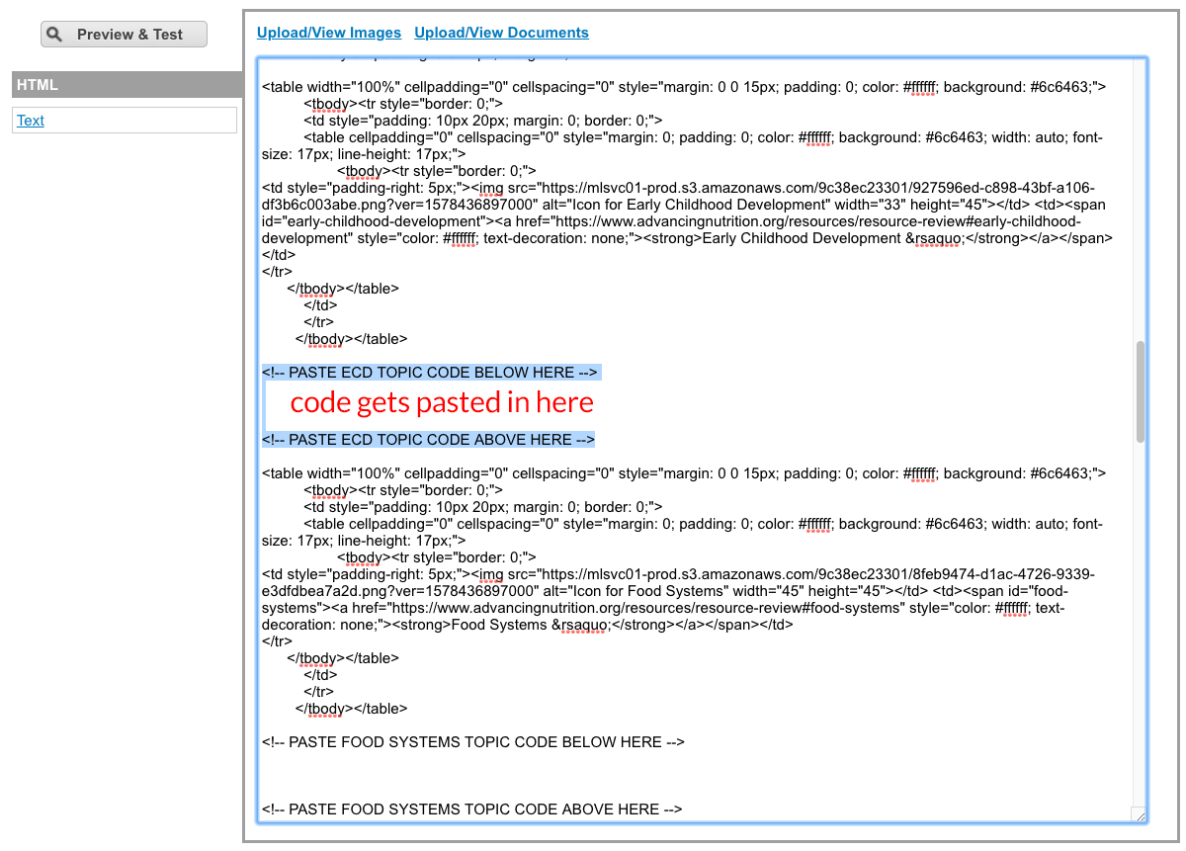
We created this handy region in our Constant Contact template for the e-news person

Slide 19
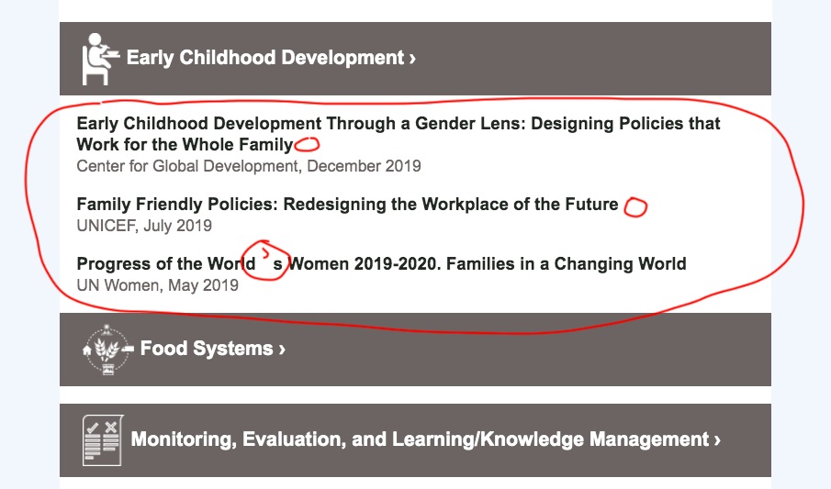
So it looks like this.
But, alas,
special characters!

Slide 20
Twig doesn’t preserve encoding
for special characters
Ideally, if I put &rsaquo; into the twig it would output &rsaquo;
But it doesn’t. It will output ›
So I will have to clean that up in Constant Contact ☹

Slide 21
Special characters have to be fixed
HTML e-newsletters need special characters to be encoded.
Changing every instance of › with its code &rsaquo;
Changing every curly ’ or “ ” needs to be replaced with keyboard ' and " " OR their curly encodes &rsquo; and &ldquo; and &rdquo;
Changing every — and – with its code ;mdash; and ;ndash;

Slide 22
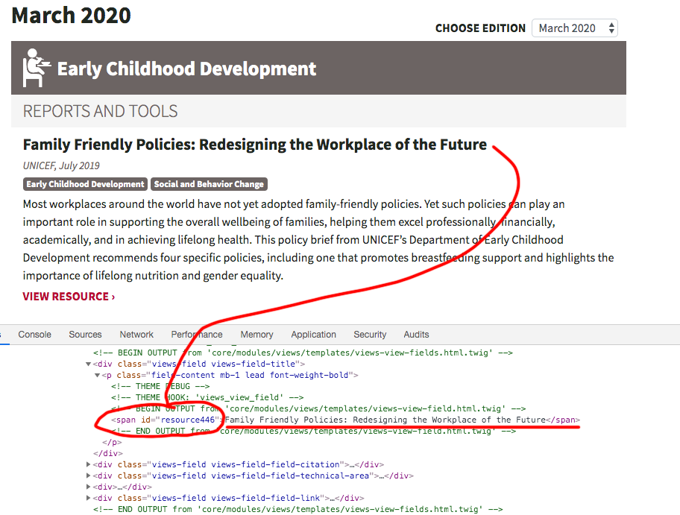
Linking from your e-newsletter back to
the website version of it
For example, we rewrote the title of every piece of content to have a linkable ID in a <span>

Slide 23
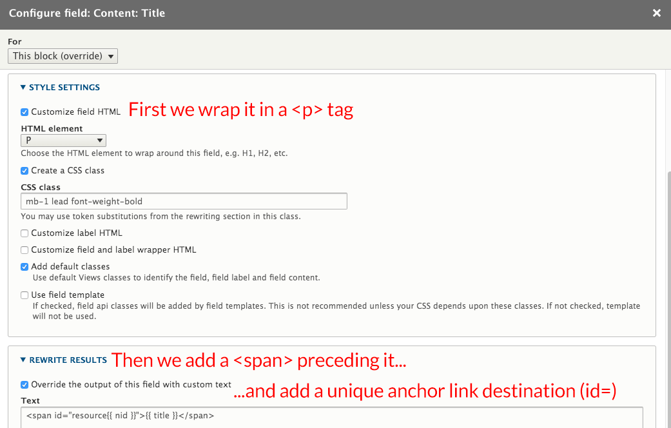
Creating anchor link destinations in a view
<span id="resource{{ nid }}">{{ title }}</span>

Slide 24
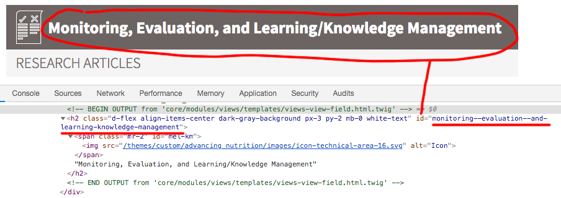
More complicated rewrites in views
For example, let’s rewrite this header field (a taxonomy term):
Monitoring, Evaluation, and Learning/Knowledge Management
In the view (NOT twig), we’ll rewrite it into an H2 and also reformat it:
<h2 id="{{ field_resource_review_section__value|replace({' ': '-', ',': '-', '/': '-'})|lower }}">{{ field_resource_review_section }}</h2>
The result is a nice clean id that an anchor link will see:
id="monitoring--evaluation--and-learning-knowledge-management

Slide 25
THANK YOU, QUESTIONS?

Slide 26
PLEASE PROVIDE YOUR FEEDBACK!
mid.camp/6279

Slide 27
CONTRIBUTION DAY
Saturday 10am to 4pm
You don't have to know code to give back!
New Contributor training 10am to Noon with AmyJune Hineline of Kanopi Studios

