Slide 1
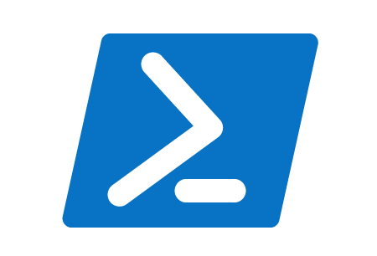

Do you even test, bro?
Adventures with Pester
John McCarthy
midacts

Slide 2
Summary
Properly configuring your functions
What are unit tests
  Creating unit tests
What are integration tests
  Creating integration tests

Slide 3
Writing Functions
Write functions and ultimately modules
  There is a difference in running commands from the console or even writing one off scripts
  Using “aliases” or shortcuts
    Gci, ?, %
Write functions that do only one thing
  No monolithic functions
  This will help your logic in the code and make testing things easier

Slide 4
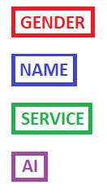
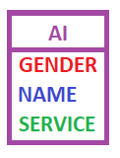

Slide 5
Gotchas
Active Directory cmdlets
PowerCLI cmdlets
Invoke-Command
Integration tests that require credentials
InModuleScope
  https://github.com/pester/Pester/wiki/Unit-Testing-within-Modules

