Slide 1
CoverageLedger
Enrollment transmission, reconciliation & LLM-RAG analytics for a TPA book of business
Built for Nonstop Health — Senior Data Engineer · Christian Kouadio Kouassi
X12 834 · MongoDB · AWS Lambda · S3 · Chroma RAG

Slide 2
What the role asks for
X12 834 enrollment transactions
Real DC HBX companion-guide spec: segment layout and 021/024 maintenance codes, not invented
Transmission ledger, exactly-once
MongoDB ledger with a unique natural-key index; retry-after-success is a verified no-op
Identifier normalization (EIN / group code / member ID)
Reconciliation resolves enrollment events against either identifier, not a single assumed key
AWS serverless orchestration
Real Lambda handler uploading generated 834 files to S3, verified against moto-mocked S3
PMPM/PEPM rollups, census, regulatory outputs
Claims-derived member-months denominator; corrected mid-build from a headcount mistake
LLM-RAG grounded in a governed semantic layer
Chroma index over the real spec and a single versioned field/business-rule layer

Slide 3
Real spec anchor, disclosed-synthetic estate
Real: DC HBX 834 Companion Guide
Disclosed-synthetic: TPA document estate
A real public carrier enrollment spec, not invented.
Segments: ISA · GS · ST · BGN · N1 · INS · REF · DTP · SE · GE · IEA
Maintenance codes (INS03): 021 = Addition
024 = Cancellation / Termination
Generator and reverse-parser round-trip member IDs, maintenance codes, and effective dates — 4/4 tests passing.
6
274
employer-group clients
members
321
1,674
enrollment events
claims
Seeded into a pymongo-API-compatible store (mongomock) — the real mongod binary is unreachable from this sandbox, so the constraint is disclosed, not hidden (see data/bronze/SOURCE.md). One client's enrollment loader is seeded with a real-world identifier bug on purpose — the source of Incident 2.

Slide 4
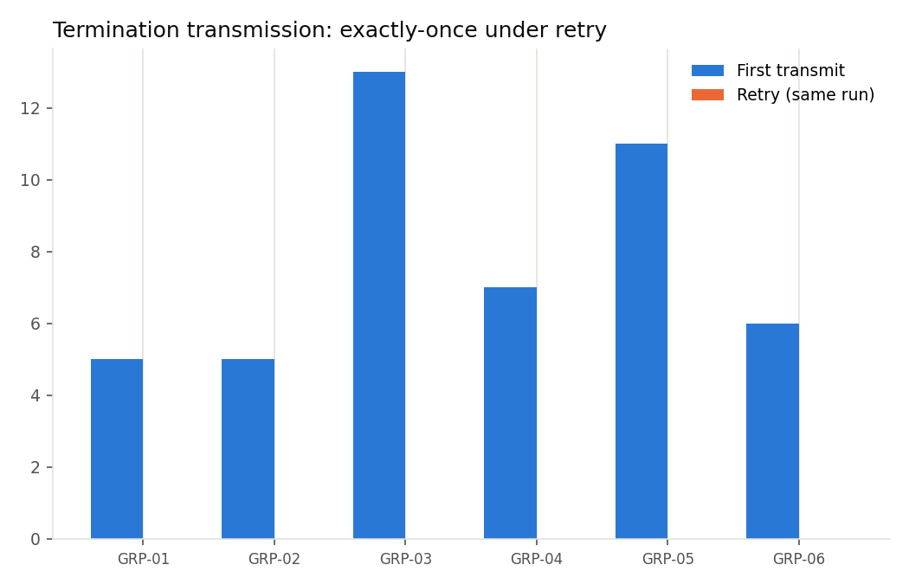
Incident 1 — a retry after success re-sends a termination
Scenario. A simulated SFTP timeout fires after the ledger write already landed. The caller retries from the top.
Naive behavior. transmit_naive() has no memory of what already succeeded — a retry re-sends and re-logs every termination.
Fix. A unique natural-key index on (member_id, event_type, effective_date) plus an already-sent check — a retry after success is a verified no-op.
Business impact. A carrier receiving a duplicate 834 termination can reject the whole batch file or silently double-process it — a real audit/compliance finding waiting to happen.
bc50295 reproduced: ledger doubles after retry
b17620f fixed: retry after success is a no-op, 2/2 tests passing

Slide 5
Incident 2 — an identifier mismatch silently zeroes a census
Scenario. A legacy loader wrote one client's EIN into the group_code field instead of its real group code.
Naive behavior. A straight group_code join reports zero enrolled members for that client — while its claims-derived PMPM still looks fine, masking the problem on the one report that would normally catch it.
Fix. Resolve enrollment events against EITHER group_code OR ein, built from an explicit identifier map — not a single assumed foreign key.
Business impact. A client-facing census report showing zero enrolled members for a paying client erodes trust fast — exactly the reconciliation-mindset failure this role exists to catch.
buggy["enrolled"]
buggy["paid"]
0
> 0
A paying, utilizing client — reported as zero members.
4d5303d reproduced: census zeroed, test confirms bug
88681f2 fixed: resolves by group_code OR ein, 8/8 tests passing
Every other client's figures are unchanged by the fix — proven by a dedicated test, not assumed.

Slide 6
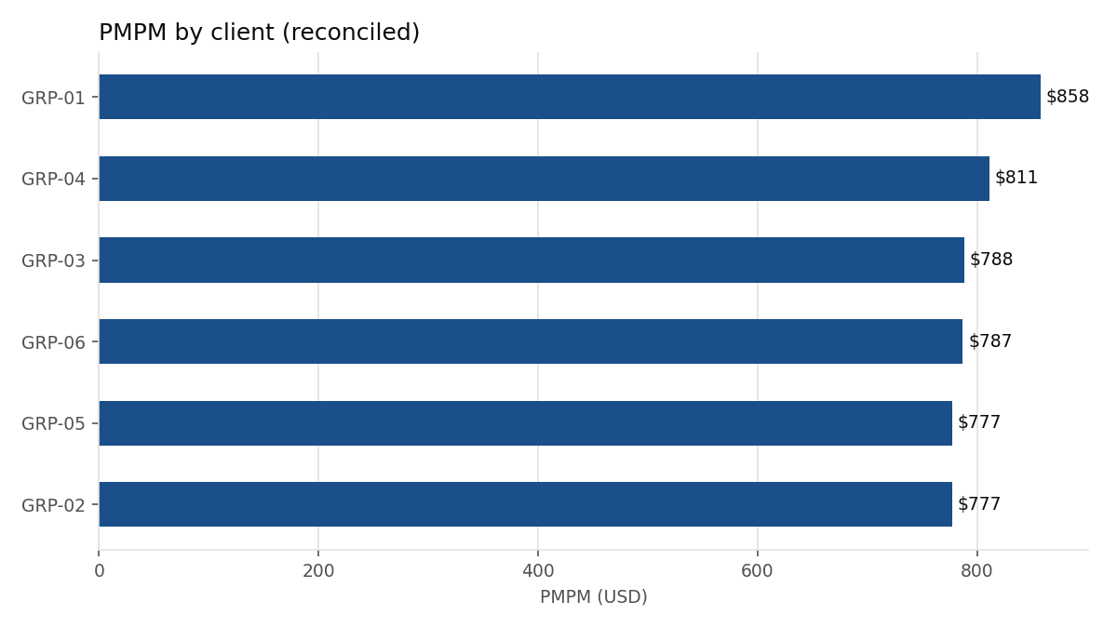
PMPM reconciliation — caught before it shipped
First pass (wrong)
$4,700 – $5,381 / month
PMPM computed as paid ÷ one-time enrollment headcount — not a member-month denominator, and far above a realistic health-plan PMPM.
Corrected
$777 – $858 / month
Re-derived from claims-based member-months — realistic, and still independent of the Incident 2 identifier bug (which lives in census, not PMPM).

Slide 7
A governed semantic layer, grounding both report and RAG
semantic_layer.py
reconcile_pmpm.py
rag_index.py
Field definitions, business rules, join keys — a single versioned source of truth
Reads the semantic layer's join-key rules directly — no second copy of the identifier logic to drift
Indexes the same semantic layer + the real X12 834 spec, so LLM answers can't contradict the governed schema
Grounded Q&A, not guesswork
“What does maintenance code 024 mean?” → grounded in the real X12 834 spec notes, not model prior knowledge
“What's the join key between clients and enrollment_events?” → grounded in semantic_layer.py's own business rules
huggingface.co is blocked in this sandbox, so retrieval runs on a local TF-IDF + TruncatedSVD embedding function — a disclosed stand-in for a hosted embedding model (Bedrock Titan / OpenAI) in production, behind the same Chroma interface. 2/2 grounding tests passing.

Slide 8
Architecture
Real spec +
synthetic estate
→
Generator /
Transmitter
→
Reconciler /
RAG index
→
Lambda →
S3 (moto)
→
Dashboard /
Q&A
Storage
mongomock (pymongo-API-compatible) — no reachable mongod in this sandbox; application code is unchanged against a real cluster
Orchestration
A real Lambda handler, verified against moto-mocked S3; EventBridge/Step Functions documented as the production scheduling layer around it
BI layer
Tableau/QuickSight are the JD's stated tools and are unreachable here; charts render from the same underlying MongoDB queries instead

Slide 9
12/12 tests passing. Two incidents, reproduced and fixed with genuine git history.
Real X12 834 spec · idempotent transmission · identifier-normalized reconciliation · governed semantic layer · grounded RAG · AI-assisted build, human-verified throughout (see AI_DEV_LOG.md)

