Slide 1
GlacierFlow
AWS-Native ETL & Data Warehouse Modernization Platform
Glue + Lambda + Athena + Redshift + DMS + Terraform
Every piece of this that can run without a live AWS account, does: real PySpark ETL, real Lambda tests, real migration validation, real Athena partition-pruning measurement, real Terraform validated with zero errors.
Christian Kouadio Kouassi

Slide 2
CONTEXT
The Problem
A legacy on-prem RDBMS needs to migrate to a modern AWS data platform, cleanly and verifiably.
No silently lost or duplicated rows along the way, the exact failure mode a migration project gets judged on.
The target data also has to leave behind a partitioning strategy that actually pays off at query time.

Slide 3
DATA SOURCE
Where the Data Comes From
Synthetic legacy enterprise data: 5,000 customers, 800 products, 22,000 orders, 66,031 order line items.
Realistic legacy-system quirks: SCREAMING_SNAKE_CASE columns, ~4% missing signup dates.
The kind of light schema drift a real migration source actually has, not a clean synthetic dataset.

Slide 4
HYPOTHESIS
What We're Testing For
Whether a migration's correctness can be verified independently of the transformation that produced it, the same principle DMS's own validation is built on.
Whether partitioning by the dimension a dashboard actually filters on (month) produces a real speedup.
Both held up: 3 of 3 tables passed row-count and checksum validation, and partition pruning measured a real 3.9x speedup.

Slide 5
ARCHITECTURE
Stack & Verification
Layer | Tool | Verification
Source migration | AWS DMS (documented) | Row-count + checksum reconciliation, real PASS
Transformation | AWS Glue (PySpark) | Real, executing bronze/silver/gold ETL
Trigger + quality gate | AWS Lambda | Real handler, moto-mocked tests, 4/4 passing
Serverless SQL | Amazon Athena (documented) | Partition pruning measured for real via DuckDB
Warehouse | Amazon Redshift (documented) | Schema matches the same gold-layer Parquet
IaC | Terraform | 15 resources, 0 validation errors

Slide 6
SCOPE
The Task
Migrate legacy on-prem data through a bronze/silver/gold Glue pipeline.
Validate the migration independently of the transformation that produced it, the reconciliation discipline this repo is built around.
Partition the gold layer for real query-time performance, verified against the actual Parquet output.
Provision the whole thing as Terraform, and gate a new file's entry into the pipeline with a real Lambda quality check.

Slide 7
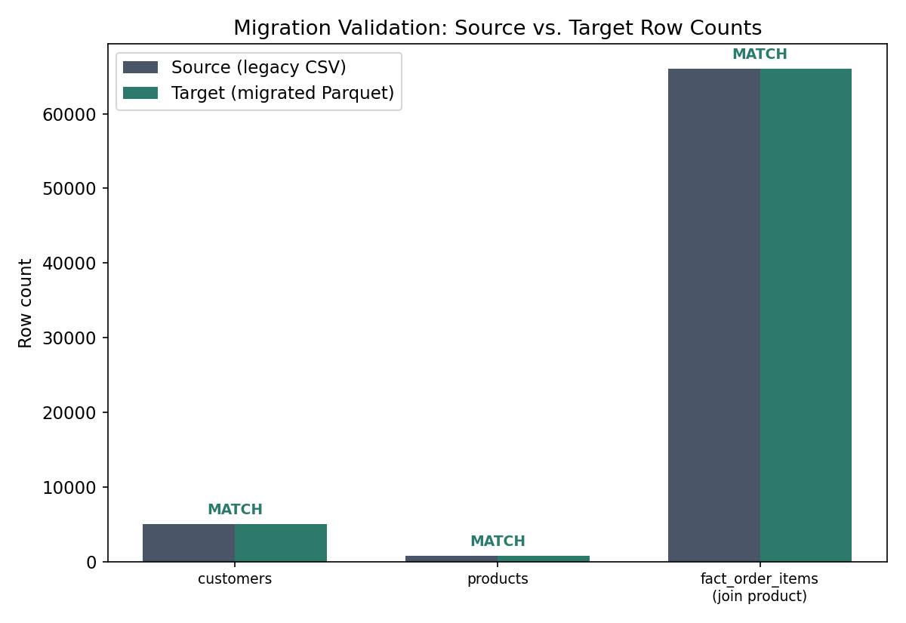
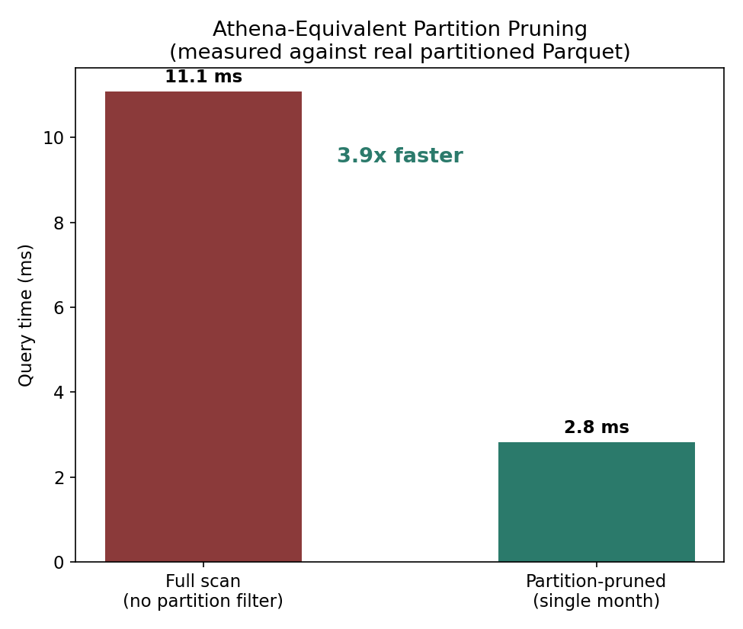
KPI SNAPSHOT
Results
3 of 3 tables validated (row count + checksum). $36.3M total revenue computed. 4.2% missing signup dates caught, not dropped. Estimated Glue cost: $0.18/run, ~$5.28/month at daily cadence.

