Slide 1
LineSight
Real-Time OEE, Statistical Process Control & Predictive Maintenance
Hybrid Databricks + Snowflake architecture, orchestrated end to end by Dagster
A real 5-step Dagster asset graph ran this entire pipeline across both platforms and returned RUN_SUCCESS. See docs/dagster_run_log.txt.
Christian Kouadio Kouassi

Slide 2
CONTEXT
The Problem
A shop floor needs to know, in near real time, whether a line is within statistical control, how efficiently it runs, and whether a machine is about to fail.
That spans classical statistics and modern ML, and in practice runs on two different platforms talking to each other.
Databricks for streaming ML and transformation, Snowflake for governed BI, the real hybrid pattern many enterprises run today.

Slide 3
DATA SOURCE
Where the Data Comes From
4 production lines, 12 machines: 77,760 sensor readings, 19,440 quality measurements, 107 downtime events.
Built on a documented latent-wear degradation process: sensor readings drift and quality degrades as wear increases.
A failure is injected once wear crosses a threshold, giving both SPC and the ML model real, physically-motivated signal.

Slide 4
HYPOTHESIS
What We're Testing For
Whether a real X-bar/R chart can visually surface tool-wear-driven quality drift. It does, drift climbs visibly into the UCL band.
Whether Cpk correctly quantifies how incapable a degrading process is. It does: ~0.02 on every line, far below the 1.33 capable threshold.
Whether a Random Forest can predict failure from sensor data alone. It does: 0.976 ROC-AUC, vibration the dominant feature.

Slide 5
ARCHITECTURE
Stack & Verification
Layer | Tool | Verification
Lakehouse / ML | Databricks (via PySpark) | Real, executing medallion transformation
Predictive maintenance | MLflow + Random Forest | Real model, registered, 0.976 ROC-AUC
Statistical modeling | Python (X-bar/R, Cpk) | Real Shewhart control-chart math
Governed warehouse | Snowflake (synced, via DuckDB) | Real dbt build, 11/11 tests passing
Orchestration | Dagster | Real 5-step asset graph, RUN_SUCCESS

Slide 6
SCOPE
The Task
Transform telemetry through a real Databricks-equivalent medallion pipeline.
Compute real SPC control charts and process capability, train and register a predictive-maintenance model.
Sync the governed layer into Snowflake and certify OEE and downtime Pareto metrics via dbt.
Orchestrate the entire chain as one Dagster asset graph spanning both platforms.

Slide 7
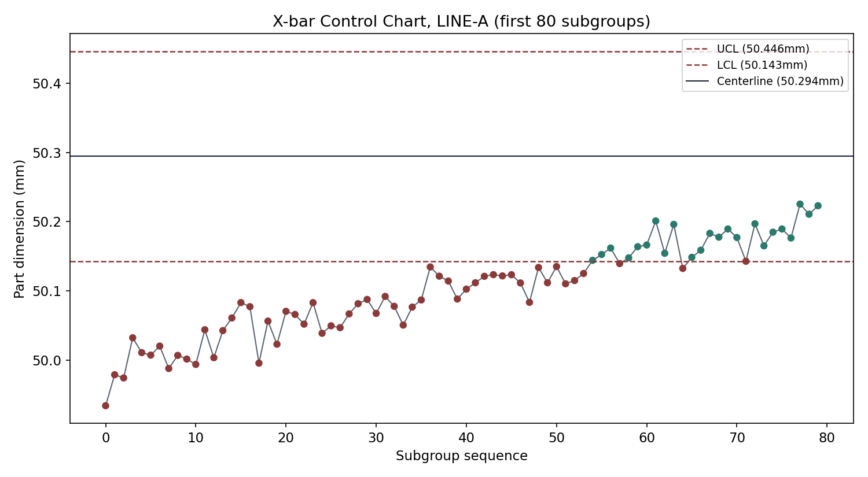
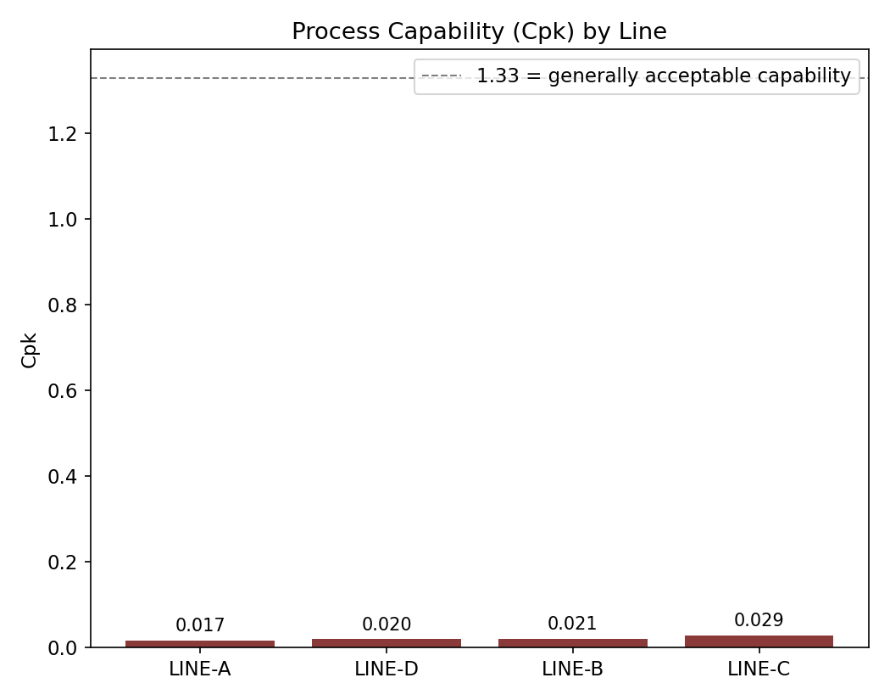
KPI SNAPSHOT
Results: Control Chart & Capability
The control chart makes the wear drift visible by eye. Cpk confirms it numerically: every line is dramatically below the 1.33 capable threshold.

Slide 8
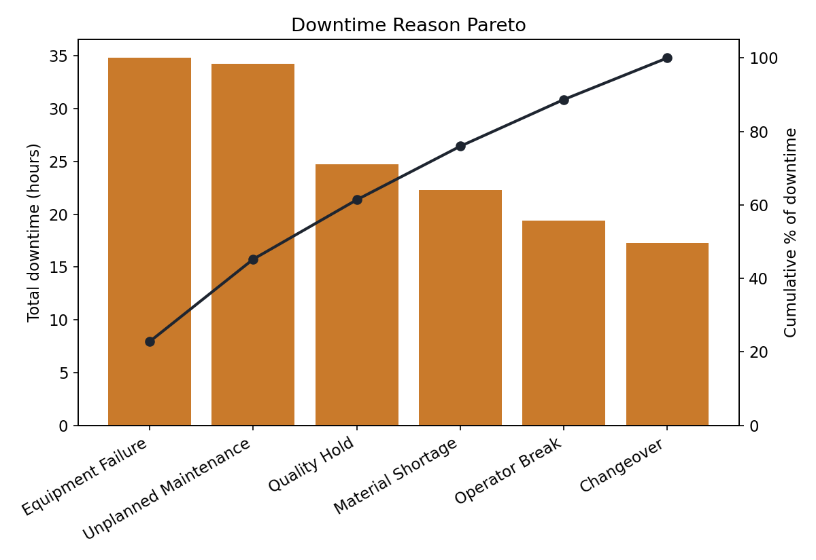
KPI SNAPSHOT, CONTINUED
Results: Downtime & Maintenance
Equipment Failure and Unplanned Maintenance together account for 45% of downtime hours, the top two levers for a plant manager's next improvement project.

