Slide 1
MetricVault
Subscription Revenue Data Product
dbt + MetricFlow + LookML + Dagster + Snowflake + Tableau, with a real SOX reconciliation control
Every pipeline stage in this deck actually ran. dbt build: 40/40 tests passing. Dagster: full asset graph, RUN_SUCCESS.
Christian Kouadio Kouassi

Slide 2
CONTEXT
The Problem
A subscription company's revenue metrics get defined multiple times: a BI calculated field, an analyst's ad hoc SQL, Finance's spreadsheet, and they quietly drift apart.
Because the company is public, the numbers this pipeline produces directly support financial reporting, so accuracy, lineage, and Finance reconciliation aren't optional.
The role: own the shared transformation and metric layer everything else depends on, not a pipeline role, not a dashboard role.

Slide 3
DATA SOURCE
Where the Data Comes From
Synthetic data shaped to mirror real Stripe API objects exactly: Customer, Subscription, Invoice, Charge, Refund, plan-change events.
18-month history, documented growth/churn model: 4,503 customers, ~27,000 invoices, ~3.2% monthly churn.
Finance's independently-recorded ledger (NetSuite GL stand-in) is generated separately, with deterministic noise, so reconciliation results are real and reproducible.

Slide 4
HYPOTHESIS
What We're Testing For
Whether MRR movement classification, the genuinely hard part of subscription analytics, can be built as governed dbt logic both MetricFlow and LookML read identically.
Whether an independent Finance reconciliation catches real variance rather than trivially always passing.
It does: 2 of 18 months fail the 2% control threshold, tied to a documented one-time adjustment, not silently absorbed.

Slide 5
SEMANTIC LAYER
Certified Metrics, One Definition Each
Primary: dbt Semantic Layer / MetricFlow, ARR, MRR, NRR, Logo Retention, Paying Customers, and every MRR movement type, each with exactly one definition.
Secondary: LookML, a migration-period mirror for existing Looker consumers, wired to the same certified mart tables, never independently defined.
Verified: semantic_layer_refresh validated 9 metrics against their underlying measures, live, in the Dagster run.

Slide 6
ARCHITECTURE
Stack & Why It Fits
Layer | Tool | Why
Ingestion | Stripe-shaped extract + Dagster | Matches target ingestion + orchestration stack
Warehouse | Snowflake (verified via DuckDB) | Runnable and testable without a live account
Transformation | dbt (staging → intermediate → marts) | Version control, tests, CI, documentation
Semantic layer | MetricFlow (primary) + LookML (migration) | Certified metrics, one source of truth
Orchestration | Dagster | Real asset graph + SOX asset check
BI | Tableau | Executive ARR/MRR bridge, retention, reconciliation

Slide 7
COMPLIANCE
The SOX Control, Live
fct_finance_reconciliation compares data-team ARR against Finance's independently-recorded ledger, every month, automatically.
The Dagster asset check ran for real and correctly flagged two months by name and exact variance, without blocking the pipeline.
Access control, change management, and this reconciliation are each documented and mapped to a specific SOX ITGC control objective in sox/.

Slide 8
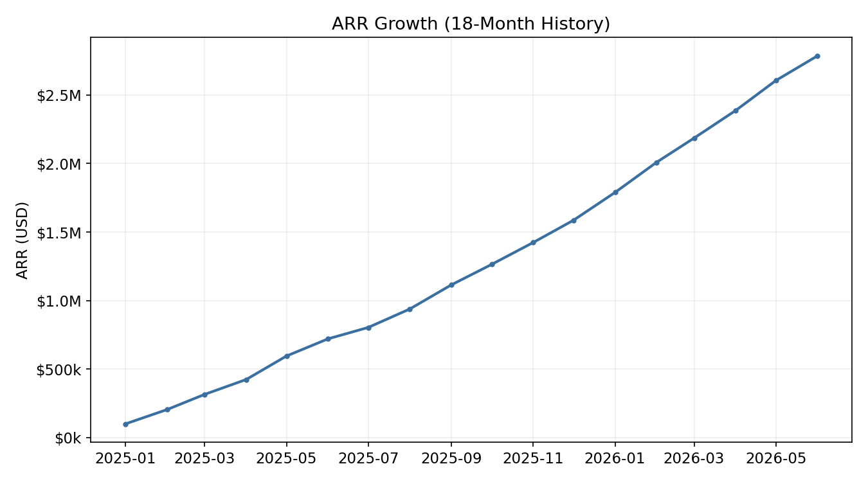
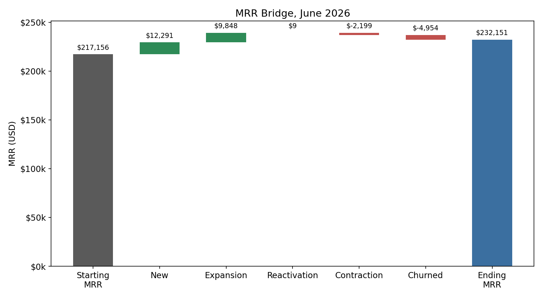
KPI SNAPSHOT
Results
ARR grew from ~$100K to $2.79M over 18 months, 2,888 active paying customers.
114.3% average Net Revenue Retention, 95.3% average Logo Retention across 6-month cohorts.
40/40 dbt tests passing. Dagster: full asset graph RUN_SUCCESS.

Slide 9
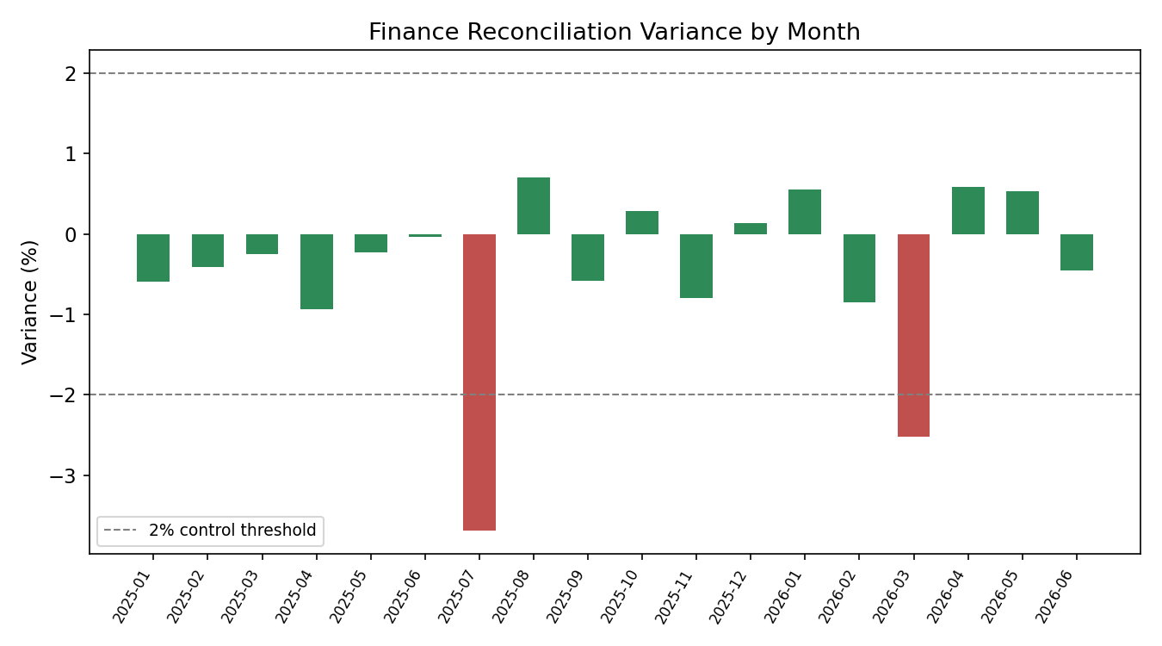
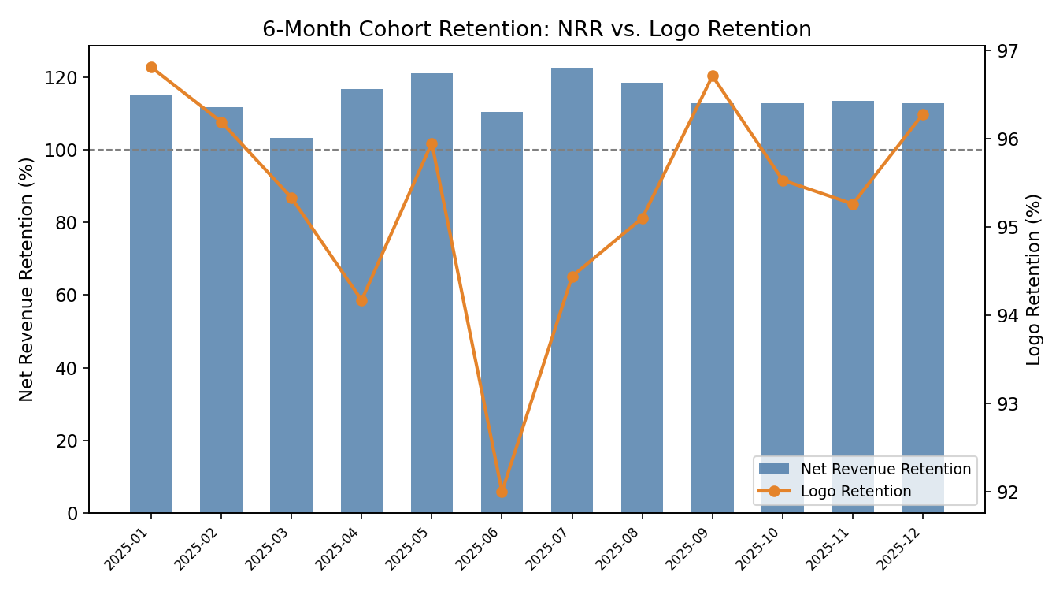
KPI SNAPSHOT, CONTINUED
Reconciliation & Retention
16 of 18 months reconcile within the 2% control threshold; the two flagged months (Jul 2025, Mar 2026) trace to a documented one-time GL adjustment, exactly what this control is designed to catch.

