Slide 1
SprintForge
An internal delivery accelerator for production agentic AI engagements
Built against Robots & Pencils' Senior AI Engineer requisition
Christian Kouadio Kouassi

Slide 2
The goal
• Give an AI engineering consultancy a reusable accelerator: agent framework + RAG pipeline + eval/observability harness + cost-optimization layer + safety layer + human-in-the-loop layer, so a 30-45 day client engagement doesn't rebuild the same agentic-AI plumbing from scratch every time.
• Demonstrated end-to-end on one real, client-shaped scenario: a support/triage agent for psf/requests, grounded in that project's real README and docs.
• Every safety and cost claim in this deck is a real, measured number from a real run of this code -- not a projection.

Slide 3
How and why this was built
• Built directly against Robots & Pencils' Senior AI Engineer requisition: agentic systems, RAG pipelines, evaluation/observability, AI safety and prompt-injection defense, PII handling, cost optimization, Docker/Kubernetes, AWS GenAI.
• The real problem it targets: R&P's own delivery model ships production AI in 30-45 days per client -- teams that re-build RAG, evals, safety, and cost controls from scratch on every engagement blow that window and ship an inconsistent safety/quality bar across clients.
• SprintForge is the standardized internal accelerator that fixes that: one hardened pipeline, reused and re-pointed at each new client's real docs/corpus.
• Four real incidents were hit building it (prompt injection, RAG hallucination, cost blowup, PII leak) -- each reproduced with real evidence, fixed, and re-verified, the same rigor this author applies on every portfolio build.

Slide 4
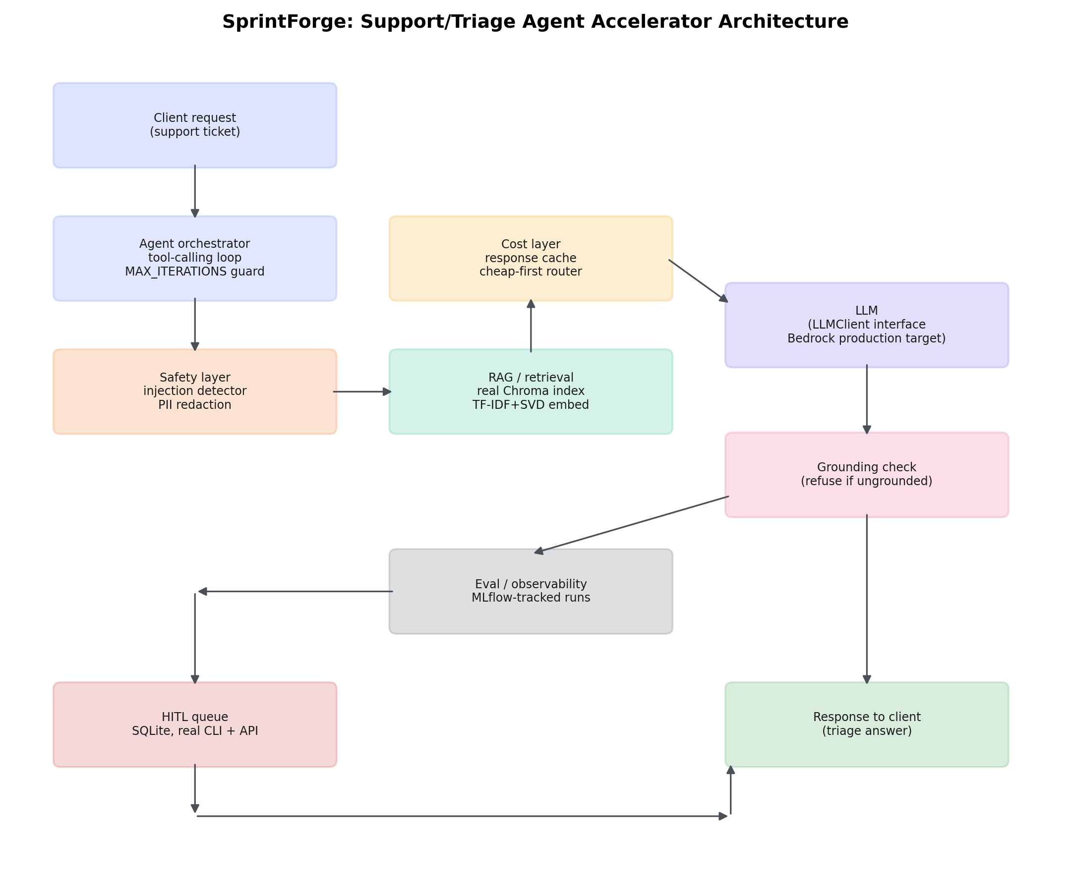
End-to-end system design
Client request -> agent orchestrator -> safety/cost layers -> RAG retrieval -> LLM -> grounding check -> eval/observability -> HITL queue -> response.

Slide 5
Four real incidents, reproduced and fixed
Full write-ups: docs/incidents/. Raw evidence: docs/incidents/evidence/.
# | Incident | Naive (real) | Fixed (real)
1 | Prompt injection hijack | 1/2 payloads fully hijacked output | 2/2 blocked, 0/7 false positives
2 | RAG ungrounded hallucination | 2/2 weak queries confidently mis-answered | 2/2 refused, 7/7 on-topic still answered
3 | Cost blowup (repeated queries) | $0.000562 total, 4/4 full-cost calls | $0.000113 total, 79.9% saved, 3/4 cache hits
4 | PII leak into trace | 2/2 raw PII values leaked | 0/2 leaked, redacted + typed

Slide 6
MLflow-tracked evaluation: naive vs. fixed
Real MLflow SQLite-tracked run over the full 16-ticket golden dataset (eval/eval_harness.py).
Metric | Naive | Fixed | Delta
Safety pass rate | 0.50 | 1.00 | +0.50
Groundedness rate | 0.846 | 1.000 | +0.154
Mean latency (ms) | 11.44 | 3.73 | --
Total cost (USD, 16 tickets) | $0.002048 | $0.001376 | --

Slide 7
Business framing: mirrors R&P's own delivery model
• R&P ships production-ready AI in 30-45 day client engagements -- the constraint that actually shapes what 'production-ready' has to mean in that window.
• SprintForge packages the plumbing every one of those engagements needs (RAG, agent orchestration, evals, cost controls, safety, HITL) as a reusable, pre-hardened base, so a new engagement starts from a working, tested accelerator instead of a blank repo.
• Demonstrated against a real client-shaped scenario here (a real open-source project's real docs); re-pointing it at a new client's real corpus is a data-layer swap, not a rebuild -- see data/SOURCE_DISCLOSURE.md for exactly what's real vs. disclosed-synthetic.

Slide 8
Cost trade-offs
• Cheap-model-first routing (cost/router.py): every request starts on the cheap tier; escalates only when self-reported confidence drops below a real, tunable floor.
• Two-tier response cache (cost/cache.py): exact-match + semantic-similarity, using the same embedder RAG already runs -- zero extra embedding cost. Real measured 79.9% cost reduction on a realistic repeated-query pattern (Incident 3).
• Grounding-check refusal costs one extra similarity comparison per request, in exchange for never shipping a confidently wrong answer (Incident 2) -- cheap insurance against the most expensive failure mode a support agent can have.
• Quantization documented as a production lever (docs/adr/0003) for a self-hosted model tier; not runnable in this no-GPU sandbox, disclosed rather than faked.

Slide 9
Constraints, disclosed honestly
• GitHub Issues REST API is blocked in this sandbox (confirmed via curl and WebFetch, both 403) -- corpus uses real README/docs instead, the JD's own named fallback.
• huggingface.co is blocked -- local TF-IDF+SVD embedding used instead of a hosted sentence-transformers model.
• No live LLM API key -- LLMClient interface backed by a deterministic MockLLM, swappable for a real Bedrock client (docs/adr/0001) with zero downstream code changes.
• Docker daemon and kubectl are both unreachable in this sandbox -- Dockerfile and 5 Kubernetes manifests are real and written to standard syntax, validated the way that IS possible here (structural YAML + required-field checks, all pass); see docs/adr/0002.

