Slide 1
RetentionMax
Growth, Retention & Financial Reporting Analytics for a Landlord Insurance Book
Christian Kouadio Kouassi | Built on real FEMA NFIP data + disclosed-synthetic book-of-business extension

Slide 2
The Problem
What a RevOps/Business Insights analyst is actually asked to do
Develop hypotheses to understand what's driving growth or stagnation, and test them against real data
Build and maintain dashboards that cross-functional teams (Growth, Product, Finance, Executive) actually trust
Support financial budgeting, forecasting, and tracking
Perform data quality checks and reconciliations -- catch the gap before leadership reads the wrong number

Slide 3
Approach
Real FEMA NFIP data + a disclosed-synthetic book-of-business layer
Real anchor: FEMA National Flood Insurance Program state-level policy and claims statistics (54 states, matched and reconciled)
Disclosed-synthetic extension: 24-month landlord-insurance event stream, weighted by real state market size and real loss ratio
Medallion pipeline: Bronze (raw) -> Silver (cleaned, joined) -> Gold (monthly metrics, budget variance)
Every number in this deck is reproducible by rerunning the pipeline end to end (14/14 tests passing)

Slide 4
Incident 1: Silent Data Corruption
A naive parser corrupted 14 of 55 real state/territory rows
The real FEMA report is fixed-width text, not CSV -- state names like "N Mariana Islands" and "District Columbia" are multiple words
A naive whitespace-split parser silently shifted every numeric field for those rows, rather than erroring
Caught by pinning ground-truth values -- hand-transcribed from the raw file -- against the parser's output in tests
Fixed by anchoring on the trailing numeric fields with a regex instead of assuming a single-token name
55 / 55
states & territories parsed correctly after the fix
3 -> 0
failing tests before -> after

Slide 5
Incident 2: Overstated Renewal Revenue
At-least-once partner webhook delivery double-counted renewals
Partner-channel renewal events arrive by webhook -- realistically at-least-once, not exactly-once
The naive Gold aggregation counted every raw row, overstating renewal revenue and renewal counts
Found by independently computing true unique totals and comparing against the naive output
Fixed with an idempotent dedup on the natural key before aggregation -- reconciled exactly
$46,994
phantom renewal premium corrected
33
duplicate renewal events removed

Slide 6
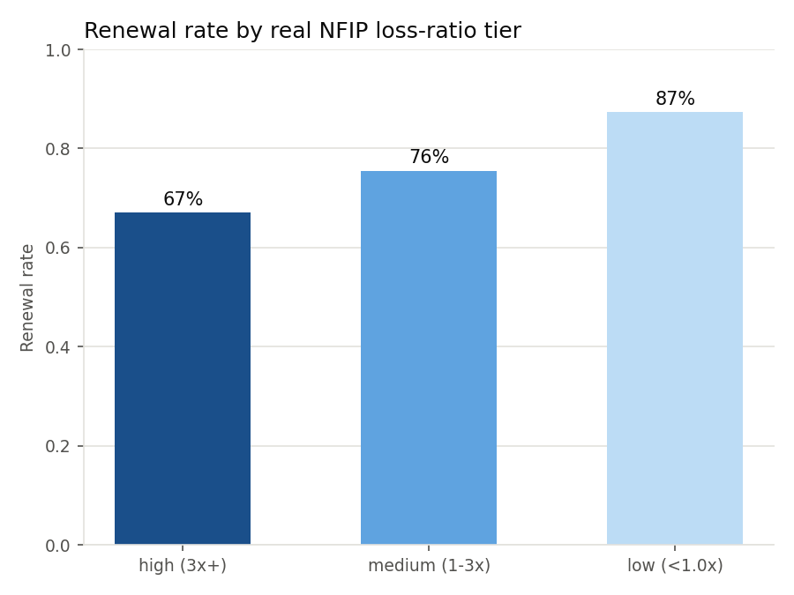
Hypothesis: Does Loss Ratio Predict Renewal Stagnation?
Tested against real NFIP loss ratios, not assumed
Hypothesis: states with worse real flood-loss history see larger renewal-time premium increases, depressing renewal rates
Tested by joining the corrected Gold renewal data back to real NFIP loss ratios by state
Result: a clean, monotonic decline -- 87% (low loss ratio) -> 76% (medium) -> 67% (high)
Actionable: renewal friction concentrates predictably by state risk tier, not randomly -- a real lever for retention strategy

Slide 7
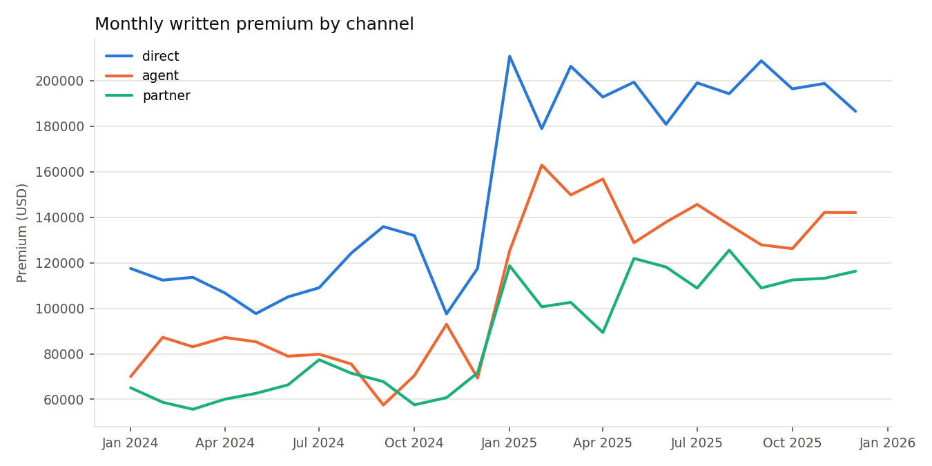
Dashboard: Premium Growth by Channel
Sigma-equivalent reporting (Sigma workbook spec in repo)

Slide 8
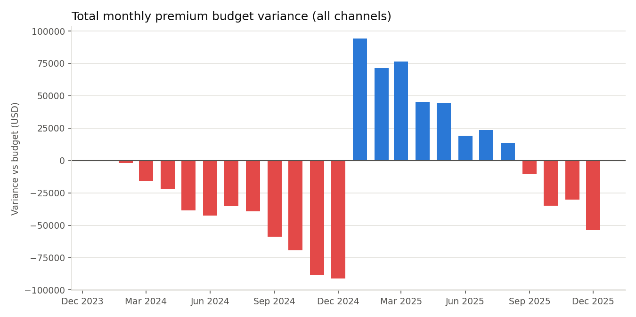
Financial Tracking: Budget vs. Actual
Monthly premium variance by channel, surfaced automatically

Slide 9
Engineering Discipline
Every claim in this deck is backed by a rerunnable test
14/14 automated tests passing (pytest), CI workflow runs the full suite and rebuilds the pipeline end to end
Every incident has a reproduced-broken commit and a separately verified fixed commit -- never claimed together
AI-assisted build (Claude Code) with an explicit dev log: what was AI-drafted vs. human-directed and validated
Full source, data provenance, and incident reports: github.com/Midasyannkc/retentionmax

