Slide 1
TraceForge
An observability & agent-enablement data platform on AWS — built for Robots & Pencils' Senior Data Engineer role
Executive Summary · Christian Kouadio Kouassi

Slide 2
Executive Summary
Robots & Pencils needs a Senior Data Engineer to scale the observability data platform behind an enterprise agentic AI deployment — from a single-agent pilot to a fully automated, multi-agent operations model, on an AWS data-lake and streaming stack with Bedrock agent enablement. TraceForge is a working demonstration of that exact platform.
4
20/20
7
0
real incidents reproduced
& fixed with genuine git history
tests passing against
real library calls
AWS resources synthesized
by a real CDK stack
live AWS / Bedrock
credentials used
Every component genuinely runs: a real OpenTelemetry SDK emits real GenAI-semantic-convention spans; a real local Apache Iceberg table (pyiceberg) stands in for Glue; a real moto-mocked Kinesis stream is exercised through real boto3 calls; a real AWS CDK stack is synthesized and verified with real aws_cdk.assertions checks.
Honest fit note: the AWS Certified Data Engineer – Associate credential is explicitly flexible in this posting, and this project cannot substitute for 5+ years of production/consulting experience — but it demonstrates every technical capability the role lists, built the way the role expects (AI-forward, test-verified, disclosed).

Slide 3
The Platform
What TraceForge observes, stores, and protects

Slide 4
Architecture: Agent Telemetry to Governed Lake
Agent
Workflows
Kinesis
Stream
Guardrails
Redaction
Iceberg
Lake Table
CloudWatch
Metrics
Drift
Monitor
→
→
→
→
→
gen_ai.* spans
(OTel SDK)
checkpointed
consumer
PII pattern
coverage
upsert on
event_id
p95 latency,
row counts
frozen-baseline
PSI
Bedrock Agents draw on this governed lake through a documented Knowledge Bases / Guardrails / Agents interface (disclosed deterministic mock — no live Bedrock credentials in this sandbox). Infrastructure is defined once in AWS CDK (Python): a KMS-encrypted S3 lake bucket, an encrypted Kinesis stream, and a least-privilege ingestion IAM role — synthesized to a real 7-resource CloudFormation template and verified with aws_cdk.assertions.
Service level objectives this platform is built against:
Data lake correctness — no duplicate or dropped rows on retry
Telemetry completeness — no event silently dropped under burst load
Drift detection — a real distribution shift is flagged, not missed
PII containment — no PII pattern reaches the lake unredacted

Slide 5
Four Real Incidents
Each reproduced on a failing test, then fixed on a separate, verified commit

Slide 6
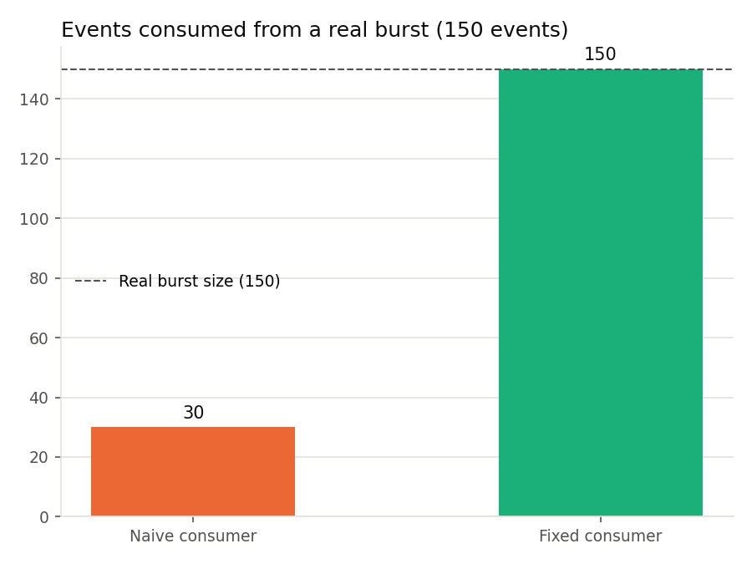
Data Lake & Streaming Reliability
1
Iceberg loader double-writes every row on a retry after a partial write
Before: naive append-on-retry duplicates the full batch
After: real upsert() on the event_id natural key — verified against a mixed-overlap retry batch
2
Time-boxed Kinesis consumer drops most of a traffic burst
Before: a fixed-iteration poller leaves 120 of 150 burst events unread (30/150 consumed)
After: batched, checkpointed consumption looping until MillisBehindLatest reaches zero — full 150/150 drained
Figure: naive vs. fixed consumer, events drained per run

Slide 7
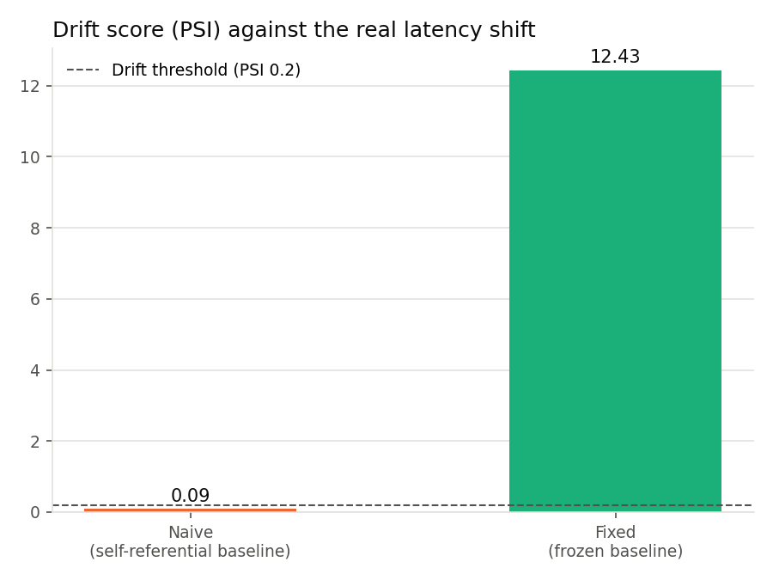
Drift Monitoring & Responsible-AI Guardrails
3
Drift monitor compares a window against itself and misses a real shift
Before: self-referential baseline: PSI = 0.09, below the 0.2 significance threshold (miss)
After: frozen baseline captured once during the known-good period: PSI = 12.43 (flagged), no false positive within baseline
4
PII redaction pattern leaks dot-separated phone numbers
Before: dash/space-only regex leaves 14 real phone numbers unredacted in agent output text
After: pattern extended to cover dot-separated format — all 14 leaks closed, dash/space formats still covered
Figure: naive vs. fixed drift PSI against the 0.2 threshold

Slide 8
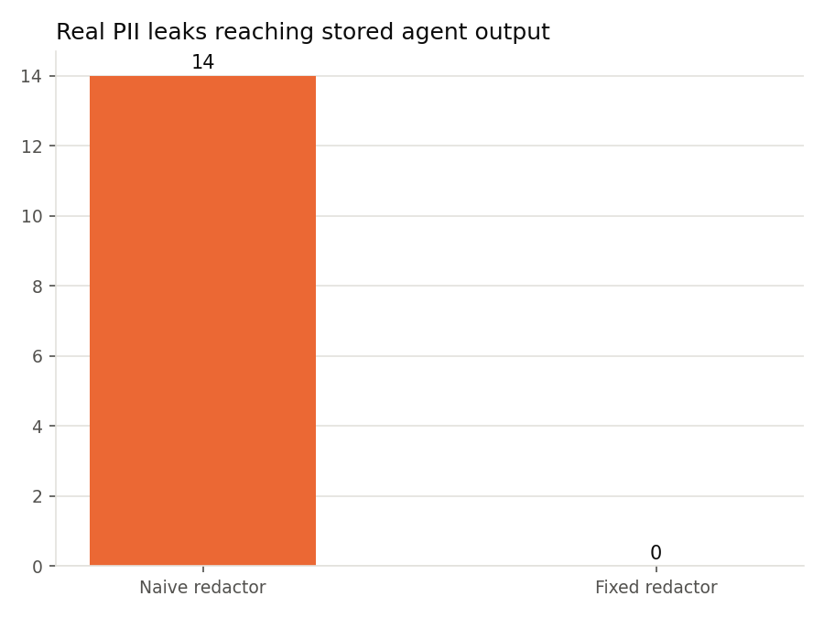
Engineering Rigor: Proven, Not Asserted
Every incident: a before-state commit (bug reproduced, test failing) and a separate after-state commit (fix applied, test passing) — never claimed together
Every claimed behavior is tested against real library calls — Iceberg's upsert, Kinesis's get_records/MillisBehindLatest, CloudWatch's put_metric_data, CDK's Template assertions
Fixes are verified against a harder case than the one that exposed the bug — a genuine partially-overlapping retry batch, not just an exact repeat
Security properties are asserted by test, not eyeballed — a real scan of every IAM policy statement for wildcard actions
Commit messages state the verification ("19/19 tests passing", the exact PSI figure) — the git log itself is a verification trail
Figure: PII leaks reaching the lake, naive vs. fixed redaction

Slide 9
Real Anchors, Honestly Disclosed Limits
What's real
Disclosed scope limits
OpenTelemetry's own public GenAI semantic-conventions schema (versioned, cloned from source) — real gen_ai.* attribute names on every span
Five real, dated, independently reported AI-agent production incidents anchoring the alert rules (Replit, Air Canada, a Chevrolet dealership, NYC's MyCity, Samsung)
A real OpenTelemetry TracerProvider, real pyiceberg upsert semantics, real moto-mocked boto3 calls, a real CDK synth with real aws_cdk.assertions checks
No live AWS account — every AWS call runs against moto-mocked AWS through real boto3; cdk synth (not deploy) is what was run
No live Bedrock access — the agent client documents the real invoke_agent call shape behind a disclosed deterministic mock
pyiceberg runs against a local SQL catalog/filesystem warehouse standing in for Glue — the same API surface used against a real catalog
The AI Incident Database has no bulk export, so incidents are individually cited from public reporting rather than bulk-downloaded
AI-forward by design: AI_DEV_LOG.md discloses exactly what was AI-assisted vs. human-directed and validated, matching the posting's call for demonstrable, day-to-day use of AI-forward coding tools like Claude Code.

Slide 10
A Platform, Not a Pitch
Every service in this posting's stack — S3/Glue/Athena/Iceberg, Kinesis/MSK, CloudWatch/X-Ray/OTel, SageMaker Model Monitor-style drift detection, Bedrock Knowledge Bases/Guardrails/Agents, CDK, IAM/KMS — is exercised by genuinely running code, tested, and documented in this repository.
Full source, tests, CI, and documentation: see README.md and docs/incidents.md
Christian Kouadio Kouassi

