Slide 1



SARS-Cov-2 Spike Protein Analysis using second Vassiliev Measure
UTC iCompBio REU 2021
Jason Middlebrook
Professor Eleni Panagiotou

Slide 2
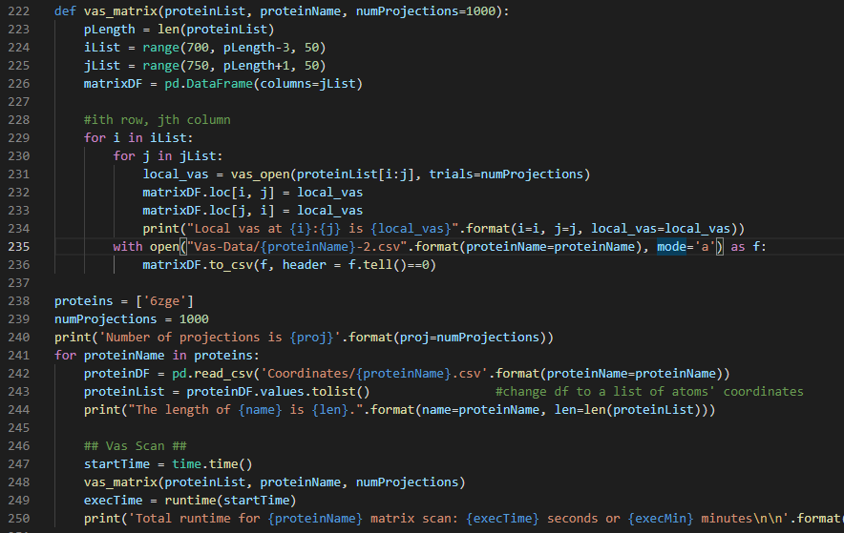
Code Example

Slide 4

Total Values Of V2 For Proteins At 100 And 1000 Projection Sizes

Slide 5
Total Values Of V2 For Proteins At 1000 And 2000 Projection Sizes

Slide 6
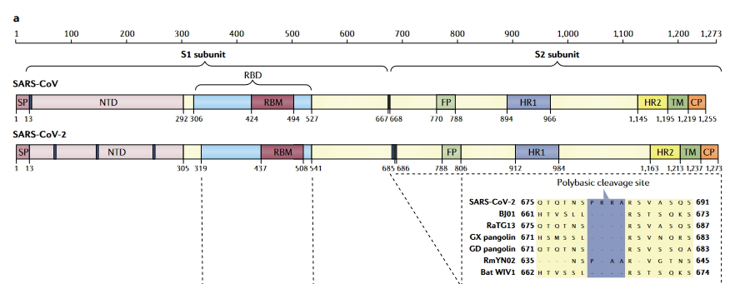
Protein Structure and Approximate Domains
Source: [1], figure 3a

Slide 7
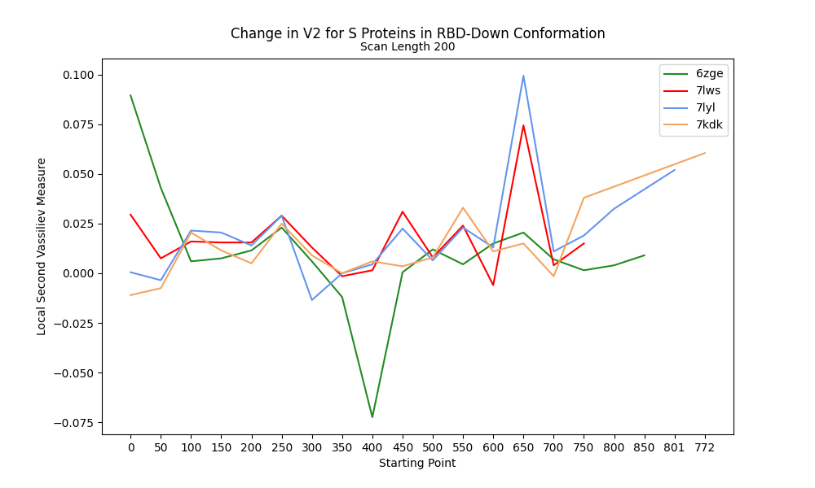
Change in V2 along RBD-Down Proteins

Slide 8
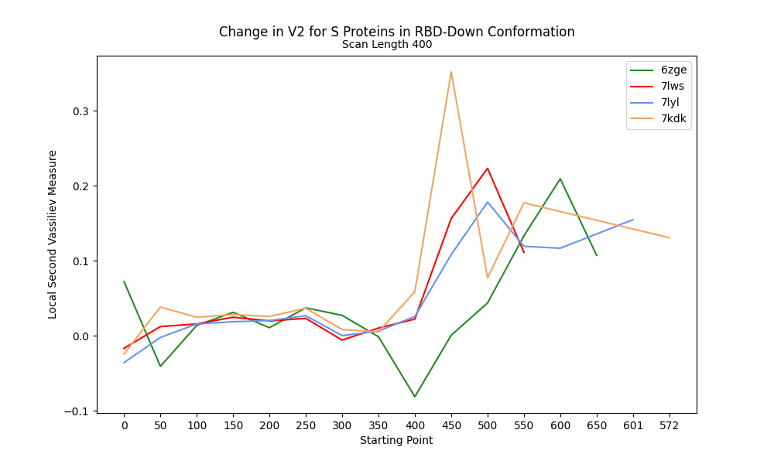
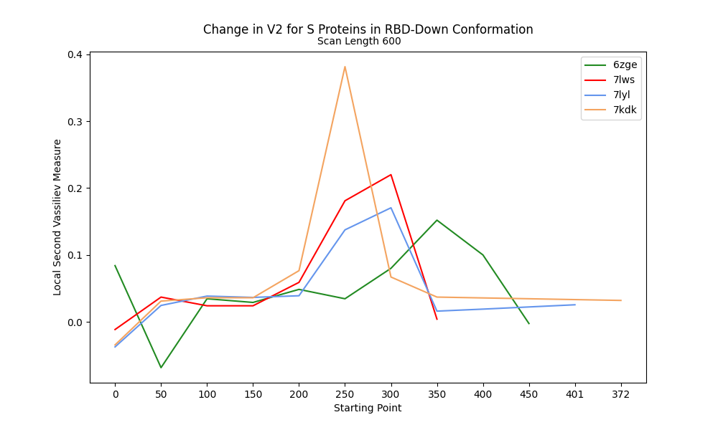
V2 along RBD-Down Proteins at 400 and 600 Scanning lengths

Slide 9
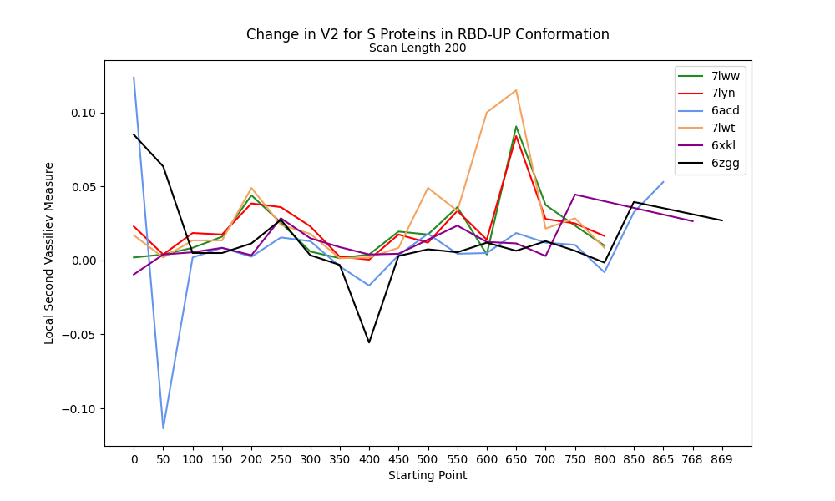
Change in V2 at 200 Scan Length for RBD-Up

Slide 10
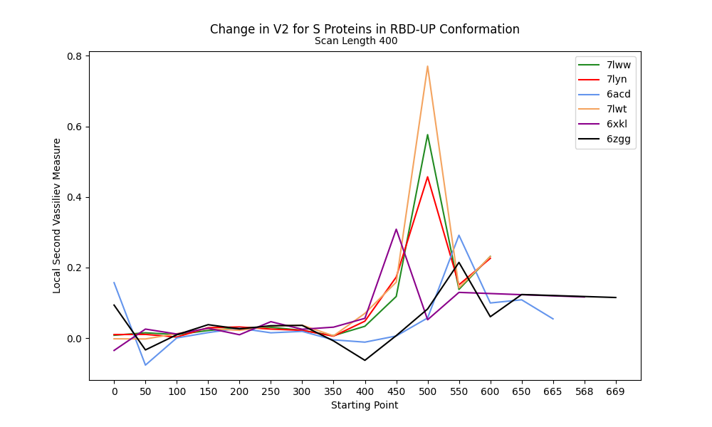
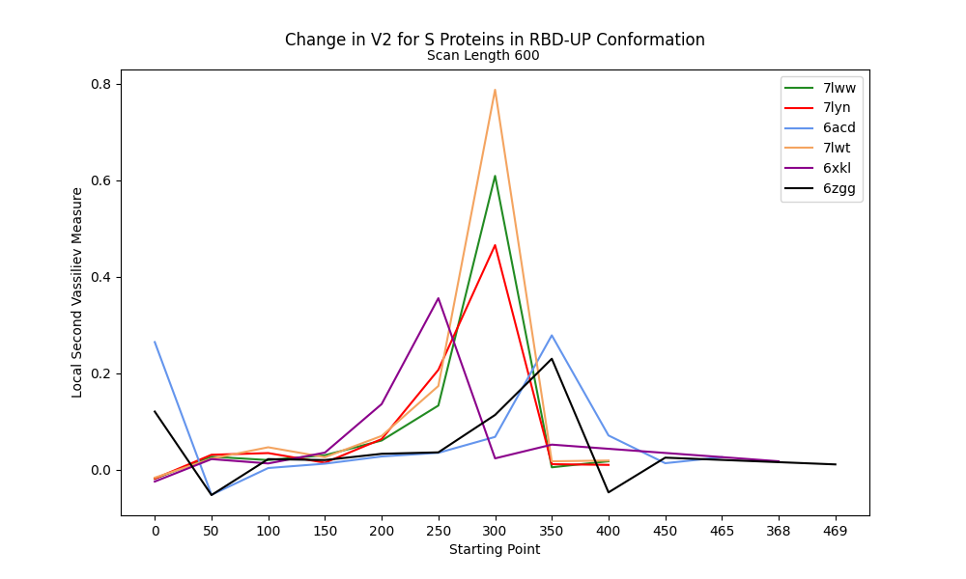
V2 along RBD-Up Proteins at 400 and 600 Scanning lengths

Slide 11
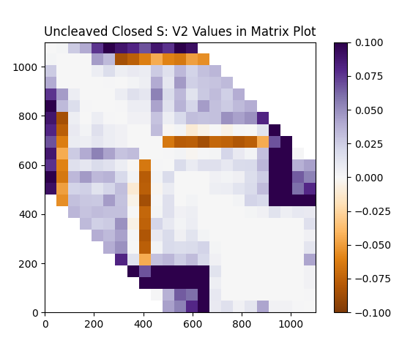
Difference Distance Matrix (DDM) for the V2 values Of The Uncleaved Closed S Protein For SARS-CoV-2 (PDB: 6zge)

Slide 12
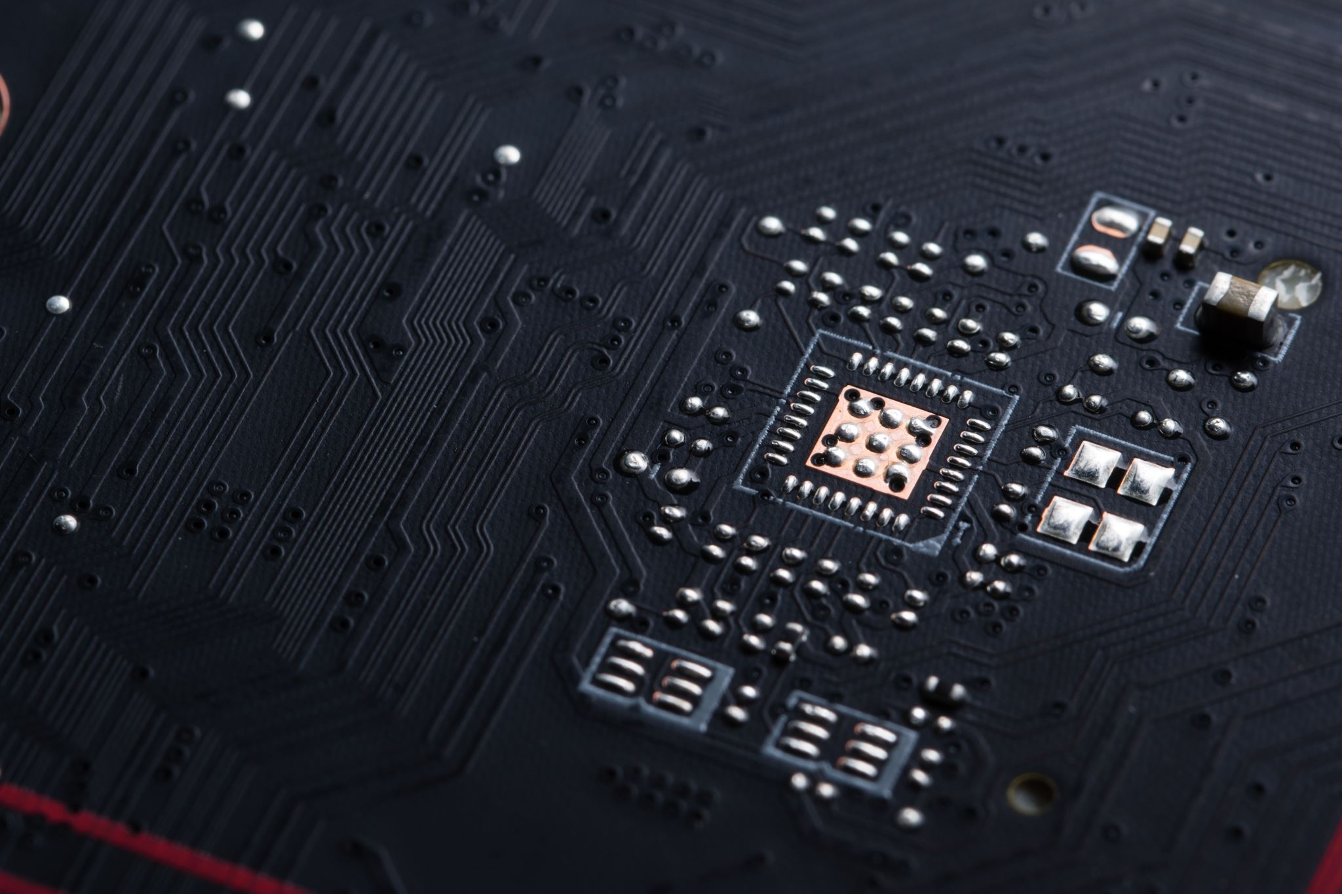
THANK YOU
References:
Hu, B., Guo, H., Zhou, P. et al. Characteristics of SARS-CoV-2 and COVID-19. Nat Rev Microbiol 19, 141–154 (2021). https://doi.org/10.1038/s41579-020-00459-7
https://github.com/MiddlebrookJF/iCompBio-Summer2021
MiddlebrookJF@gmail.com

