Slide 1



SARS-Cov-2 Spike Protein Analysis using second Vassiliev Measure
Subtitle

Slide 2
Total Values of V2 for Proteins At 100 and 1000 Projection Sizes

Slide 3
Total Values of V2 for Proteins At 1000 and 2000 Projection Sizes

Slide 4
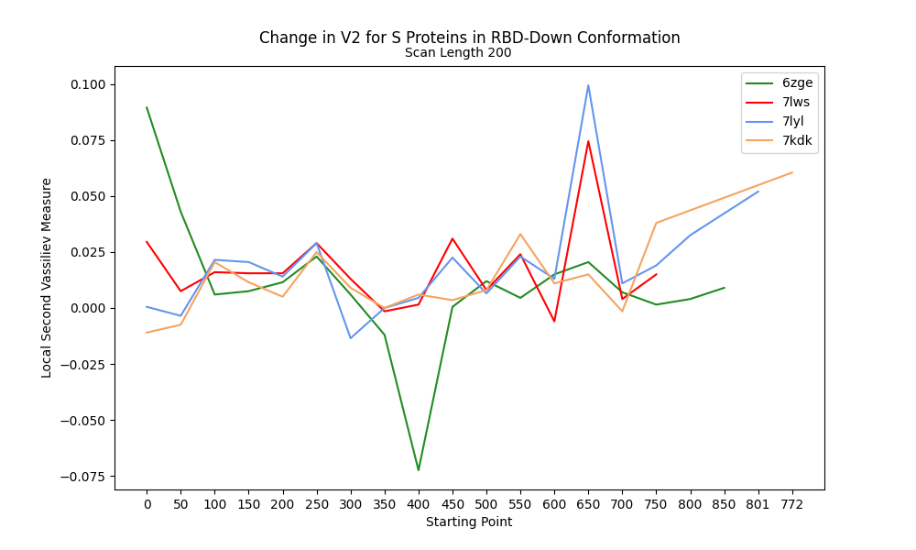
Change in V2 along RBD-Down Proteins

Slide 5
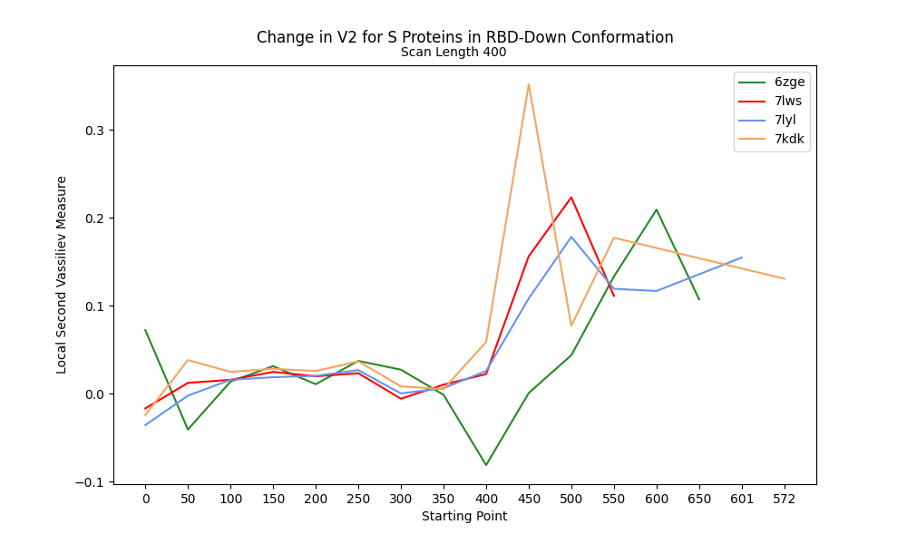
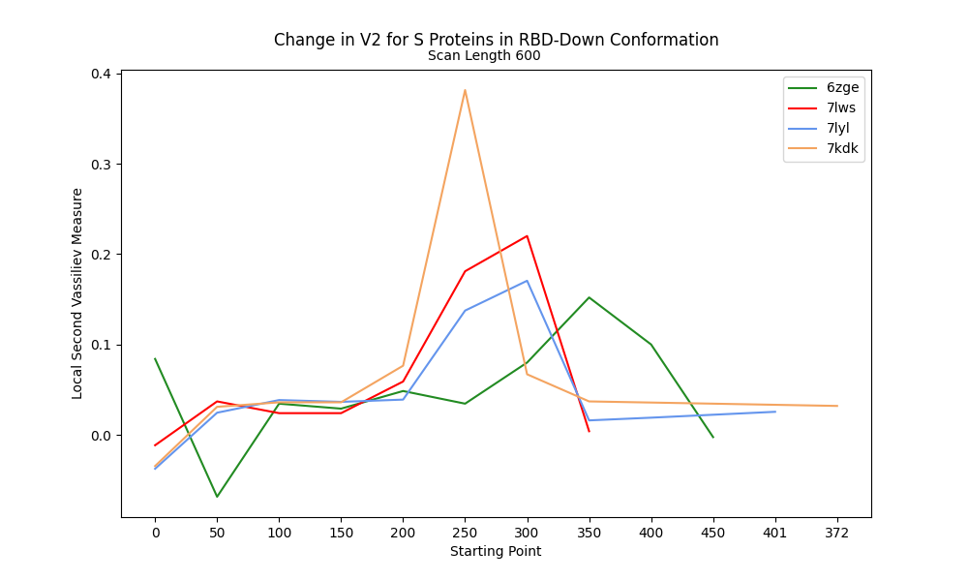
V2 along RBD-Down Proteins at 400 and 600 Scanning lengths

Slide 6
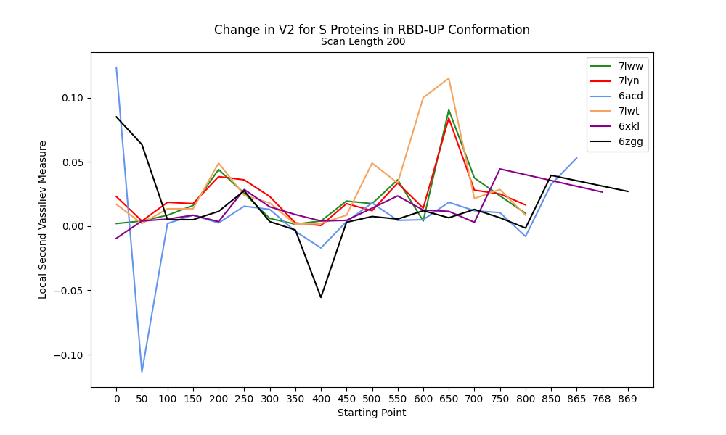
Change in V2 at 200 Scan Length for RBD-Up

Slide 7
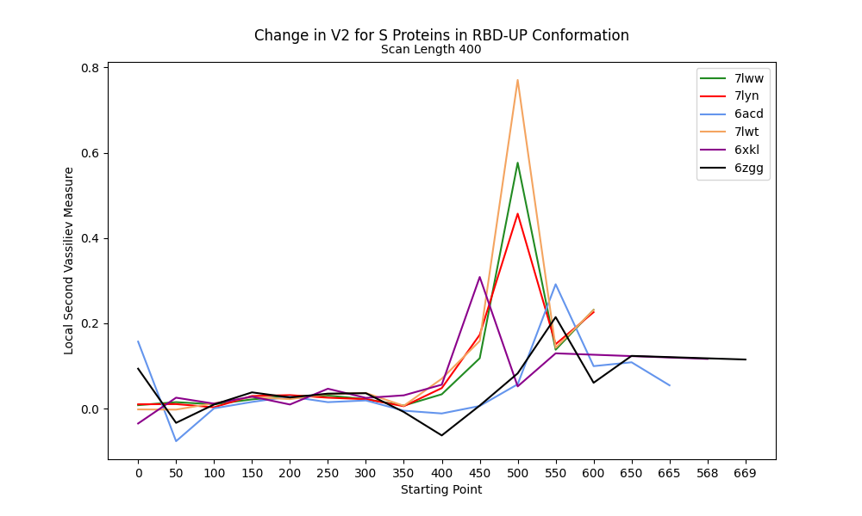
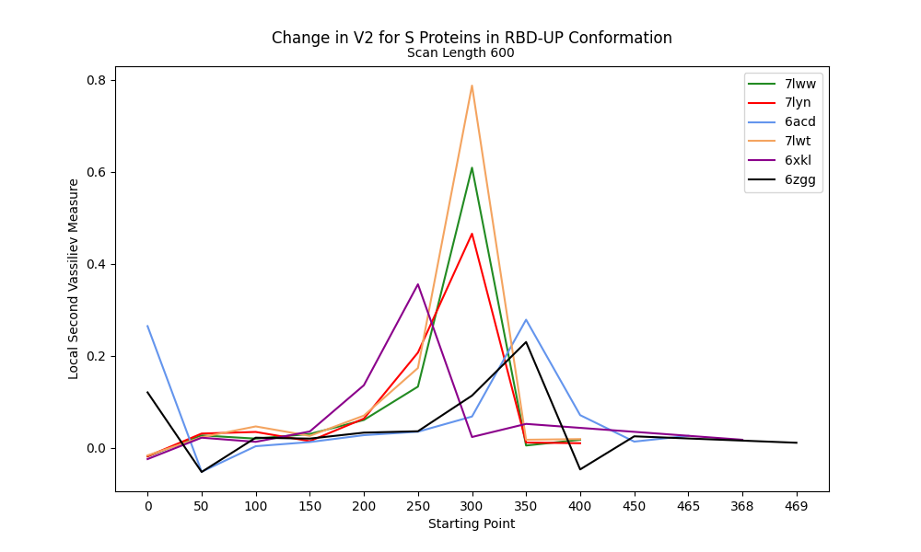
V2 along RBD-Up Proteins at 400 and 600 Scanning lengths

Slide 8

THANK YOU

