Slide 1



SARS-Cov-2 Spike Protein Analysis using second Vassiliev Measure
Subtitle

Slide 2
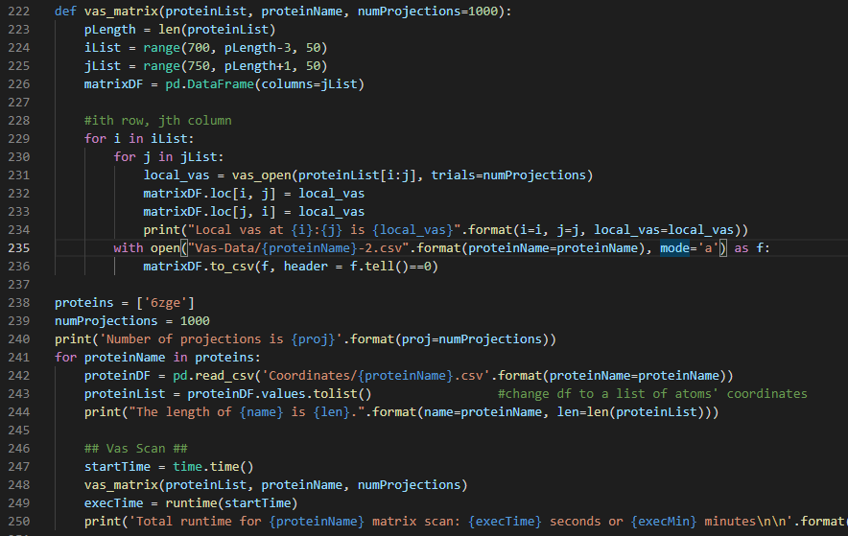
Code Example

Slide 4

Total Values Of V2 For Proteins At 100 And 1000 Projection Sizes

Slide 5
Total Values Of V2 For Proteins At 1000 And 2000 Projection Sizes

Slide 6
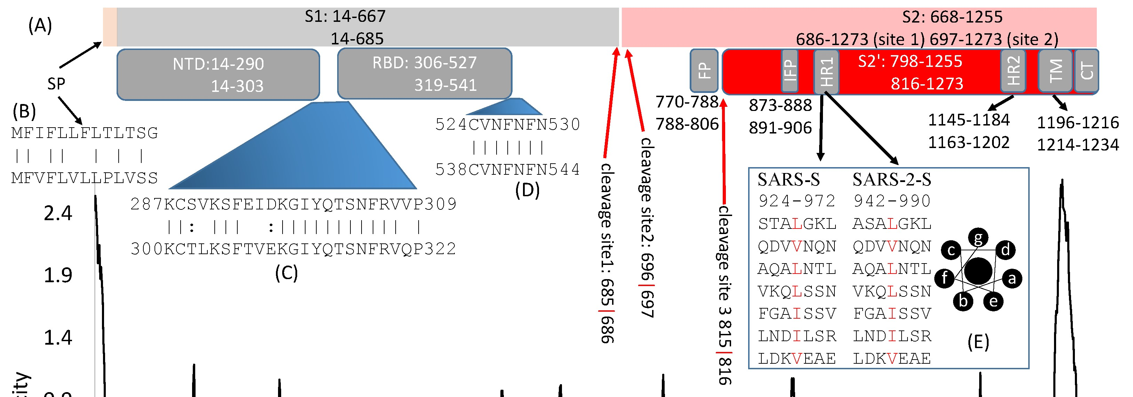
Protein Structure and Approximate Domains
Source: [1], graph truncated for space

Slide 7
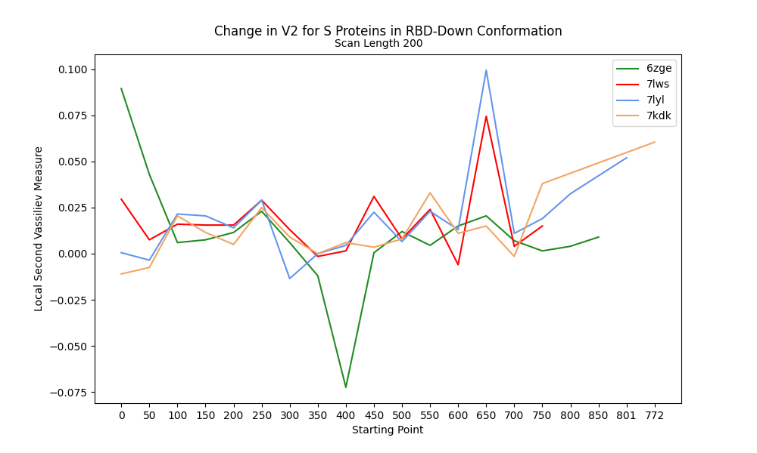
Change in V2 along RBD-Down Proteins

Slide 8
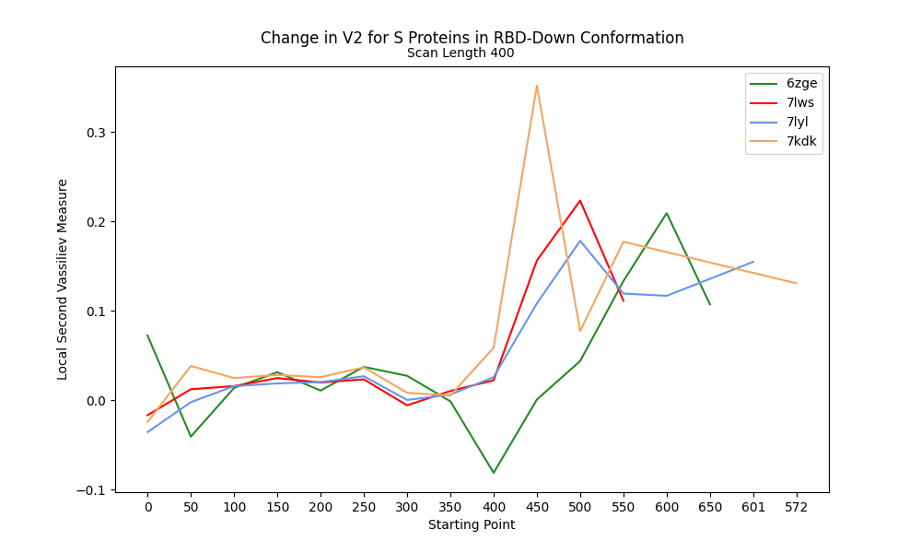
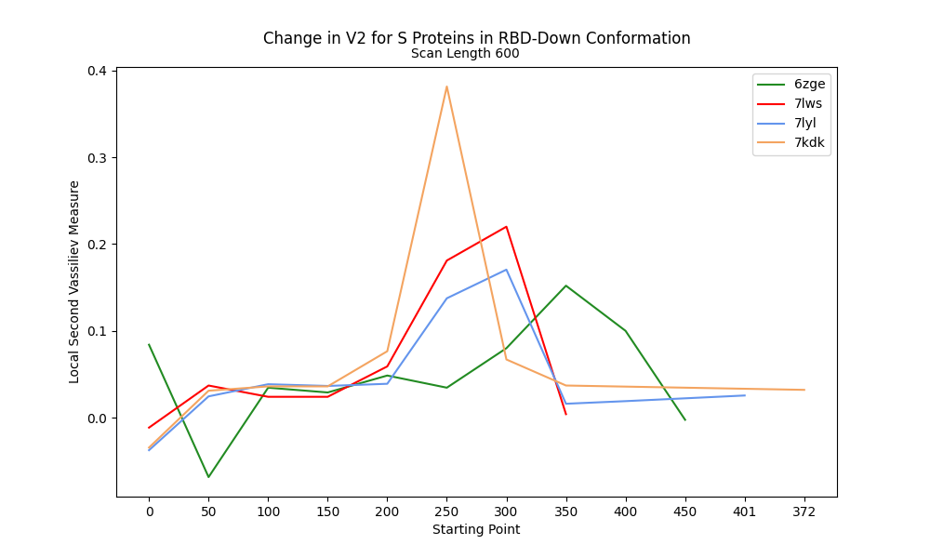
V2 along RBD-Down Proteins at 400 and 600 Scanning lengths

Slide 9
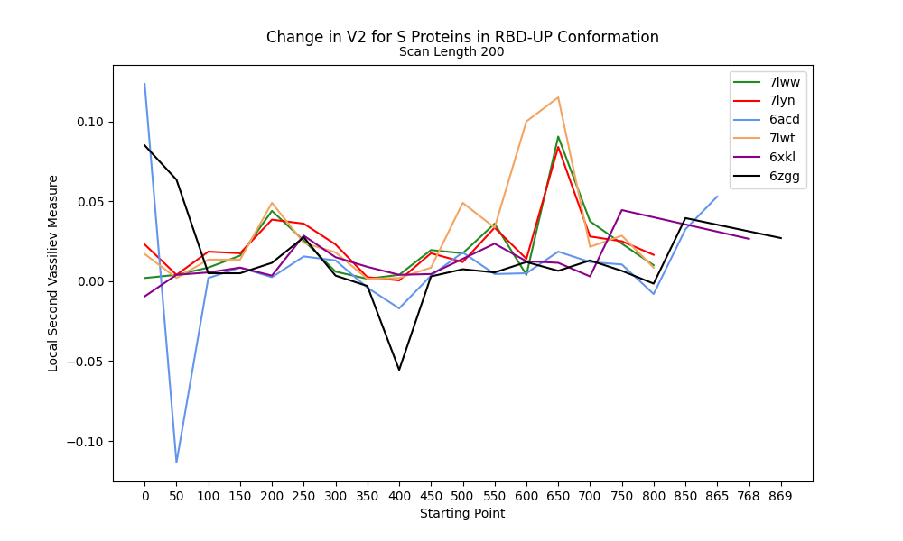
Change in V2 at 200 Scan Length for RBD-Up

Slide 10
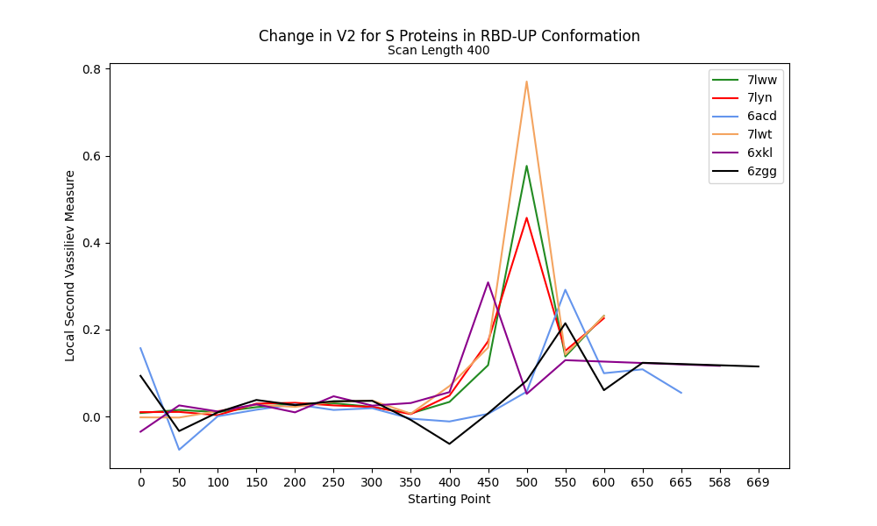
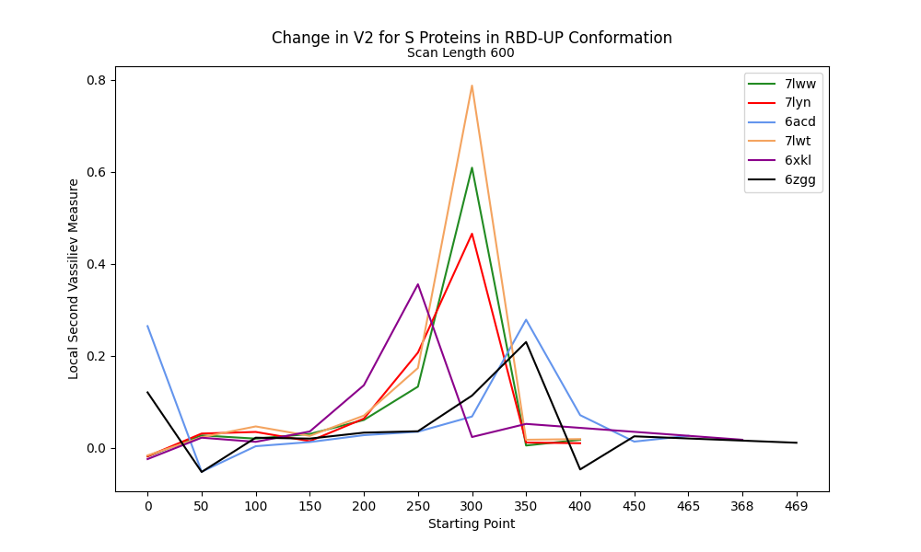
V2 along RBD-Up Proteins at 400 and 600 Scanning lengths

Slide 11
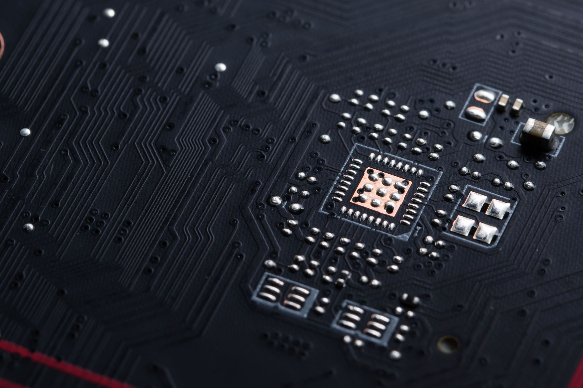
THANK YOU
References:
Xia X. Domains and Functions of Spike Protein in Sars-Cov-2 in the Context of Vaccine Design. Viruses. 2021 Jan 14;13(1):109. doi: 10.3390/v13010109.
Other references here
https://github.com/jmidrichards/iCompBio-Summer2021
jmidrichards@gmail.com

