Slide 1


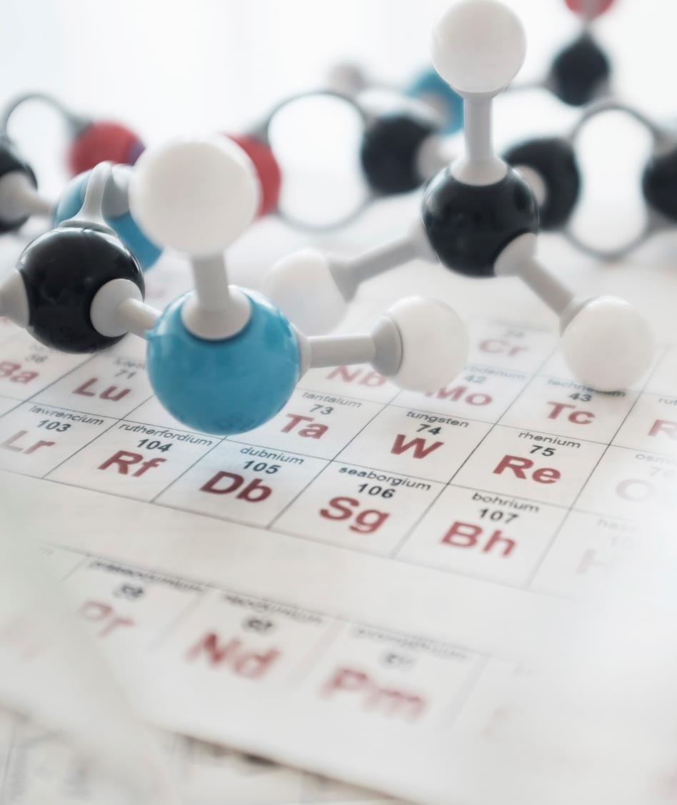
SARS-Cov-2 Spike Protein Analysis using second Vassiliev Measure
Subtitle

Slide 2
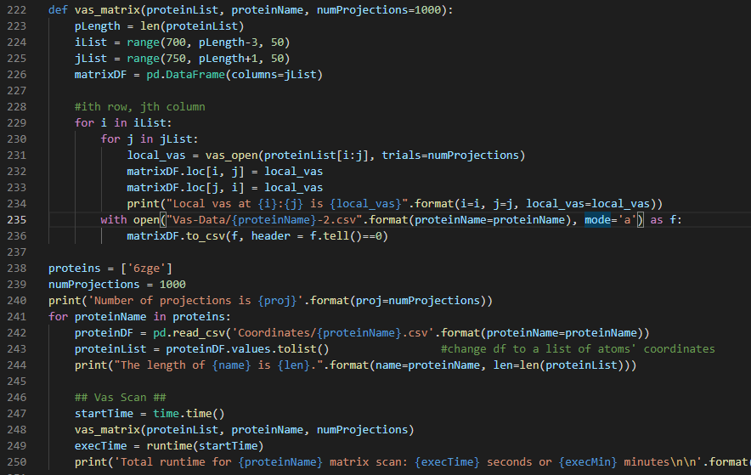
Code Example

Slide 4

Total Values Of V2 For Proteins At 100 And 1000 Projection Sizes

Slide 5
Total Values Of V2 For Proteins At 1000 And 2000 Projection Sizes

Slide 6
Protein Structure and Domains
Receptor Binding Domain (RBD) is at amino acids 327-529

Slide 7
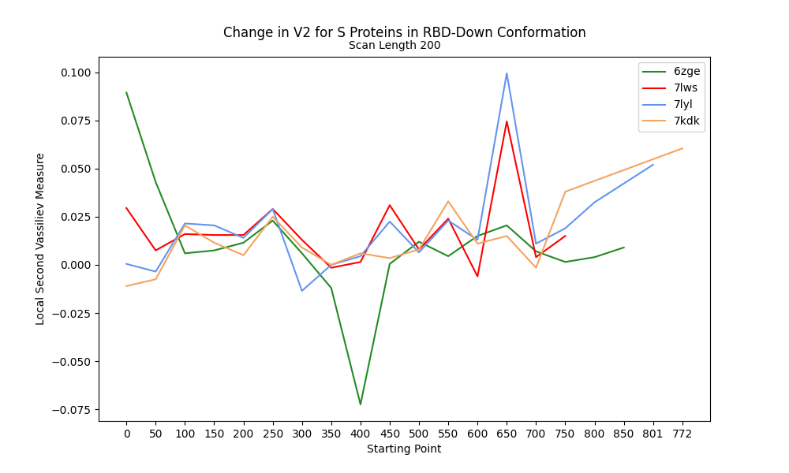
Change in V2 along RBD-Down Proteins

Slide 8
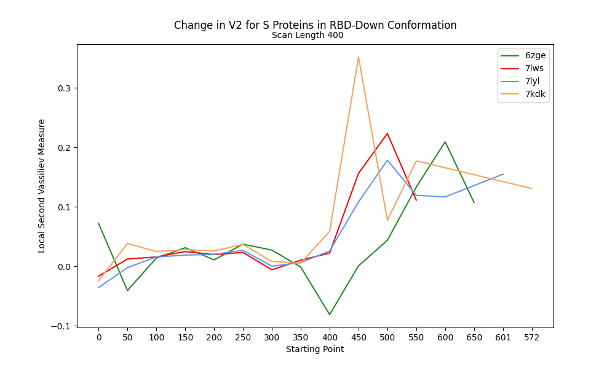
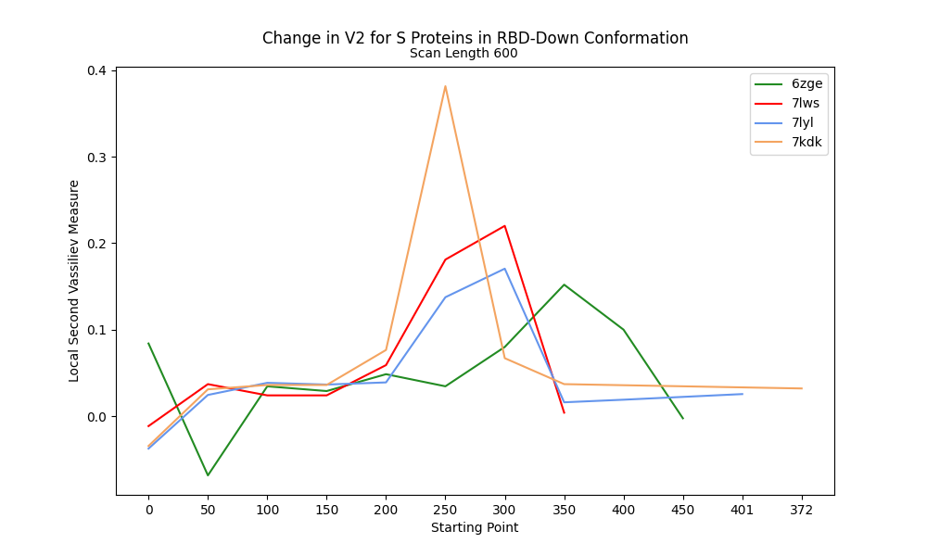
V2 along RBD-Down Proteins at 400 and 600 Scanning lengths

Slide 9
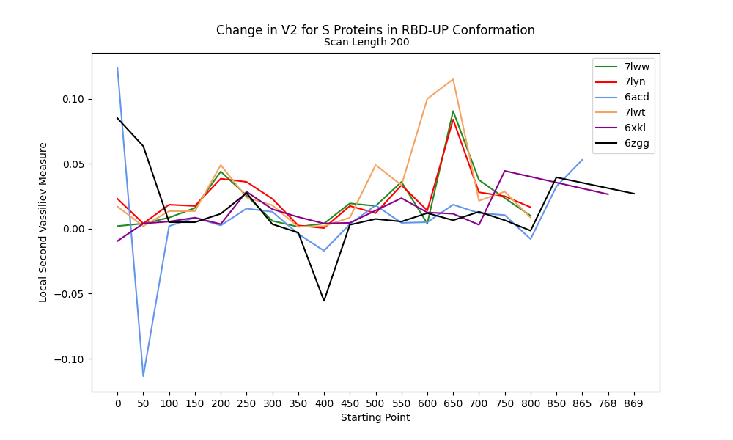
Change in V2 at 200 Scan Length for RBD-Up

Slide 10
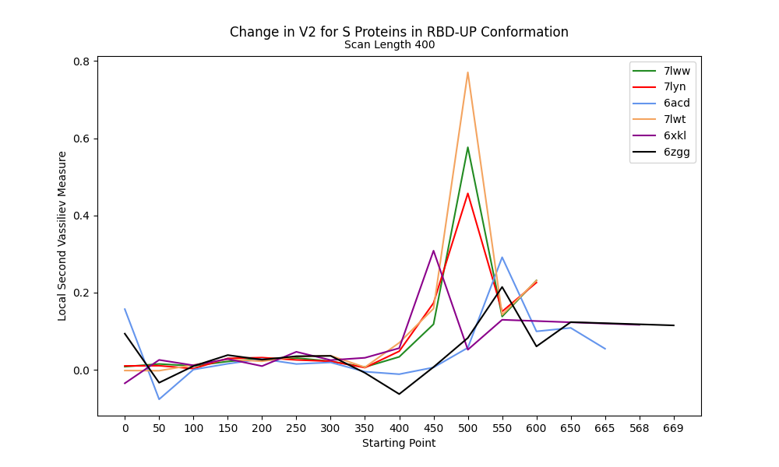
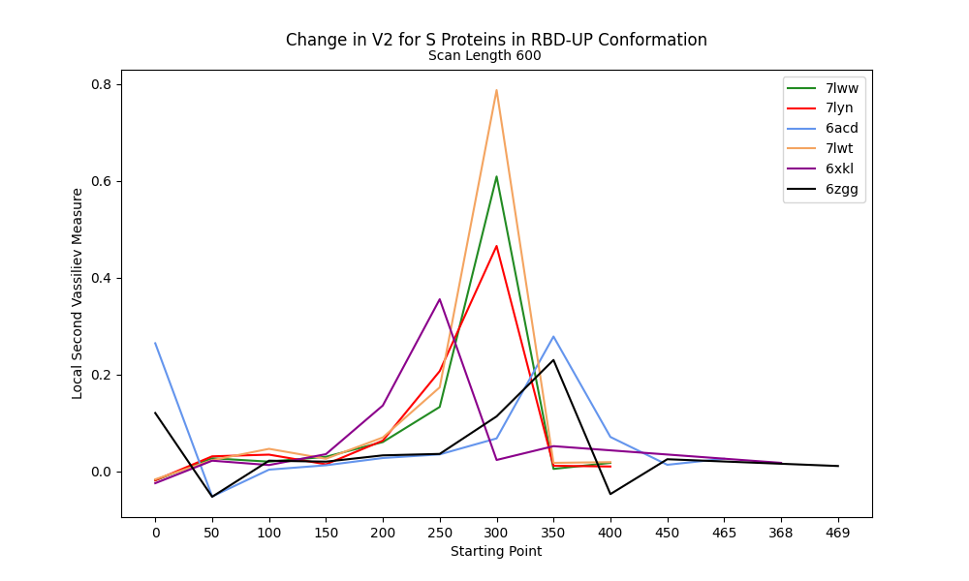
V2 along RBD-Up Proteins at 400 and 600 Scanning lengths

Slide 11

THANK YOU
https://github.com/jmidrichards/iCompBio-Summer2021
jmidrichards@gmail.com

