Slide 1


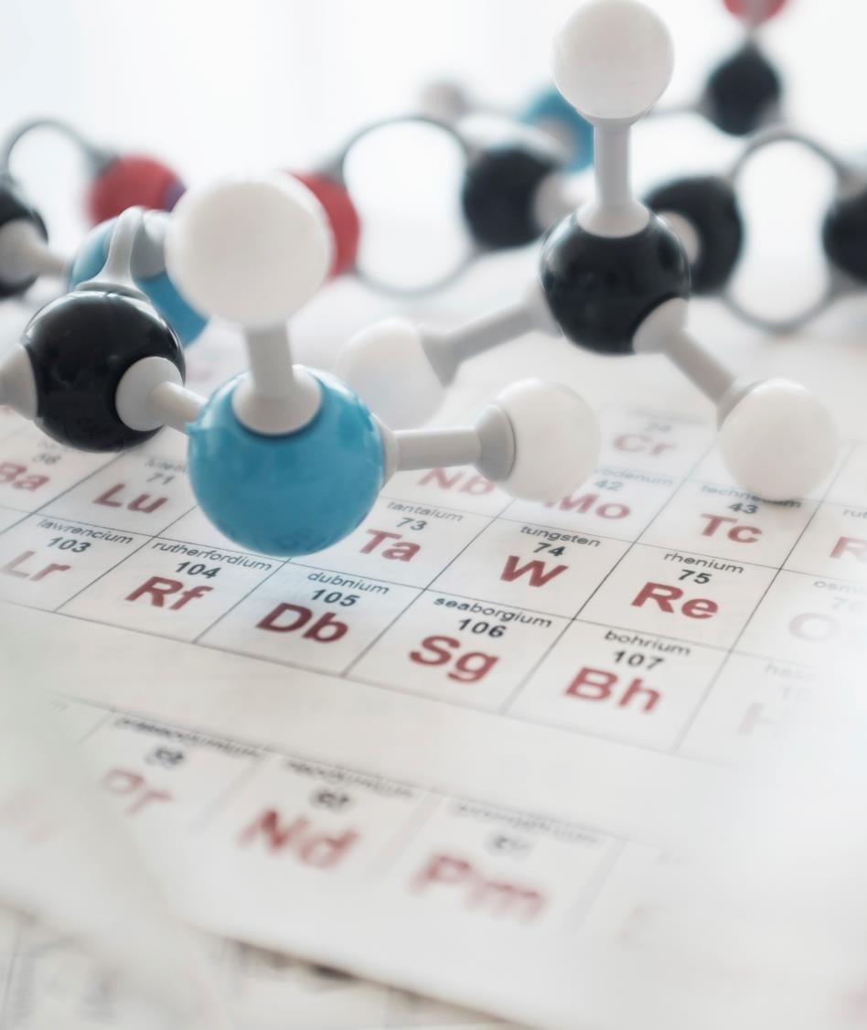
SARS-Cov-2 Spike Protein Analysis using second Vassiliev Measure
Subtitle

Slide 2
Total Values of V2 for Proteins At 100 and 1000 Projection Sizes

Slide 3
Total Values of V2 for Proteins At 1000 and 2000 Projection Sizes

Slide 4
Protein Structure and Domains
Receptor Binding Domain (RBD) is at amino acids 327-529

Slide 5
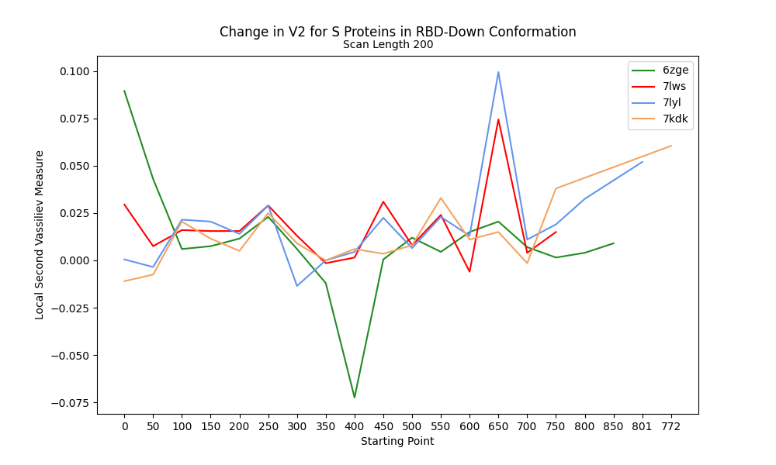
Change in V2 along RBD-Down Proteins

Slide 6
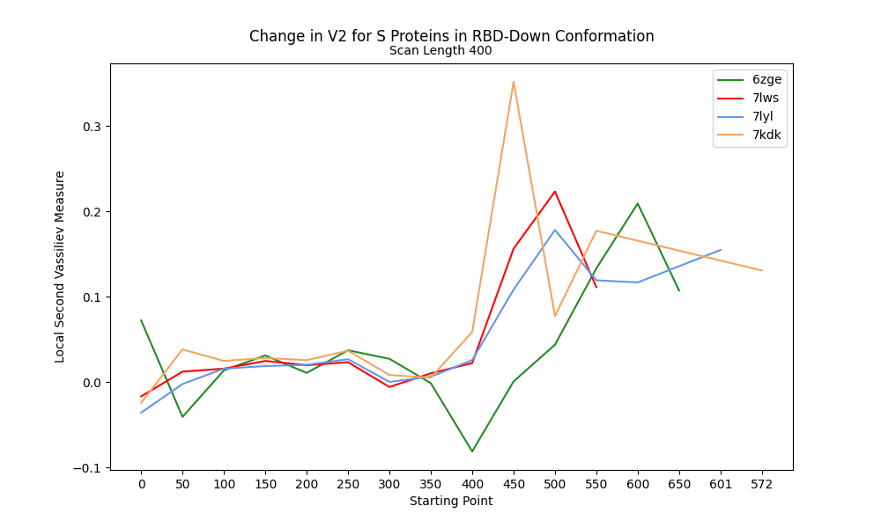
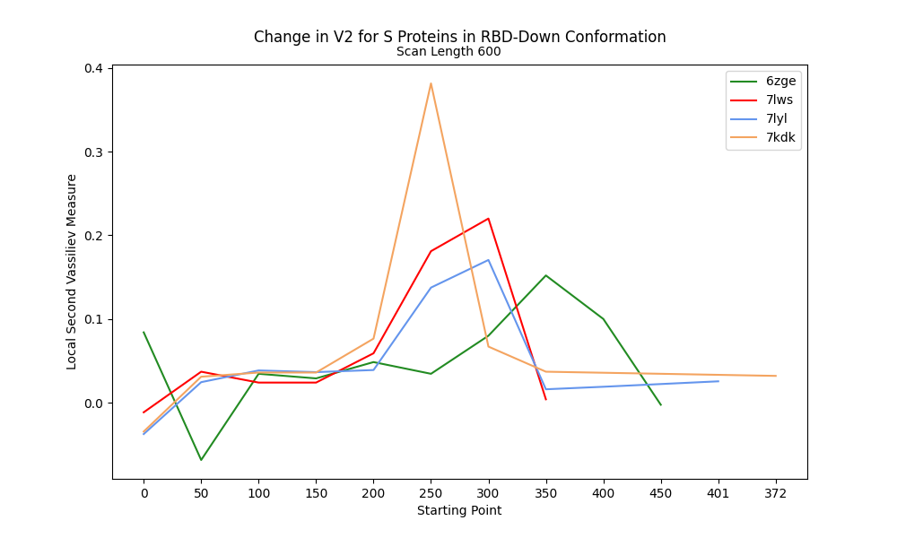
V2 along RBD-Down Proteins at 400 and 600 Scanning lengths

Slide 7
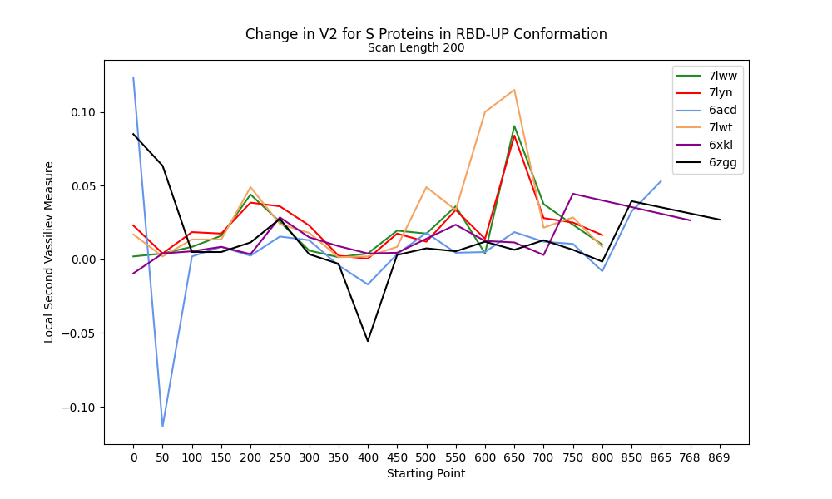
Change in V2 at 200 Scan Length for RBD-Up

Slide 8
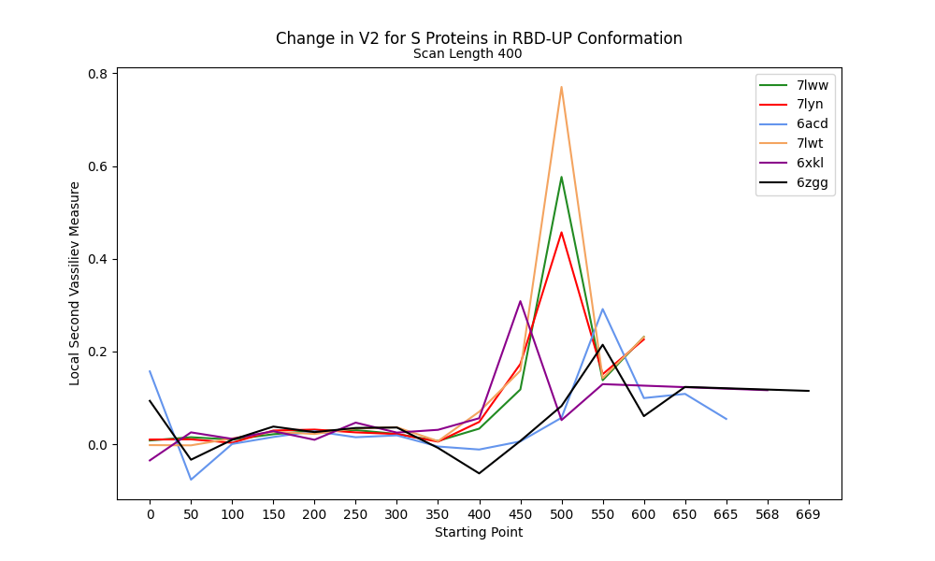
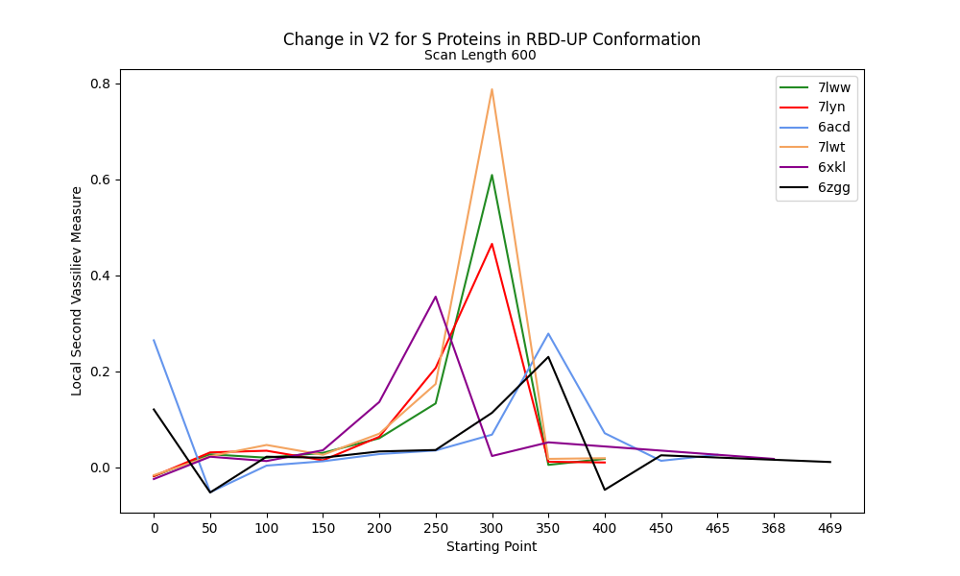
V2 along RBD-Up Proteins at 400 and 600 Scanning lengths

Slide 9

THANK YOU

