Slide 1
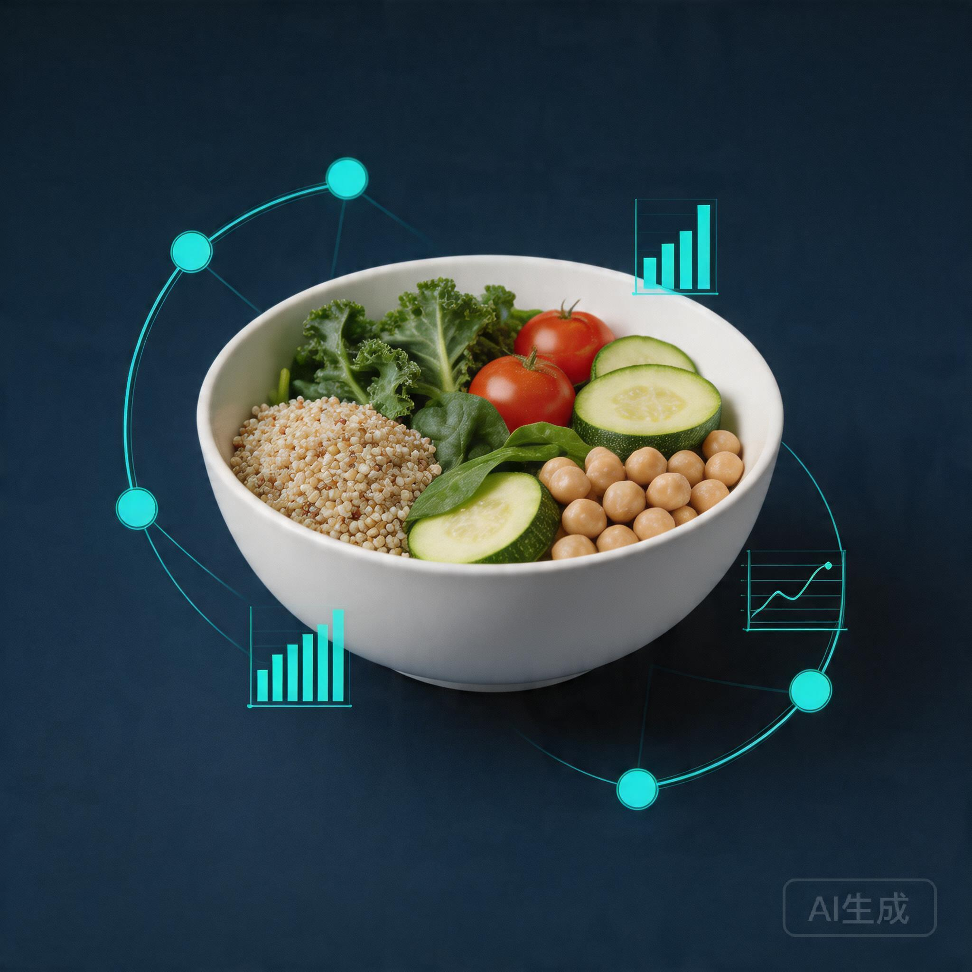
XJCO3011 Web Services and Web Data
Nutrition and Recipe Analytics API
FastAPI + SQLite coursework project with CRUD, derived nutrition analytics, automated testing, and submission-ready deliverables
Shuyu Cao | 5-minute oral presentation
1

Slide 2
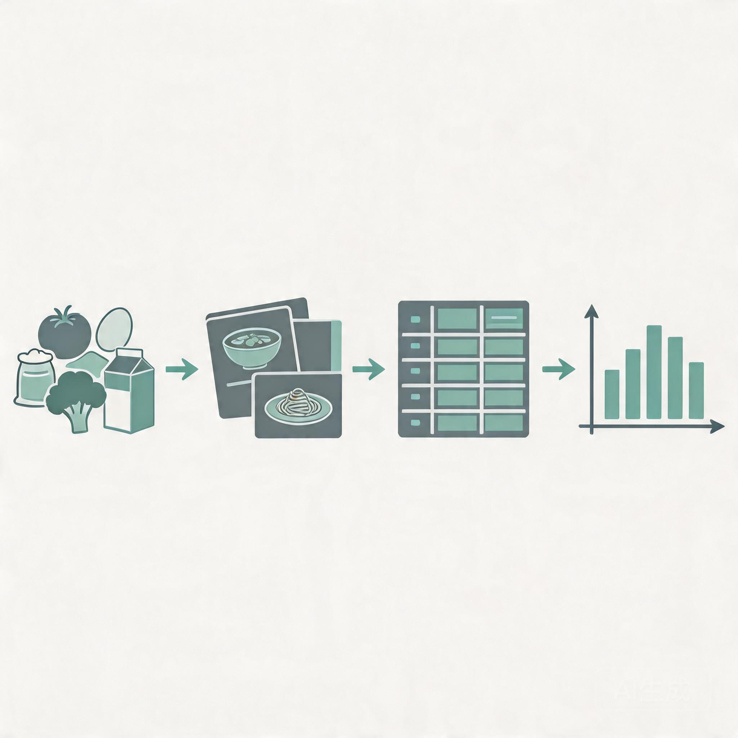
Why This Project Is More Than Basic CRUD
PROJECT SCOPE
A recipe API is a good coursework domain because it needs both transactions and calculation.
Input data
recipes + ingredients
Recipes and ingredients form a real many-to-many relational model.
Nutrition totals are derived from linked ingredient quantities rather than typed in manually.
The API can demonstrate CRUD, validation, authentication, and analytics in one coherent system.
>
relational storage
>
analytics output
2

Slide 3
Architecture and Technology Stack
SYSTEM DESIGN
Technology stack
Request flow
FastAPI
Client
Routers
Schemas
Services
Models
SQLite
>
>
>
>
>
SQLite
FastAPI provides typed endpoints and automatic OpenAPI documentation.
The layered structure makes the code easier to explain, test, and extend.
SQLAlchemy
Pydantic
pytest
This structure helps in the oral exam because each layer has a clear responsibility: routers for HTTP, schemas for validation, services for derived logic, and models for persistence.
3

Slide 4
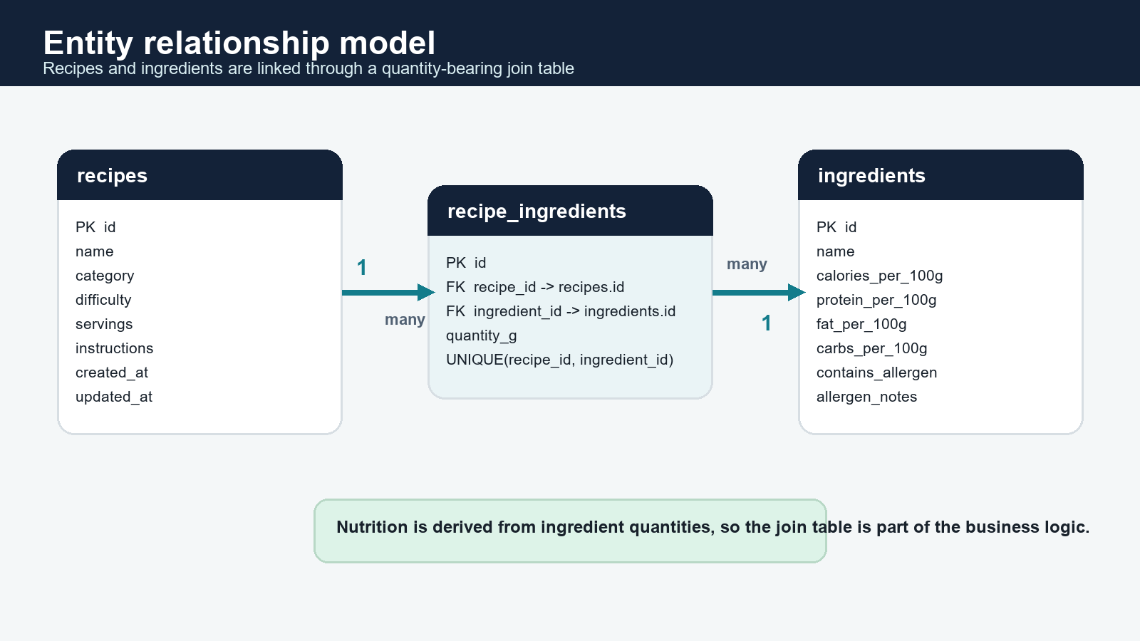
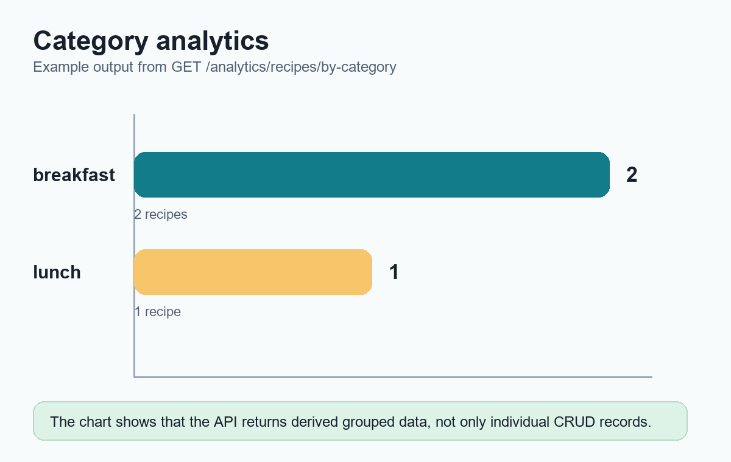
Database Design and API Surface
RELATIONAL MODEL
ER view of the core SQL model
Why this matters
The join table stores quantity_g, so nutrition can be calculated from linked ingredient data instead of hardcoded recipe totals.
Representative endpoints
CRUD: /recipes
CRUD: /ingredients
Search: /recipes/search
Links: /recipes/{id}/ingredients
4

Slide 5
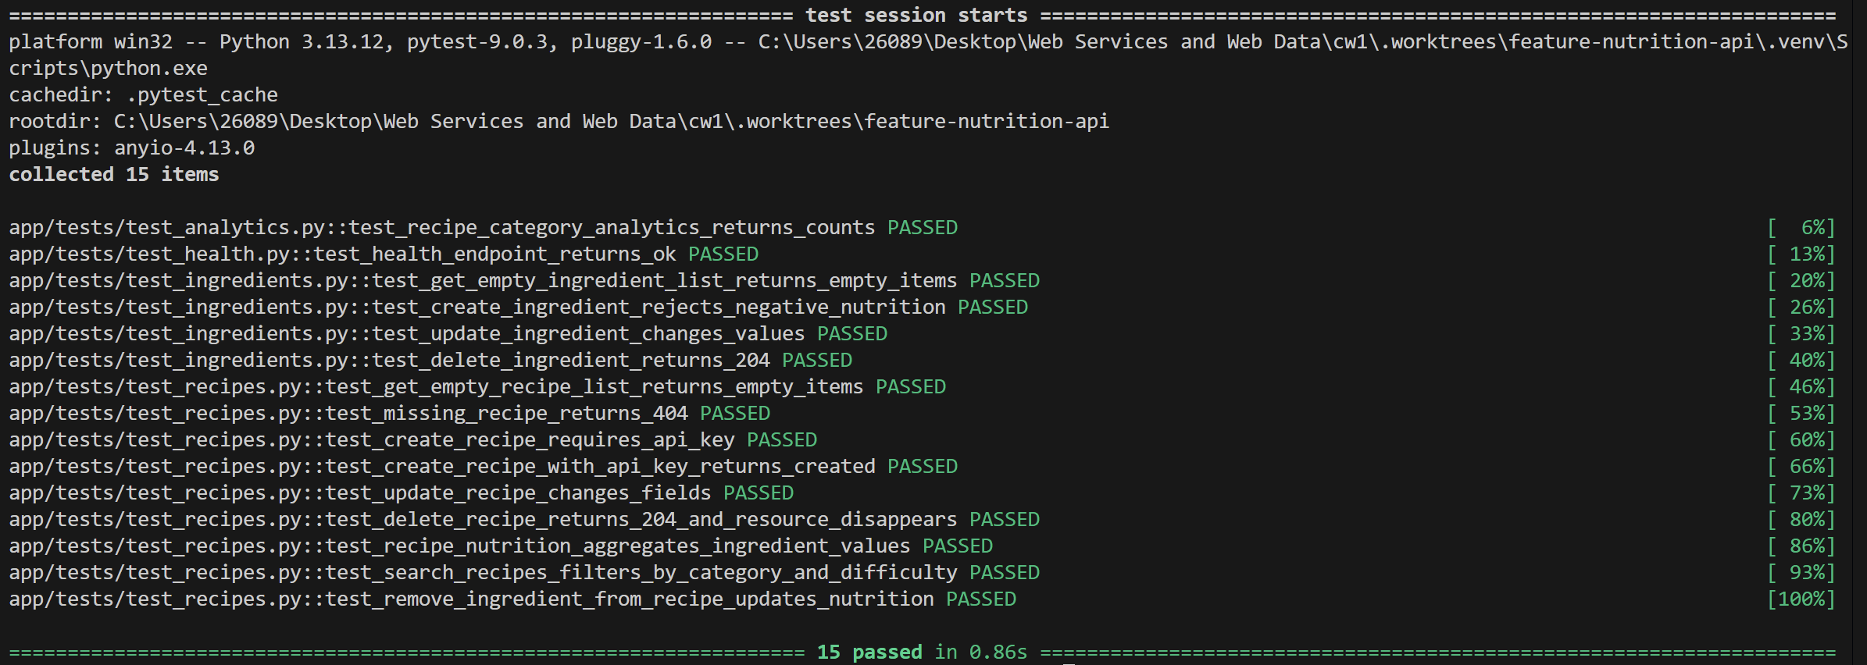
Security, Validation, and Testing
ENGINEERING QUALITY
15
401
Automated verification
15 passed
automated tests
unauthorized writes blocked
Controls and validation
Write endpoints require the X-API-Key header.
Pydantic validates payload shape and data types before business logic runs.
422
health | CRUD | search | analytics | nutrition | relationship removal
schema validation
responses
Rejected before service logic runs
Tests cover CRUD, search, analytics, nutrition aggregation, and relationship removal.
5

Slide 6
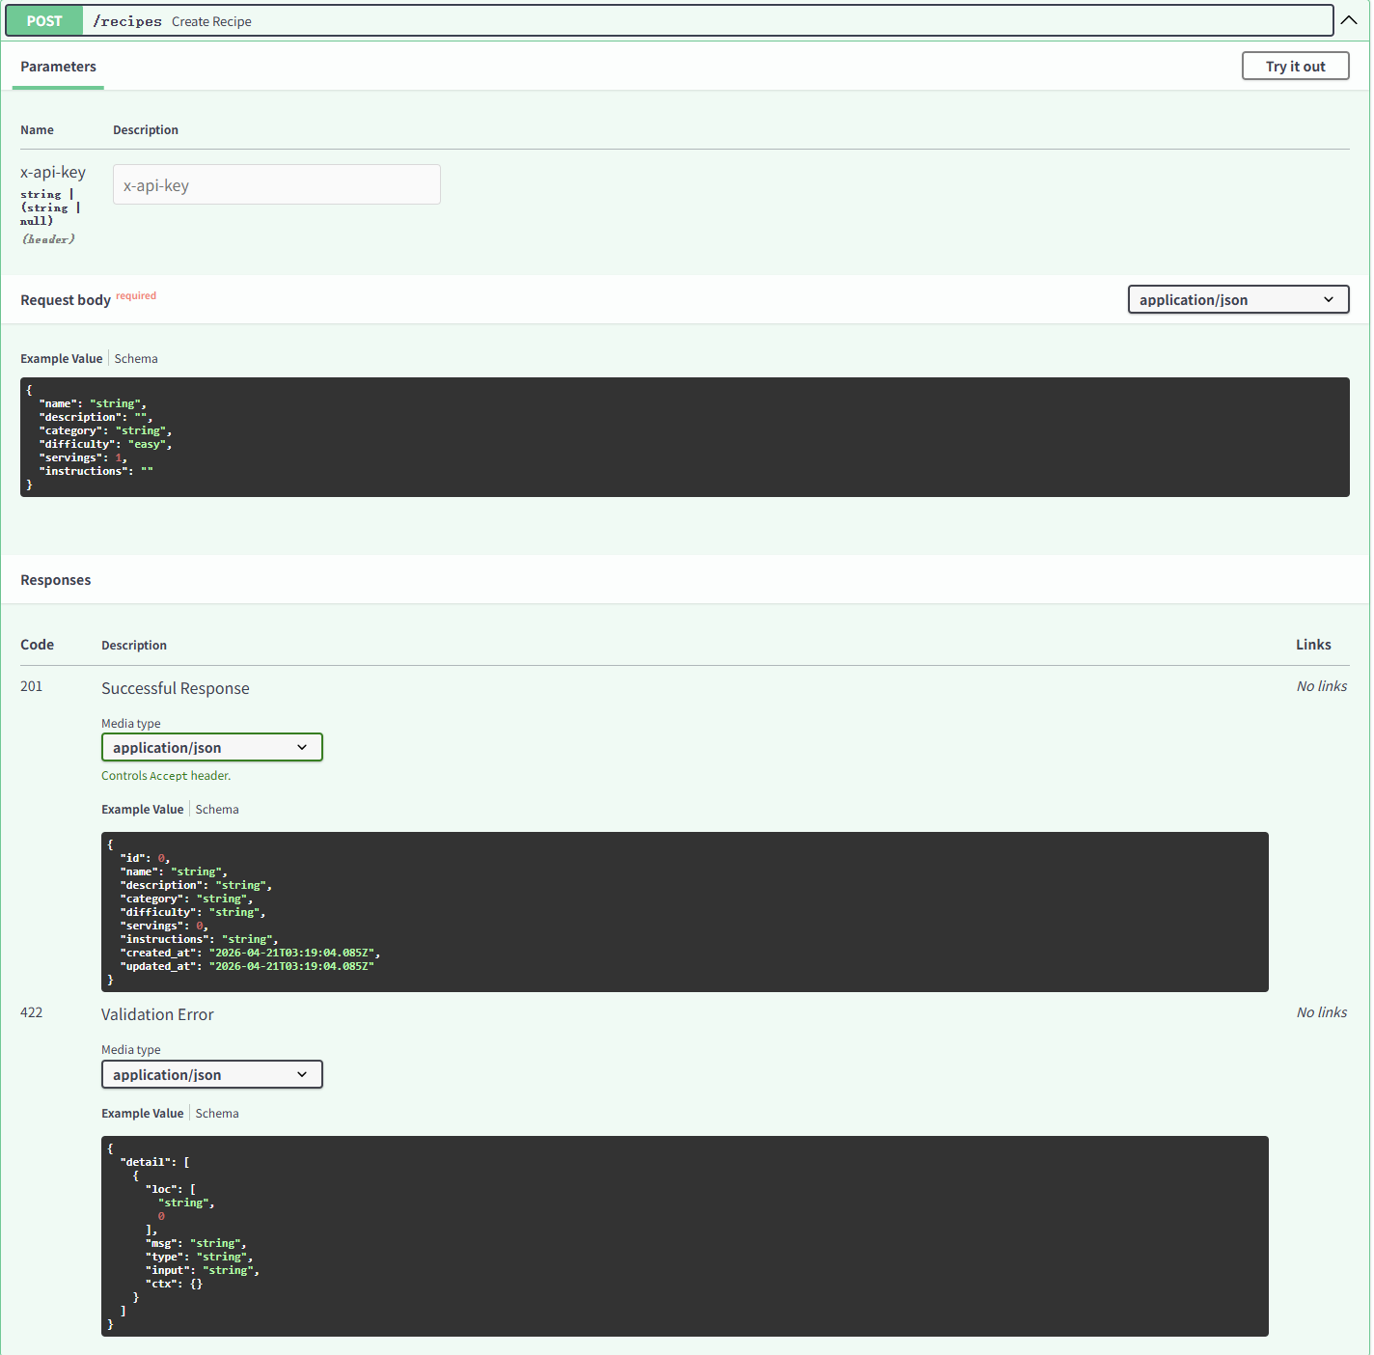
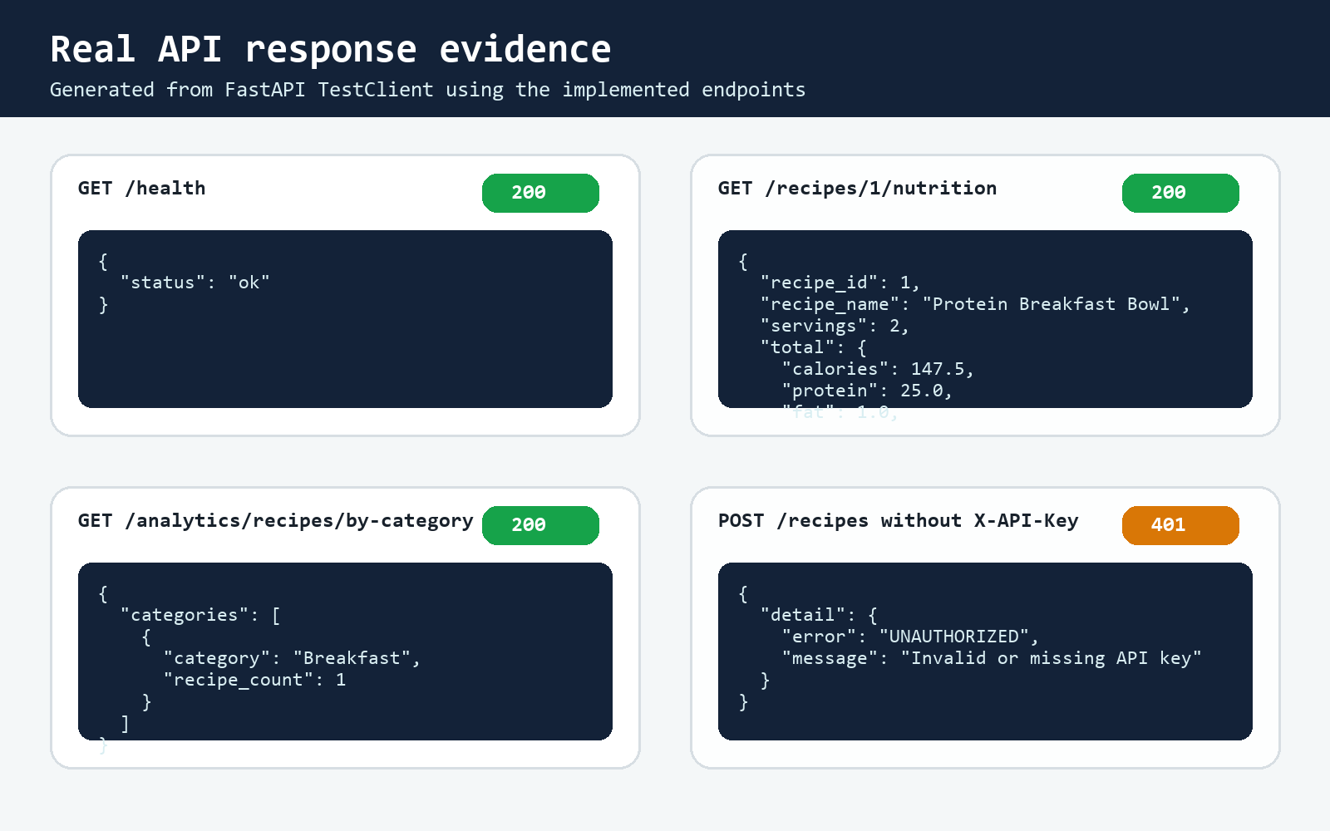
API Documentation Overview
DELIVERABLE 1
Swagger UI
Response evidence and pack
API documentation was also exported into a separate PDF deliverable.
6

Slide 7
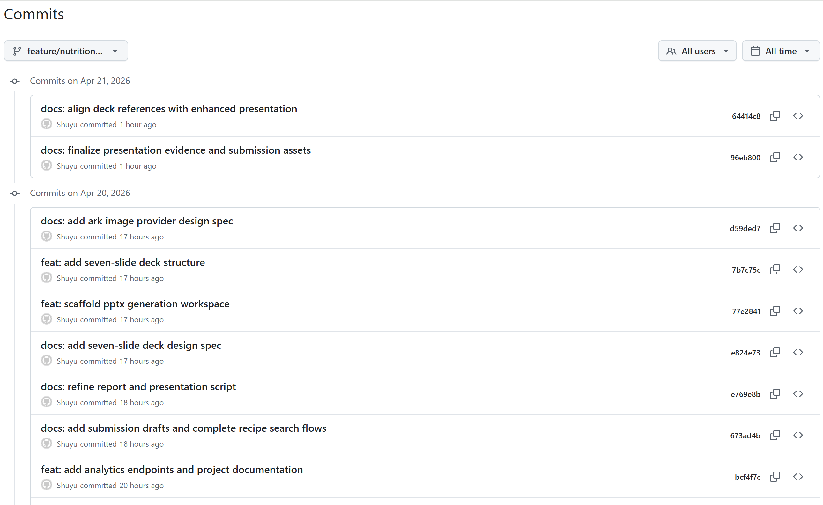
Version Control and Deliverables
DELIVERABLES
Commit history evidence
Submission deliverables
Public GitHub repository with visible commit history
README with setup, run, seed, and test instructions
API documentation PDF, technical report PDF, and presentation deck
7

Slide 8
Demo Flow and Technical Report Highlights
ORAL EXAM FLOW
Live presentation path
Technical report highlights
1
Open GitHub repository and README
Rationale for choosing FastAPI, SQLite, and a layered design
Testing approach, route-conflict lesson, limitations, and future work
GenAI declaration included transparently in the report
2
Show commit history and project deliverables
3
Open Swagger /docs
4
Create recipe, link ingredients, show nutrition and category analytics
This gives examiners a clean path from repository evidence to working endpoints and supporting documents.
8

Slide 9
Technical Report Highlights and Q&A Readiness
Key outcome
Future work
The project satisfies the coursework brief with a runnable SQL-backed API, visible version history, documentation, testing evidence, and a defensible architecture.
Upgrade from API key auth to JWT-based authentication
Expand analytics and richer recipe filtering
Move from SQLite to PostgreSQL for a stronger deployment story
GenAI declaration
GenAI was used for planning, debugging support, and documentation drafting, with final technical decisions kept under student control.
Q&A ready: architecture choices, testing evidence, route design, and submission deliverables
9

