Slide 1
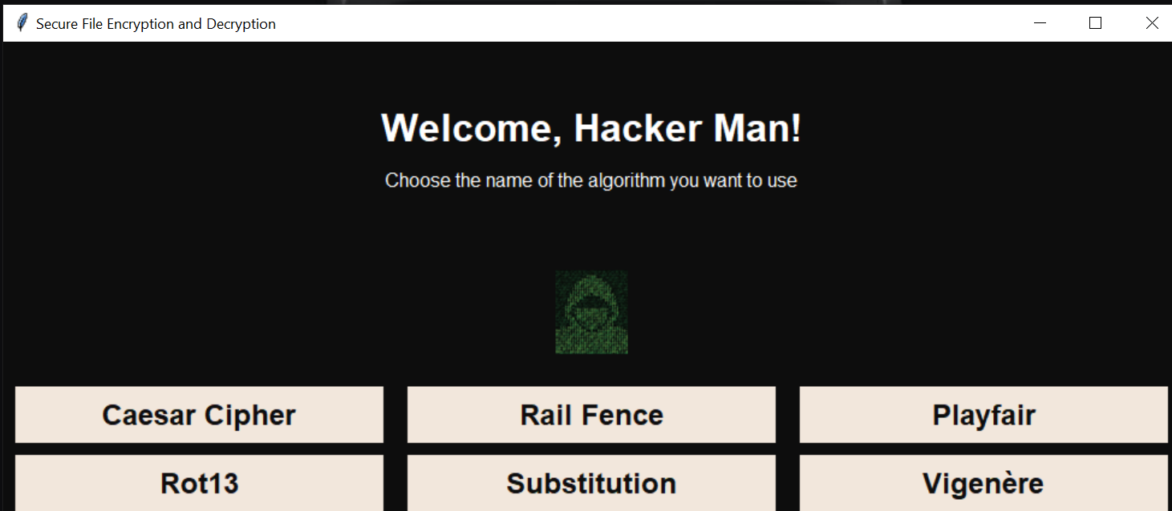
Secure File Encryption and Decryption

Slide 2
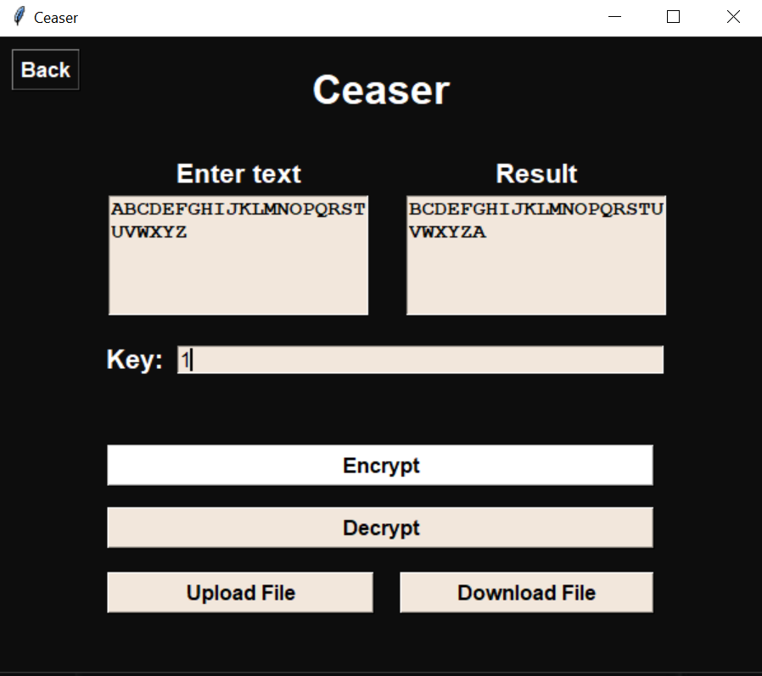
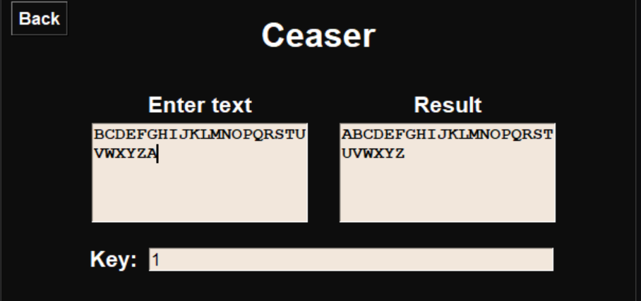
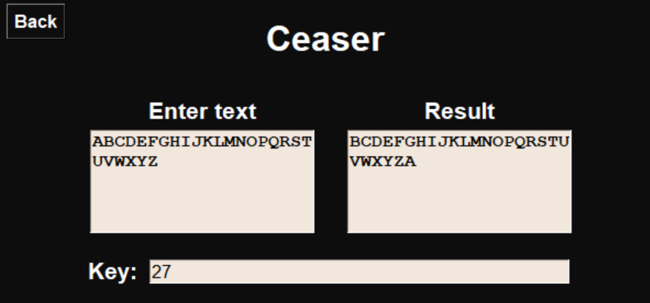
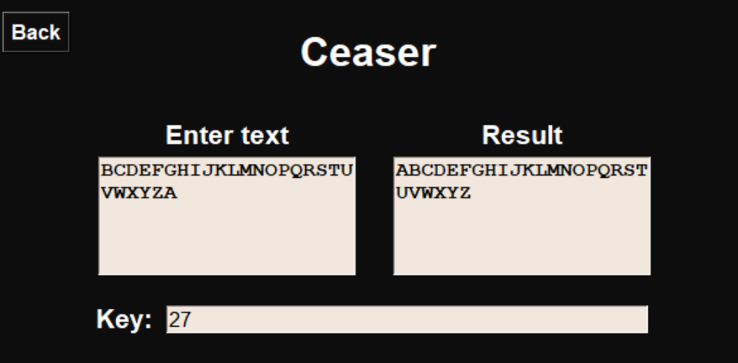
Key Scenario
Valid Positive Integer
Decryption
Encryption

Slide 3
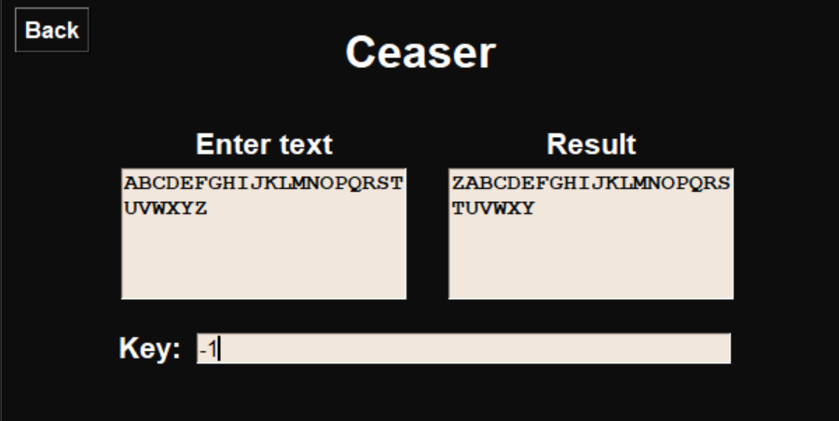
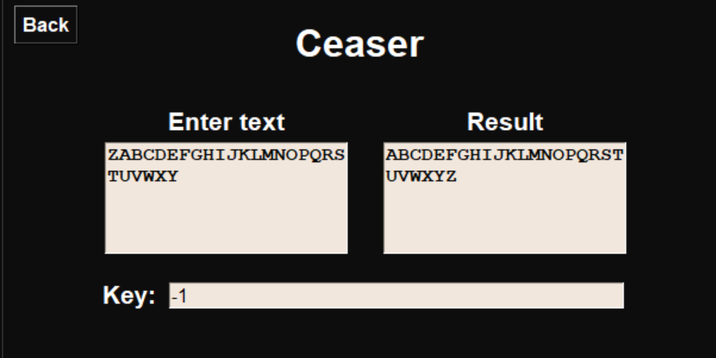
Key Scenario
Valid Negative Integer
Encryption
Decryption

Slide 4
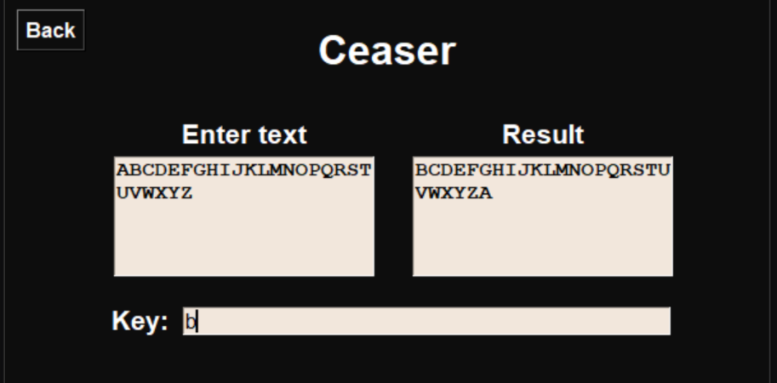
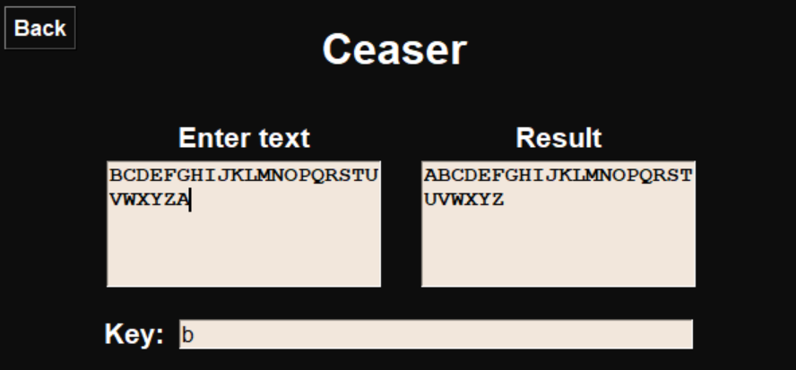
Key Scenario
Valid Letter
Encryption
Decryption

Slide 5
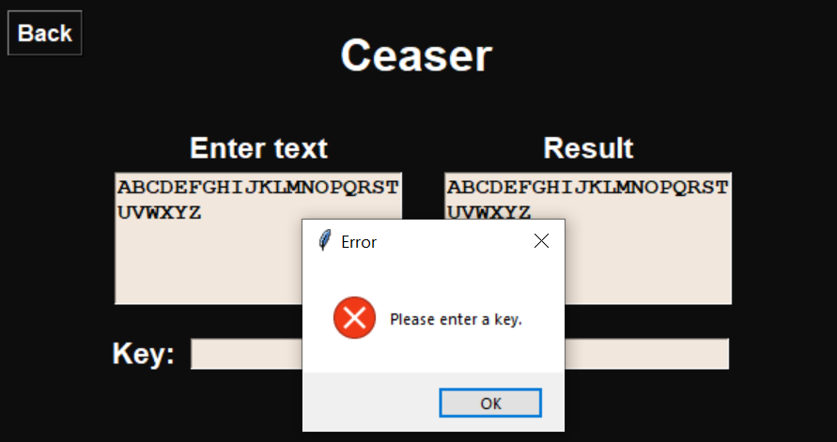
Key Scenario
Invalid Empty Key

Slide 6
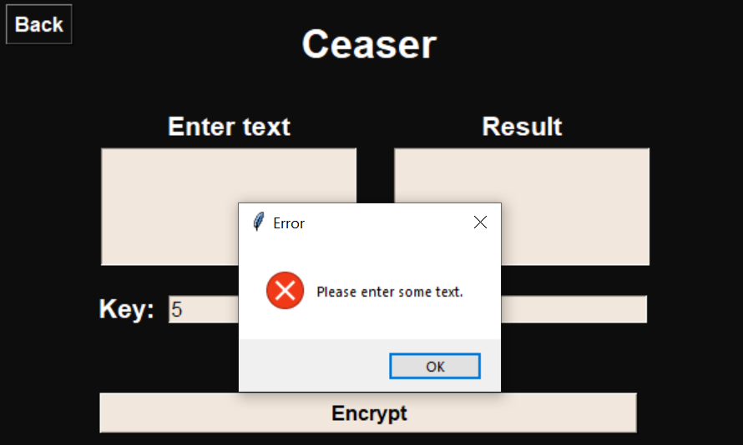
Plaintext Scenario
Invalid Empty Plaintext

Slide 7
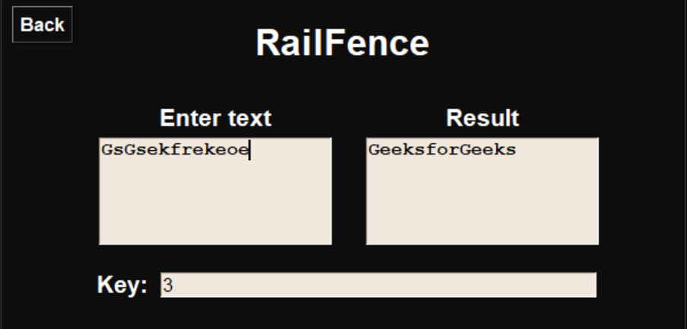
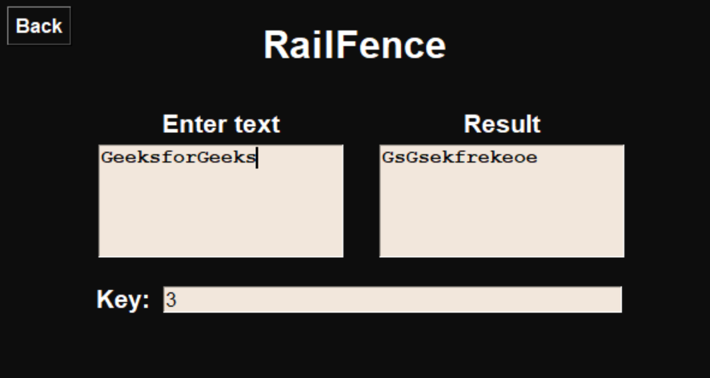
Key Scenario
Valid number
Encryption
Decryption

Slide 8
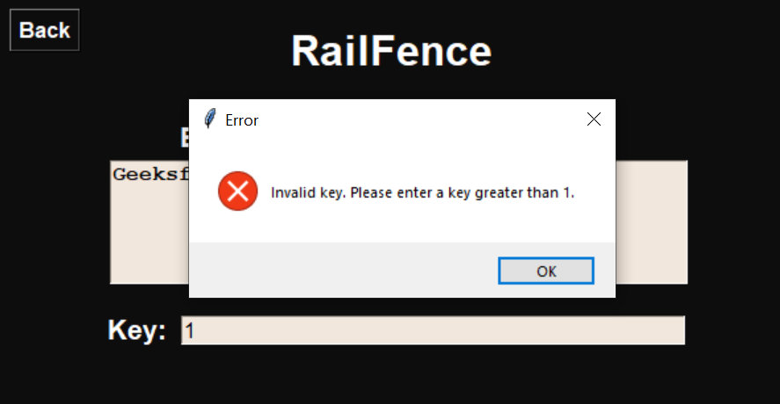
Key Scenario
Invalid number

Slide 9
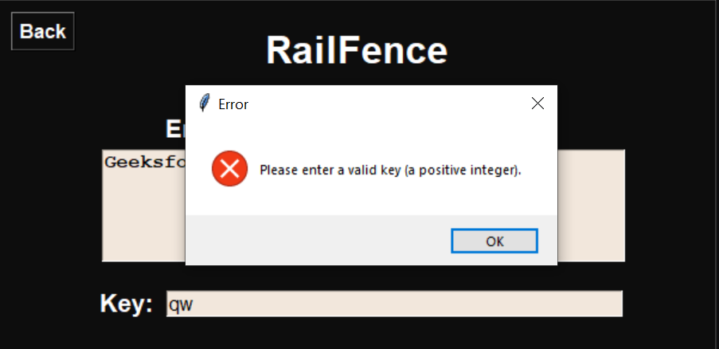
Key Scenario
Invalid letter

Slide 10
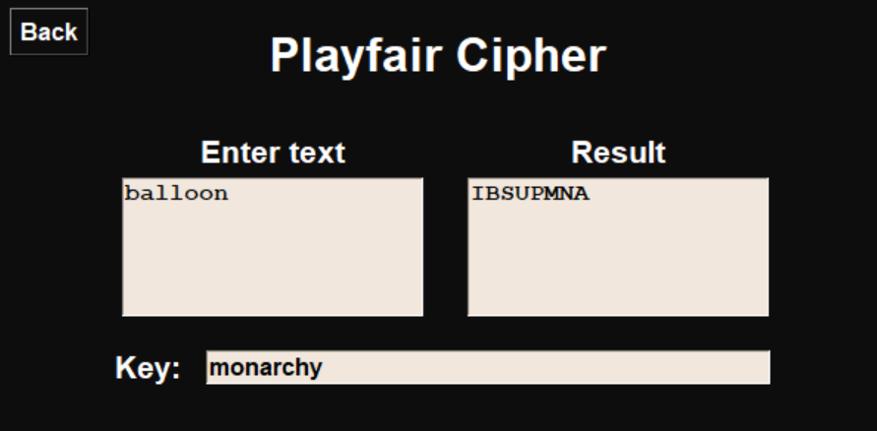
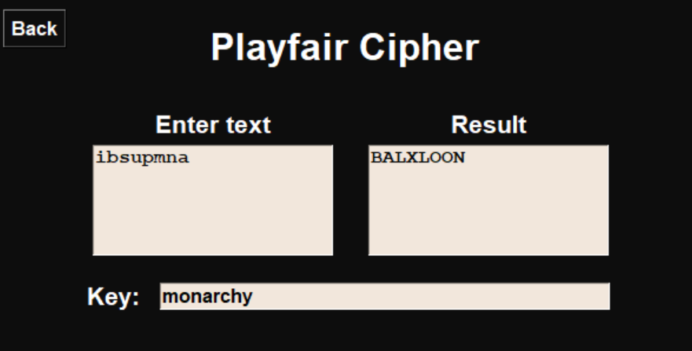
Key Scenario
Valid Letter
Encryption
Decryption

Slide 11
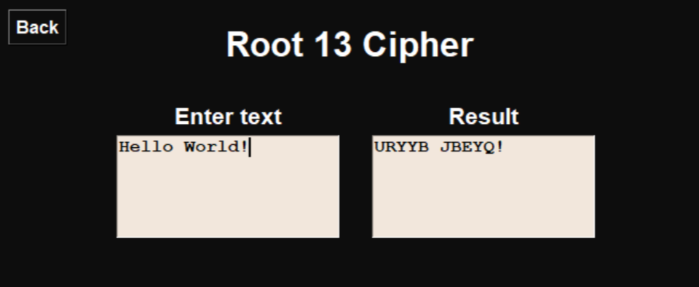
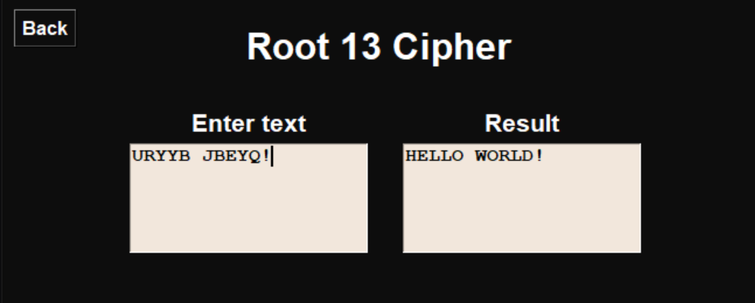
Key Scenario
Valid Letter
Encryption
Decryption

Slide 12
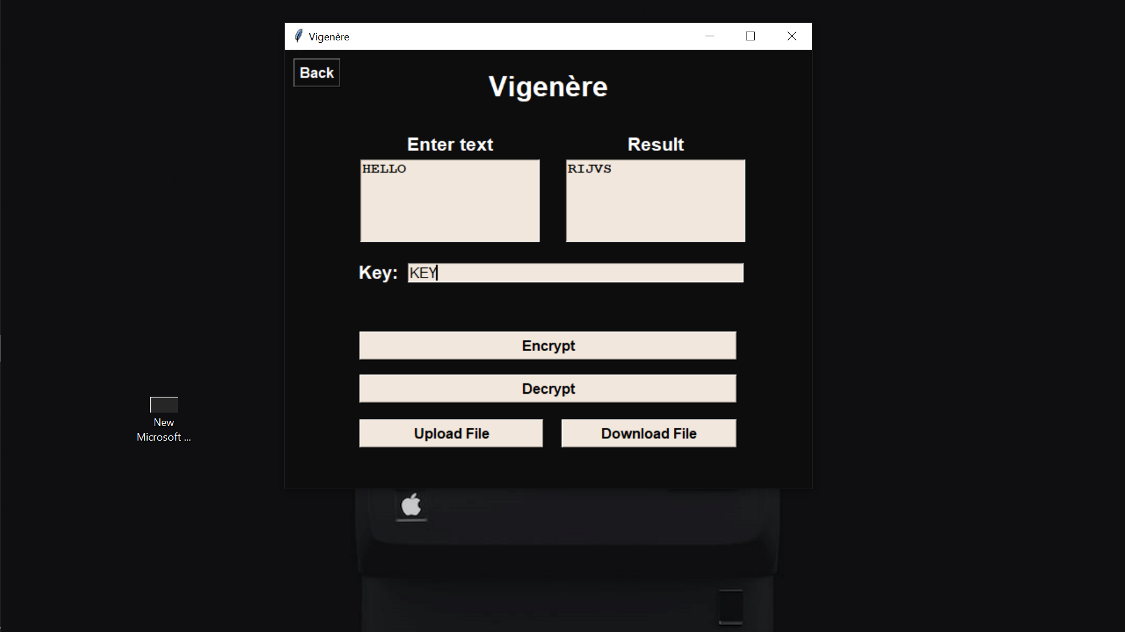
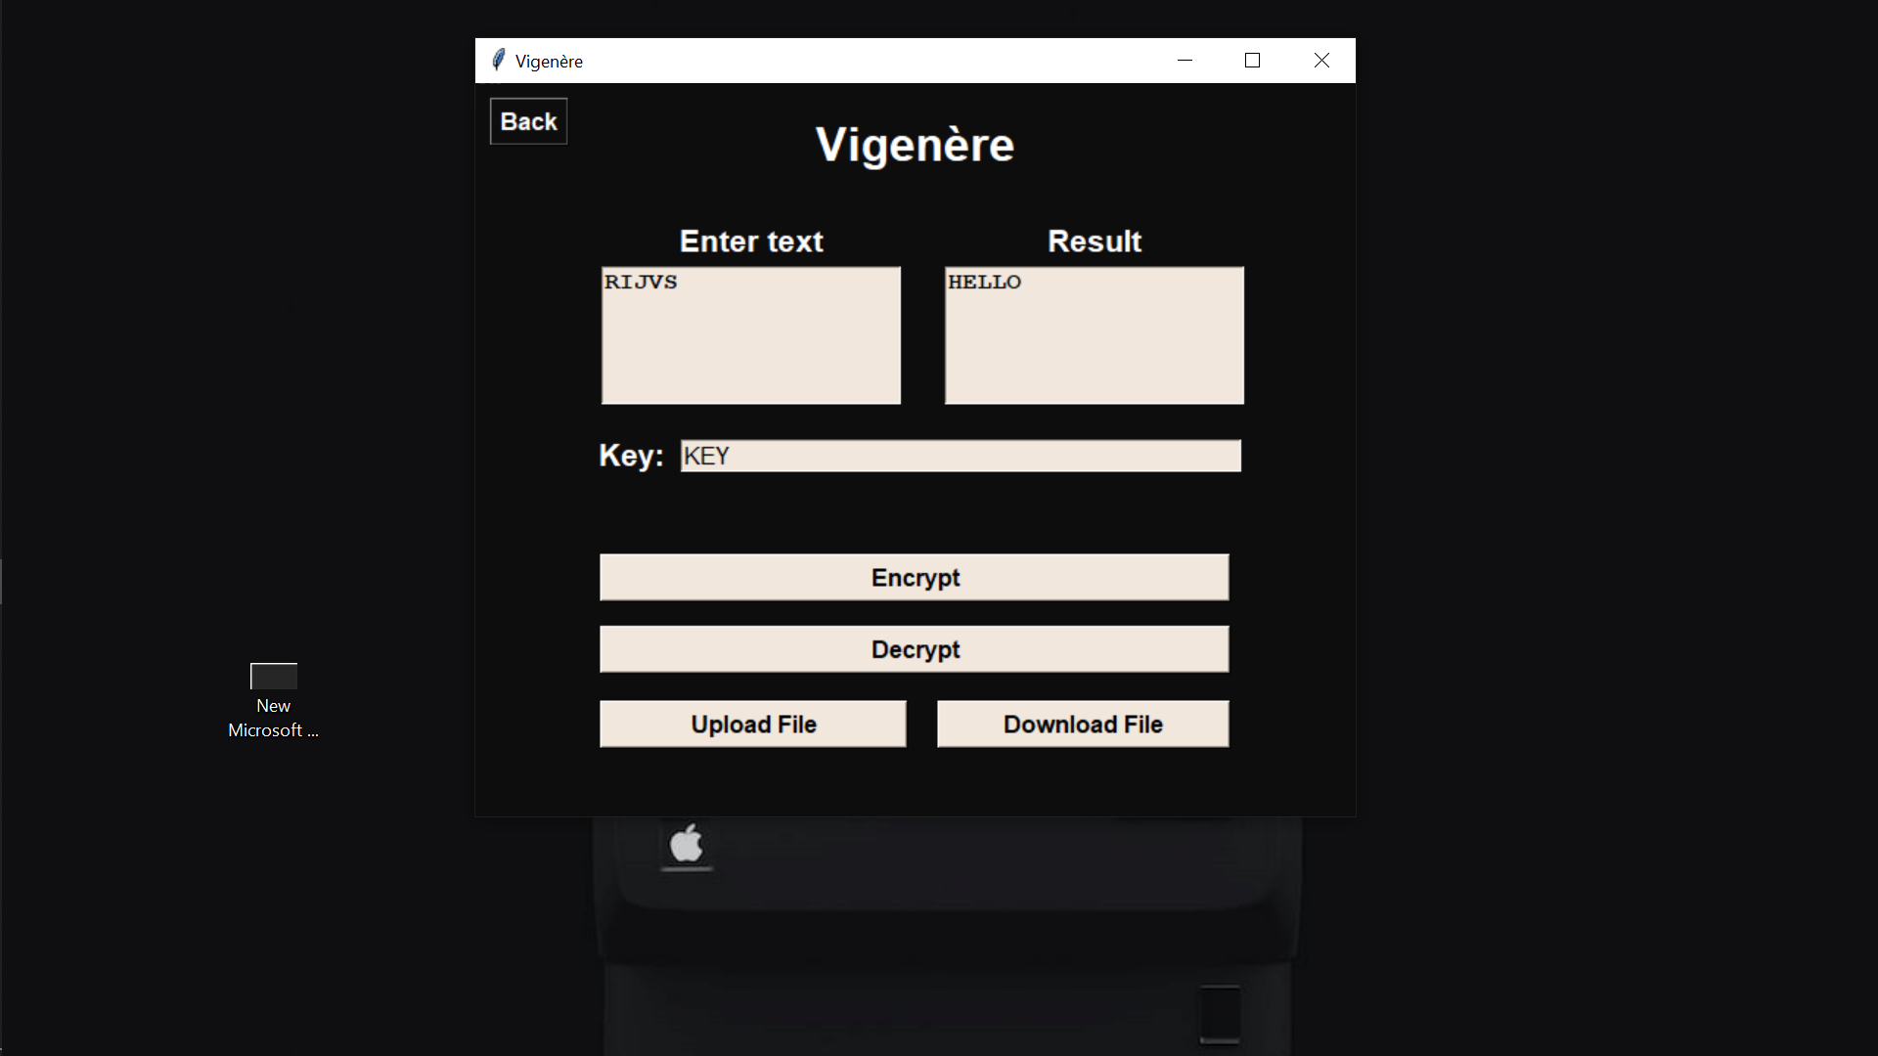
plaintext Scenario
Valid Letter
Encryption
Decryption

Slide 13
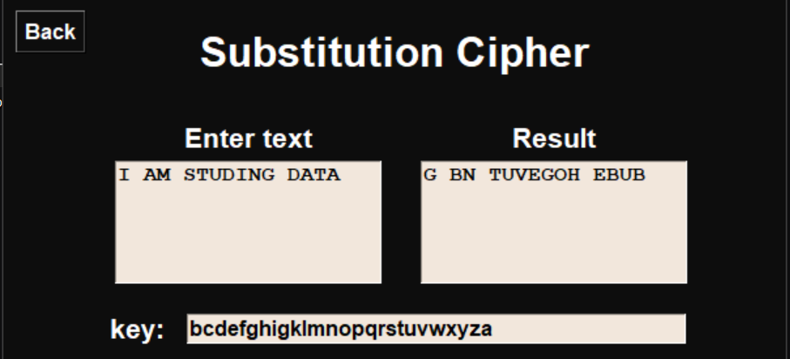
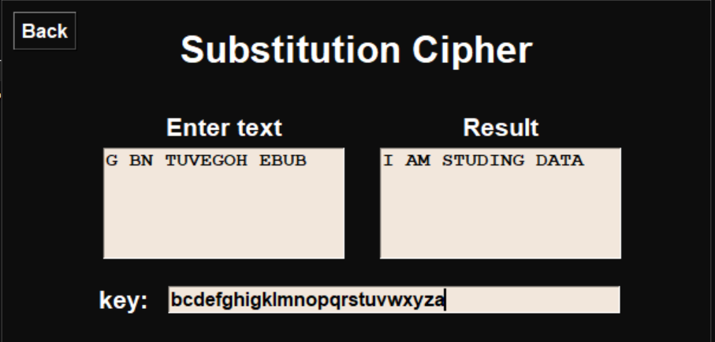
Key Scenario
Valid Letter
Encryption
Decryption

Slide 14
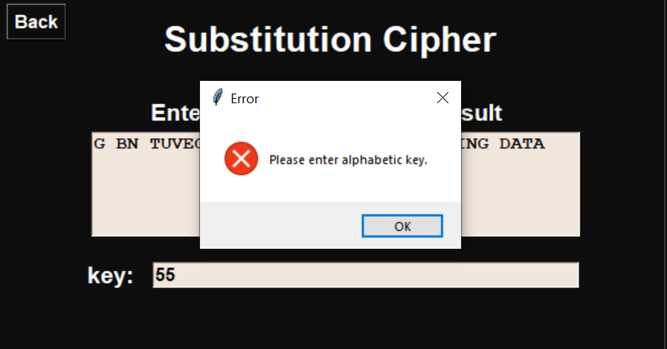
Key Scenario Invaild input

