Slide 1





INTERNSHIP AT ALTEN SO
R&D : Urgency in the Digital Twin Smart Green Supply Chain
Measuring declared against real urgency in a supply chain digital twin to acted upon
HOARAU John
Cohort 2026 DED
COMPANY
PERIOD
TUTORS
ALTEN Sud-Ouest
13 April → 16 October 2026
S. Perthuisot and F. Jules, ALTEN
Direction de l’Innovation · Lab de Toulouse
Confidential: YES
Dr. D. Gomez, ESTIA · Dr. P. Sherar, Cranfield
Notes:
(Name, Intership, ALTEN SO, DIN , TLSE)
1 number to open
8 turns before a satellite manufacturer missed its delivery commitment, the tool I built had already flagged it.
At that moment, its own manager was declaring an urgency near inexistent
Flagging, mesuring, forecasting that gap is what this mission is realy about

Slide 2







PLAN
1
CONTEXT, PROBLEM, MISSION
2
HOW THE PROJECT WAS RUN
3
LITERATURE, DESIGN AND REALISATION
4
RESULTS AND VALIDATION
5
ASSESSMENT AND PERSPECTIVES
Notes:
This prez will be in 5 parts !
The first three build the instrument.
The 4 is where the number I just gave you comes from.
The 5 is what I would do next.

Slide 3




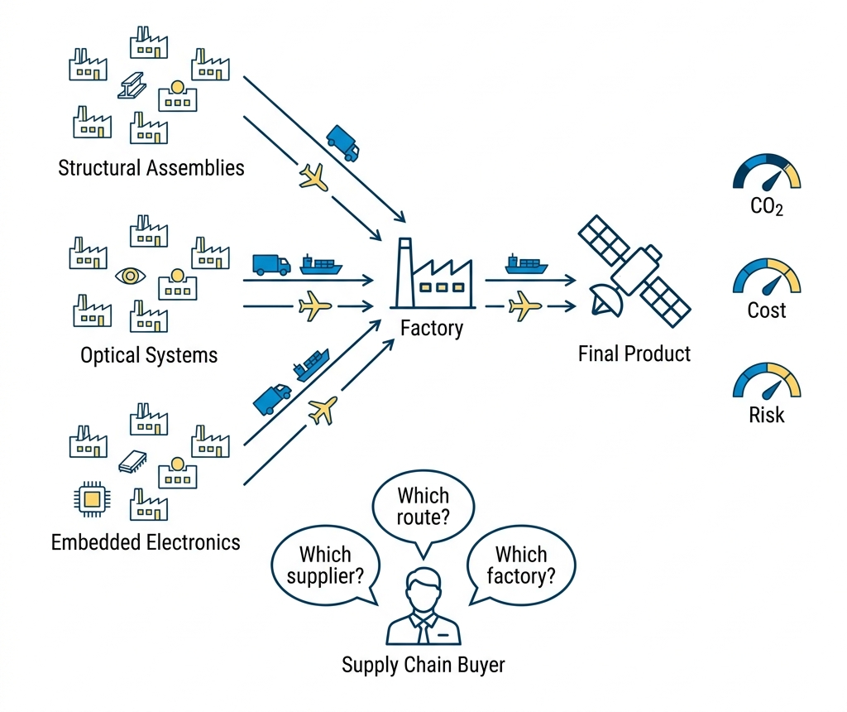




THE COMPANY AND THE PROGRAMME
ALTEN · Direction de l’Innovation · Toulouse Lab
1988
+30
11
31 %
FOUNDED
COUNTRIES
ALTEN LABS
R&D ON ENVIRONMENT
SMART GREEN SUPPLY CHAIN: THREE AIMS AT ONCE
LEAN
Cost, delay, excess stock
GREEN
Carbon per transport leg, to GLEC v3.2 and ISO 14083
PREDICTIVE
Anticipation of disruption.
DISCO, A serious game and a digital twin
Notes:
ALTEN Eng/Tech Consulting group.
Sell Eng expertise rather than product
Consulting grp work for many clients, they see the redudency in the diffuculty companys are facing
That how problem gets recognised as belonging to the industry rather than to a customer.
The program SGSC aim to unite Lean,Green,Predictive in a DT. My work sit in the 3rd one
Its central artefact is DISCO, a serious game and digital twin covering twenty-two suppliers.
Earlier internships built the routing, the risk scoring, the carbon and the transport
Not one of them computes urgency.

Slide 4





THE PROBLEM
THE TWIN HAS
THE TWIN NEVER SEES
Computed physical state
The human who decides
RESEARCH QUESTION
Can the gap between declared and computed urgency be measured reliably enough, inside a working digital twin, to be acted upon?
It must say which node is mismanaged
It must be reliable and explainable
It must beat the raw indicators a coordinator already has
Notes:
A coordinator opens the week with a list of nodes and a finite amount of attention
Somewhere on that list is the supplier that will cause next month's line stoppage. Nothing on the screen says which one it is.
The twin computes the physical state of every node. What it never sees is the human who decides.
A buyer says a supplier is critical, a plant says a line is at risk, and the twin records the consequence of those judgments without ever evaluating them.
Littérature showed across five controlled experiments that people favour imminent low-value tasks over distant high-value ones, and that the bias survives being told about it.
A twin that swallows that declaration as ground truth inherits the bias.

Slide 5
PLAN
1
CONTEXT, PROBLEM, MISSION
2
HOW THE PROJECT WAS RUN
3
LITERATURE, DESIGN AND REALISATION
4
RESULTS AND VALIDATION
5
ASSESSMENT AND PERSPECTIVES
Notes:
This prez will be in 5 parts !
The first three build the instrument.
The 4 is where the number I just gave you comes from.
The 5 is what I would do next.

Slide 6




THE WEEK
V-cycle for the model · Agile and Test and Learn for the week
MON
TUE
WED
THU
FRI
Planning
Scrum
Programme director
Scrum
Demonstration
The week’s objective
Blockages surface in a day
Scientific decisions
Course correction
Shown
TEST AND LEARN MEANS SOMETHING ONLY IF THINGS WERE LEARNED WHILE FAILING
The first urgency model, and why it could not fit
A single time-driven curve: urgency rose only as a deadline approached
It could not represent a node on time but out of capacity
It discarded indicators the twin already held
Notes:
The internship agreement prescribes Agile and Test and Learn, and I applied it literally.
The V-cycle runs on the model. Agile and Test and Learn run the week.
Five standing meetings a week is heavy for research and development, and it was the most useful organisational feature of the internship.
The Friday demonstration required something to be shown, making sure that project is evolving.
Test and Learn means something only if things were dropped and that i devlopped knowledge
The first urgency model was a single time-driven curve that rose as a deadline approached. It could not represent a node on schedule but out of capacity
I dropped it in April, at a cost of three weeks.
I gain knowledge and expericen in suplly chain organization, digital twin modeling and AI as i experienced all of them.

Slide 7
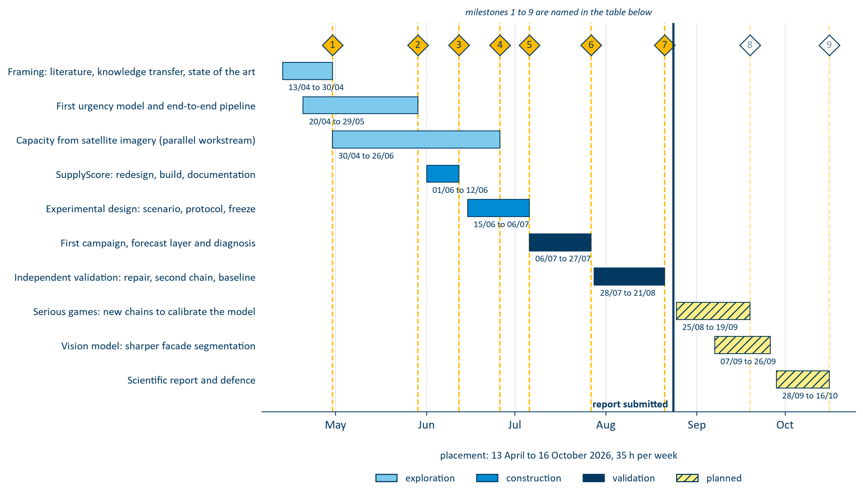
PHASES AND MILESTONES
10 phases · 9 milestones
Notes:
Ten phases, nine milestones, seven closed at the time of writing
One decision matters more than the rest. The original plan gave the second half of the mission to extending the model's scope. I reallocated it to validating what already existed.
An unvalidated extension of an unvalidated model compounds the problem rather than advancing it. That is why I can state a measured result today
Everything to the right of that line is planned, not done.

Slide 8
PLAN
1
CONTEXT, PROBLEM, MISSION
2
HOW THE PROJECT WAS RUN
3
LITERATURE, DESIGN AND REALISATION
4
RESULTS AND VALIDATION
5
ASSESSMENT AND PERSPECTIVES
Notes:
This prez will be in 5 parts !
The first three build the instrument.
The 4 is where the number I just gave you comes from.
The 5 is what I would do next.

Slide 9






LITTERATURE REVIEW GAP
What is new ?
PUBLISHED RESEARCH
THE PATENT RECORD: THREE LINES
Deadline-driven value. Time-varying, but one task only.
IBM. Revenue at risk from measured inputs. No operator opinion anywhere in the claims.
Ripple effect. Propagates, but takes the node score as given.
Wipro. Inputs replaced by language. The human narrates; nothing evaluates the narration.
Rupture indicators. Monitored one at a time, never combined.
Digital twin control tower. Oriented to automation. The operator receives decisions.
Cognitive bias. Quantified in the lab, no operational correction.
AHP, BWM, PROMETHEE. Static, and never compared to a computed value.
Fifteen years running away from the human declarant.
Digital twins. Scored on state; their inputs are assumed to arrive.
THE GAP
No system, published or patented, combines a declared urgency, a computed one, and their propagated mismatch. To achive a forcast.
Notes:
I looked in two places.
Six streams, and each one settles something and leaves something open.
Read the second half of each line and you have my specification.
The patent record was more interesting.
IBM, 2007: computed entirely from measured inputs.
Wipro, 2019: those inputs are replaced by language, so the human narrates but is never assessed.
The most recent is a control tower where the operator receives decisions.
Fifteen years running away from the human declarant.
So the gap is specific. No system, published or patented, elicits a declared urgency, computes its counterpart on the same node, and scores the difference against recorded outcomes

Slide 10
OBJECTIVES AND INDICATORS
OBJECTIVE
INDICATOR
O1
Define real/declared urgency and the adequacy score
Every term decomposable; aggregation justified
O2
Propagate across tiers, rank by criticality
Real-programme scale, interactive time budget
O3
Deliver a working, auditable application
Every write logged, tests passing
O4
Establish whether the signal predicts outcomes
Serious game testing
O5
Global warehouse capacity imagery modeling
KPIs
Notes:
5 objectives
I flag the fourth now, because it changed the shape of the mission.
Its test runs inside the serious game, against a baseline
Holding to that clause turned a validation step into the main contribution.

Slide 11

THE MISSION
A working application, two independently elicited signals, and the score that compares them
DECLARED U_{D}
COMPUTED U_{R}
AHP, FUZZY BWM AND PROMETHEE II
WEIGHTED PROBABILISTIC OR AGREGATION METHOD
Operational impact
↔
Performance and capacity
Time window
↔
Time, against the next deadline
Downstream dependencies
↔
Severity propagated across tiers
Recoverability
↔
Risk, through its recovery term
No declared counterpart
↔
Cost and carbon, arbitration only
ADEQUACY SCORE
The distance between the two signals, on a 0–100 scale.
False urgency · declared > state · penalty ×1
Hidden risk · state > declared · penalty ×2
Every term stays recoverable, so the operator sees what moved the answer.
Notes:
Two signals, elicited independently, and a score that compares them.
On the left, declared urgency: at each node the operator compares four criteria pairwise, which yields a consistency-checked weight per criterion.
On the right, computed urgency, aggregated from six indicator blocks.
The four declared criteria were chosen so that each one has a computed counterpart.
Without that correspondence, the comparison would be between unrelated quantities.
Cost and carbon have no declared counterpart. They arbitrate, they do not enter the comparison.
The score is the distance between the two, on a zero to one hundred scale, and it is asymmetric.
False urgency costs one. Hidden risk costs twice as much.
That is the rule clinical triage has applied for decades: under-triage costs a life where over-triage costs a queue.

Slide 12



REAL URGENCY
Non-compensatory aggregation score
A node is in trouble if any one block fires. A healthy block cannot offset a failed one.
U_{r} = 1 − ∏_{m} (1 − u_{m})^{ω}_{m}
NODE A
NODE B
one block has failed
nothing has failed
The average sends the coordinator to Node B , where nothing broke. The OR sends them to Node A , where capacity did. Same six numbers, opposite ranking.
time
0.05
time
0.20
capacity
0.90
capacity
0.20
performance
0.05
performance
0.20
risk
0.05
risk
0.20
cost
0.05
cost
0.20
carbon
0.05
carbon
0.20
FOUR CAUSES · TWO CONSTRAINTS
average
0.19 → 2nd
average
0.20 → 1st
probabilistic OR
0.92 → 1st
probabilistic OR
0.74 → 2nd
Time
Capacity
Performance
Risk
Cost
Carbon
Notes:
A moment on the aggregation, because it is the central modelling decision
Read each block as an independent cause that could on its own put the node in trouble.
The node is in trouble if one fires, or another does. The probability of that disjunction is one minus the probability that none of them fires
The OR in the name is the logical connective, not an arithmetic operation
Node A has capacity failed at 19 and everything else healthy. Node B has all six blocks at zero point two and nothing actually broken.
A weighted average ranks Node B first, and sends the coordinator to the node where nothing is wrong, because five healthy blocks average away the one that failed
The probabilistic OR gives Node A zero point nine two against zero point seven four, and ranks Node A first.
For a signal whose job is to catch the node about to fail, non-compensatory behaviour is not a preference, it is a requirement.

Slide 13
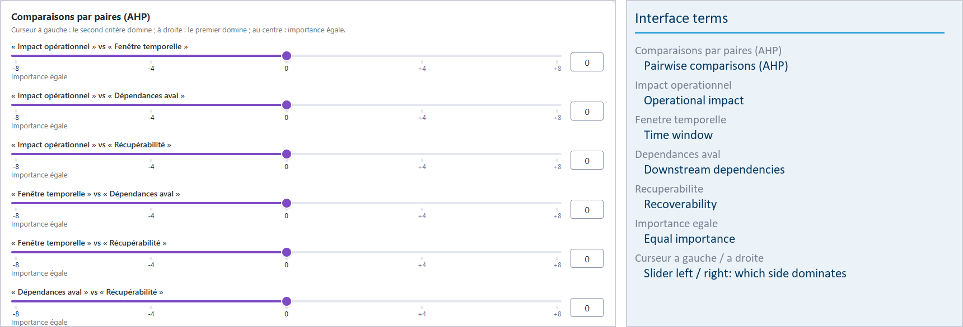
DECLARED URGENCY
Elicited from the operator, gated on consistency, then propagated downstream
THE CONSISTENCY GATE
A weight vector whose consistency ratio exceeds the threshold is refused . The operator is sent back to the most contradictory of their own comparisons.
Without it, an incoherent judgment would propagate as though it were a considered one.
The application is operated by a French research programme, so its interface is French. The report carries an English key for every term on screen.
FOUR CRITERIA, EACH WITH A COMPUTED COUNTERPART
Pairwise comparisons, not a free-text estimate
Operational impact
Time window
AHP · fuzzy BWM · PROMETHEE II
Downstream dependencies
Recoverability
Notes:
Declared urgency is not a free-text estimate. It comes from pairwise comparisons.
The important part is the gate.
A vector that fails the consistency ratio is refused, and the operator is sent back to the most contradictory of their own comparisons.
It is the only place in the system where a human input can be rejected.
One hypothesis, because everything downstream rests on it.
The weekly review is taken at face value, as a sincere report of what its author perceives.
That is what makes the two signals independent in source.

Slide 14
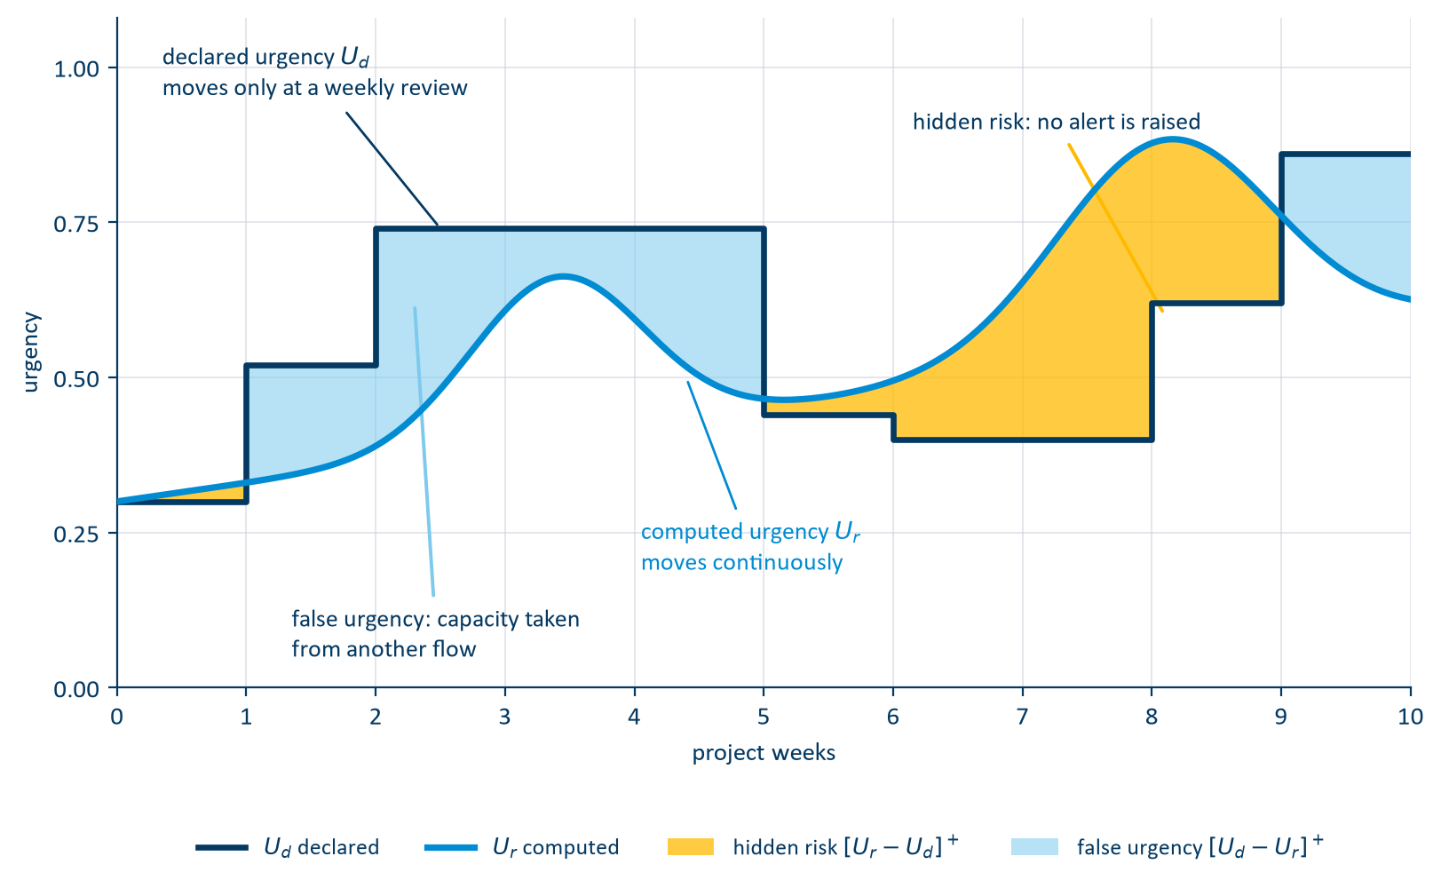
THE ADEQUACY
Elicited separately, propagated in opposite directions
PROPAGATION ACROSS THE NETWORK
γ
Customer · final assembly
Tier 1 · systems
Tier 2 · subassemblies
Tier 3 · raw material
β
γ attenuates the declaration as it descends: demand pressure is what a customer transmits
β amplifies computed risk as it ascends: physical risk is what a supplier transmits
Notes:
Both signals over the life of one task.
The declaration is a staircase: it moves only when someone sits down for the weekly review. The computed signal moves continuously, because the indicators do
Where the declaration is above the state, the operator is spending attention on a node that does not need it. Capacity taken from another flow.
Where the state is above the declaration, nobody has raised an alert
That is hidden risk, and it is the quantity every result in this presentation is built on.
Both areas are one-sided. When the declaration is the higher of the two, hidden risk is exactly zero.
Both signals also propagate, in opposite directions. Gamma attenuates the declaration as it descends, beta amplifies computed risk as it ascends.
The asymmetry is physical: demand pressure is what a customer transmits, physical risk what a supplier transmits.
Hidden risk is the quantity every result in this presentation is built on.

Slide 15
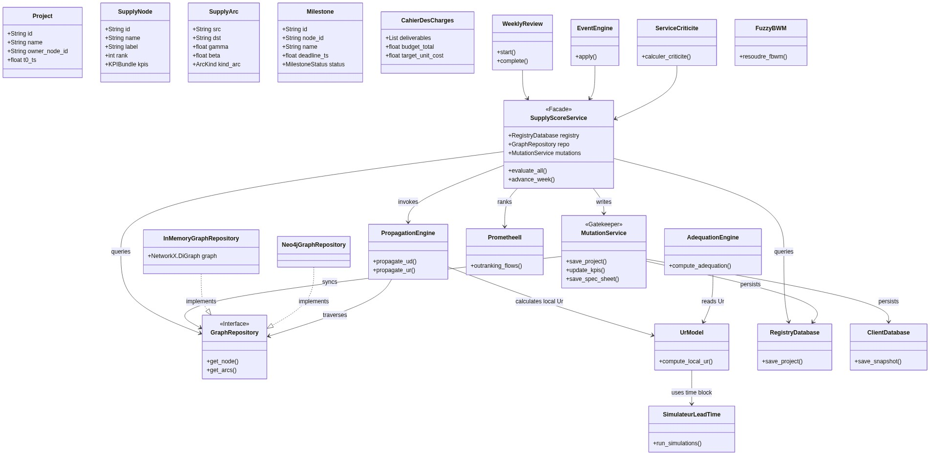
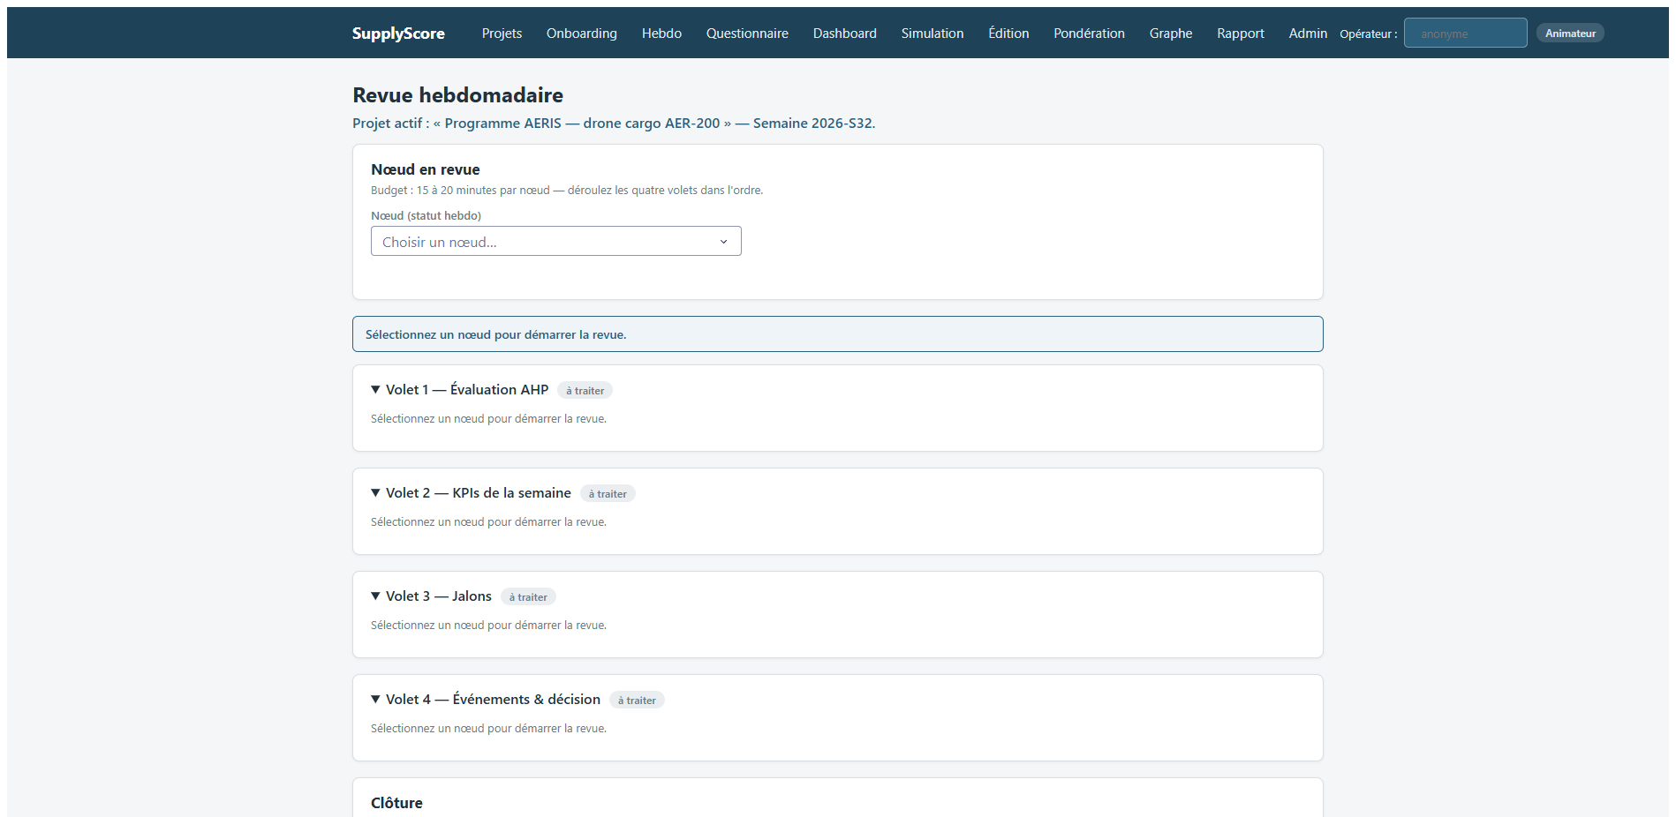
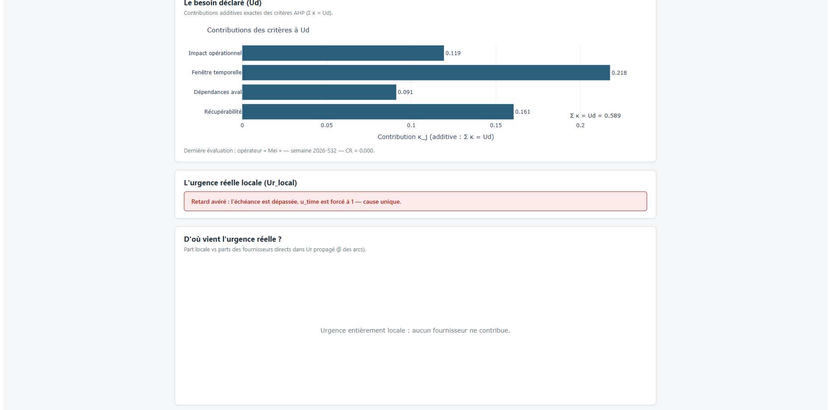
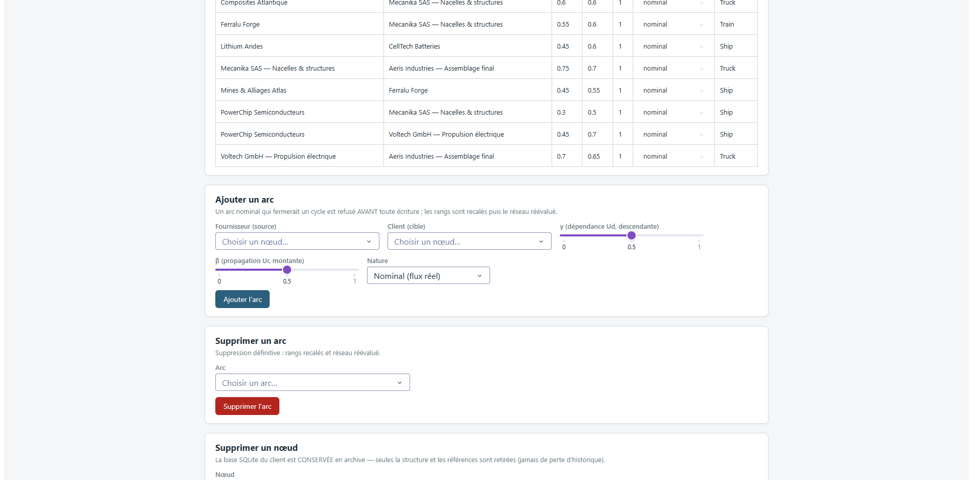
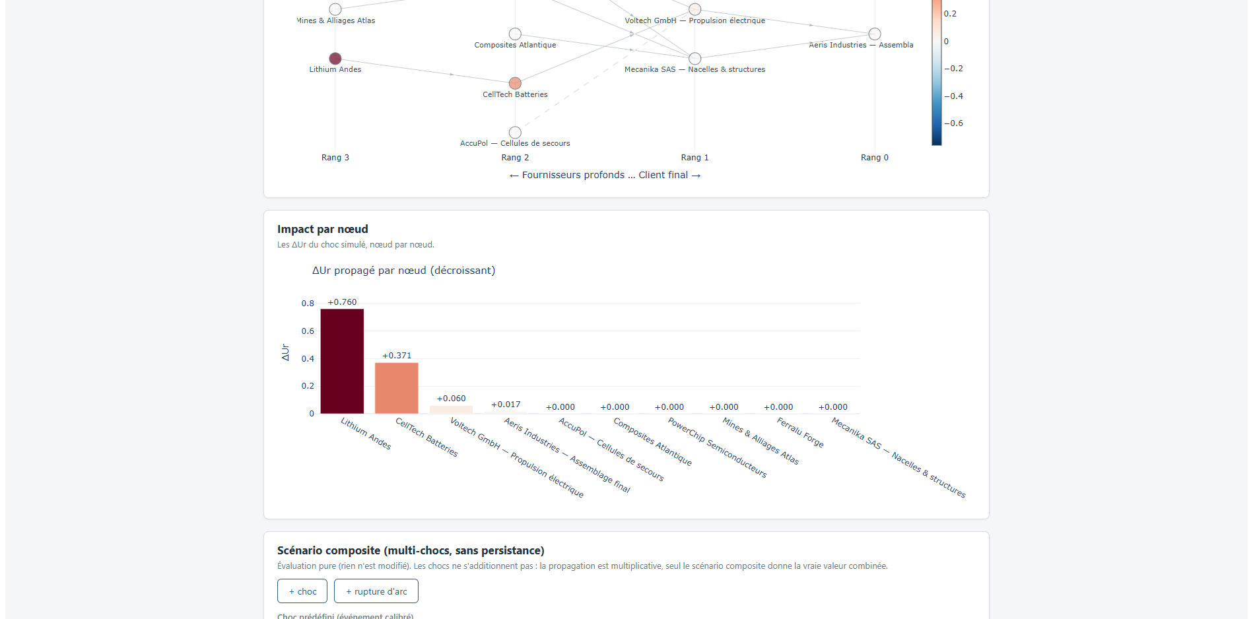
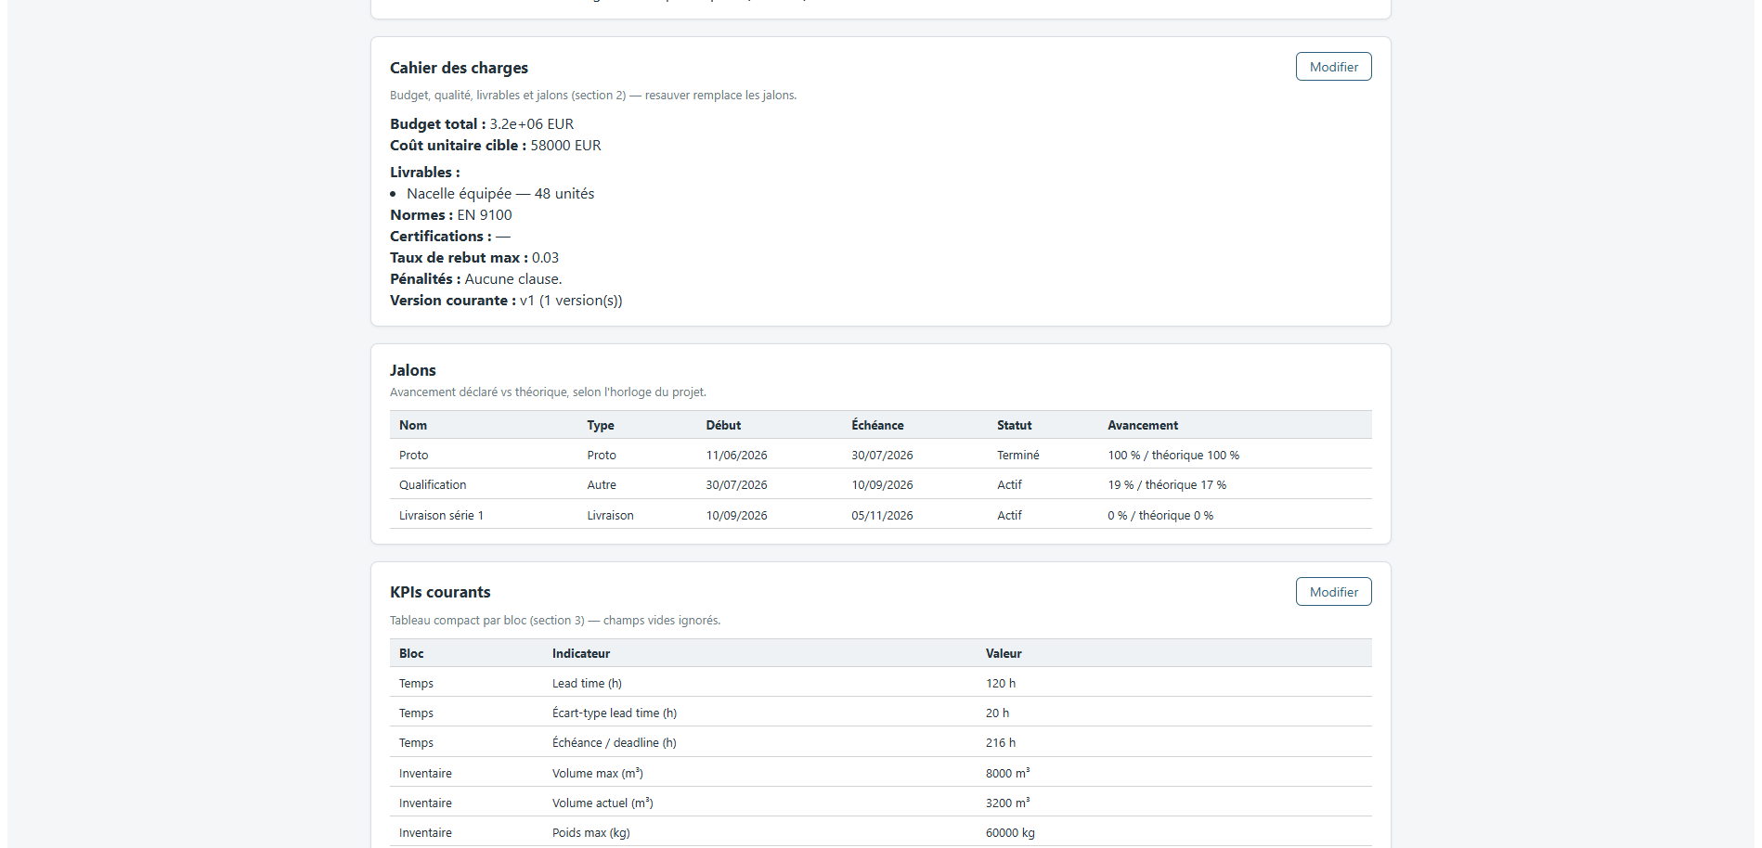
SUPPLYSCORE: ARCHITECTURE
The class model, and the pages it drives
THE CLASS MODEL
THE APPLICATION, AS THE OPERATOR MEETS IT
Weekly review · one signed transaction
Explainability · term by term
Network · generated per project
Criticality · each node knocked out
A NODE, AND WHAT IT CARRIES
Facade the only entry point
Mutation service the audit trail is architectural
One DB per node isolation by storage layout
Every arrow into the data crosses the facade, then the mutation service. Two graph repositories sit behind one interface, so the network can be held in memory or in Neo4j without the domain knowing which.
Notes:
You cannot read this diagram from where you are sitting, and you do not need to. Three decisions carry the engineering weight.
Every operation passes through a single orchestrating facade, so there is no second write path into the domain, including from the administration interface.
Every business write then crosses a single mutation service that validates ranges, diffs against current state, and records the author.
The audit trail becomes a property of the architecture rather than a convention someone has to remember.
And persistence is split one database per node, so tenant isolation follows from the storage layout rather than from a query filter someone could forget
On the right, the application as the operator meets it.
The weekly review commits as one signed transaction. The explainability page reconstructs any score term by term
That explainability page is what made the next diagnosis possible from the application rather than by hand

Slide 16
PLAN
1
CONTEXT, PROBLEM, MISSION
2
HOW THE PROJECT WAS RUN
3
LITERATURE, DESIGN AND REALISATION
4
RESULTS AND VALIDATION
5
ASSESSMENT AND PERSPECTIVES
Notes:
This prez will be in 5 parts !
The first three build the instrument.
The 4 is where the number I just gave you comes from.
The 5 is what I would do next.

Slide 17

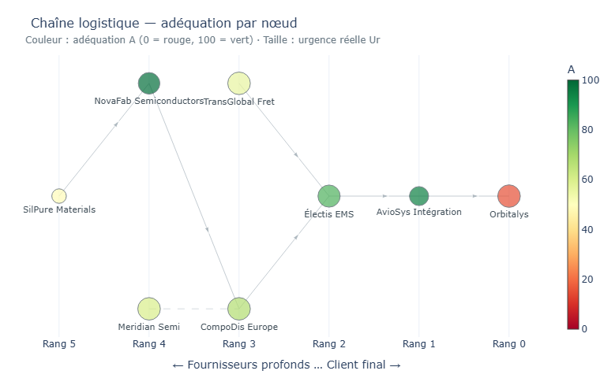
RESULT 1
Nodes ranked by hidden risk above 0.10, against the nodes that later missed
1.00
3 / 4
0
8
PRECISION, TURNS 0–5
FUTURE FAILURES FLAGGED
FALSE ALARMS IN SIX TURNS
TURNS OF ADVANCE WARNING
T0 – T5 · signal sharp
T6 – T18 · crisis public, the gap closes
The worst-scoring node is the satellite prime. Flagged from turn 0, it misses at turn 8: eight turns of warning, while its own manager declares an urgency of 0.001.
THE DASHBOARD THE COORDINATOR READS
The flag comes from an optimistic declaration against a computed state that is not . From turn 6 precision falls to 0.50 or below: the crisis becomes public, everyone raises their declaration, and a difference closes mechanically.
Early warning, not crisis management.
Notes:
Now the results. Four tests, all designed to try to break the tool rather than to show it working
The first campaign replays the 2020 to 2022 semiconductor shortage over nineteen turns across eight nodes
Real urgency comes from public time series of the actual crisis, declared urgency from the participants
Four of the eight go on to miss a commitment.
At each turn I rank the nodes by hidden risk and flag those above zero point one zero.
For six consecutive turns, before the crisis is visible, the signal flags exactly three nodes, and all three go on to miss
The worst-scoring node throughout is the satellite prime. Flagged from turn zero, it misses at turn eight
Eight turns of warning, raised while its own manager declares zero point zero zero one.
That flag does not come from a pessimistic declaration. It comes from an optimistic declaration against a computed state that is not.
A system aggregating only indicators would have ranked that node by its indicators. A system collecting only declarations would have believed it.
From turn six precision falls to zero point five zero or below, and that is not a failure.
The crisis becomes public, everyone raises their urgency, and a measure defined as a difference closes mechanically.
I will state the limit before you ask. Eight nodes, four positives, one scenario.
That precision is an encouraging observation, not an established rate

Slide 18
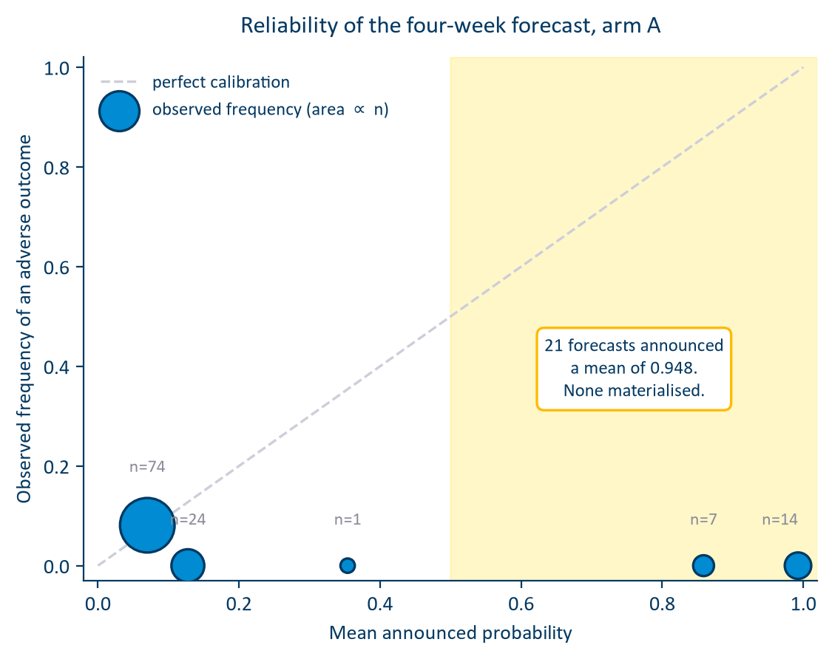
RESULT 2
Scored → Calibration → forcast → re-measured
BRIER SKILL, BEFORE → AFTER
HORIZON
before
structure
+ uncert.
1 week
−1.278
−0.646
−0.687
2 weeks
−0.690
−0.401
−0.367
3 weeks
−0.654
−0.360
−0.286
4 weeks
−0.553
−0.272
−0.216
The calibration deficit roughly halved at every horizon. AUC movement is not interpretable at this sample size : with twenty-six positives the four-week interval runs from 0.21 to 0.87.
Notes:
The second question is different: turning that ranking into a probability attached to a named week.
Scored against the outcome definition the system itself applies, the first version failed on both axes
Discrimination indistinguishable from chance, and a Brier skill several times worse than a forecaster who simply announces the base rate
The reliability diagram localises it. Where the model announces a low probability, it is right.
Where it announces a high probability, it is wrong every time: twenty-one forecasts announcing a mean of zero point nine four eight, and not one materialised
Then the explainability layer gave me the cause, and it comes down to a count
Across three hundred and twenty-eight indicator snapshots, the accumulated-delay field that the time block reads was written a non-zero value exactly zero times
The event engine writes to capacity, cost and failure probability. Never to any quantity on the time axis
The block is blind by construction, and because it drives the entire confident tail, so is the forecast.
The repair is a change to the event mapping, not to the mathematics.
Lost production time is additive: a four-week freeze costs four weeks whether the order is a tenth done or nine tenths done
On the same one hundred and twenty frozen forecasts, the Brier skill improves from minus one point two seven eight to minus zero point six four six at one week.
It is still negative everywhere, and I report it as such. On discrimination I claim nothing: with twenty-six positives the interval is too wide to read.

Slide 19

RESULT 3
A second chain
WHICH RANKING FINDS THE THREE FAILING SUPPLIERS?
500 MONTE CARLO TRAJECTORIES VS. A TWO-NUMBER RATIO
Adequacy score
0.00
Hidden risk
0.00
6 / 8
−1.60
Forecast probability
0.56
horizons where the baseline ranks better , by 0.082 of AUC at one week
simulation Brier skill vs. −4.85 for the baseline. The trajectories buy calibration
Base rate · 3 of 15
0.20
six urgency blocks
AR(1) state
client-impact channel displayed, never scored
lead-time draw
milestone term
the quantity that is scored
THE MISPERCEPTION BOUNDARY
The tool measures misperception, not non-disclosure . Precision 1.00 on chain 1 and 0.00 on chain 2 do not contradict: they name the domain.
On this chain the forecast layer is a calibration wrapper around a lead-time ratio . Defensible, but not what the interface presents. The fix is one line: the AR state must reach the milestone term.
Notes:
The third test is a negative result, and it is the one I would defend hardest
A result measured on one scenario stays a property of that scenario. So I built a second chain: an airframer's supply base, fifteen nodes over five tiers, no exogenous events, and milestone truth computed from the indicators rather than written by me
The adequacy signal scores a precision of zero point zero zero across nineteen turns, against a base rate of zero point two zero. Worse than chance
The only ranking that finds them at all is the forecast probability, at zero point five six. The very layer I have just spent two minutes criticising
The reason is in the opening turn. The three suppliers that go on to miss declare the first, second and fourth highest urgencies in the chain, before anything has visibly gone wrong."
"Hidden risk is the positive part of computed minus declared, so when the declaration is the higher of the two, it clips to zero."
"Their hidden risk is exactly zero for nineteen turns, and no threshold could have selected them."
The free text says why: all three intend to delay informing their customer until they have a recovery plan.«
So here is the boundary, and it is the contribution I would put first."
"The tool measures misperception, not non-disclosure."
"It finds the supplier who has misread their own situation. It cannot find the one who has read it correctly and is managing what they say."
"Precision one on the first chain and zero on the second do not contradict. Together they name the domain."
"On the right, the fourth test. I wrote the cheapest thing that could replace the forecast layer, a two-number ratio of weeks remaining to weeks required, and it beats five hundred Monte Carlo trajectories at six horizons of eight."
"What the simulation buys is calibration: minus one point six against minus four point eight five."
"On this chain, the forecast layer is a calibration wrapper around a lead-time ratio."

Slide 20
PLAN
1
CONTEXT, PROBLEM, MISSION
2
HOW THE PROJECT WAS RUN
3
LITERATURE, DESIGN AND REALISATION
4
RESULTS AND VALIDATION
5
ASSESSMENT AND PERSPECTIVES
Notes:
This prez will be in 5 parts !
The first three build the instrument.
The 4 is where the number I just gave you comes from.
The 5 is what I would do next.

Slide 21


OBJECTIVES VS. OUTCOMES
2 campaigns · 2 chains · 23 nodes · 33 milestones · 510 declarations
O1
Met
Six blocks, bidirectional propagation, asymmetric score — every term decomposable
O2
Met
SupplyScore delivered: multi-tenant, every write audited, tested, documented
O3
Met
Propagation and criticality operational; the saturation collapse found and repaired
O4
Met, domain established
Right at node level on chain 1; scored, located, repaired, re-measured; then bounded by chain 2 and the baseline
O6
Met, ongoing
Segmentation model is ongoing but show interesting reults
WHAT THE PROGRAMME CAN NOW SAY ABOUT THE INSTRUMENT
Detects misperception, not discretion
An early-warning instrument that closes once a crisis is public
Its forecast buys calibration , not short-horizon discrimination
Notes:
Everything you have seen rests on this: two campaigns, two chains, twenty-three nodes, thirty-three milestones, five hundred and ten déclarations
All objectives met
The fourth is met with its domain established, which is more than the indicator asked for.
What the programme can now say about SupplyScore comes down to three statements."
"It detects misperception, not non-disclosure."
"It is an early-warning instrument that closes by construction once a crisis is public."
"And its forecast layer buys calibration rather than short-horizon discrimination."
"Not one of those three was in the specification. Each came from a test built to find it rather than to confirm the tool."

Slide 22


LIMITS · NEXT · WHAT I TAKE
Three limits of sample, one of method, and a list produced by measurement
LIMITS
FOR ALTEN, IN ORDER
THE LESSON I KEEP
Agents, not human consultants
1
Connect computed urgency to the forecast quantity. One afternoon of work.
Each time it looked like a modelling defect; each time it was circularity.
Small positive class: 4 of 8, 3 of 15
I would now design the independence of two signals before designing either.
2
Fill the indicators before calibrating anything
Carbon block least exercised, for want of node-level data
And: before trusting a component, write the cheapest thing that could replace it.
3
Make the forecast state its own ignorance; smooth the alarm
Methodological, and it does not dissolve with data: no number holds without its outcome definition
ESTIA COMPETENCY FRAMEWORK
4
Run the campaign with humans, the only run that decides
CI1
CI3
CI5
CE3
CE4
CE5
CST1
CST2
CST7
Notes:
"Four limits, and I will not soften them."
"The declarants were agents, not human consultants. The positive class is small on both chains, four of eight and three of fifteen. The carbon block is the least exercised, for want of node-level data."
"The fourth is different. It is methodological, and it does not dissolve with more data: no number in this presentation holds without the outcome definition it was read against."
"For ALTEN, four actions in order of cost."
"Connect computed urgency to the quantity being forecast. One afternoon, on forecasts that already exist."
"Fill the indicators before calibrating. Make the forecast state its own ignorance. And run the campaign with humans, which is the only run that decides."
"What I take is a method. Twice the system turned out to be measuring itself, and each time it looked like a modelling defect when it was circularity."
"I would now design the independence of two signals before designing either."
"And before trusting a component, write the cheapest thing that could replace it."

Slide 23


THANK YOU
QUESTIONS
HOARAU John · Promotion 2026 ALTEN Sud-Ouest · Direction de l’Innovation · Lab de Toulouse 13 April → 16 October 2026

