Slide 1

EXECUTIVE PRESENTATION
Supply Chain Intelligence & Feature Engineering for Predictive Logistics
SwiftLog Logistics Limited · Mission DS05
Sharin Mideva · Junior Data Scientist · AnalystLab Africa Consulting · October 2026

Slide 2
Business problem and objectives
The problem
Our objectives
Rapid growth, with rising delivery delays and operational bottlenecks
Inventory imbalances, with unclear stock visibility
Supplier inconsistencies, with no performance view
Before investing in AI, management needs to understand what its data says
Integrate and validate11 linked tables
Explore and testdelivery, revenue, returns and stock patterns
Engineer featuresfor future machine learning
Segmentcustomers and warehouses
Recommendevidence-backed operational actions
Goal: turn raw logistics data into evidence for decisions and a foundation for AI.

Slide 3
Data and methodology
Acquire
Validate
Clean & merge
Explore (28 charts)
Test (6 tests)
Engineer & segment
5,000
1,000
15,000
15
250
500
orders
customers
order lines
warehouses
products
returns
Period:1 Jan to 8 Sep 2026 (September is partial)
Tools:Python, pandas, SciPy, scikit-learn, seaborn, ydata-profiling
11 tables from orders to returns; suppliers could not be linked to any other table.

Slide 4
Data preparation: clean structure, incomplete content
0
0
4,000 → 2,455
236
missing values
orphan foreign keys
inventory rows after summing stock movements
orders without items (revenue set to 0)
Delayed = 3+ days late, inferred and matching the supplied status on all 5,000 shipments
Net revenueexcludes cancelled orders; revenue = Quantity × UnitPrice (no revenue column existed)
Two analytical datasets: order_master (5,000 rows) and item_master (15,000 rows)
Gaps:no supplier link, warehouse capacity, ship or promised dates; return reasons unverified
Most cleaning was validation; the real limits are missing fields, not dirty values.

Slide 5
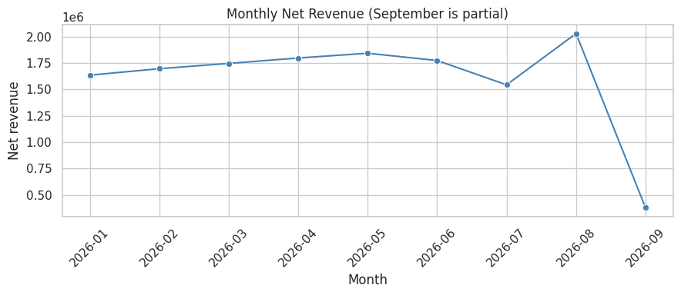
Revenue and demand
14.44M
net revenue
21.67M
gross revenue
7.23M
August peak: 2.03M net revenue; July dipped to 1.54M despite normal order volume
Fashion leads(37.5%) through catalogue size; Food earns most per product (92k)
cancelled (33% of gross)
Demand is steady; the revenue leak is cancellations, not lack of orders.

Slide 6
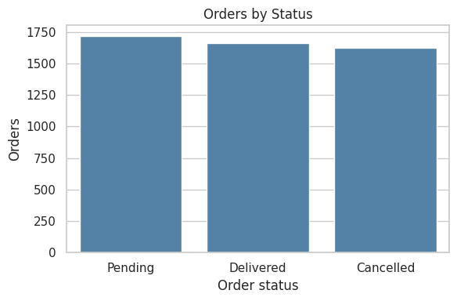
Fulfilment: only one order in three is delivered
33% delivered,34% pending, 32.5% cancelled
Pending after 8 monthslooks unrealistic and needs an ageing rule
Order values are similar across statuses(4,460 to 4,688), so size does not drive cancellation
Cancelled orders hold 7.2Mof order value
Capture cancellation reasons and age every pending order.

Slide 7
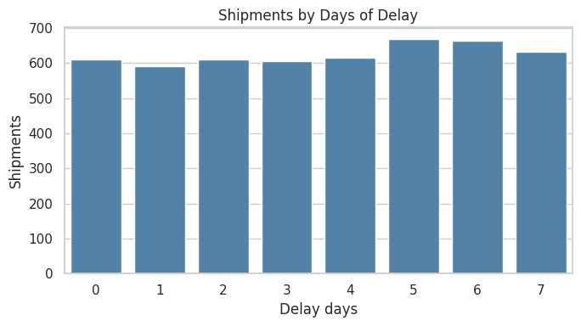
Delivery delay is systemic
63.7%
3.57
shipments 3+ days late
average delay (days)
Delay is spread evenlyacross 0 to 7 days: no typical delay
"On Time" allows up to 2 days late,so the real on-time rate is lower than it looks
Nearly two in three shipments are late: a process problem, not isolated incidents.

Slide 8
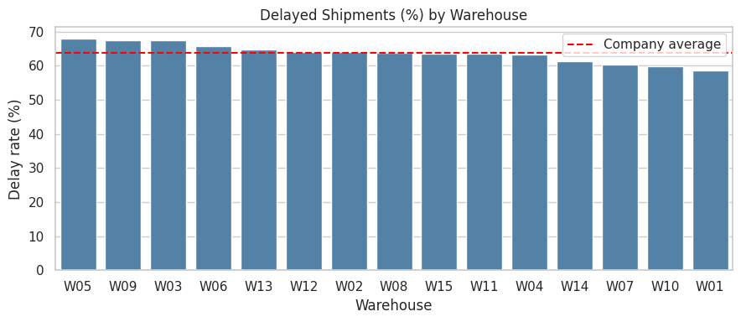
It is not a few bad warehouses
Range 58.7% to 68.0%around a 63.7% average
Not significant:warehouses p = 0.328, delay days p = 0.759
No link todistance (same city 63.9% vs 63.7%) or workload (r = −0.13)
Watch-list:W05, W09, W03 weakest; W01, W10, W07 strongest
Fix shared processes company-wide; ranking individual warehouses is not supported by the data.

Slide 9
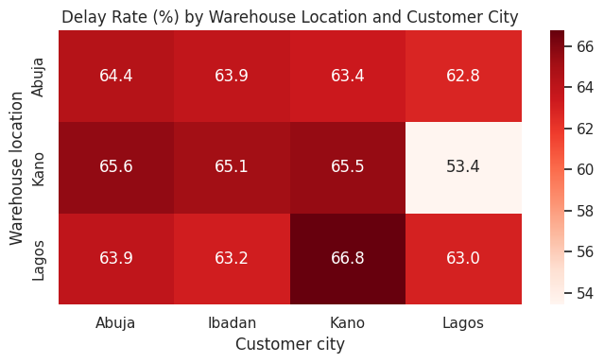
The one route that works: Kano to Lagos
53.4%
63.7%
delayed on Kano → Lagos
company average
249 orders,adjusted p = 0.008 across 12 routes
No geographic advantage,so the cause is likely carrier, dispatch or handling
A lead to investigate,not a proven cause
Study what Kano to Lagos does differently and trial it on other routes.

Slide 10
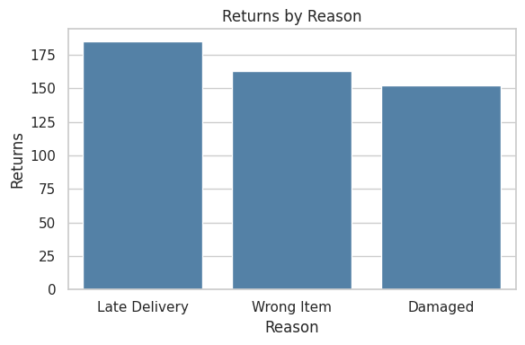
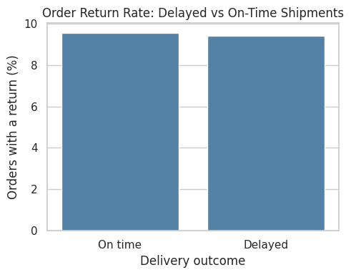
Returns: a steady 9.5%, unrelated to delay
9.5% of ordershave a return; categories sit between 9.3% and 9.8%
Delayed 9.42% vs on-time 9.54%(p = 0.928)
Wrong Item + Damaged = 63%of returns: picking and packing quality
36% of "Late Delivery" returnscame from On-Time shipments, so the reason field is unreliable
Returns by reason
Return rate: delayed vs on time
Cutting delays will not cut returns; fix order accuracy and handling instead.

Slide 11
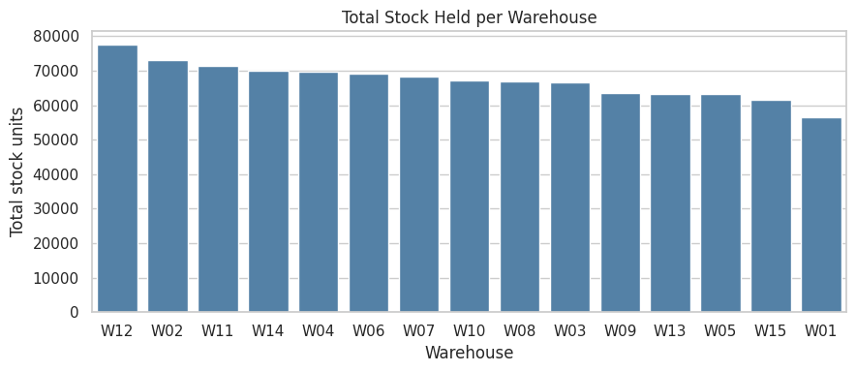
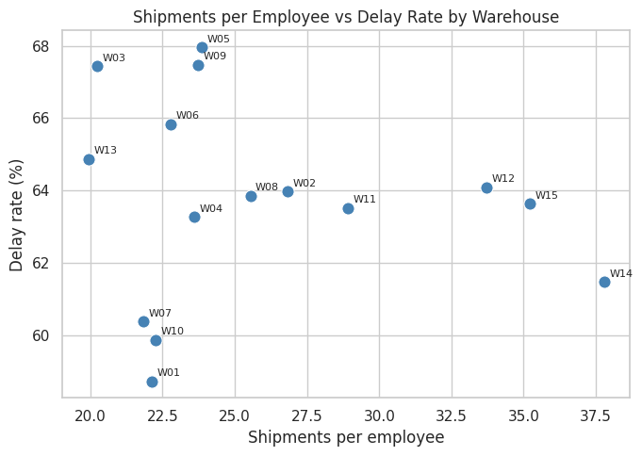
Inventory and workforce
Stock is about 28× units sold(indicative): overstock or unreliable records
34.4% of shipped pairshave no inventory record; 10.8% of stocked pairs hold under 100 units
W12 holds 77.5k units, W01 56.5kfor near-equal shipments
W12, W14, W15 carry 35.6 shipments per employeevs 23.8 typical, with similar delay
Reconcile stock to shipments first; then rebalance stock and pilot a staffing shift.

Slide 12
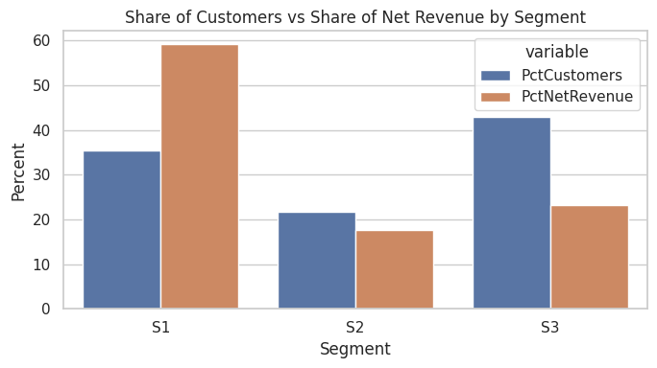
Customer segments: S1 carries the business
 | S1 Loyal high-value | S2 Return-prone | S3 Low-value
Customers | 351 (35%) | 215 (22%) | 425 (43%)
Net revenue share | 59.2% | 17.7% | 23.1%
Avg orders | 7.1 | 4.6 | 3.6
Return frequency | 0.07 | 0.31 | 0.00
Days since last order | 34 | 48 | 61
K-Means on 4 standardised features, k = 3, silhouette 0.31: use for targeting, not hard boundaries.
Protect S1, win back S3, and fix order accuracy for S2.

Slide 13
Statistical evidence: five of six tests are null
Question | Test | p-value | Decision
Delay rate differs across 15 warehouses? | Chi-square | 0.328 | No
Delay days differ across warehouses? | Kruskal-Wallis | 0.759 | No
Delay rate differs across customer cities? | Chi-square | 0.099 | No
Delayed orders returned more often? | Chi-square | 0.928 | No
Return reason related to delay? | Chi-square | 0.199 | No
Any route differs (12, Bonferroni)? | Chi-square per route | 0.008 (adj.) | Yes: Kano to Lagos
Revenue is driven by basket size(units ordered r = 0.89); delay, returns and distance are unrelated to revenue
Revenue and stock are right-skewed:use medians; delay days, quantity and price are uniform, so the data may be simulated
Null results are findings too: delay needs company-wide fixes.

Slide 14
Recommendations (13 in the report)
Delivery
Cancellations
Data capture
Replicate Kano to Lagos; set a company-wide delay target
Capture reasons; age and clear the pending backlog
Promised dates, timestamps, supplier link, capacity, valid return reasons
Inventory
Customers
Returns and growth
Reconcile records with shipments; set reorder levels; rebalance stock
Priority service for S1; win-back and bundles for S3
Picking and packing checks; expand Food; plan April and August peaks
Every recommendation is tied to a measured finding in the Technical Report.

Slide 15
Expected impact and future machine learning
Illustrative impact (not forecasts)
Machine learning roadmap
≈515 fewer late shipmentsif every route matched Kano to Lagos (5,000 × 10.3 points)
≈0.72M recoveredif 10% of cancelled value is saved (about +5% net revenue)
≈63 fewer returnsif Wrong Item and Damaged returns fall 20% (315 × 20%)
Use case | Outlook
Order value | Strong (r = 0.89)
Customer value | Moderate to high
Delay and returns | Low until dates captured
Demand forecast | Needs 24+ months
Rebuild customer and warehouse features using only earlier data before training, to avoid leakage.
Conclusion: fix process and data capture first; AI will then have signal to learn from.

