Slide 1

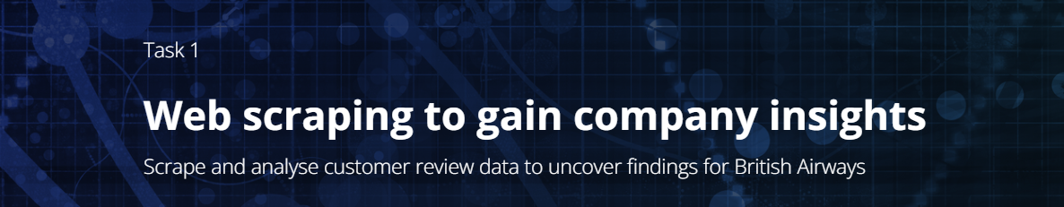
Presented by : Midhir Nambiar
Date : 07-04-2023

Slide 2
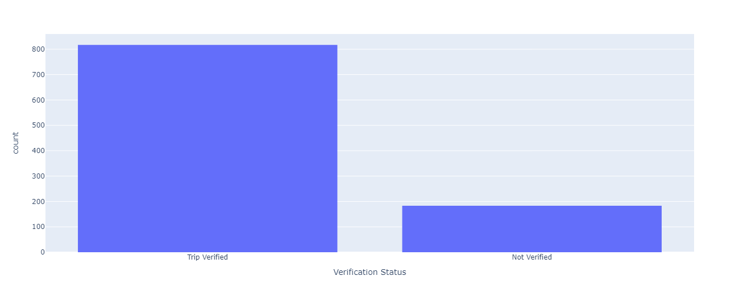
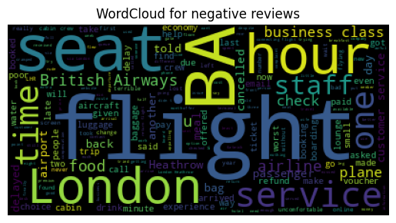
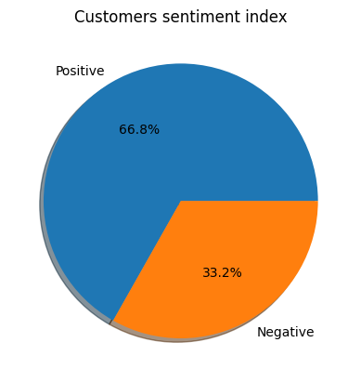
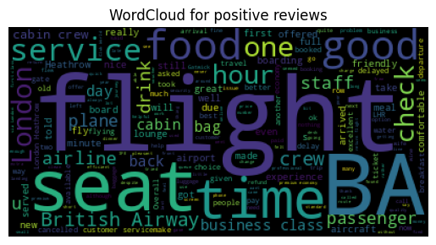
Verification status of Customers
Insights gathered from the Analysis
Firstly, out of 1000 trips, 817 trips were verified while about 183 trips were unverified by the British Airways.
66.8% of customers gave a positive response towards British Airways and their services, on the other hand 33.2% of customers gave a negative response.
Flight, seat, hour, BA, time, London, service, business class, staff, one etc. are the 10 most frequent words from reviews of customers who gave a positive response.
Flight, service, food, one, check, seat, time, BA, good, hour etc. are the 10 most frequent words from reviews of customers who gave a negative response.

