Slide 1


Presented by : Midhir Nambiar
Date : 10-04-2023

Slide 2
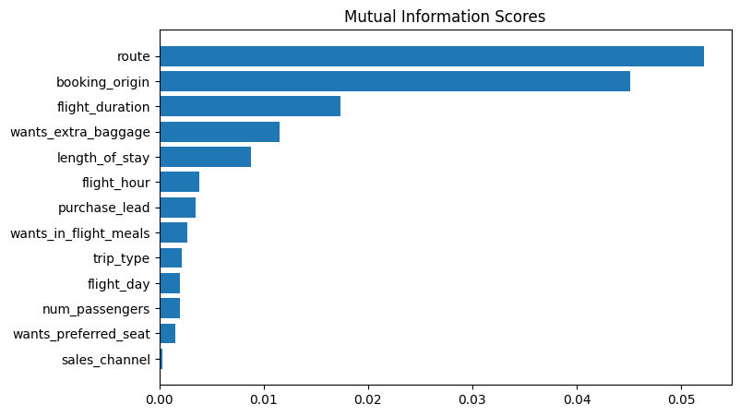
Insights gathered from the Analysis
About 42,522 customers have completed the booking while 7,478 haven’t.
The top 5 features which influence our customer’s buying behavior are :
The origin to destination flight route
Country from where booking was made
Total duration of flight in hours
If the customer wanted extra baggage in the booking
Lastly, the number of days spent at the destination
We have trained our model with Random Forest Classifier and achieved a Accuracy of 84.86 on our train as well as test data.

