Slide 1
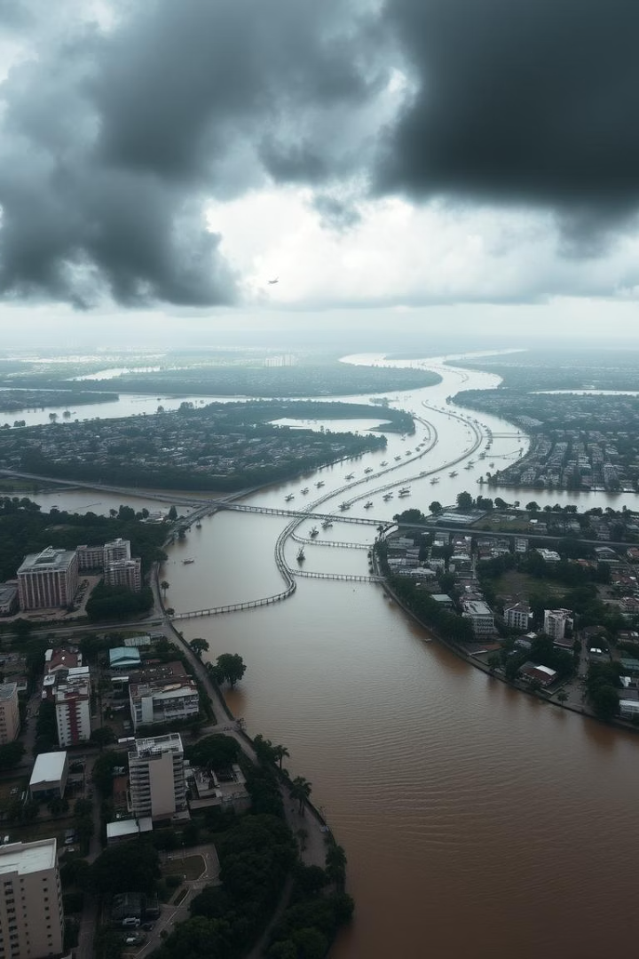

Flood Risk Analysis Using Satellite Imagery
Accurate flood risk data is more critical than ever. Satellite imagery offers a revolutionary approach to flood analysis.
This presentation will explore how satellite imagery is transforming flood risk assessment, providing timely insights for better preparedness.
by Vinay & Midhun
Notes:
1

Slide 2
Understanding Flood Risk Analysis
Flood risk is defined as probability multiplied by impact. Traditional methods include hydrological models, historical data, and ground surveys.
Limitations are data scarcity, high costs, and limited spatial coverage. These challenges highlight the need for better approaches.
Data Scarcity
High Costs
Limited information hinders accurate assessment.
Traditional methods are expensive to implement.
Limited Coverage
Ground surveys have restricted spatial reach.
Notes:
2

Slide 3
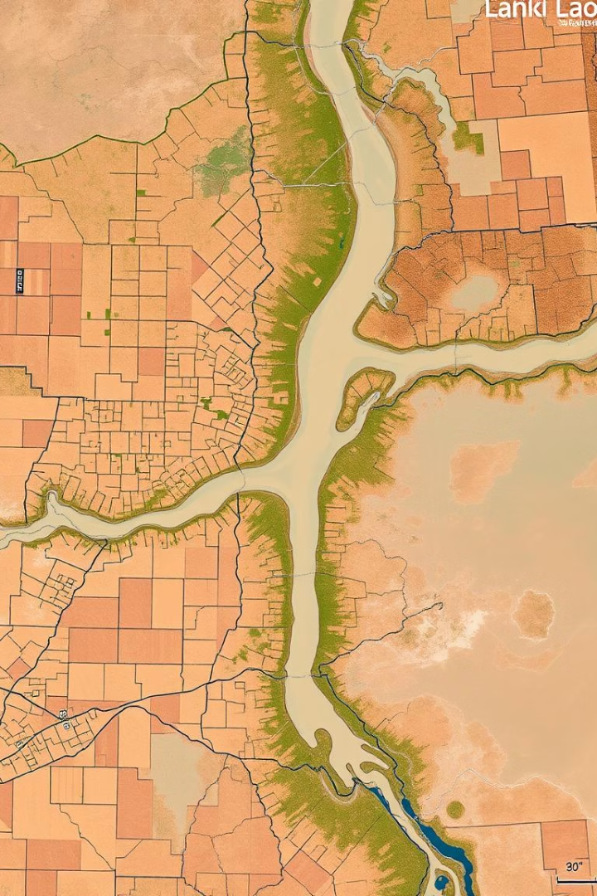



Satellite Imagery for Flood Mapping
Optical and radar satellite imagery provide flood mapping. Radar excels due to all-weather, day/night imaging capabilities.
This technology offers flood extent mapping, water depth estimation, and damage assessment. It provides a comprehensive view.
Optical Imagery
Radar Imagery
Flood Extent
Notes:
3

Slide 4
Key Satellite Data Sources
Sentinel-1 provides C-band SAR data with 10m resolution, free and open. Landsat offers multi-spectral data at 30m, with a long archive.
Commercial options offer higher resolution, but at a cost. Consider the trade-offs between cost and detail.
Sentinel-1
Landsat
Free and open data
Multi-spectral
10m resolution
30m resolution
C-band SAR
Long archive
Notes:
4

Slide 5
Advantages and Challenges
Advantages include wide coverage, rapid assessment, and cost-effectiveness. Challenges involve data processing complexity and cloud cover.
Interpretation skills are needed for accurate analysis. Accuracy metrics range from 85-95%, dependent on image resolution.
Advantages
Challenges
Wide coverage
Data complexity
Rapid assessment
Cloud cover
Cost-effective
Skill needed
Notes:
7

Slide 6
The Future of Flood Risk Analysis
Integration of satellite data with AI/ML will improve accuracy. Near real-time flood forecasting systems are being developed.
High-resolution satellite data is becoming more available. The market for these services is expected to reach $2B by 2027.
AI/ML Integration
Enhanced accuracy.
Real-Time Systems
Improved forecasting.
Market Growth
$2B by 2027.
Notes:
8

