Slide 1


Bank of Baroda Hackathon - 2022
Technology Partner
Your Team Name : ACE
Your team bio : Achievers
Date : 13.09.2022

Slide 2
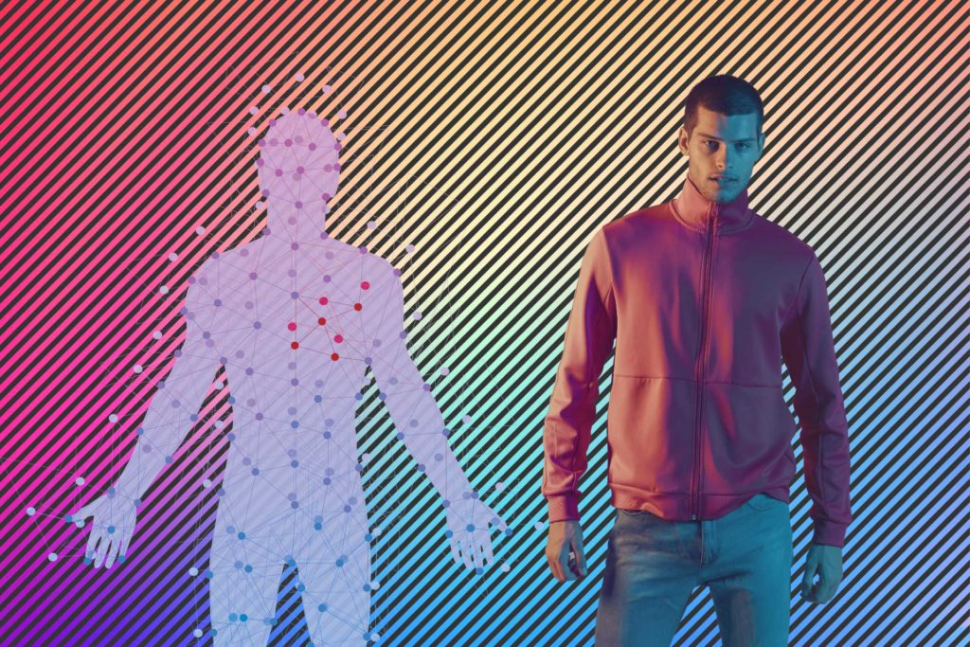
Problem Statement?
Why did you decide to solve this Problem statement?
To build a unique Virtual Avatar (2D/3D) for the Bank, to create a Differentiated experience for Account opening and relationship management. Activities like Account opening, KYC (Know Your Customer), form filing can be automated with Virtual experiences.

Slide 3
User Segment & Pain Points
Which user /advertiser segment would be early adopter of your product & why?
This project focuses for illiterate people, who struggling to fill up their forms.
This can also speed up the filling process with the help of a virtual avatar for individual user.
Form filling
Pain Points :
Blind people also able to fill the process of form using speech to text.

Slide 4
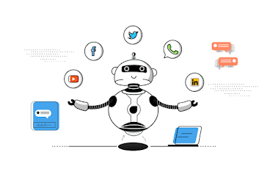
Pre-Requisite
What are the alternatives/competitive products for the problem you are solving?
Dave AI :
You can build your digital brand persona that can interact with customers.
DaveAI avatars strikes a conversation with customers in natural language, understands their preferences and makes personalized recommendations both via speech and text.

Slide 5

Azure tools or resources
Azure tools or resources which are likely to be used by you for the prototype, if your idea gets selected
Azure resources :
Azure cognitive services
Software developer tool for python, java, .net and other languages.
Reference APIs
Learning resources :
Microsoft Azure AI fundamentals :
Explore computer vision, Machine Learning, Natural Language Processing, Explore conversational AI, Cognitive Speech Services.

Slide 6
Any Supporting Functional Documents
Present your solution, talk about methodology, architecture & scalability
Methodology :
A front-end that allows the on-screen visualisation of the Virtual Assistant, which is expressive and has human-like features. This interface hosts both the conversation transcript and the visualisation of the retrieved information.
An NLP Chat Bot to interpret the conversation, classify the research intents and elaborate answers.
Deep Learning algorithms for Face Recognition, to allow the chatbot to recognise registered users.
Neural networks to personalise the dialogue with the Avatar after facial recognition.

Slide 7
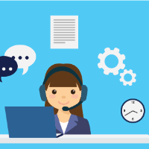
Key Differentiators & Adoption Plan
How is your solution better than alternatives and how do you plan to build adoption?
Development of Step-by-Step Form
Branching of What details to be filled as per the selections.
Autofill Repeating Information
Voice (to support multiple India Languages) and Virtual Keyboard based interactions.
Clicking Documents with HL camera
Accuracy of data collection will be the key.
Ease of using the Virtual Avatar experience will be important.

Slide 8
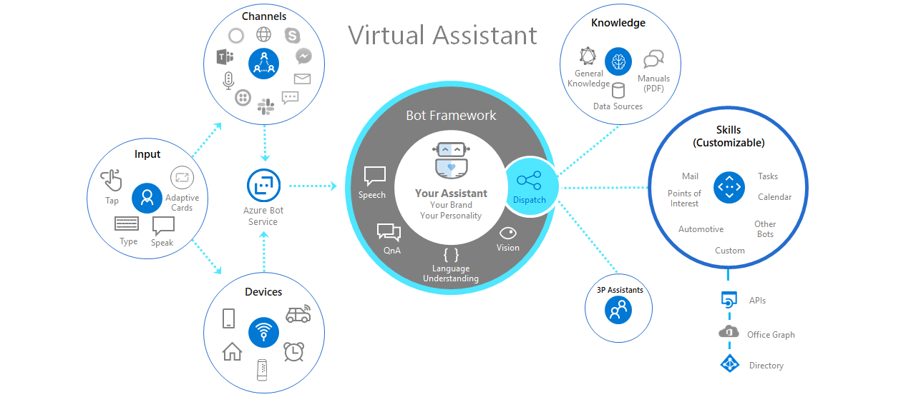
GitHub Repository Link & supporting diagrams, screenshots, if any
How far it can go?
Virtual Avatar

Slide 9
Thank You
By
MIDHUNKUMAR M
DHANASIVA S
KARTHIKAINATHAN J N
KATHIRVEL S

