Slide 1

Craving! Web Application
Architecture Type: Application Architecture
View: Logical View
Style: Layered Architecture Pattern
Users Delivery Channels Core Business Processes Data & Information Technology Enablers
Authentication
Login Data
Real-time Event Bus
Account Profile
User Data
E-Payment
Mobile Device
Subscription Management
Account Data
Email
Internal User
Checkout
Orders Data
B2B-Gateway
Support
Payment Data
Payment Data
Internet Browser
External User
Product Review
Filter Data
Protocol Transformation
Internal Management
Products Data
Message & Service Routing

Slide 2

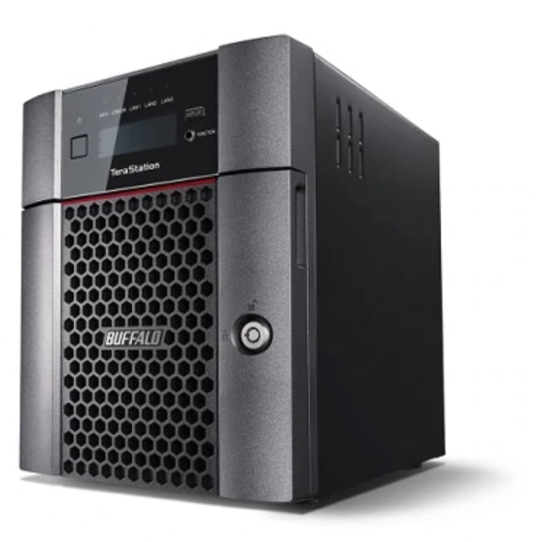
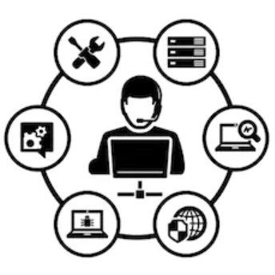
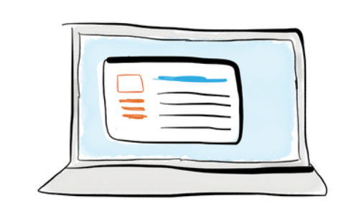


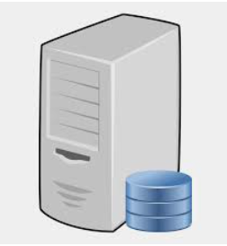
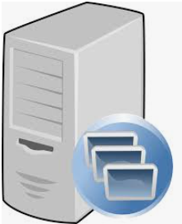
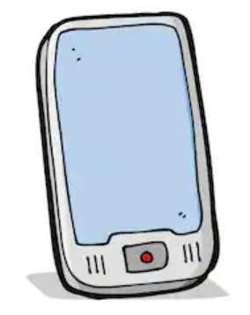
Craving! Web Application
Architecture Type: Application Architecture
View: Process View
Style: Client-Server Pattern
Firewall
Internal Users
NAS Server
Internet
External Users
Web Server
App Server
DB Server

Slide 3
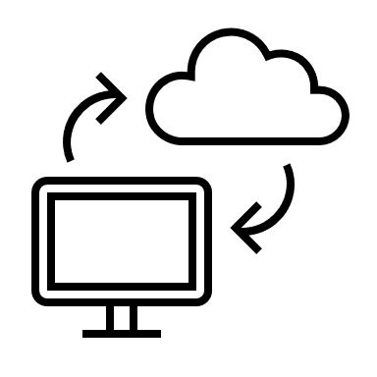

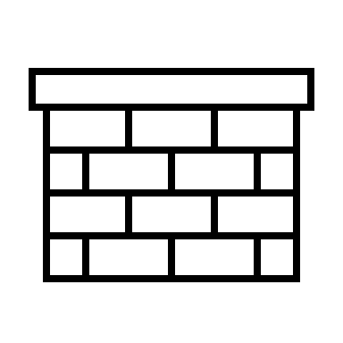














Craving! Web Application
Architecture Type: Application Architecture
View: Physical View
Style: Client-Server Pattern
Internet
Web Application Layer
External Layer
Cisco ASA5506-K9
Firewall
HP X3 Web Application Server
IBM Database
Server
Internal Layer
Sonic H5400
Firewall
Cisco 850
Router
CISCO ASA 5400 Firewall
Cisco 5X
Switch
HP 6000 Graphic
Server
Communication
IBM Server
Microsoft SQL
Database Server
Dell N4032
Router
Workstations
Department of Office Equipment
Employees
PC 1
PC 3
Wireless
MacBook/PC
Subscribed User
PC 2
PC 4
HP Laserjet Pro m15W Printer/Scanner

