Slide 1

How Reddit influencers establish a network of linked subreddits
CIS 600: Principles: Social Media and Data Mining
Amrith Sai Bharath Kumar
Rajaraajeshwaran Ramasamy Kannan
Midhuneshwar Kandasamy Kanivalavan

Slide 2

Introduction
Reddit stands out in the social media realm due to its content-centric approach, where users engage in themed communities called subreddits. While this structure encourages varied discussions, identifying influential users poses a challenge. In contrast to platforms with follower counts, Reddit measures influence through karma, a sum of up and downvotes. This prompts the question: How can we utilize Reddit influencers to reveal networks of interconnected subreddits?.

Slide 3
Problem Identification
One obvious flaw with this system is that it is difficult to quickly identify the influential users in it. Unlike redditors, who only have access to karma the net total up and down votes since account creation and a history of their posts and comments across many subreddits, users of other social media platforms may immediately measure the amount of reach that a user is likely to have by their follower counts.
The arrangement makes it difficult to identify which people are significant in certain subreddits, but the two data taken together provide a general idea of a user's activity.

Slide 4
Objective
Search Top Posts:
Analyze a subreddit's top 500 most upvoted posts to identify impactful content.
User Analysis:
Drill down into these posts to analyze the users behind them.
Defining 'Influencers':
Identify 'influencers' as users appearing more than once in top posts.
Impact Exploration:
Investigate top submissions by users to discover their influence beyond the initial subreddit.
Network Graph:
Map relationships between influencers and related subreddits using a network graph.

Slide 5
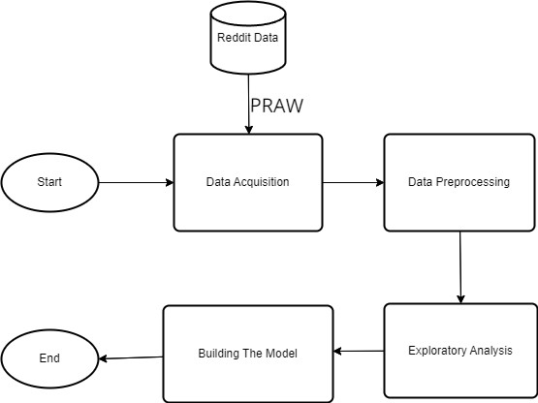
Workflow

Slide 6
Methodology - Data Acquisition
This study explores the vibrant r/all. Using PRAW, a powerful Python tool, we gathered insights from active users, ensuring secure API access. Our custom 'get_posts' function efficiently analyzes a specified number of posts, providing a comprehensive view of the subreddit's activity and community engagement.

Slide 7
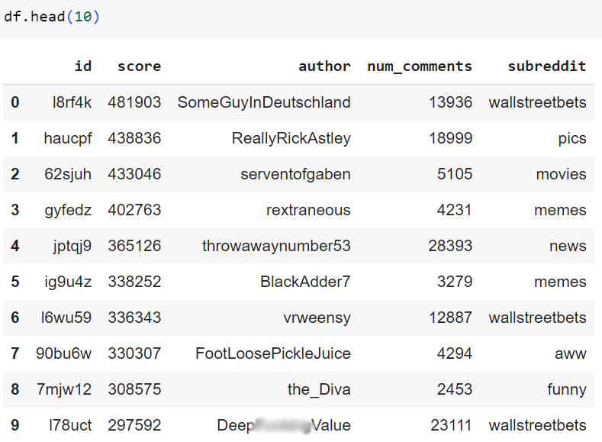
Top 10 Users in r/all

Slide 8

PRAW
The Python module known as PRAW, or "Python Reddit API Wrapper," offers easy access to the Reddit API. Through programmatic interaction with Reddit, developers can retrieve data from the platform, including posts, comments, and user profiles.

Slide 9
Methodology - Data Pre-processing
To ensure the accuracy of our data, we removed any null (deleted) users who appeared in the top posts of a subreddit. We compiled a list of users who frequently made top posts in a subreddit, then eliminated any null values from that dataset.

Slide 10
Methodology - Exploratory Analysis – Part 1
Analyzing the top 500 posts on r/GTA, Figure 1 shows an unexpected trend: the number of comments doesn't consistently increase with higher net scores. Remarkably, comments remain steady between post scores of 20,000 and 60,000, defying our expectation of a direct correlation. A similar pattern emerged when examining r/all on a larger scale.

Slide 11
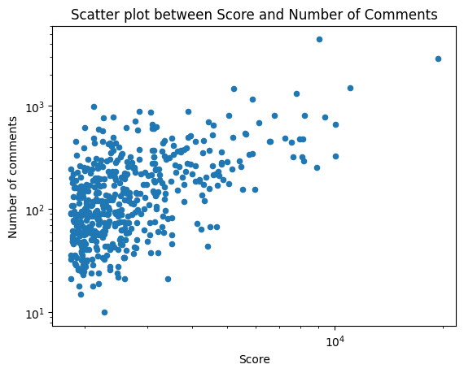
Figure 1

Slide 12
Methodology - Exploratory Analysis – Part 2
Examining users with recurring top 500 posts on r/GTA, it is found that only 13% appeared more than once. This percentage varied by subreddit. Following the Part 2 process of Data collection and bar graph generation, scraping of the top 10 posts per user and generated a bar graph for r/GTA submissions. The "Influencer" cut-off, based on 2 or more top posts, proved subjective to subreddit size and submission frequency. Figure 2 illustrates the distribution of authors and their posts.

Slide 13
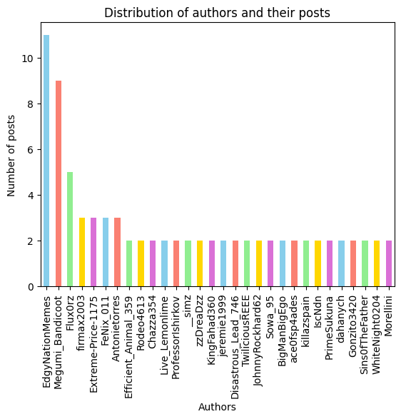
Figure 2

Slide 14
Methodology - Exploratory Analysis – Part 3
Examining the broader impact of top posters, the analysis identified authors who appeared multiple times across various subreddits. To construct a network graph, data on the specific subreddits where these influencers were active was necessary. For simplicity, the visualization focused on subreddits where influencers made at least 2 posts, utilizing the Y-axis for submission counts and the X-axis for respective subreddits. Figure 3 illustrates the distribution of other subreddits where influencers post.

Slide 15
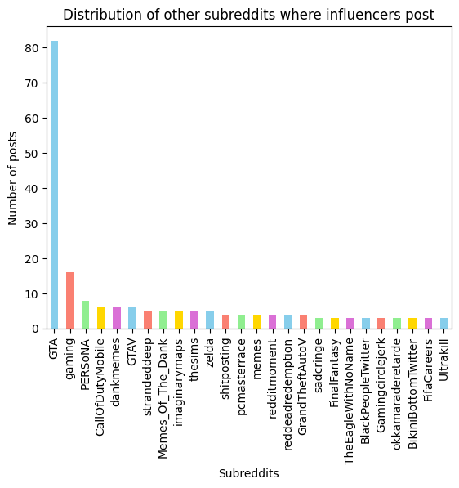
Figure 3

Slide 16
Methodology – Building the Model
Creating a network graph with the acquired data posed a challenge, transitioning from traditional row-and-column thinking to nodes and edges. Opting for a standardized approach, we utilized NetworkX's spring layout. To maintain clarity, we established conventions: thin and grey edges, small grey nodes for influencers, blue nodes sized by connections for subreddits (labeled for tidiness), and influencers with connections beyond r/GTA highlighted in yellow.

Slide 17
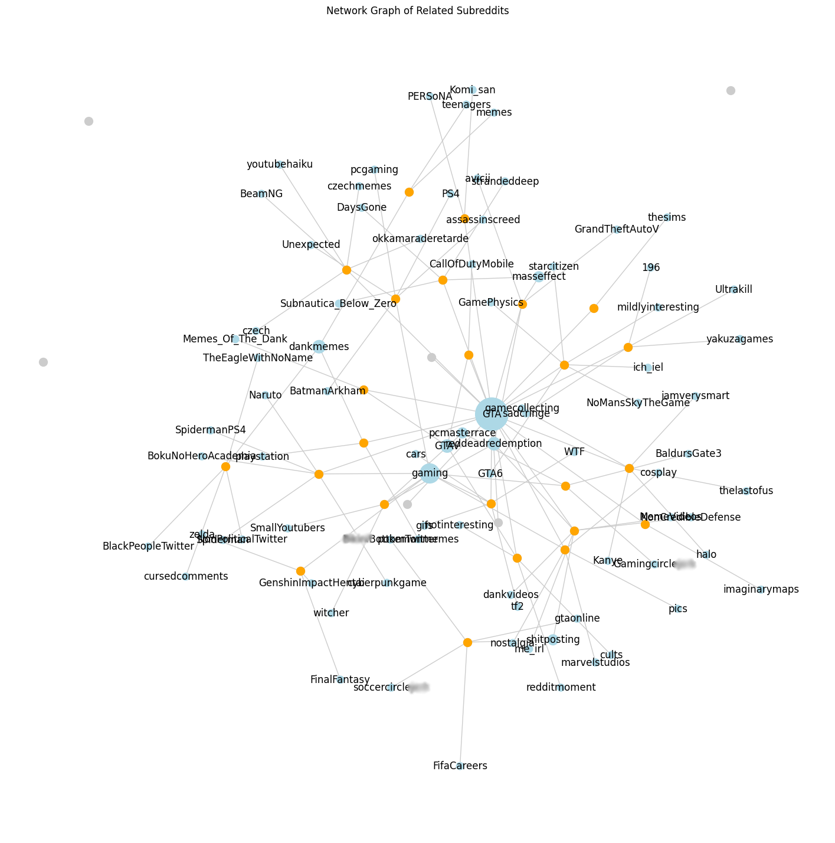

Slide 18
!!THANK YOU!!

